Slide 1
Bit Rate vs Baud (Signal) Rate vs Bandwidth
PHYSICAL LAYER
How do you measure the speed of a communication link ?
  km/s ?

Slide 2
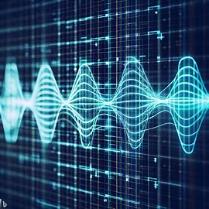
PHYSICAL LAYER
In order to send 1 BIT of data, a signal must have 2 level, eg +2V,0V
+1V
1
1
0
0
1
0V
+3V
11
10
+2V
01
+1V
00
0V

Slide 3
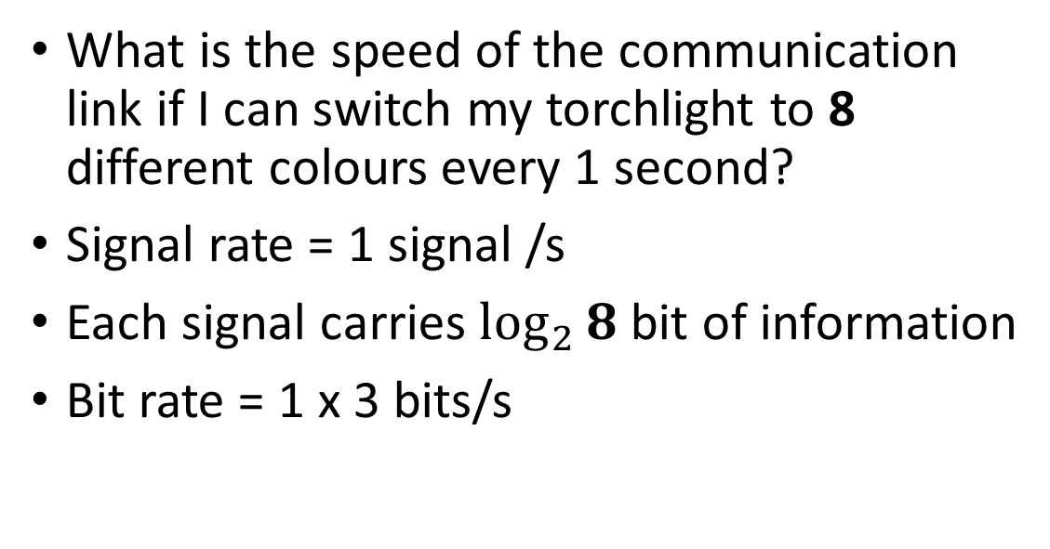
Bit Rate of a torch light communication link
PHYSICAL LAYER
000
001
010
011
100
101
110
111

Slide 4
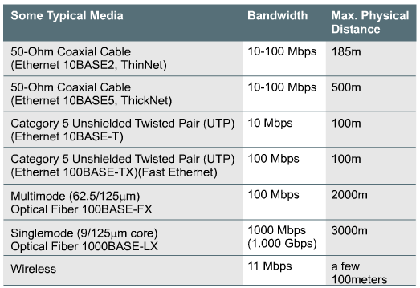
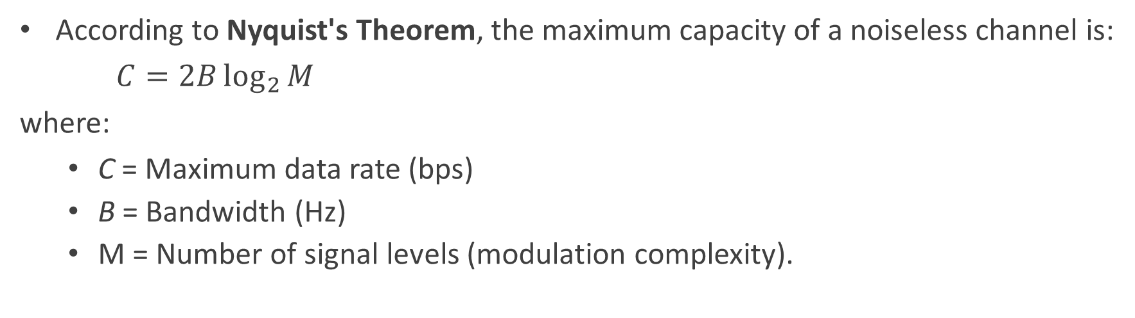
Bandwidth
What is the definition ?
- Physics
- Data Communication
units ?
- Hz or bps
  Maximum Capacity of a media to carry data
  dependent on the physical characteristics of the media like:
    range of frequencies
    amplitude levels

Slide 5
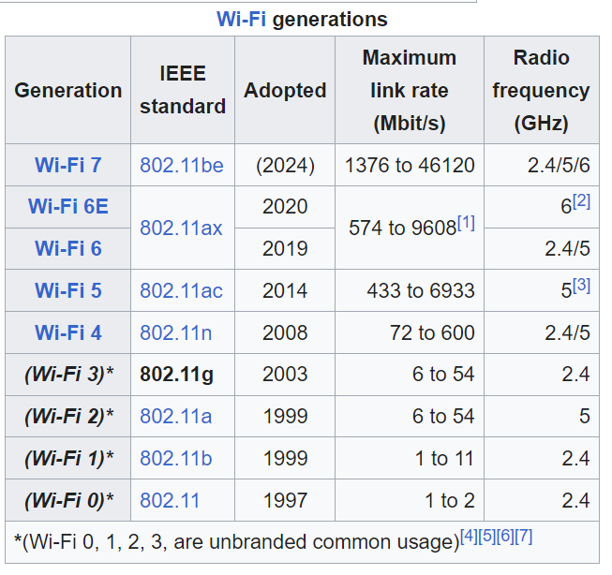
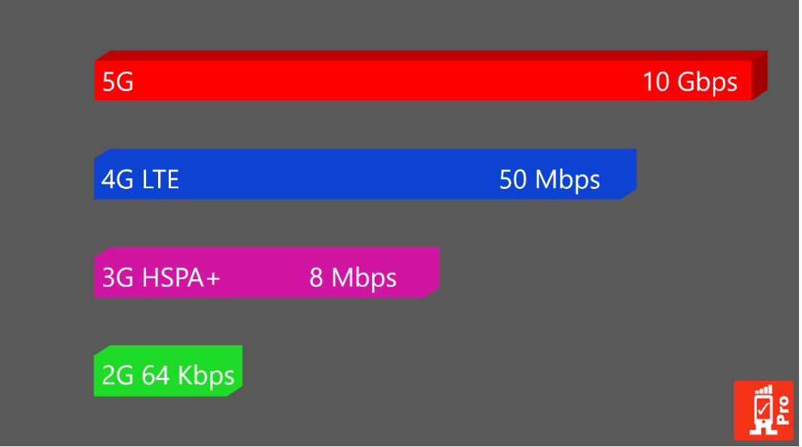
WIFI
Cellular/Mobile

Slide 6
DATALINK LAYER
Need to
  break data stream into chunks
  add bits to indicate stat/stop of each chunk
  error detection
Need to indicate
  who you are transmitting to
  who you are
  uses MAC Address
Broadcast vs Unicast
Network Contention
Pass down by Network,Transport and App layers
Layer 2 Header
LAYER 2 FUNCTION
LAYER 2 PAYLOAD
SRC/DST
START
PREAMBLE
1101010100011011001
11001010011101010101010101010
LAYER 1 FUNCTION

Slide 7
DATALINK LAYER
Error Detection
Even Parity
  Number of 1s must be even
Odd Parity
  Number of 1s must be odd
1 | 1 | 0 | 1 | 0 | 1 | 1
1 | 1 | 0 | 1 | 0 | 1 | 1
0 | 0 | 1 | 1 | 0 | 1 | 1
0 | 0 | 1 | 1 | 0 | 1 | 1

Slide 8
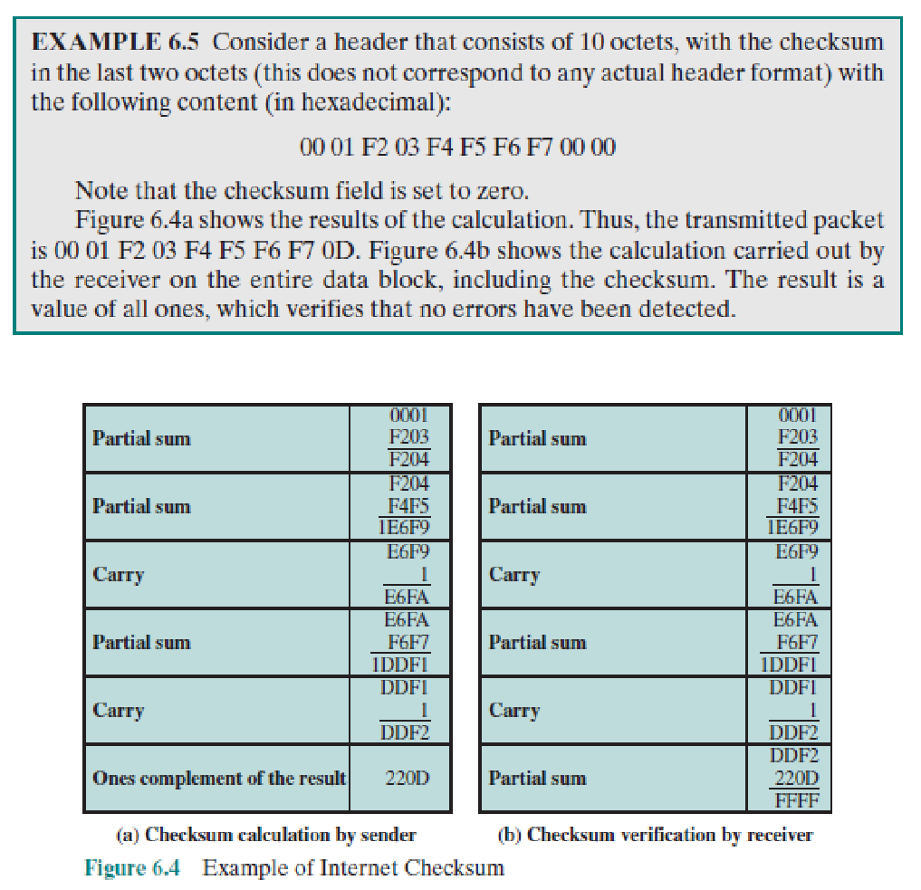
Error Detection
using Checksum

Slide 9
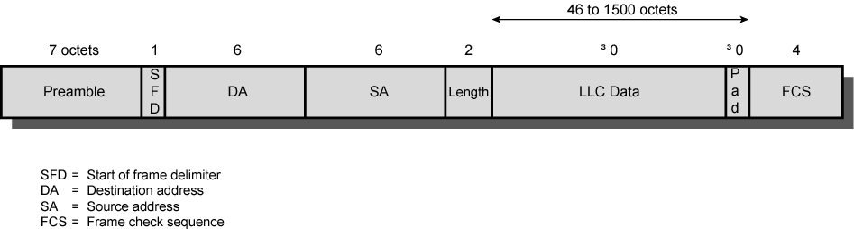
IEEE 802.3 Frame Format
≥
≥
Preamble: 7 octets of 10101010
SFD: 10101011
Length: the maximum frame size is 1518 octets, excluding the preamble and SFD.
Pad: octets added to ensure that the frame is long enough for collision detection
FCS: 32-bit CRC, based on all fields except preamble, SFD, and FCS

Slide 10
Summary of Data Link Layer
The physical layer(media) provides the physical characteristics for data transmission.
  Encoding of bits (data) to signal. This is also known as modulation.
  The signal must be able to propagate from source to destination.
  Data rate, signaling rate, bandwidth
Additional functionality are needed provided by the Data Link layer software(firmware)
  Addressing for multi-point communication using mac-addresses
  Segmenting the payload to be transmitted into packets.
  Assembling the packets into the original payload
  Handling error detection/ retransmission
  Detecting and resolving data collision on shared media (Bus) networks.

Slide 11
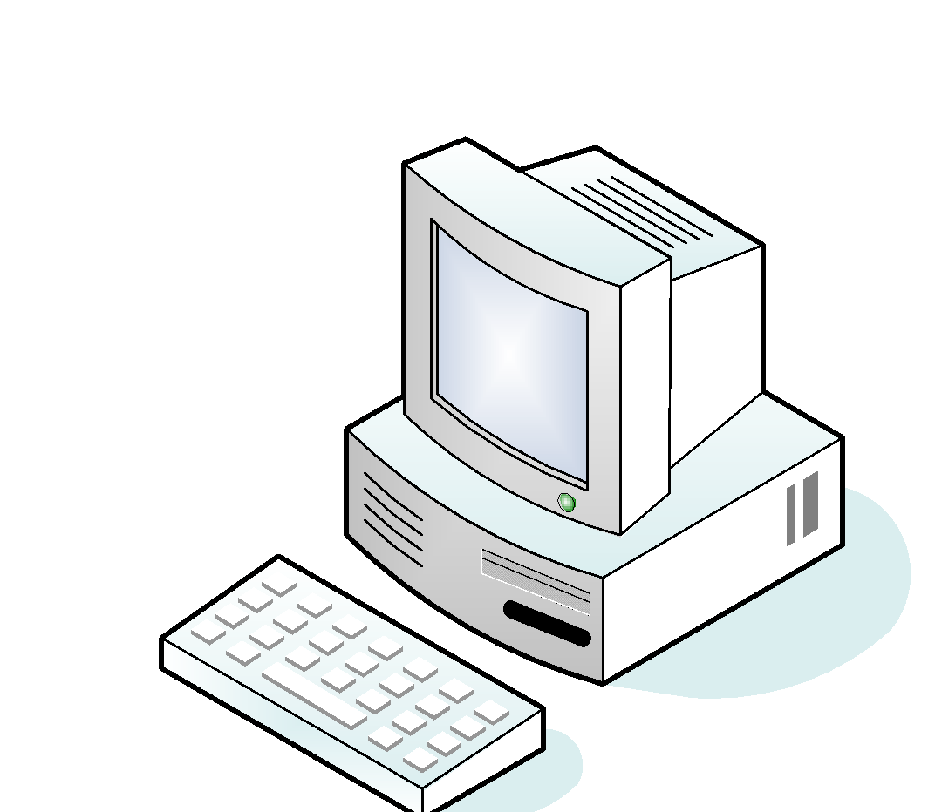
Data Link on different physical network topology
Bus
Wired/Wireless
Mesh
Ring
Star

Slide 12
Data Link on Shared Bus Topology
Collison
Domain
B
C
A
Wired / Wireless Shared Bus topology
Notes:
Shared Bus Topology can be implemented by a Hub or a Wireless Access Point
Collision Domain is created in a shared media

Slide 13
CSMA/CD: Used in Shared Physical Media
Carrier Sense Multiple Access with Collision Detection
Collision Detection:
  Stations listen whilst transmitting. If collision is detected, stop transmission immediately.
Rules of CSMA/CD:
If the medium is idle, transmit; otherwise, go to step 2
If the medium is busy, continue to listen until the channel is idle, then transmit immediately
If a collision is detected during transmission, transmit a brief jamming signal to assure that all stations know that there has been a collision and then cease transmission
After transmitting the jamming signal, wait a random amount of time, referred to as backoff, then attempt to transmit again (repeat from step 1)

Slide 14
Data Link on a star topology
Mac Address Table
-------------------------------------------
Mac Address Type Ports
------------------- ------------ -------
000a.41cd.c8c4 DYNAMIC 1
0023.a3bc.c701 DYNAMIC 3
203a.abc2.57a1 DYNAMIC 2
011a.919d.d8a4 DYNAMIC 4
DST MAC: 00-23
payload
1
2
switch
DST MAC: 00-23
payload
3
4

Slide 15
Mac Address Table
-------------------------------------------
Mac Address Type Ports
------------------- ------------ -------
000a.41cd.c8c4 DYNAMIC 1
0023.a3bc.c701 DYNAMIC 3
203a.abc2.57a1 DYNAMIC 2
011a.919d.d8a4 DYNAMIC 4
Mac Address Table
-------------------------------------------
Mac Address Type Ports
------------------- ------------ -------
1111a.466d.c764 DYNAMIC 1
0523.12bc.8701 DYNAMIC 3
34ac.abc2.8761 DYNAMIC 2
0234.917d.d874 DYNAMIC 4
5
5
switch1
switch2
5
5

