Slide 1
Application Layer
Re-visit Network Layer Model
What is a Web Application?
Client Server Architecture
HTTP Protocol

Slide 2
Network Layered Model
END DEVICE
END DEVICE
5-APPLICATION
SEND THIS MESSAGE OVER
5-APPLICATION
ROUTER
3-NETWORK
ROUTING
4-TRANSPORT
END_TO_END COMMUNICATION
4-TRANSPORT
END_TO_END COMMUNICATION
FIND YOUR WAY TO THE DESTINATION
2-DATALINK
POINT TO POINT
1-PHYSICAL
ENCODING BITS TO SIGNALS
3-NETWORK
ROUTING
3-NETWORK
ROUTING
TRANSMIT TO THE OTHER SIDE
2-DATALINK
POINT TO POINT
2-DATALINK
POINT TO POINT
CONVERT TO THE PHYSICAL SIGNALS
SWITCH
1-PHYSICAL
ENCODING BITS TO SIGNALS
2-DATALINK
POINT TO POINT
1-PHYSICAL
ENCODING BITS TO SIGNALS
1-PHYSICAL
ENCODING BITS TO SIGNALS

Slide 3
The TCP/IP Protocol Suite
HTTP
Application
DNS
SMTP
BitTorrent
Sockets
Port 25
Port 80/443
Port 6881
Port 53
Port 1010
TCP
UDP
Transport
NAT
RIP/OSPF
NETWORK
IP
ARP
DHCP
Ethernet/802.3
DATALINK
Wireless/ Copper Cable/ Fibre Optic Cable
PHYSICAL

Slide 4
Web Application Architecture
Web Application
  HTTP (Hyper Text Transfer Protocol)
  URL (Uniform Resource Locator)
  HTML(Hyper Text Markup Language)
  JSON (Javascript Object Notation)
Client Server (Centralised)
  Fat Client / Client-side scripting)
  Thin Client / Server-side scripting)
Peer to Peer (Decentralised/Distributed)

Slide 5
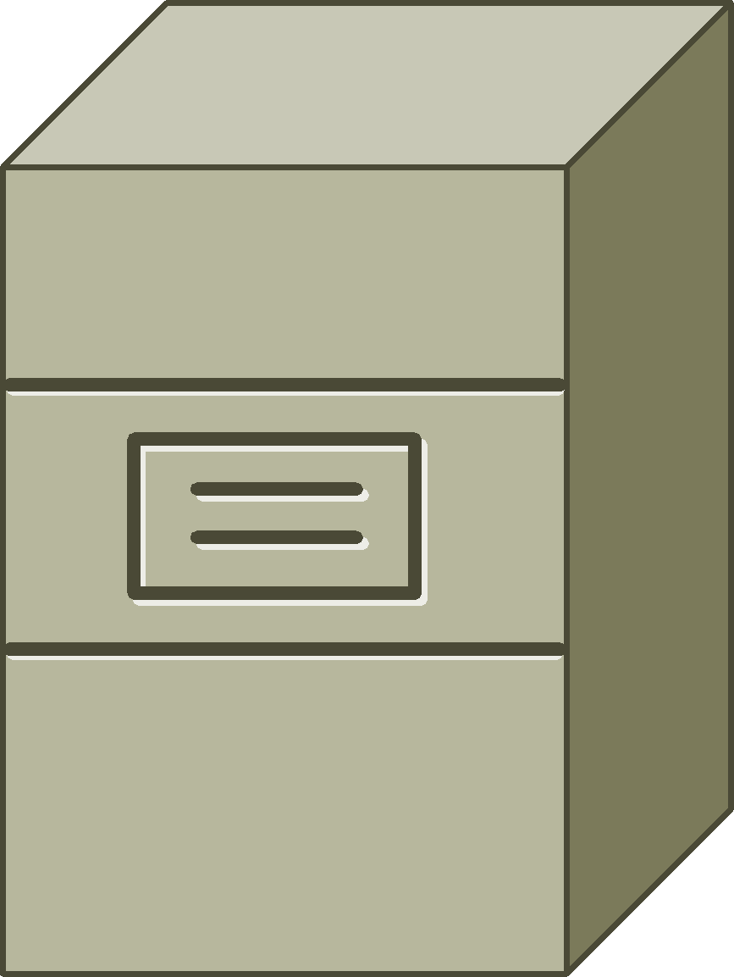



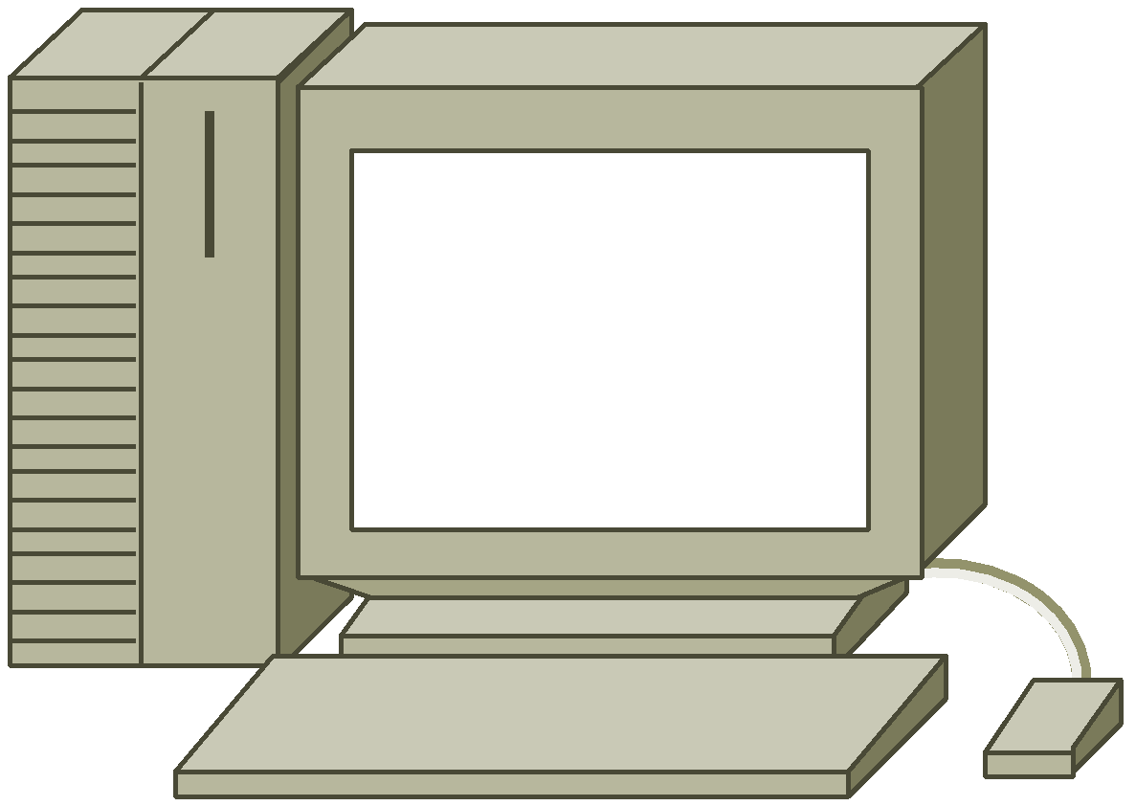
Application Network Topology
Client Server
  client must know the address of the server
Peer to Peer (P2P)
  nodes discover peers by multicast, dns seeds, tracker servers

Slide 6
Client Server vs Peer to Peer
Client Server
Pros
Easy to code
Easy to maintain
Centralised Security management
Centralised Data Management
Cons
Single Point of Failure
Performance bottleneck at Server
Peer to Peer
Pros
No single point of Failure
Scalable
Parallel Processing
Cons
Harder to Code
Difficult to maintain
Decentralise Security is difficult to enforce
Data consistency
    - Synchronisation
    - Conflict Resolution

Slide 7
Anatomy of an Application
PRESENTATION/View
CODE
BUSINESS LOGIC/Controller
CODE
DATA/Model
SQL/NON-SQL

Slide 8

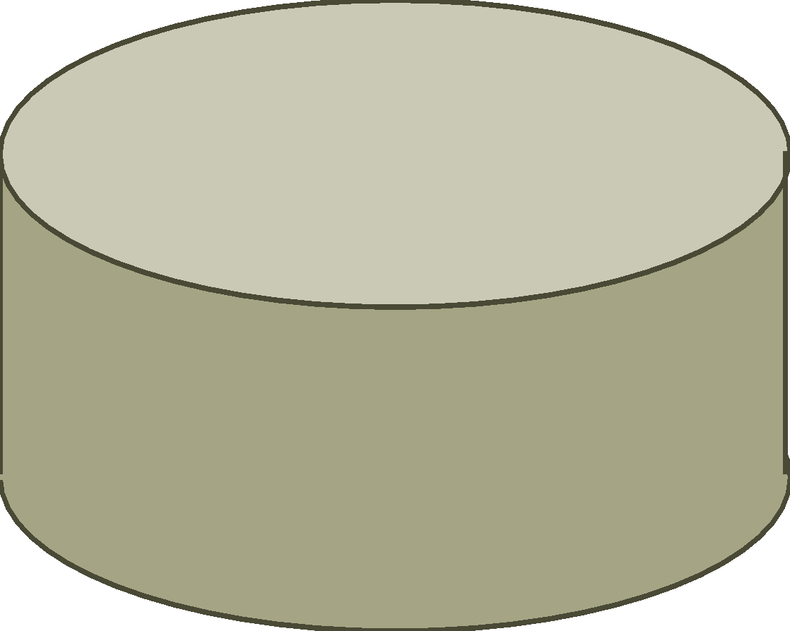
Thin Client/Server-side scripting Architecture
Web Browser
(Client)
Web Server
PRESENTATION/View
Flask/Jinja
Framework
BUSINESS LOGIC/Controller
javascript
DATA/Model
<html>
</html>
{ JSON
}

Slide 9
Fat Client/Client-side scripting Architecture
Web Browser
(Client)
Web Server
PRESENTATION/View
javascript
WEB API
BUSINESS LOGIC/Controller
javascript
BUSINESS LOGIC/Controller
json
DATA/Model
<html>
</html>
{ JSON
}

Slide 10
HTTP
Stateless
  Send and Forget
Support
  Get, Post, Put, Delete operations
Scalable
INITIATOR
Request
Response
Request
Web Browser
(Client)
Web Server
Response

Slide 11
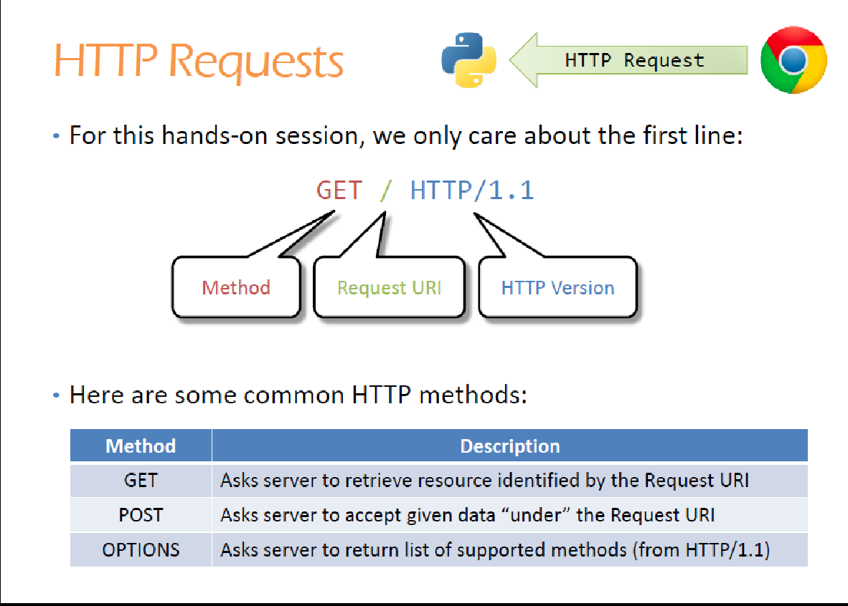

Slide 12
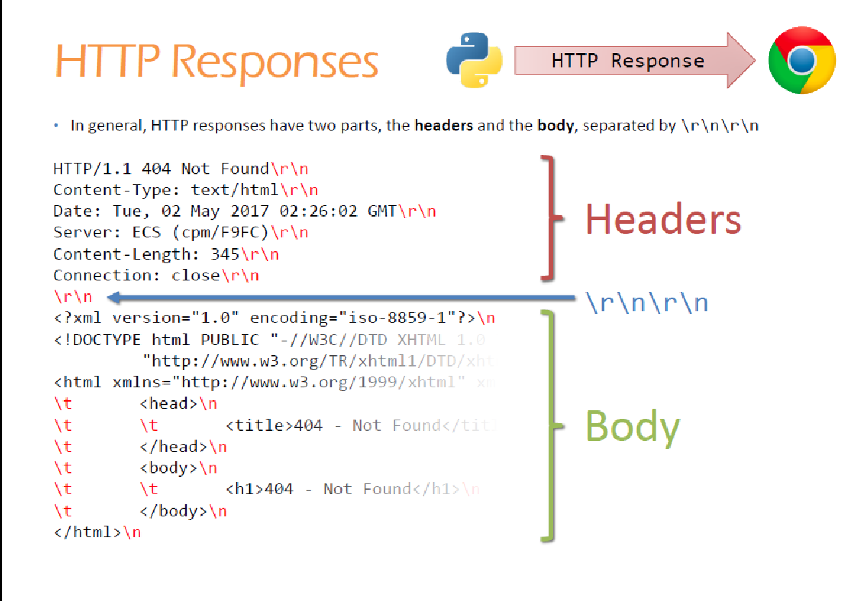
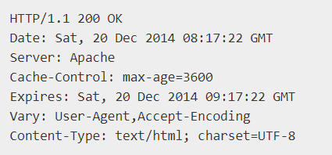
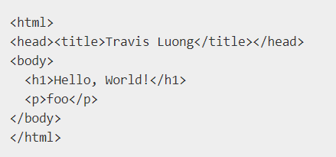

Slide 13
