Slide 1
Road map for Web App Development
Semester 1
WWW
HTML - Basics
CSS – Basics
Build static web pages for a (example use case Product Catalogue)
Semester 2
Python with Flask framework
Build an interactive app for creating, updating and viewing a Product Catalogue
Project (10%)

Slide 2
Introduction to Web Application
THE BIG PICTURE
World Wide Web
Web Application Architecture
Notes:
world wide web is one way to access the internet

Slide 3

What is the World Wide Web ?
https://shorturl.at/afCER

Slide 4
“What was often difficult for people to understand about the design was that there was nothing else beyond URLs, HTTP and HTML. There was no central computer "controlling" the Web, no single network on which these protocols worked, not even organisation anywhere that "ran" the Web. The Web was not a physical "thing" that existed in a certain "place". It was a "space" in which information could exist.”
― Tim Berners-Lee

Slide 5
World Wide Web
It is a global collection of resources that is build using a set of open standard specifications. (tell people how to build it)
These specifications are:
  Hypertext Transfer Protocol (HTTP/S), a set of rules to define how to request, exchange data, handle errors and security.
  Hyper Text Markup Language(HTML), a markup language use for presentation of data.
  Uniform Resource Locator (URL), a universal identifier of resource that tells you where the resource is.
Components
  Web Browser
  Web Server
Is it Centralised or Decentralised today?
Notes:
Is the internet centralised or decentralised?
Concept: Want everyone to be able to provide and receive service - decentralised
But politically, there are big powerful and private corporations which have a lot of power - influence how their service is consumed, centralised power
A level say decentralised, but companies can monopolise how their service is being used

Slide 6
Web Application Architecture
Client Server (Centralised)
  Fat Client/Thin Server (Client rendering)
  Thin Client/Fat Server (Server Rendering)
Peer to Peer (Decentralised/Distributed)

Slide 7





Client Server Architecture
HTTP Request
Example:
GET /class?id=24SH09
Web Browser
(Thin Client)
Web Server
CALL get_class(id=‘24SH09)
RETURNS
“
<html>
<head>..
<body> ...
</html>
“
HTTP Response
24SH09
AI Bob
10,Male
Likes Talking
javascript
Super Kid
8,Female
Likes Flying
<html>
</html>
{ JSON
}

Slide 8
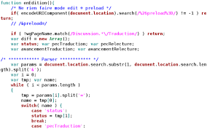
Client Server Architecture
HTTP Request
Example:
GET /class
Web Browser
(Fat Client)
Web Server
<html>
<head>
<script>
</script>
<body> ...
</html>
HTTP Response
24SH09
AI Bob
10,Male
Likes Talking
Super Kid
8,Female
Likes Flying

Slide 9
Fat Client vs Thin Client
 | Fat Client Client rendering | Thin Client Server Rendering
Advantages | Interactive/Reactive Supports Mobile Clients | Security Quick prototyping
Disadvantages | Slow Initial load/ Development effort: Client side scripting + Server side scripting | Limited UI Only support web browser client

Slide 10
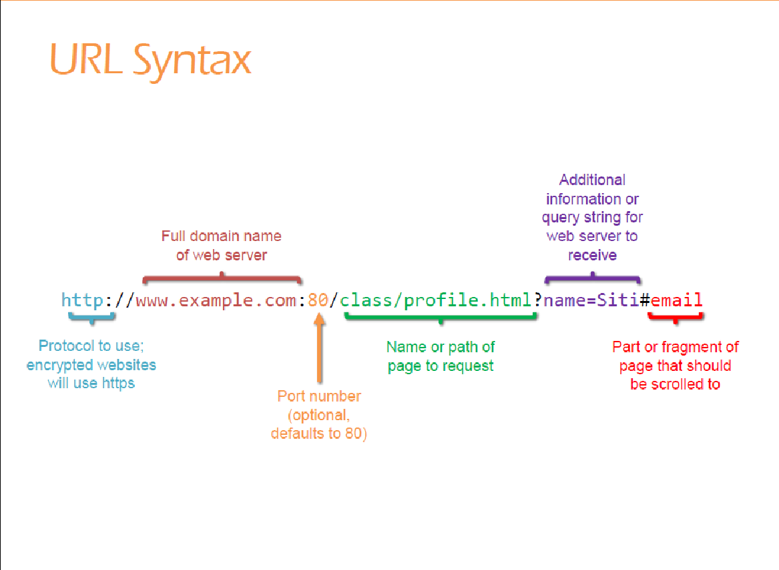

Slide 11
Summary
WWW
  URL, HTML, HTTP/S
Web App
Client Server
  Thin vs Thick Client

Slide 12

Activity
Web App | Mobile App | Desktop App
Access via a Web Browser
Example: | Example: | Example:
For each of the app, complete the list of characteristics .
If possible, give an example of the app you are referring to
Submit via
https://padlet.com/leong_khar_woh/types-of-applications-o5sq0ovtmc7s
Notes:
Other terminologies
Progressive Web Application (PWA)
Responsive Web Application
Single Page Application (SPA)

Slide 13
Software Application
What are the different types of Apps that you use ?

Slide 14
Possible Ans:
Web App | Mobile App | Desktop App
Access via a Web Browser Access via a API Dynamic contents User interaction is limited by the web browser | Access to network Needs installation/updates Binds to a platform. (android/IOS) Access to device capabilities (camera, sensors, etc) | Binds to a platform. (android/IOS) Needs installation/updates Access to device capabilities (camera, sensors, etc)
Example: | Example: | Example:
For each of the app, complete the list of characteristics .
If possible, give an example of the app you are referring to
Submit via https://padlet.com/leong_khar_woh/th571hqib95egy4u
Notes:
Other terminologies
Progressive Web Application (PWA)
Responsive Web Application
Single Page Application (SPA)

