Slide 1
What is a “Good” web site ?
https://www.airbnb.com.sg/
https://www.apple.com/sg/
https://www.singaporeair.com/
https://www.art.yale.edu/
http://www.roverp6parts.com/
https://www.arngren.net/

Slide 2
Web User Interface (UI) Design Principles
Visual Hierarchy
Consistency
Affordance
Responsive

Slide 3
visual hierarchy
arrangement & formatting
of different elements to show relative importance
Use of colour, size, spacing and layout
Use contrast between screen elements

Slide 4
Using visual hierarchy
Why is visual hierarchy important? Quick scanning. A good visual hierarchy allows users to find what they want quickly. Clear flow. With a good visual hierarchy, users are clear the sequence they should look at in a page.
Why is visual hierarchy important?
Clear flow
With a good visual hierarchy, users are clear the sequence they should look at in a page.
Quick scanning
A good visual hierarchy allows users to find what they want quickly.

Slide 5
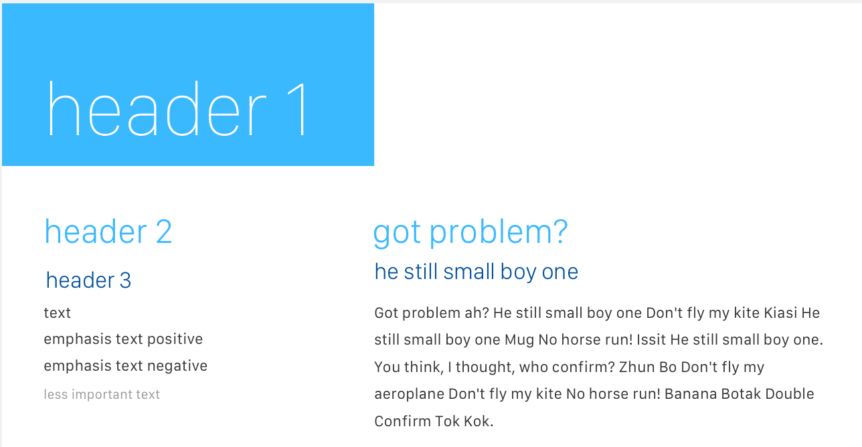
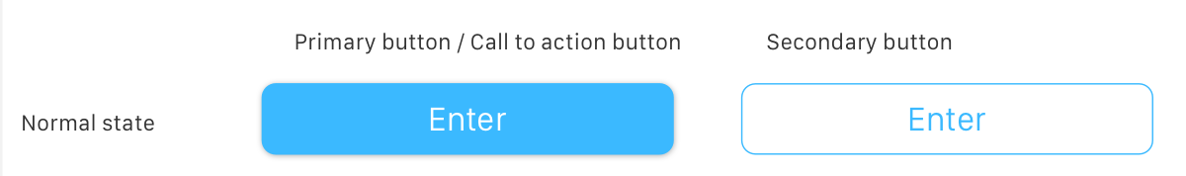
Cancel

Slide 6
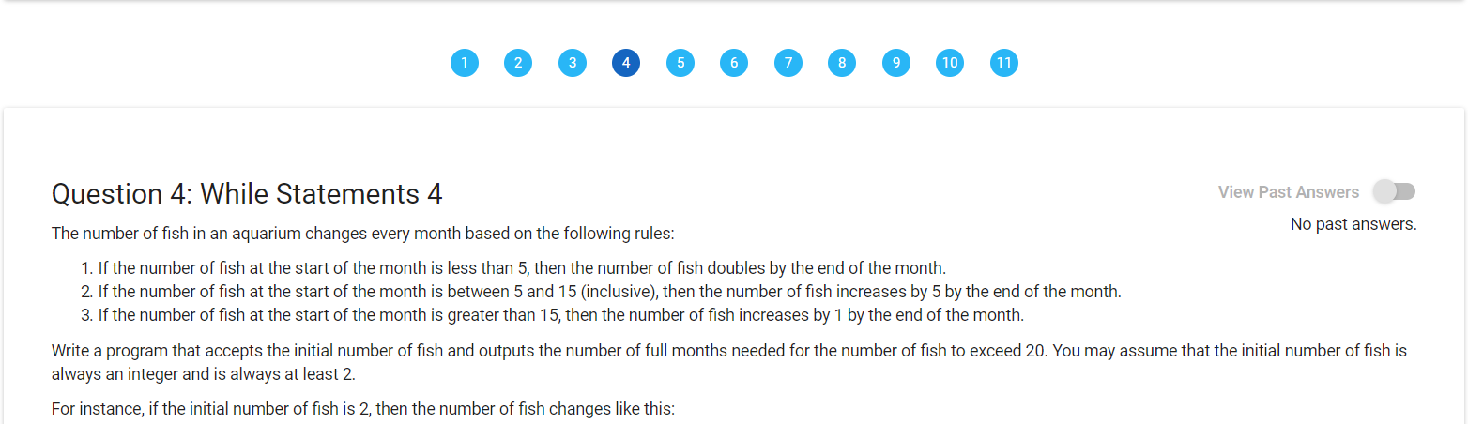
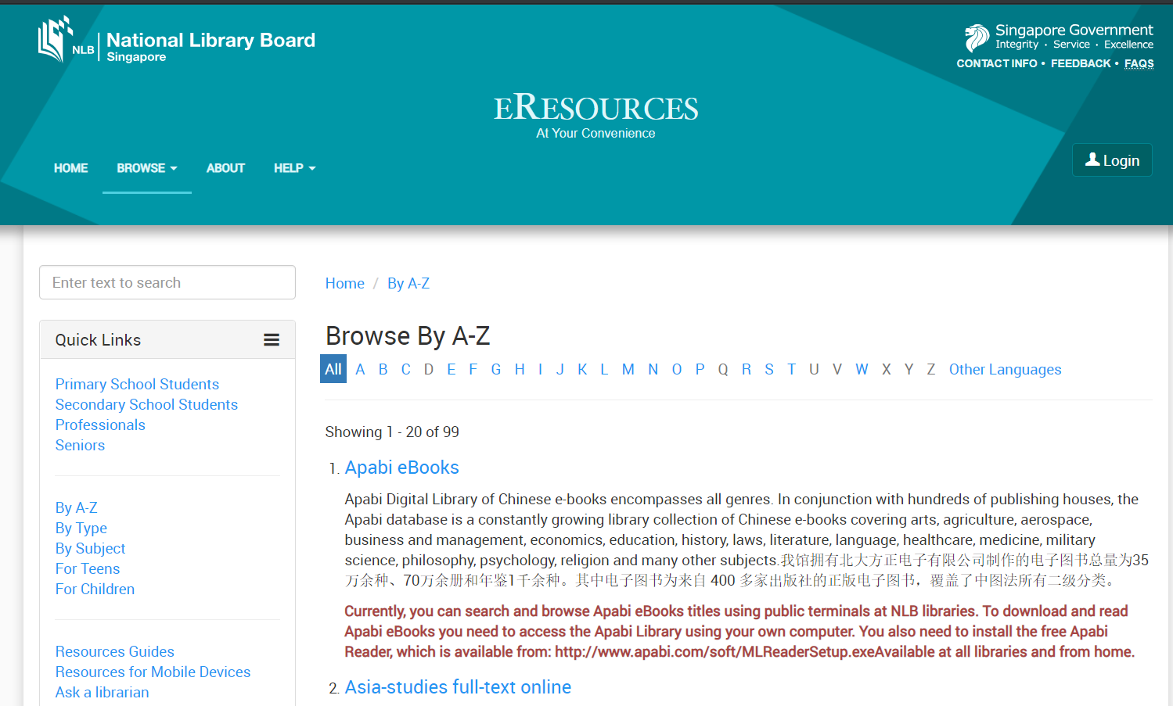
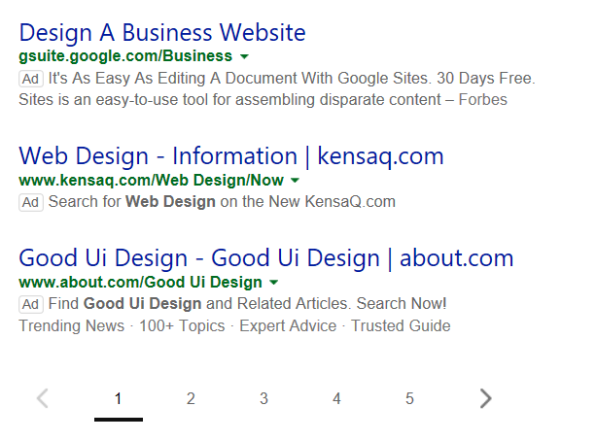
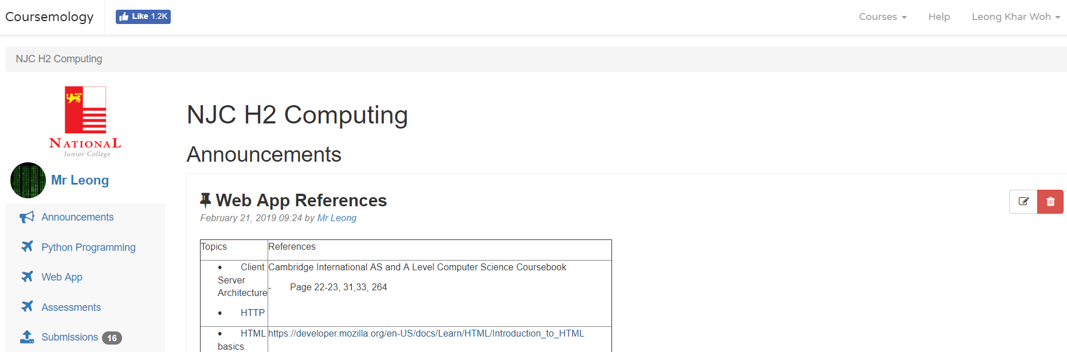
Consistency
A system should look, act and operate the same throughout
Using consistent design patterns

Slide 7


Consistency
A system should look, act and operate the same throughout
Using mental models /metaphors
  familiar concepts relating to real life
https://fontawesome.com/start

Slide 8
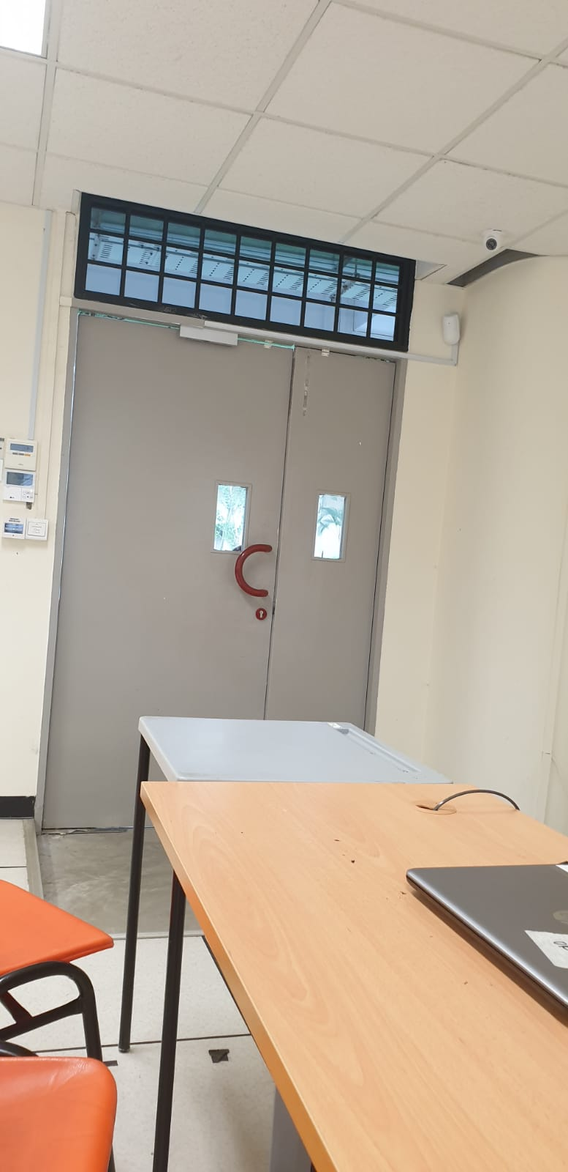
Affordance
giving clues or restrictions to the user on how it works
How do you open the door ?

Slide 9
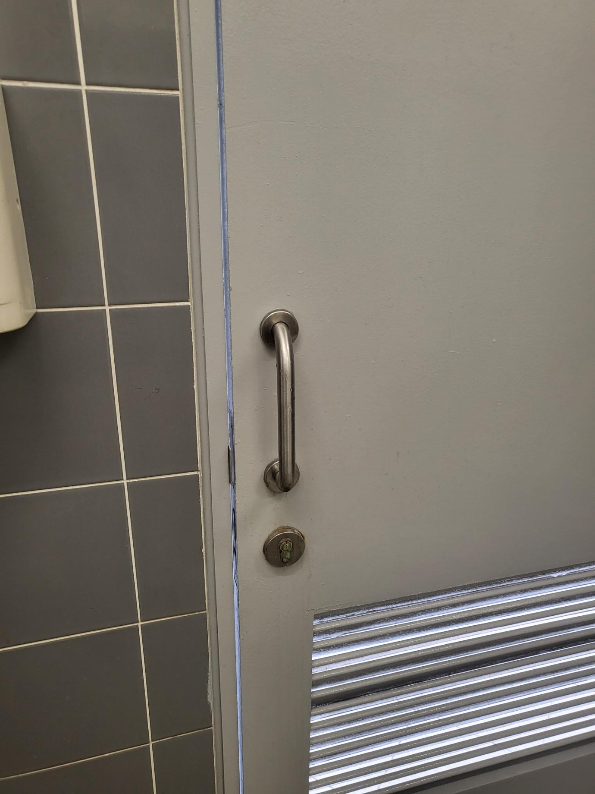
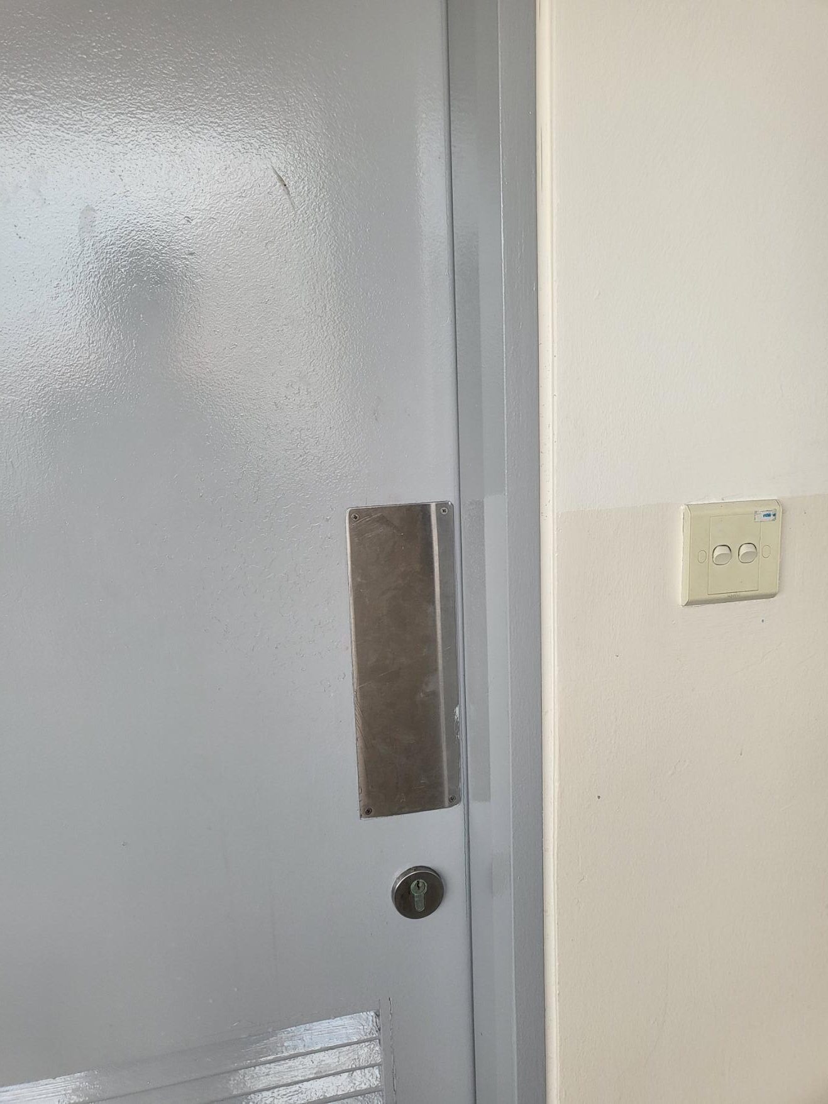
Affordance
giving clues or restrictions to the user on how it works

Slide 10
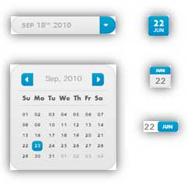
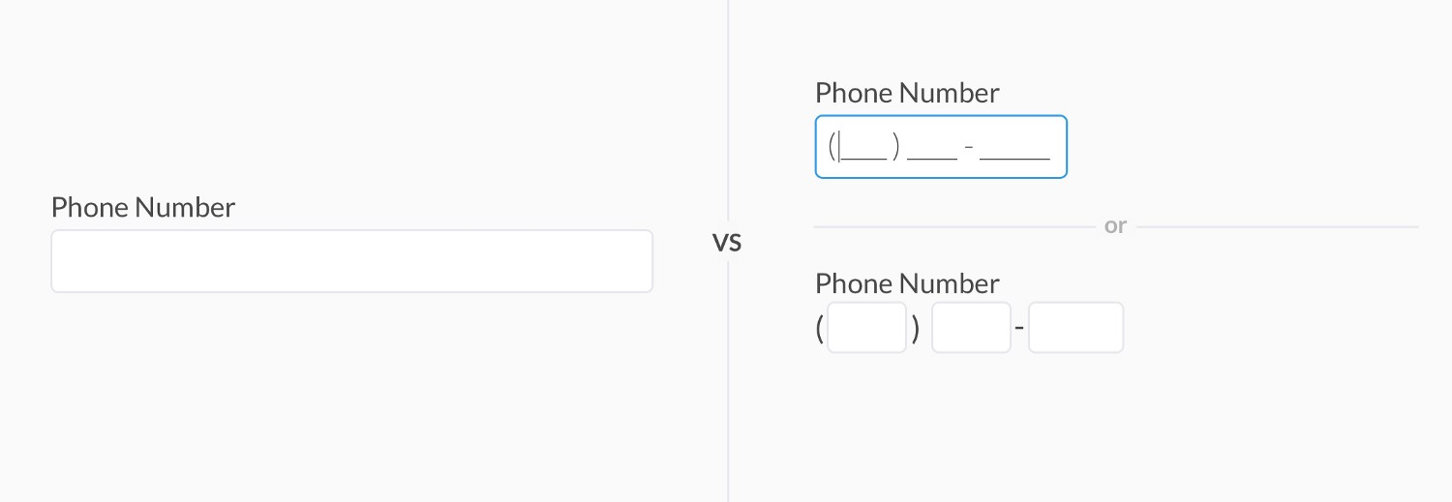
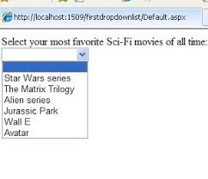
Affordance
giving clues or restrictions to the user on how it works
Using appropriate input elements

Slide 11
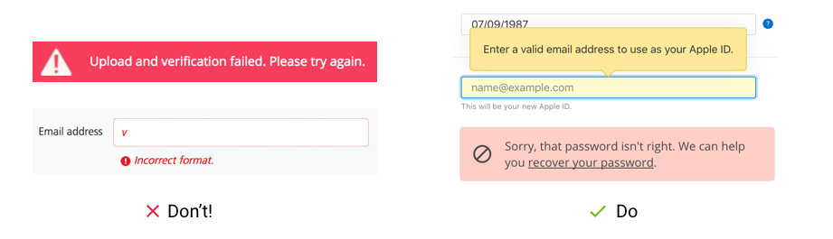
Affordance
giving clues or restrictions to the user on how it works

Slide 12
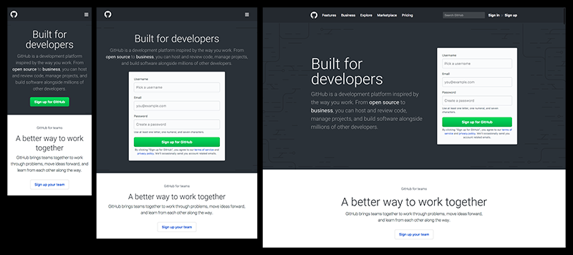
Responsive Web Design
to render contents according to the client device form factor
Smart
Phone
Tablet
Desktop

Slide 13
Responsive Design
to render contents according to the client device form factor
<html lang="en" >
<head>
<meta charset="utf-8" />
<meta name="viewport" content="width=device-width" />
<title></title>
<link rel="stylesheet" href="products.css" type="text/css" />
</head>
@media only screen and (max-width: 600px) {
.row {
flex-direction: column;
}
.product {
width:100%;
}
}

Slide 14
putting in to practice…

Slide 15
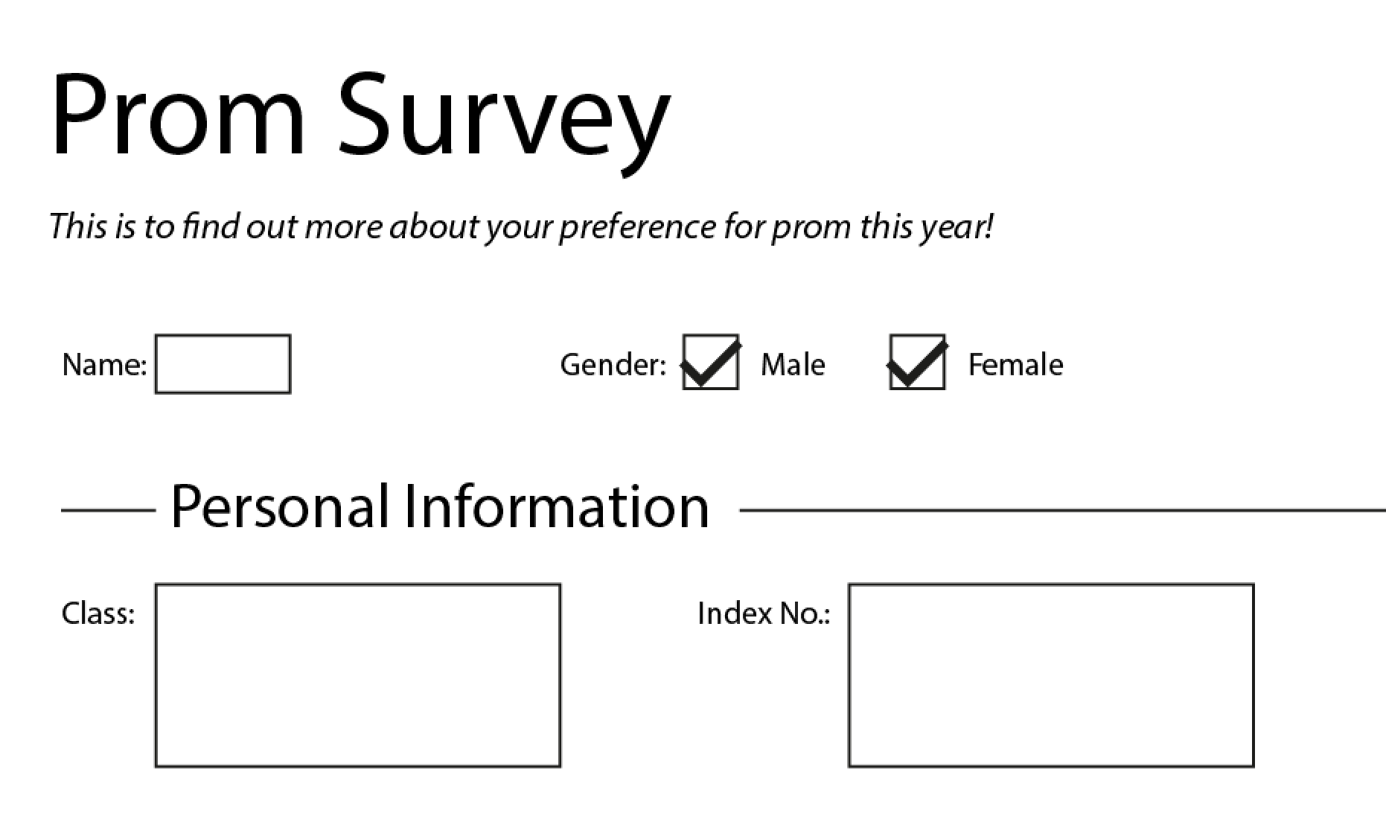
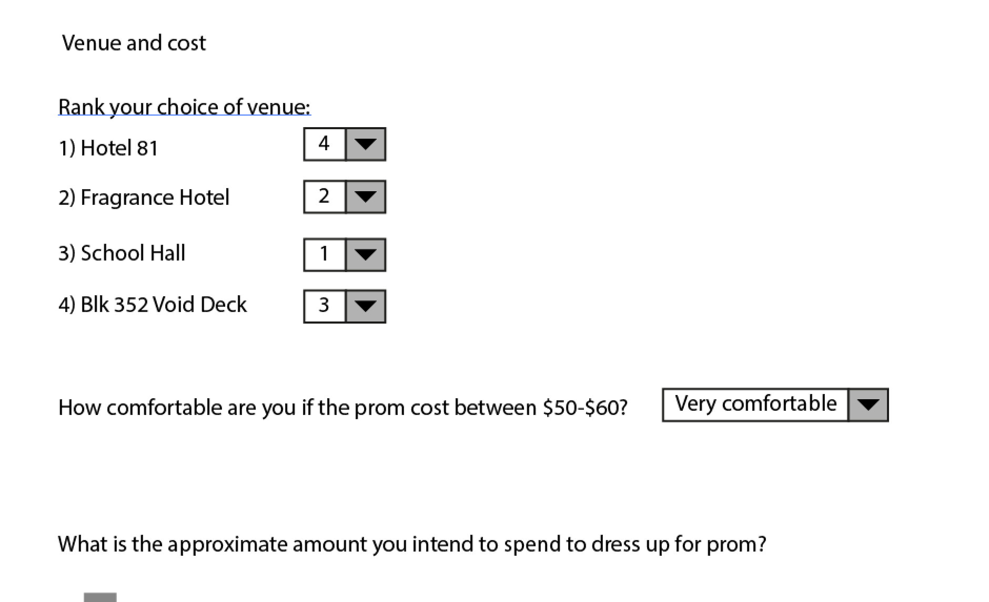
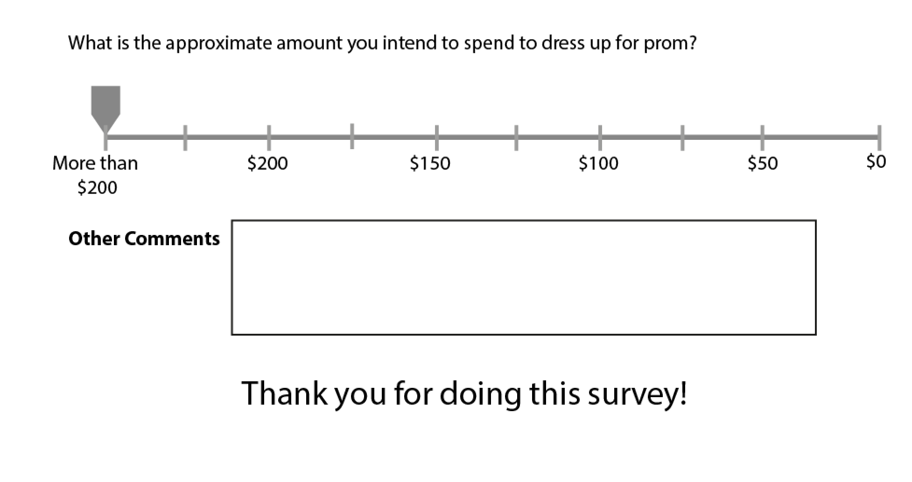
critique
With your partner/group, critique this web form (pg 3).
What’s not done well?
How to improve it?
Annotate on your paper.
Try using the terms & principles learnt (pg 1 & 2)

Slide 16
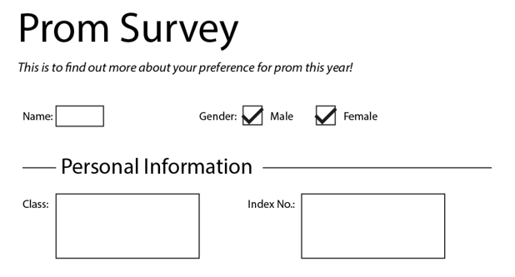
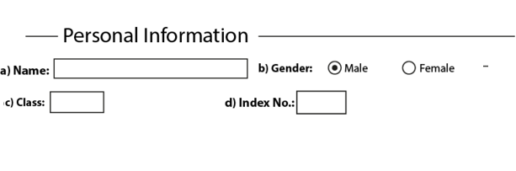

Slide 17
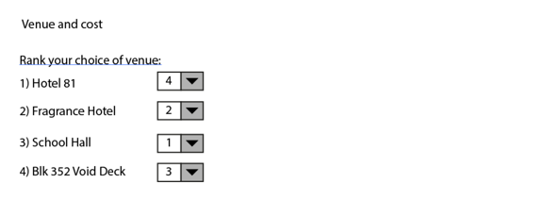
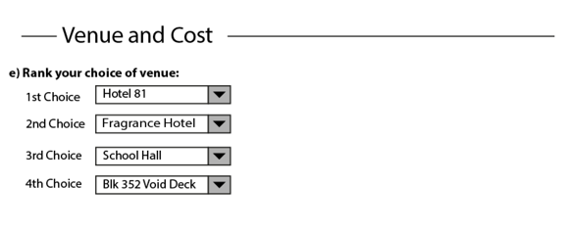

Slide 18
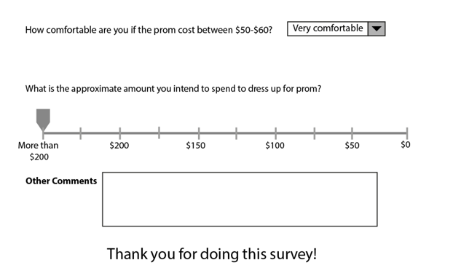
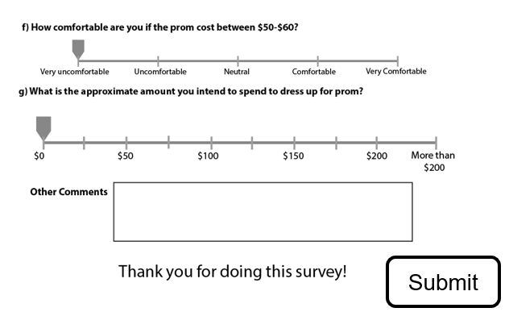

Slide 19
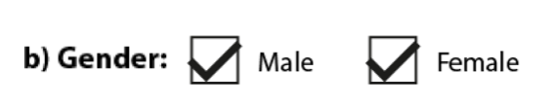


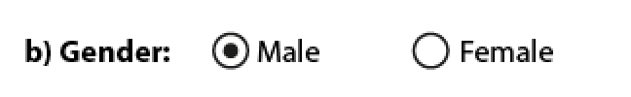

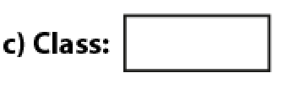
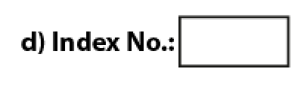



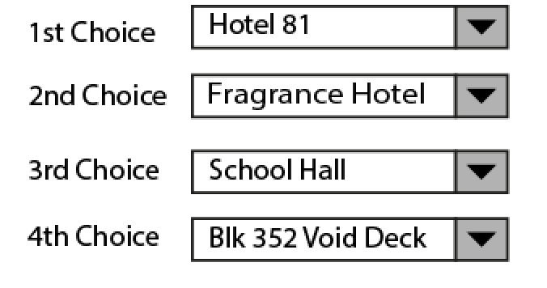

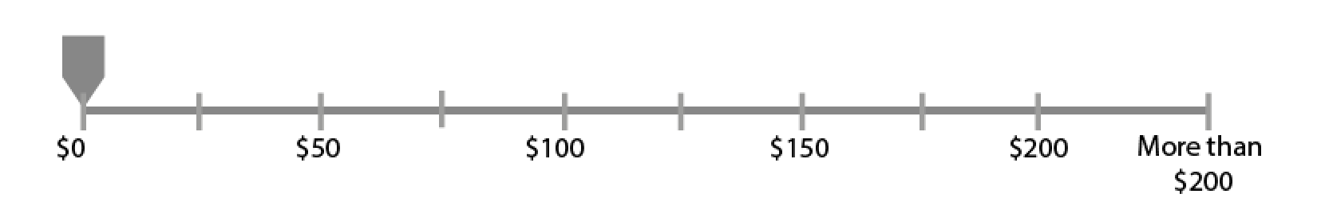
Submit

Slide 20
Does it mean that having a WebApp with Great UI will make it a Great APP ?

Slide 21

Web App Usability
the goal of every web app is to achieve its business or functional objectives
Allow students to submit assignments and read feedbacks
Allow teachers to grade assignments

Slide 22
User Experience UX
User experience (UX) in web design refers to the overall experience a person has when interacting with a website. It encompasses all aspects of the end-user's interaction with the company, its services, and its products via the website. The primary goal of UX design is to create a site that is efficient, enjoyable, and easy to use, thereby meeting the specific needs of the user without fuss or bother.

Slide 23


what is UI and UX?
UI
UX
design
design
Visual clarity & aesthetics
Delightful experience
Aligned with product strategy
Address user needs,
build loyalty,
engage user’s
emotions
Minimise errors,
maximise right inputs
MICRO
MACRO

Slide 24
why UI/UX?
UI
UX
design
Determines
design
Visual clarity & aesthetics
Delightful experience
Helps achieve
Minimise errors, maximise right inputs
Build loyalty
Engage user’s emotions

Slide 25
Usability Design
Without taking UX into consideration, it is difficult to design a user-friendly UI that delights the user.
Without a good UI, the designed UX cannot be achieved.

