Slide 1
Database Management Systems

Slide 2
Database
An organized collection of data in persistent storage.
Relational Data Model
  ERD -> Entities, Relationships, Cardinality
  Normalisations -> Relations(Tables), Attributes, Primary/Foreign Keys
  Goals of Normalisation
    Avoid redundancy,
    Maintain consistency and accuracy of data
    - Avoid anomalies from insert/delete, update

Slide 3




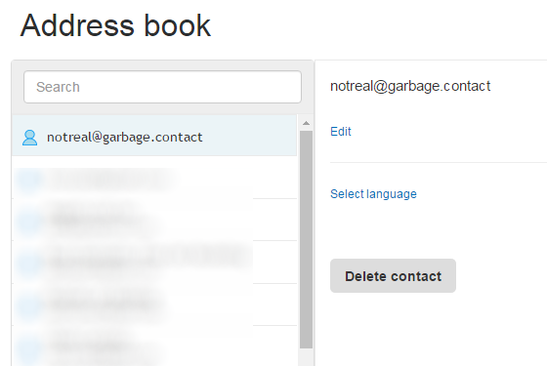
Database Application
A program for entering and retrieving information from a database
Examples
  Banking
  Education
  Air-ticket booking website
  My address book

Slide 4
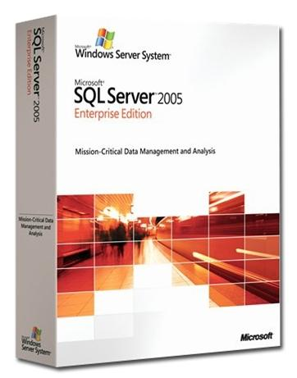




Database Management Systems (DBMS)
Software for the implementation and management of databases

Slide 5
Database, Database Application and DBMS
Database Management System
Database Application
Commands
Database
Data

Slide 6
What are the features of a Database Management System?
Persistent data
Security
Data Dictionary
DBMS
Concurrent
Access
Data Manipulation Language (DML)
Integrity
Data Definition Language
( DDL)

Slide 7
Data Dictionary
Meta-Data
the descriptions of tables, relationships and all design information such as indexing.
  indexes are data structures created for fast retrieval.
the rules about data integrity including validation rules for all attributes.

Slide 8
Referential Integrity
Referential Integrity using FOREIGN KEY and PRIMARY KEY constraints
Cannot insert a record in Student table until the referenced Teacher record is created
Cannot delete/update a Teacher record until all the records in Student table that references it are deleted
Student
Teacher
StudentID | Name | PM (FK)
 |  | TeacherID
ID (PK) | TeacherName
TeacherID

Slide 9
Data Integrity
Enforces rules known as database constraints to ensure the accuracy and consistency of the data.
Constraints Rules: NOT NULL, UNIQUE, CHECK
Example :
  CHECK(Price > 0)
  CHECK(length(Name) < 20 )

Slide 10
Concurrent Access
User 1
User 2
con.execute(“UPDATE Products
SET Price = 50 WHERE ProdID=PJ82
Web App
con.execute(“UPDATE Products
SET Price = 70 WHERE ProdID=PJ82
DBMS
ProdID | Desc. | Price
PJ82 | Bag | 67.90

Slide 11
Data Security
Access Control
  WHO can access WHAT
Backup
  Full (weekly)
  Differential, backup only changes since last full (daily)
  Purpose : for recovery when data is lost or corrupted
Archive
  Purpose: for space management and long term retention. Original may be deleted.

Slide 12
SQL (Structured Query Language)
A computer language aim to store, manipulate, and retrieve data in (relational) databases
The de facto standard in traditional database applications and DBMS

Slide 13
SQL (Structured Query Language)
Data Definition Language (DDL)
  Creating, altering and deleting tables and other database objects
Data Manipulation Language (DML)
  Inserting, updating and deleting rows
  Querying tables
Database Control language (DCL)
  Controlling access to the database
Transaction Control Language (TCL)
  Dealing with transactions within a database.

Slide 14
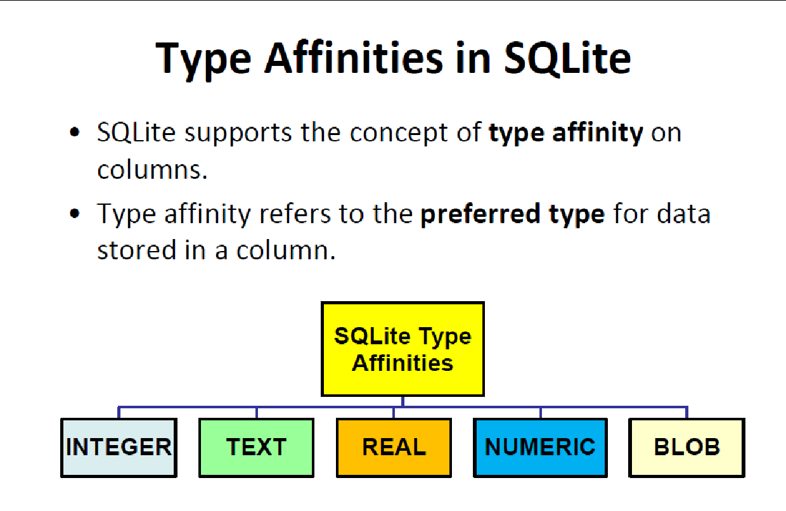

Slide 15
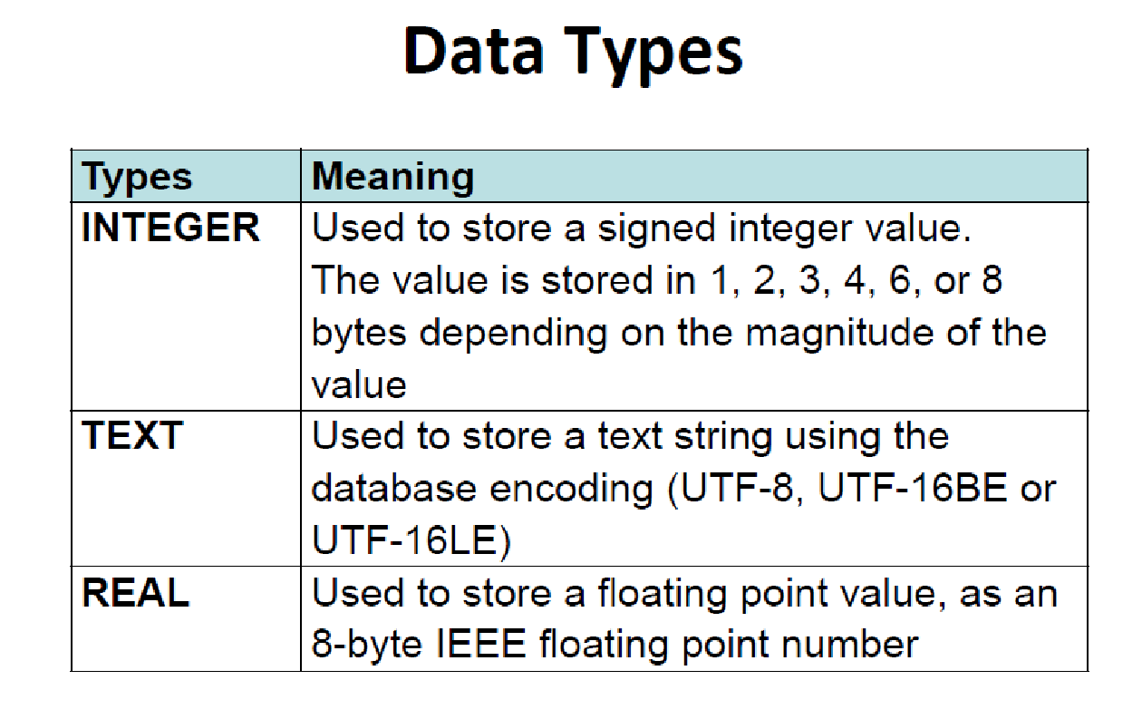

Slide 16
SQL
Data Definition Language (DDL)

Slide 17
PRIMARY KEY constraint
CREATE TABLE book (
title TEXT,
publisher INTEGER,
ID INTEGER PRIMARY KEY
);
CREATE TABLE book (
title TEXT,
publisher TEXT,
ID INTEGER,
PRIMARY KEY (ID)
);
OR
Multi-attribute PK
CREATE TABLE book (
title TEXT,
publisher INTEGER,
ID INTEGER,
PRIMARY KEY (title, publisher )
);

Slide 18
Foreign key (Referential integrity) Constraint
CREATE TABLE Loan (
ID INTEGER NOT NULL,
BorrowerID INTEGER NOT NULL,
BookID INTEGER NOT NULL,
"Date Borrowed" TEXT,
FOREIGN KEY(BorrowerID) REFERENCES Borrower (ID),
FOREIGN KEY(BookID) REFERENCES Book (ID)
);

Slide 19
DROP
To remove a table (and all the data in it).
DROP TABLE Book;

Slide 20
Conditional CREATE/Drop
CREATE TABLE IF NOT EXISTS Book (
title TEXT,
publisherID INTEGER,
ID INTEGER
);
DROP TABLE IF EXISTS Book;

Slide 21
SQL
Data Manipulation Language (DML)

Slide 22
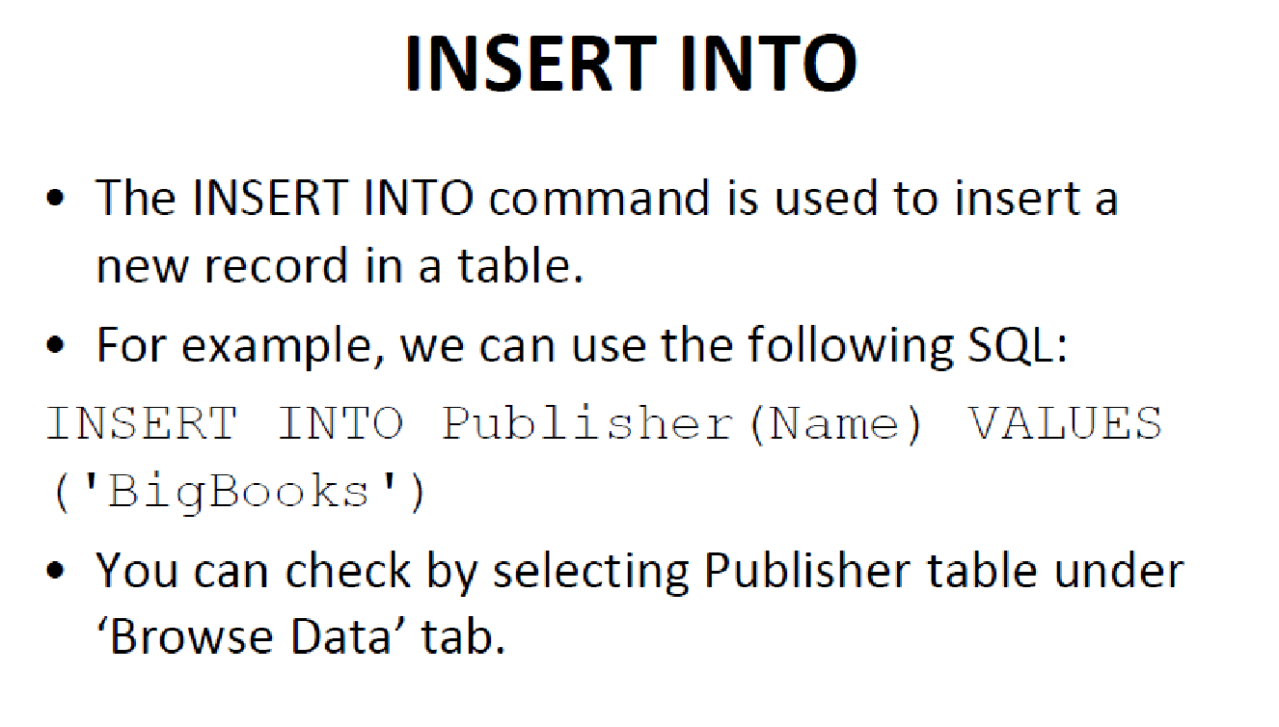

Slide 23
INSERT syntax
INSERT INTO table_name(column1_name, column2_name, ...) VALUES(column1_value, column2_value, ...);
Another form where all the table attributes’ values must be provided
INSERT INTO Book (Title, Damaged) VALUES ("Python101",0)
INSERT INTO Book VALUES (99, "Python101",NULL, 1)

Slide 24
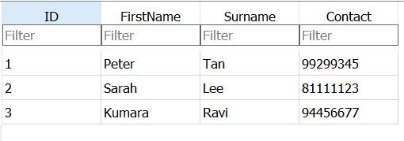
UPDATE syntax
UPDATE table_name SET
column1_name = column1_expression,
column2_name = column2_expression,
...
WHERE where_expression;
UPDATE Borrower SET Contact = 98764326
WHERE ID=2;
UPDATE Borrower
SET FirstName = FirstName || ID ;
CONCATENATE OPERATOR

Slide 25
DELETE
To remove all data in a table.
To remove selected data in a table.
DELETE FROM Book;
DELETE FROM Book WHERE damaged = 1
DELETE FROM table_name WHERE condition;
Sample Statement
Syntax

Slide 26
SELECT
To return all data in a table
To return selected columns in a table
SELECT * FROM Borrower;
SELECT * FROM table_name;
Sample Statement
Syntax
SELECT FirstName, Contact
FROM Borrower;
SELECT col_name1,col_name2,
…, col_nameN
FROM table_name;
Sample Statement
Syntax

Slide 27
SELECT
To return certain rows in a table
Using a wildcard %
SELECT * FROM Book
WHERE PublisherID = 4
SELECT * FROM table_name WHERE condition;
SELECT * FROM Book
WHERE PublisherID = 4 AND Damaged = 0
(Simplified) Syntax
Sample Statement
SELECT * FROM Book
WHERE Title LIKE "H2%"

Slide 28
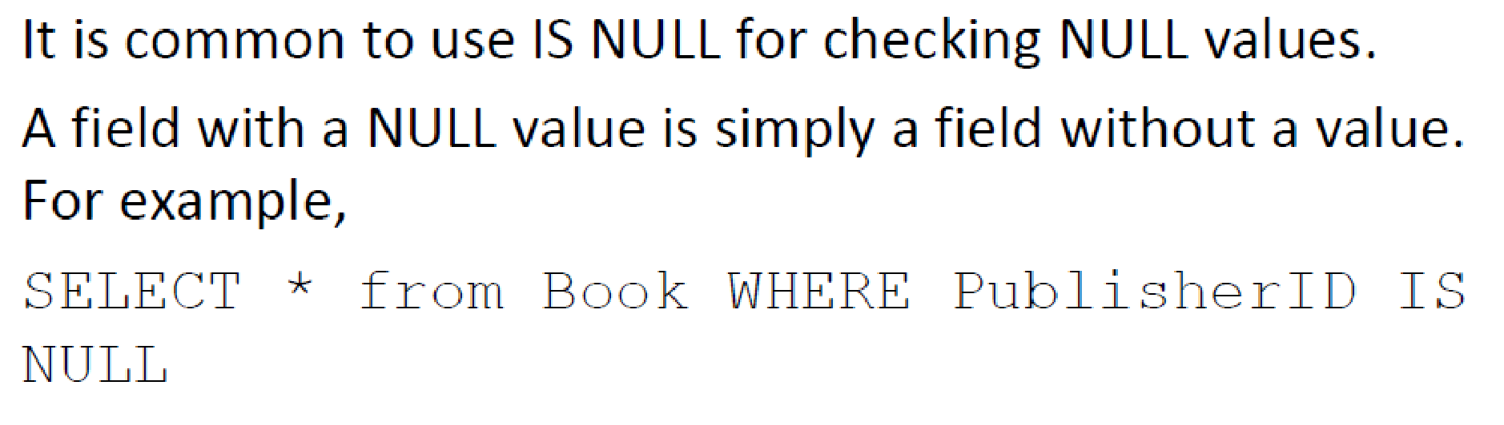
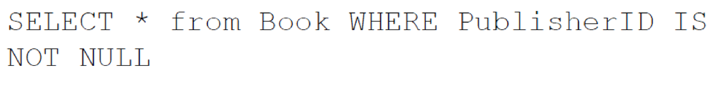
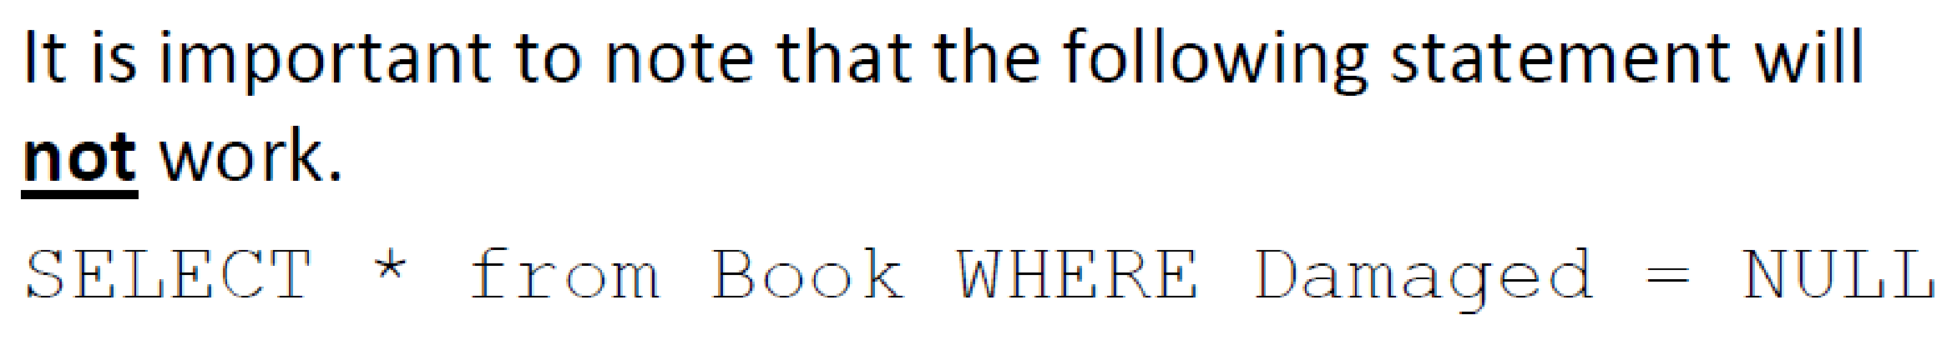
SELECT
PublisherID = NULL

Slide 29
Sorting Results
List the loan records in ascending order of the date Borrowed.
SELECT *
FROM loan
ORDER BY "Date Borrowed" ASC;
SELECT *
FROM loan
ORDER BY "Date Borrowed" DESC;

Slide 30
Limiting Results
List the first 3 books.
SELECT * FROM book LIMIT 3;

Slide 31
SQL
Advance Data Manipulation Language (DDL)
Multi-table SELECT

Slide 32
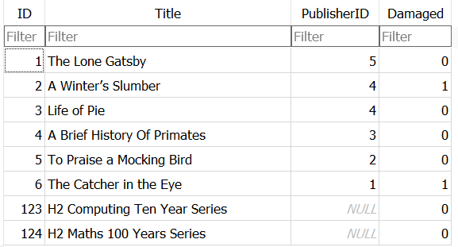
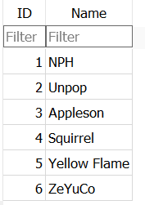
Multi-table SELECT Statements
Find the titles of all the books and their publisher
Book
Publisher

Slide 33
Inner Join
Inner join select only records from Table A and Table B which meet the join condition
SELECT *
FROM Book
INNER JOIN Publisher
SELECT *
FROM Book
INNER JOIN Publisher ON Book.PublisherID = Publisher.ID
SELECT Book.Title, Publisher.Name
FROM Book
INNER JOIN Publisher ON Book.PublisherID = Publisher.ID

Slide 34
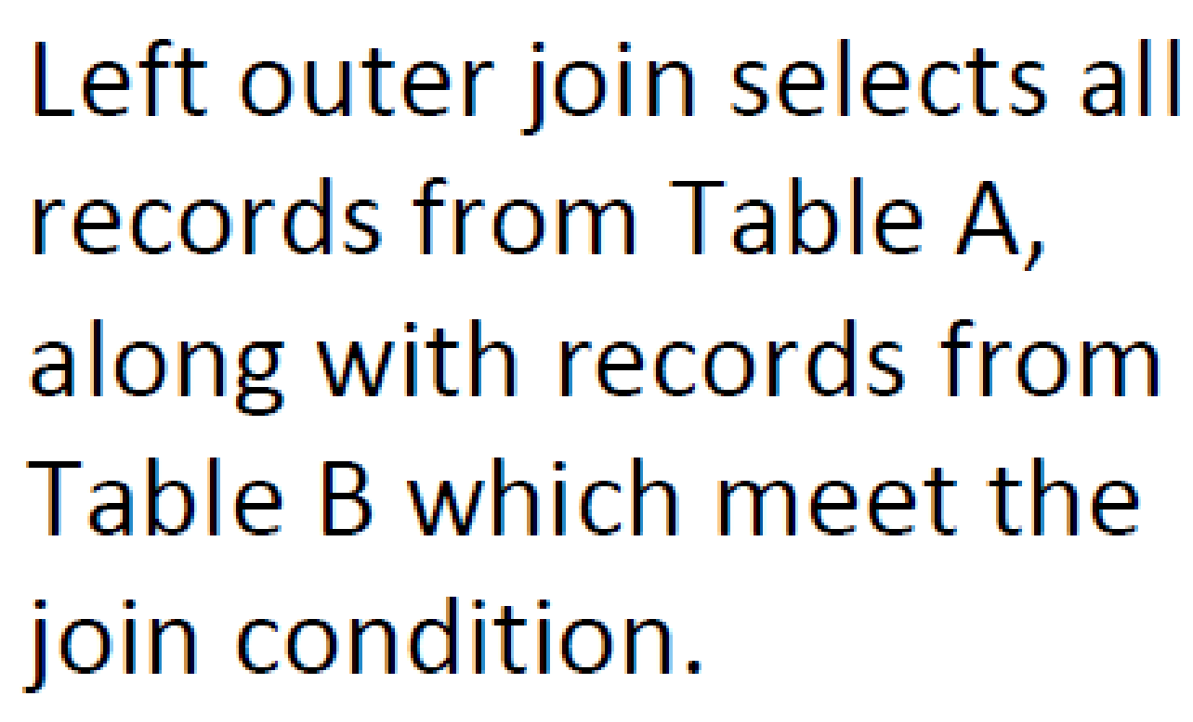
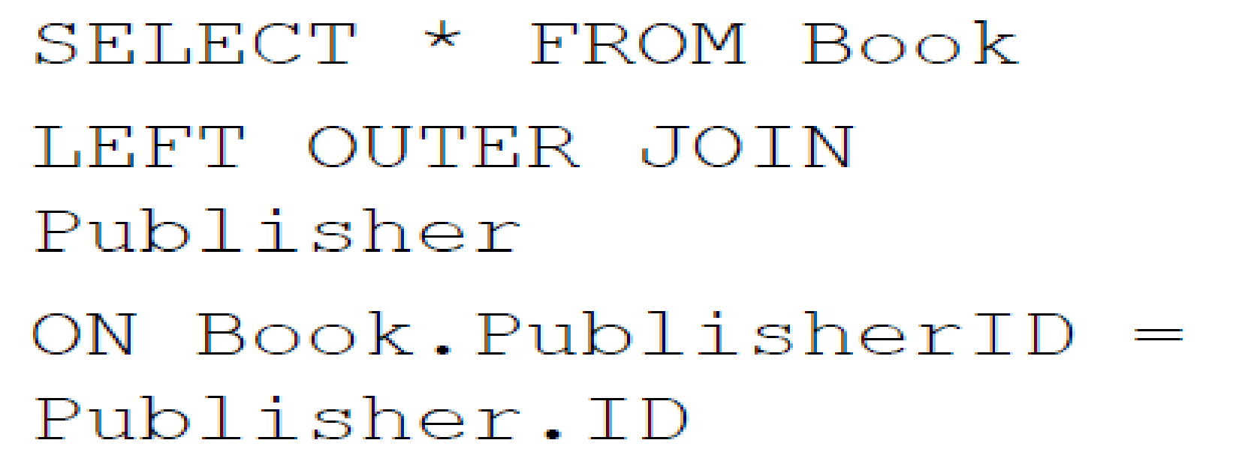
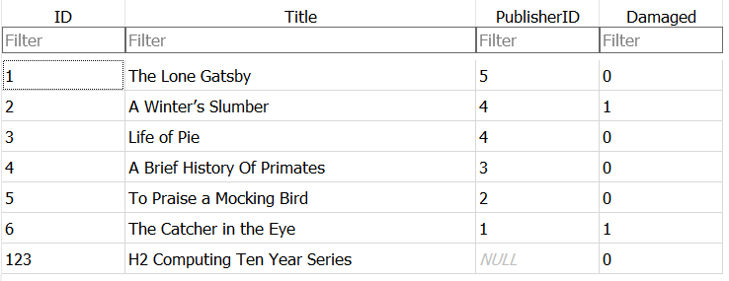
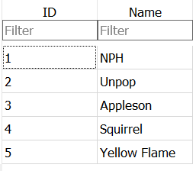
Left Outer Join
Book (Table A)
Publisher (Table B)

Slide 35
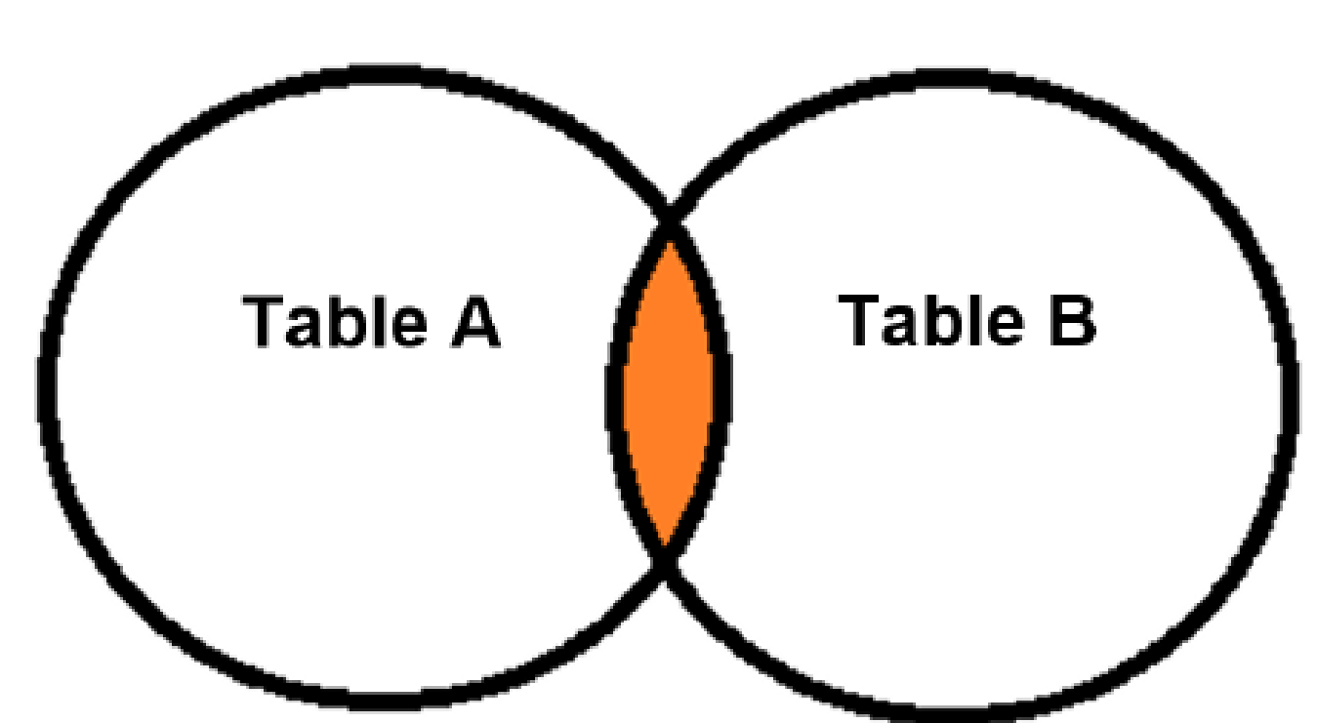
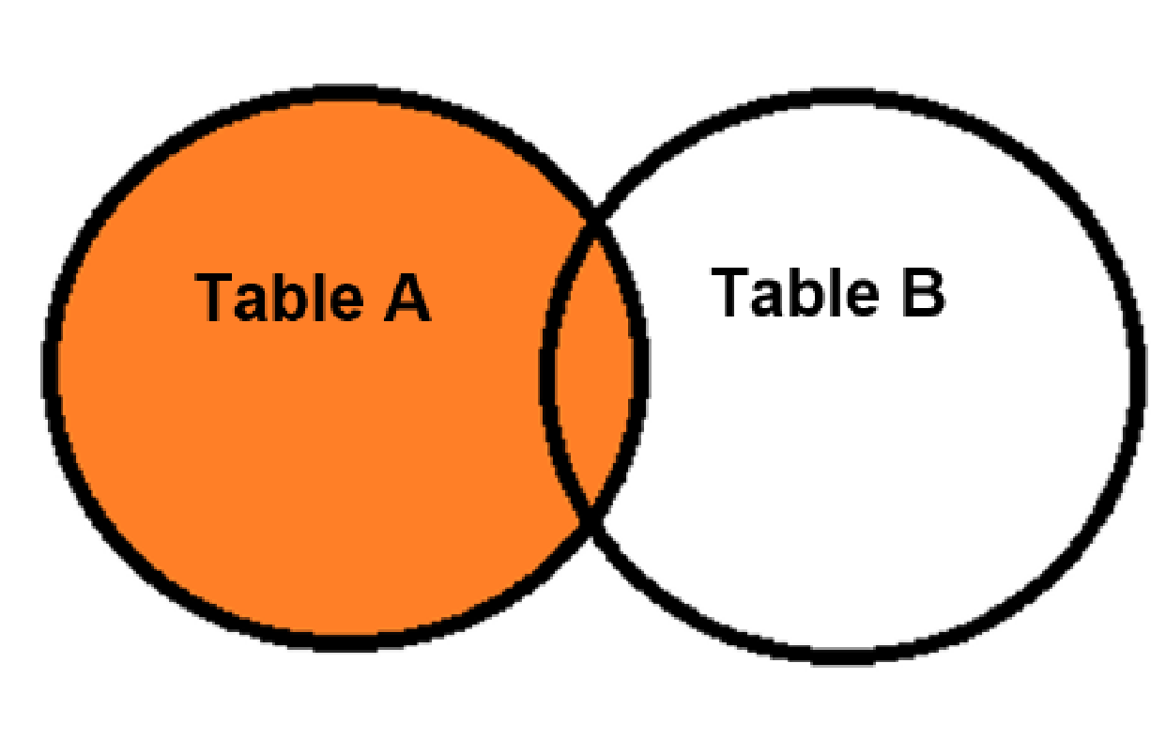
Joinsq
INNER JOIN
LEFT OUTER JOIN

Slide 36
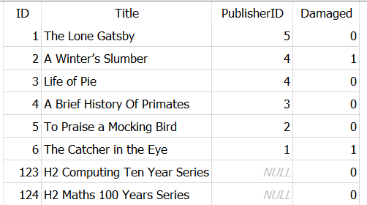
Aggregate Queries: COUNT
Find the total number of books.
Aggregate queries use aggregate functions to combine results over entire tables columns or a particular column
  Example: COUNT(), SUM(), MAX(), MIN(), AVG()
SELECT COUNT(*) FROM book;
COUNT(*)
8
SELECT MAX(ID) As "Last ID" FROM book;
Last ID
124

Slide 37
Aggregate Queries: Grouping
Find the number of books borrowed by each student.
The GROUP BY clause creates groups before applying the aggregation. function
SELECT BorrowerID, COUNT(*)
FROM Loan
GROUP BY BorrowerID

Slide 38
Aggregate Queries: Condition
Find the name of students who borrowed more than one book.
The HAVING clause specifies conditions on groups.
SELECT Borrower.FirstName, COUNT(*) AS NumBorrowed
FROM Loan
INNER JOIN Borrower ON Loan.BorrowerID = Borrower.ID
GROUP BY BorrowerID
HAVING NumBorrowed > 1

Slide 39
Using Outer Joins
Find the name of students who did not borrow any books
SELECT Borrower.FirstName
FROM Borrower
LEFT OUTER JOIN Loan ON Borrower.ID = Loan.BorrowerID
WHERE Loan.BookID is Null

