Slide 1
Issues in Computing
Ethical, Legal, Economic and Social

Slide 2
Main Topics
Code of Conduct for Computing Professional (Topic 1, Case Study 1)
Legal Issues
Personal Data Protection Act (Topic 2A , Case Study 2, Case Study 3)
Intellectual Properties (Topic 2B, Case Study 4)
Impact of Technology on lifestyle and workplace for social and economic developments.

Slide 3
Why do we need Ethics in Computing ?

Slide 4
Code of Conduct for Computing Professionals Refer to Textbook : Cambridge AS/A, Ch9 (pg99-108)
Code of Conduct
ACM , Association of Computer Manufacturer
IEEE
Principles
1 PUBLIC - Software engineers shall act consistently with the public interest.
2 CLIENT AND EMPLOYER - Software engineers shall act in a manner that is in the best
interests of their client and employer consistent with the public interest.
3 PRODUCT - Software engineers shall ensure that their products and related modifications
meet the highest professional standards possible.
4 JUDGMENT - Software engineers shall maintain integrity and independence in their
professional judgment.
5 MANAGEMENT - Software engineering managers and leaders shall subscribe to and
promote an ethical approach to the management of software development and
maintenance.
6 PROFESSION - Software engineers shall advance the integrity and reputation of the
profession consistent with the public interest.
7 COLLEAGUES - Software engineers shall be fair to and supportive of their colleagues.
8 SELF - Software engineers shall participate in lifelong learning regarding the practice of
their profession and shall promote an ethical approach to the practice of the profession.

Slide 5
Data Protection under PDPA
Personal data refers to data, whether true or not, about an individual who can be identified from that data; or from that data and other information to which the organisation has or is likely to have access.
Direct link to a particular person, Eg NRIC, fingerprint, contact number
Different pieces of information, which collected together can lead to the identification of a particular person, example the IP Address used when accessing the Web
Personal Data Protection Act (SGP)
The PDPA governs the collection, use and disclosure of individuals’ personal data by organisations in a manner that recognises both the right of individuals to protect their personal data and the need of organisations to collect, use and disclose personal data for purposes that a reasonable person would consider appropriate in the circumstances.

Slide 6
Which of the followings is/are considered as Personal Data
NRIC
Contact Number
Images, Comments that you post on social media
GPS records of your activity
TraceTogether Logs
Your vote in the General Election
CCTV captured images
Research papers that you published
Homework assignments that you have submitted
Program code that you write for a company
Websites that you have accessed from you browsers

Slide 7
Obligations of Organisations Managing your Personal Data
Consent
Purpose
Notification
Access and Correction
Accuracy
Protection
Retention Limit
Transfer Limitation
Accountability

Slide 8
Managing your own Personal Data
Always think about who you are giving your personal data to and why.
Carefully consider how much personal data you choose to post or share online
Read website privacy notices
Control your browser settings and decide how you want to be tracked, if at all.

Slide 9
y
Data Privacy == Data Security ?
Deals with how Personal Data is handled (collect, use, disclose, protected and stored) in compliance with regulations
Ensures that only authenticated and authorised users can access the Data

Slide 10
7.4 Intellectual Property Text Book Page 269 to 273

Slide 17
Copyright
Patent
Establish Ownership of Work, DO NOT need to register
Not Monopolise, someone else may have the same idea and created his/own work independently from each other
I can read an algorithm from the same book as someone else and write my own program
Expiry Period
Right granted to owner of an Invention, need to Register
Monopolise, prevent others from using the invention
CANNOT be patented
Abstract Ideas
Laws of nature
Natural phenomena
Expiry Period
Software is protected by Copyright law
Can an Algorithm be patented ?
Algorithm is NOT protected by Copyright law

Slide 18
How do you allow others to use your copyrighted software or patented invention ?

Slide 19
Types of Software Licences (Refer to Handout Notes)
Public Domain
Legal Protections have expired, surrendered or not applicable
Not protected by copyrights
Open Source (Source Code)
Freedom to share, copy, study, modify
Example : GPL, BSD, MIT, Apache
Protected by copyright
Owner may require that source code must always be distributed, attribution be given to the author
Copyleft are open source licences that ensure that the software REMAINS open source. (eg GPL)
Freeware and Shareware
Similar to proprietary software except that they are free
Trial or limited functionality
Proprietary/ Commercial (Product)
Commercial software
Source code are kept secret
Illegal to copy, modify or distribute
Dual or Hybrid license
Often incorporate an Open Source together with a commercial license
Uses Open Source license to let users add features to the software. Once a baseline set of features is there, it will be release as a commercial license with support (bug fixes)

Slide 20
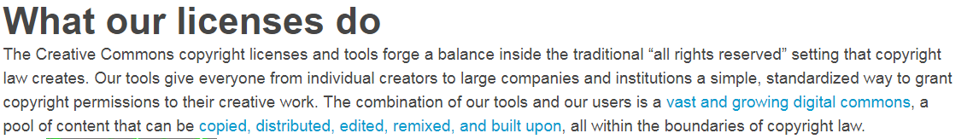



Creative Commons Licenses (Not For Software) (Refer to Handout Notes)
Source : youtube.com. flickr.com, jamendo.com, creativecommons.org

Slide 21
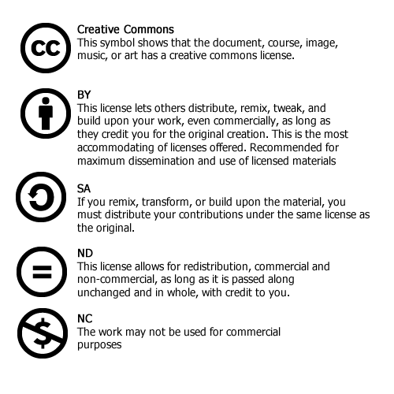
Creative Commons License

Slide 22
7.4 Infringements Text Book Page 269 to 273

Slide 23
Privacy Policies
Rules and practices followed by an organisation regarding collection, protection and use of personal or private data provided by users
Personal Data Protection Act
Social Media
Cloud Services

Slide 24
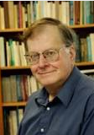
7.5 Impact of Technology on Everyday Life Text Book Page 274 to 280
Social Impact
How we interact with people
Positive or Negative impact in our life
Economical Impact
Productivity, Employment
Ethical Issues
Right or Wrong ?
Professor James H. Moor

Slide 25
Communication Internet, Social Media, Mobile devices

Slide 26
Education

Slide 27
Education

Slide 28
Finance
Cashless Society

Slide 29

Finance

Slide 30
Healthcare
http://www.aljazeera.com/news/2017/12/robots-changing-future-healthcare-171227082514530.html

Slide 31
Healthcare

Slide 32
Transportation

Slide 33
Transportation

Slide 34
Entertainment

Slide 35
Entertainment

Slide 36
Logistics
Kiva Robots

