Slide 1


Bit Rate vs Baud (Signal) Rate
PHYSICAL LAYER
How do you measure the speed of a communication link ?
km/s ?
What is the speed of your Fireworks communication link ?
when you only have 2 colour code, Red and Green and you can change their colours in 1 sec.
how to increase its speed?

Slide 2
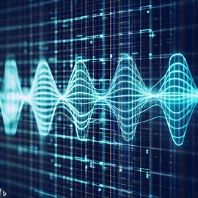
PHYSICAL LAYER
In order to send 1 BIT of data, a signal must have 2 level, eg +2V,0V
+1V
1
1
0
0
1
0V
+3V
11
10
+2V
01
+1V
00
0V
BIT RATE (bps) = SIGNAL RATE (baud) * $\log_{2}{Number of Signal Level}$

Slide 3
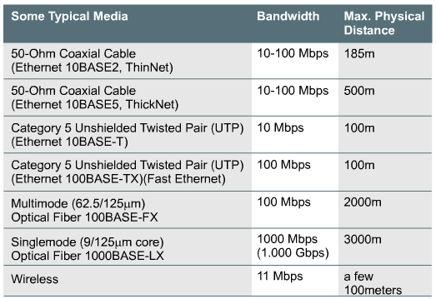
Bandwidth
What is the definition ?
units ?
Maximum Capacity of a media to carry data
dependent on the physical characteristics of the media like:
range of frequencies
amplitude levels

Slide 4
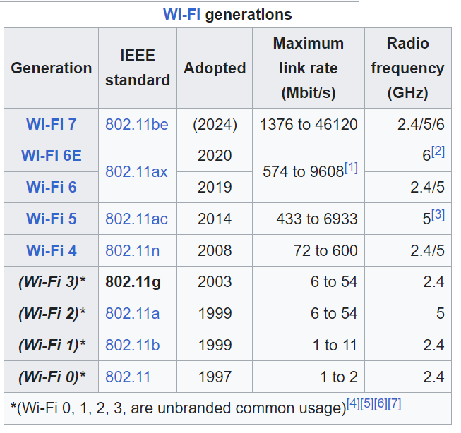
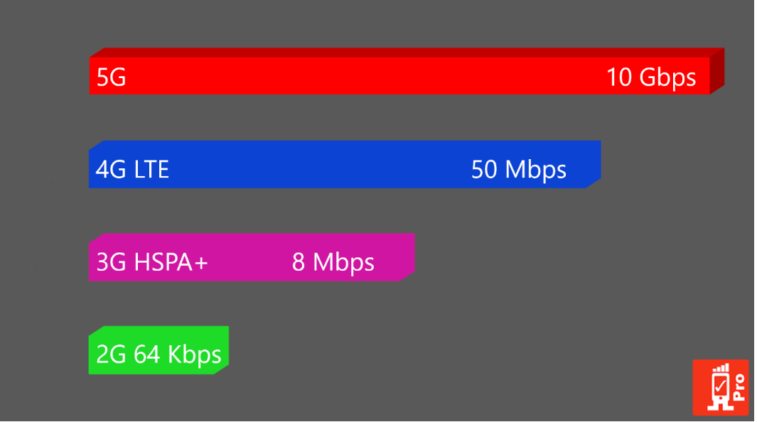
WIFI
Cellular/Mobile

Slide 5
Can we just transmit the raw data bits ?

Slide 6
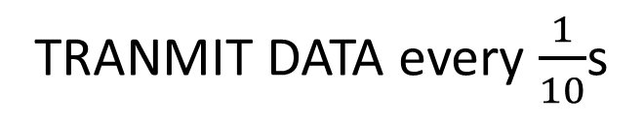
PHYSICAL LAYER
DATA RATE = 10 bits/s
TRANMIT DATA every $\frac{1}{10}$s
1
0
1
0
1
0.1s
0.1s
TRANSMITTER
RECEIVER

Slide 7

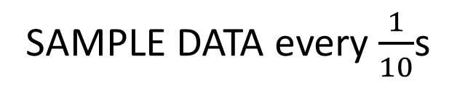
PHYSICAL LAYER
DATA RATE = 10 bits/s
SAMPLE DATA every $\frac{1}{10}$s
BOTH CLOCKS FULLY SYNCHRONISED
1
0
1
0
1
1
0
1
0
1
0.1s
0.1s
TRANSMITTER
RECEIVER

Slide 8
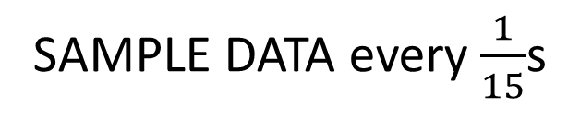
PHYSICAL LAYER
DATA RATE = 10 bits/s
SAMPLE DATA every $\frac{1}{15}$s
RECEIVER CLOCK IS SKEWED BY 0.05s
1
0
1
0
1
1
1
0
1
0.1s
0.15s
TRANSMITTER
RECEIVER

Slide 9
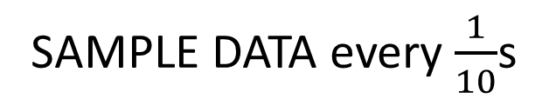
DATA RATE = 10 bits/s
SAMPLE DATA every $\frac{1}{10}$s
Using separate clock, asynchronous mode
START
STOP
1
START
...
1
START
STOP
1
0
1
START
1
0
1
0.1s
0.1s
TRANSMITTER
RECEIVER

Slide 10
DATALINK LAYER
Need to
break data stream into chunks
add bits to indicate stat/stop of each chunk
error detection
Need to indicate
who you are transmitting to
who you are
uses MAC Address
Broadcast vs Unicast
Network Contention
Layer 2 Header
LAYER 2 PAYLOAD
SRC/DST
START
PREAMBLE
LAYER 2 FUNCTION
1101010100011011001
11001010011101010101010101010
LAYER 1 FUNCTION

Slide 11
DATALINK LAYER
Error Detection
Even Parity
Number of 1s must be even
Odd Parity
Number of 1s must be odd
1 | 1 | 0 | 1 | 0 | 1 | 1
1 | 1 | 0 | 1 | 0 | 1 | 1
0 | 0 | 1 | 1 | 0 | 1 | 1
0 | 0 | 1 | 1 | 0 | 1 | 1

Slide 12
Error Detection
using Checksum

Slide 13
1) Generate the checksum for the following hexadecimal blocks using the IP checksum method
4500
05dc
6d6b
4000
8006
dc6e
c0a8
0159
cf2e
2) Validate the data received

Slide 14
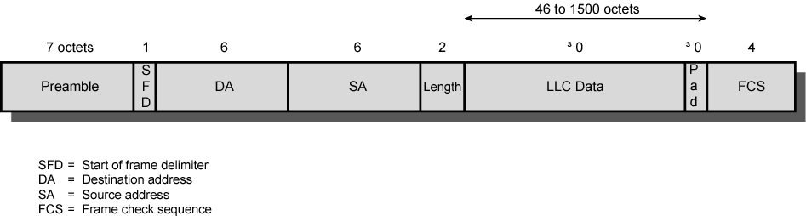
IEEE 802.3 Frame Format
≥
≥
Preamble: 7 octets of 10101010
SFD: 10101011
Length: the maximum frame size is 1518 octets, excluding the preamble and SFD.
Pad: octets added to ensure that the frame is long enough for collision detection
FCS: 32-bit CRC, based on all fields except preamble, SFD, and FCS

Slide 15
Data Link on different physical network topology
Bus Wired/Wireless
Mesh
Ring
Star

Slide 16
Data Link on Shared Bus Topology
Collison
Domain
B
C
A
Wired / Wireless Shared Bus topology
Notes:
Shared Bus Topology can be implemented by a Hub or a Wireless Access Point
Collision Domain is created in a shared media

Slide 17
CSMA/CD: Used in Shared Physical Media Carrier Sense Multiple Access with Collision Detection
Collision Detection:
Stations listen whilst transmitting. If collision is detected, stop transmission immediately.
Rules of CSMA/CD:
If the medium is idle, transmit; otherwise, go to step 2
If the medium is busy, continue to listen until the channel is idle, then transmit immediately
If a collision is detected during transmission, transmit a brief jamming signal to assure that all stations know that there has been a collision and then cease transmission
After transmitting the jamming signal, wait a random amount of time, referred to as backoff, then attempt to transmit again (repeat from step 1)

Slide 18
Data Link on a star topology
Mac Address Table
-------------------------------------------
Mac Address Type Ports
------------------- ------------ -------
000a.41cd.c8c4 DYNAMIC 1
0023.a3bc.c701 DYNAMIC 3
203a.abc2.57a1 DYNAMIC 2
011a.919d.d8a4 DYNAMIC 4
DST MAC: 00-23
payload
1
2
switch
DST MAC: 00-23
payload
3
4

Slide 19
Mac Address Table
-------------------------------------------
Mac Address Type Ports
------------------- ------------ -------
000a.41cd.c8c4 DYNAMIC 1
0023.a3bc.c701 DYNAMIC 3
203a.abc2.57a1 DYNAMIC 2
011a.919d.d8a4 DYNAMIC 4
Mac Address Table
-------------------------------------------
Mac Address Type Ports
------------------- ------------ -------
1111a.466d.c764 DYNAMIC 1
0523.12bc.8701 DYNAMIC 3
34ac.abc2.8761 DYNAMIC 2
0234.917d.d874 DYNAMIC 4
5
5
switch1
switch2
5
5

Slide 20
Mac Address Table
-------------------------------------------
Mac Address Type Ports
------------------- ------------ -------
000a.41cd.c8c4 DYNAMIC 1
0023.a3bc.c701 DYNAMIC 3
203a.abc2.57a1 DYNAMIC 2
011a.919d.d8a4 DYNAMIC 4
Mac Address Table
-------------------------------------------
Mac Address Type Ports
------------------- ------------ -------
1111a.466d.c764 DYNAMIC 1
0523.12bc.8701 DYNAMIC 3
34ac.abc2.8761 DYNAMIC 2
0234.917d.d874 DYNAMIC 4
5
5
switch1
switch2
5
5
Mac Address Table
-------------------------------------------
Mac Address Type Ports
------------------- ------------ -------
1
2
Bridge
000a.41cd.c8c4 DYNAMIC 1
0023.a3bc.c701 DYNAMIC 1
203a.abc2.57a1 DYNAMIC 1
011a.919d.d8a4 DYNAMIC 1
1111a.466d.c764 DYNAMIC 2
0523.12bc.8701 DYNAMIC 2
34ac.abc2.8761 DYNAMIC 2
0234.917d.d874 DYNAMIC 2

