Slide 1
Road map for Web App
WWW
HTML - Basics
CSS – Basics
Build static web pages for a Product Catalogue
Python with Flask framework
Build an interactive app for creating, updating and viewing a Product Catalogue
A Level Requirements
Project
extensible until end of year
Competitions

Slide 2
Introduction to Web Application THE BIG PICTURE
World Wide Web vs Internet
Web Application Architecture
HTTP request/response cycle
Notes:
world wide web is one way to access the internet

Slide 3
World Wide Web
Resources that are build and accessible using a set of
Open specifications (as opposed to proprietary)
Interoperable Protocols (HTTP)
Standards (W3C, ISO, ANSI, ECMA, IETF)
Data Syntax/Semantics/Format (HTML,JSON - next year)
All Web resources are accessible by a URL (Uniform Resource Locator)
Components
Web Browser
Web Server, CDN (Content Delivery Network)
Subset of the Internet
Centralised OR Decentralised ?
Notes:
Is the internet centralised or decentralised?
Concept: Want everyone to be able to provide and receive service - decentralised
But politically, there are big powerful and private corporations which have a lot of power - influence how their service is consumed, centralised power
A level say decentralised, but companies can monopolise how their service is being used

Slide 4
“What was often difficult for people to understand about the design was that there was nothing else beyond URLs, HTTP and HTML. There was no central computer "controlling" the Web, no single network on which these protocols worked, not even organisation anywhere that "ran" the Web. The Web was not a physical "thing" that existed in a certain "place". It was a "space" in which information could exist.” ― Tim Berners-Lee

Slide 5
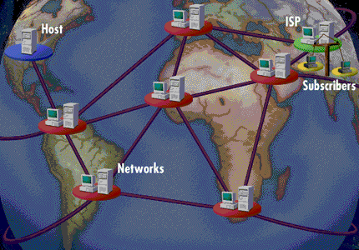
What is the Internet ?
A global public network of packet switching networks that connects computers around the world
Notes:
Comprise of interconnected networks of computers. To be interconnected, these computers need to run a stack of protocol called TCP/IP.
The Internet is a dynamic and evolving system whereby computers are constantly added and removed, a variety services are put online and taken offline, communication paths are shifted and compensate for heavy traffic and outages, people log on and log off
The Internet is NOT
Synonymous as the World Wide Web (WWW)
Designed for conducting business
A single network and owned by any single organization

Slide 6
The TCP/IP Protocol Suite
HTTP
Application
DNS
SMTP
FTP
Sockets
Port 80
Port 25
Port 21
Port 53
Port 1010
Transport
TCP
UDP
IP
Internet
ICMP
IGMP
ARP
LAN Technologies:
Ethernet, Token Ring,
FDDI
WAN Technologies:
Serial Lines, Frame Relay,
ATM
Network

Slide 7

Activity
Web App | Mobile App | Desktop App
Access via a Web Browser
Example: | Example: | Example:
For each of the app, complete the list of characteristics .
Give an example of each app. (URL or otherwise)
Submit via https://padlet.com/leong_khar_woh/th571hqib95egy4u
Notes:
Other terminologies
Progressive Web Application (PWA)
Responsive Web Application
Single Page Application (SPA)

Slide 8
Software Application
What are the different types of Apps that you use ?

Slide 9
Possible Ans:
Web App | Mobile App | Desktop App
Access via a Web Browser Access via a API Dynamic contents User interaction is limited by the web browser | Access to network Needs installation/updates Binds to a platform. (android/IOS) Access to device capabilities (camera, sensors, etc) | Binds to a platform. (android/IOS) Needs installation/updates Access to device capabilities (camera, sensors, etc)
Example: | Example: | Example:
For each of the app, complete the list of characteristics .
Give an example of each app. (URL or otherwise)
Submit via https://padlet.com/leong_khar_woh/th571hqib95egy4u
Notes:
Other terminologies
Progressive Web Application (PWA)
Responsive Web Application
Single Page Application (SPA)

Slide 10
Anatomy of an Application
PRESENTATION/View
CODE
BUSINESS LOGIC/Controller
CODE
DATA/Model
SQL/NON-SQL

Slide 11
Web Application Architecture
Client Server (Centralised)
Fat Client/Thin Server (Client rendering)
Thin Client/Fat Server (Server Rendering)
Peer to Peer (Decentralised/Distributed)

Slide 12

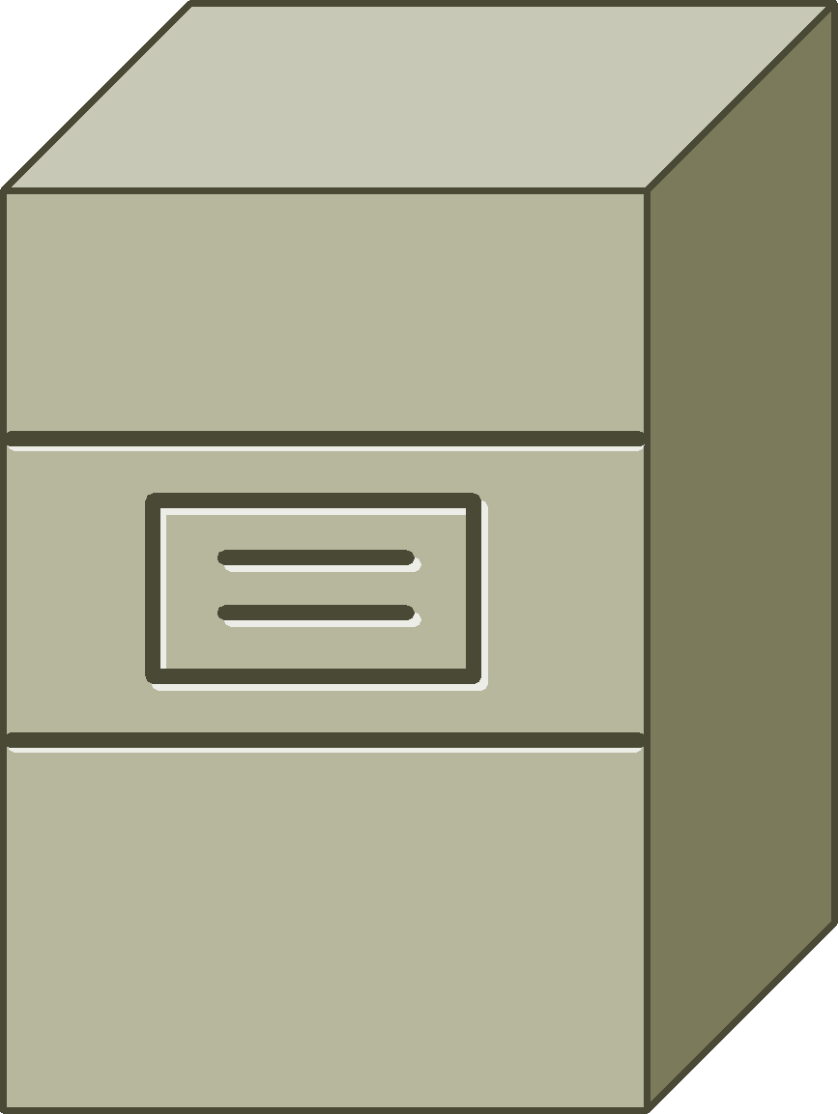
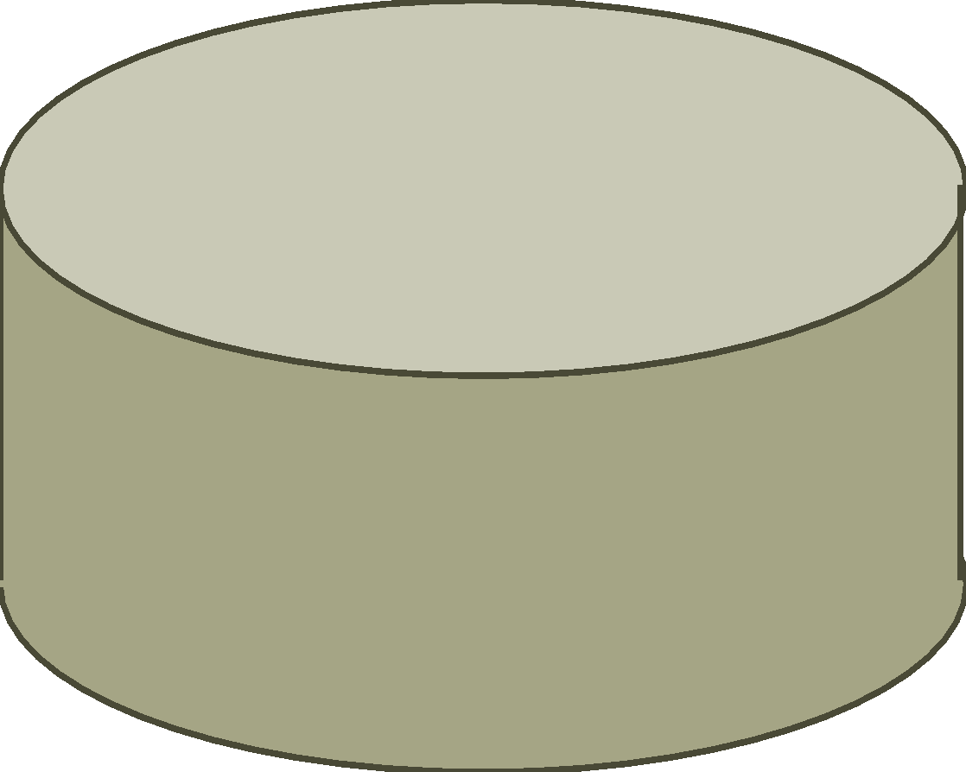
Client Server Architecture
Web Browser
(Client)
Web Server
PRESENTATION/View
BUSINESS LOGIC/Controller
javascript
DATA/Model
<html>
</html>
{ JSON
}

Slide 13
Client Server Architecture
Web Browser
(Client)
Web Server
PRESENTATION/View
BUSINESS LOGIC/Controller
javascript
DATA/Model
<html>
</html>
{ JSON
}

Slide 14
Client Server Architecture
Web Browser
(Client)
Web Server
PRESENTATION/View
BUSINESS LOGIC/Controller
BUSINESS LOGIC/Controller
javascript
DATA/Model
<html>
</html>
{ JSON
}

Slide 15
Fat Client vs Thin Client
 | Fat Client Client rendering | Thin Client Server Rendering
Advantages | Interactive/Reactive Supports Mobile Clients | SEO Security Quick prototyping
Disadvantages | Slow Initial load/ No SOE Development effort Client side scripting + Server side scripting | Frequent round trips, page refreshes Limited UI Only support web browser client

Slide 16
HTTP
Stateless
Send and Forget
Support
Get, Post, Put, Delete operations
Scalable
INITIATOR
Request
Response
Request
Web Browser
(Client)
Web Server
Response

Slide 17
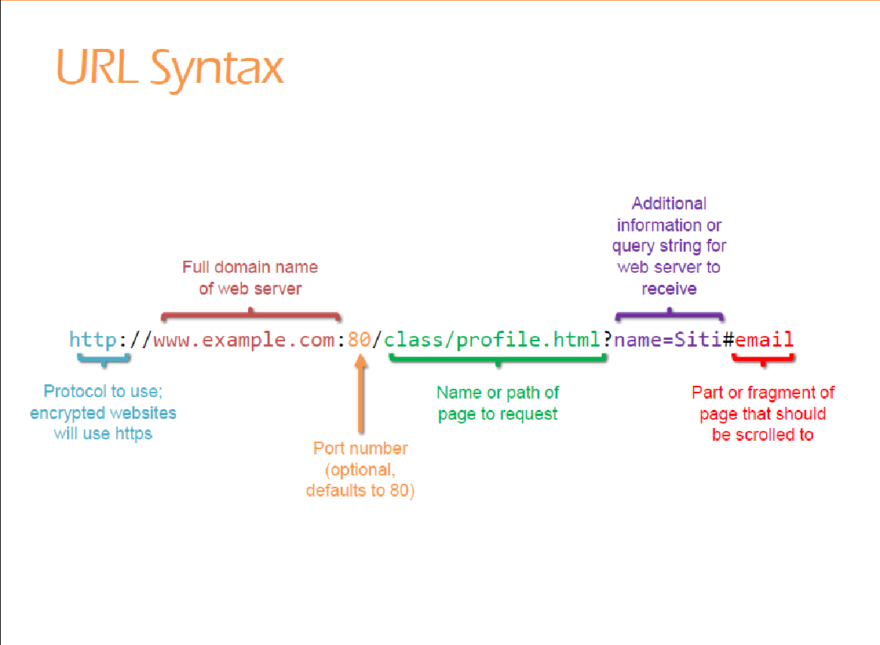

Slide 18
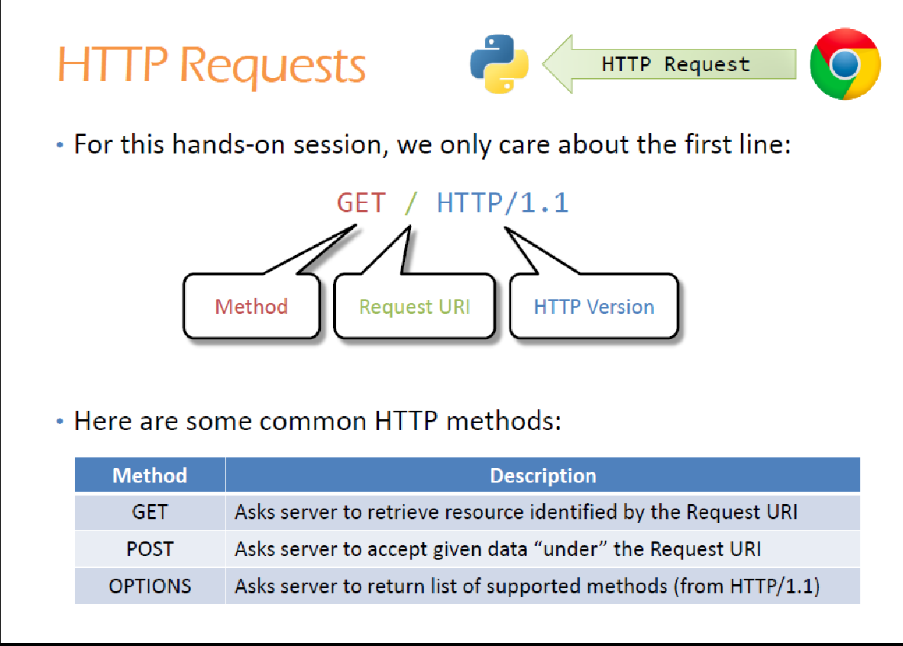

Slide 19
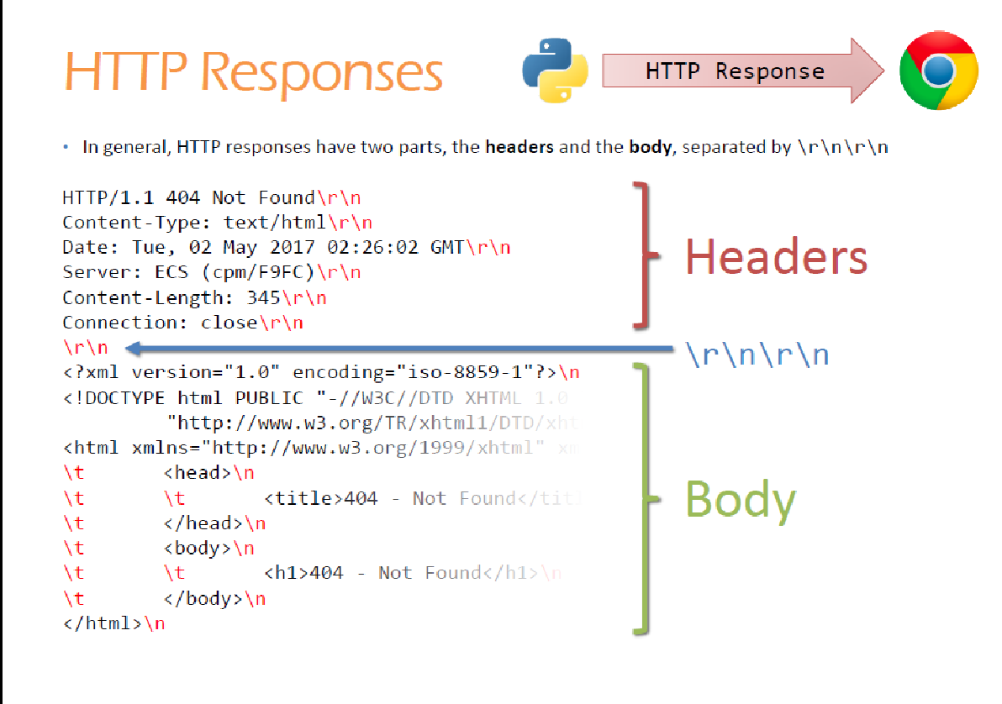
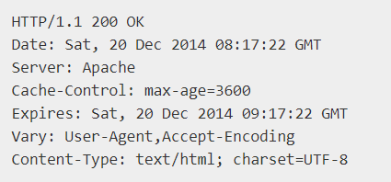
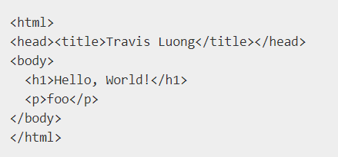

Slide 20
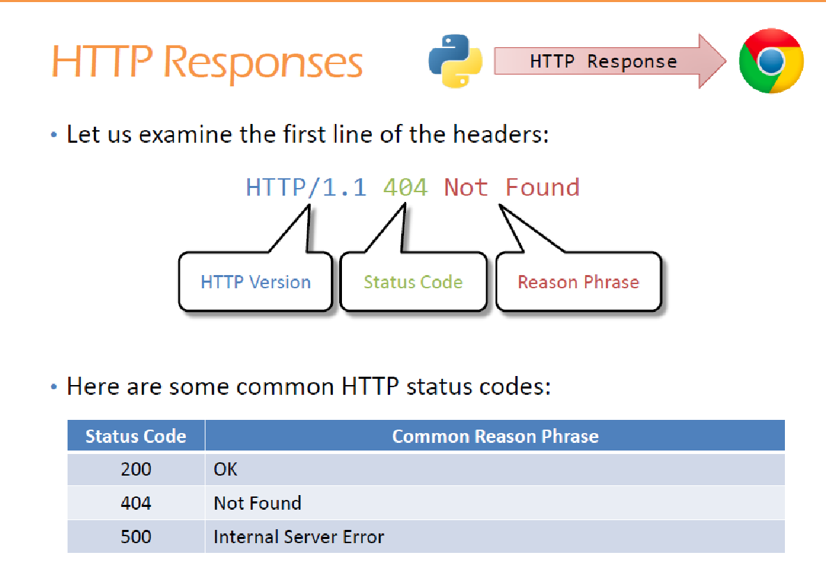

Slide 21
Summary
WWW vs Internet
Web App
URL, HTML, HTTP/S
Client Server
Thin vs Thick Client
HTTP Request / Response

Slide 22
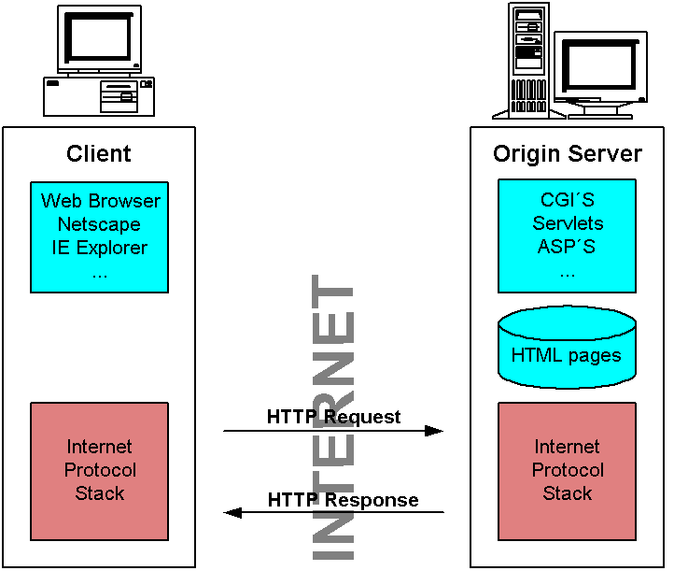
Web Programming Model
Stateless Request and Response protocol
Client makes a request for a service/resource using a URL
Server response by returning HTML content
Based on the request, the Server may executes code to dynamically generates the HTML content
Client processes the HTML content display content on Browser
Based on the content and Browser capability, the contents may contained scripts that will be executed on the Client machine
Notes:
HTTP 1.1 Protocol specification is defined in IETF RFC2616.
HTML 4.2 specification is defined by W3C http://www.w3.org/TR/html401/
What makes the HTTP protocol so successful and powerful on the Internet is its simplicity. The characteristics of the HTTP protocol is as follows:
It is a textual protocol, ie the data format of the protocol is in text. A typical request for the protocol goes something like this:
GET /index.html HTTP/1.0<crlf>
Accept: text/plain<crlf>
User-Agent: Mozilla<crlf>
<crlf>
It is a stateless protocol. After a TCP session is established on a pair of socket connection, the HTTP request is send, the HTTP response is received, the TCP session is tear down. There is no state information kept in between a HTTP request/responses. The latency in this request/response is usually around the 150ms range.

