Slide 1
Database Management Systems

Slide 2
Database
An organized collection of data in persistent storage.
Relational Data Model
ERD -> Entities, Relationships, Cardinality
Normalisations -> Relations(Tables), Attributes, Primary/Foreign Keys
Goals of Normalisation
Avoid redundancy,
Maintain consistency and accuracy of data
Avoid anomalies from insert/delete, update

Slide 3
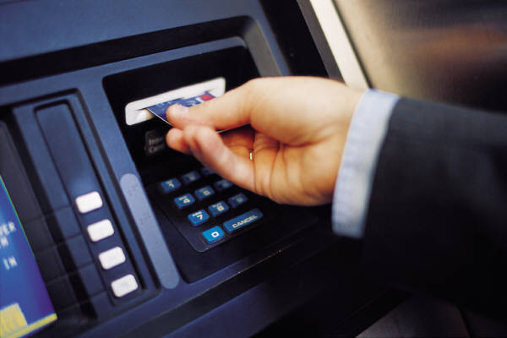
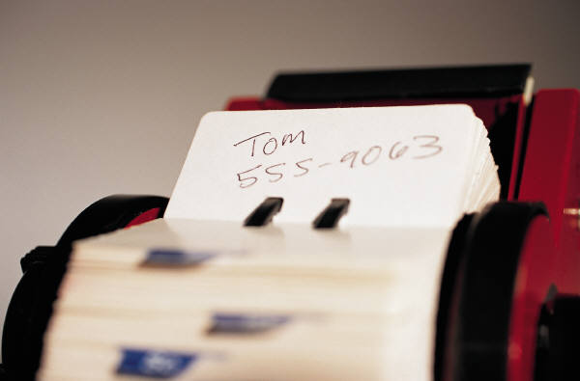
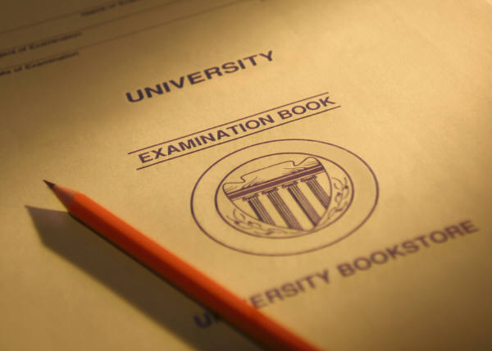

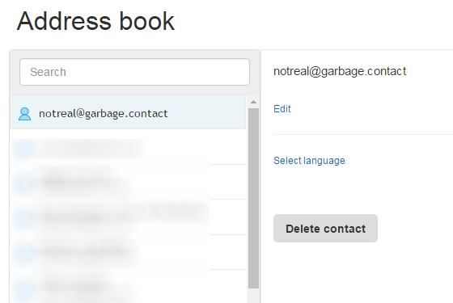
Database Application
A program for entering and retrieving information from a database
Examples
Banking
Education
Air-ticket booking website
My address book

Slide 4
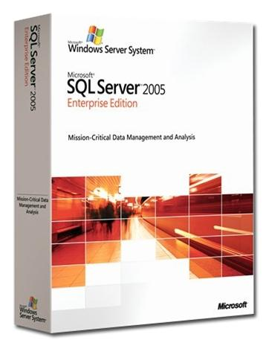




Database Management Systems (DBMS)
Software for the implementation and management of databases

Slide 5
Database, Database Application and DBMS
Database Management System
Database Application
Commands
Database
Data

Slide 6
What are the features of a Database Management System?
Persistent data
Security
Data Dictionary
DBMS
Concurrent
Access
Data Manipulation Language (DML)
Integrity
Data Definition Language
( DDL)

Slide 7
Data Dictionary
Meta-Data
the descriptions of tables, relationships and all design information such as indexing.
indexes are data structures created for fast retrieval.
the rules about data integrity including validation rules for all attributes.

Slide 8
Referential Integrity
Referential Integrity using FOREIGN KEY and PRIMARY KEY constraints
Cannot insert a record in Student table until the referenced Teacher record is created
Cannot delete/update a Teacher record until all the records in Student table that references it are deleted
Student
Teacher
StudentID | Name | PM (FK)
 |  | TeacherID
ID (PK) | TeacherName
TeacherID

Slide 9
Data Integrity
Enforces rules known as database constraints to ensure the accuracy and consistency of the data.
Constraints Rules: NOT NULL, UNIQUE, CHECK
Example :
CHECK(Price > 0)
CHECK(length(Name) < 20 )

Slide 10
Concurrent Access
User 1
User 2
con.execute(“UPDATE Products
SET Price = 50 WHERE ProdID=PJ82
Web App
con.execute(“UPDATE Products
SET Price = 70 WHERE ProdID=PJ82
DBMS
ProdID | Desc. | Price
PJ82 | Bag | 67.90

Slide 11
Data Security
Access Control
WHO can access WHAT
Backup
Full (weekly)
Differential, backup only changes since last full (daily)
Purpose : for recovery when data is lost or corrupted
Archive
Purpose: for space management and long term retention. Original may be deleted.

Slide 12
SQL (Structured Query Language)
A computer language aim to store, manipulate, and retrieve data in (relational) databases
The de facto standard in traditional database applications and DBMS

Slide 13
SQL (Structured Query Language)
Data Definition Language (DDL)
Creating, altering and deleting tables and other database objects
Data Manipulation Language (DML)
Inserting, updating and deleting rows
Querying tables
Database Control language (DCL)
Controlling access to the database
Transaction Control Language (TCL)
Dealing with transactions within a database.

Slide 14
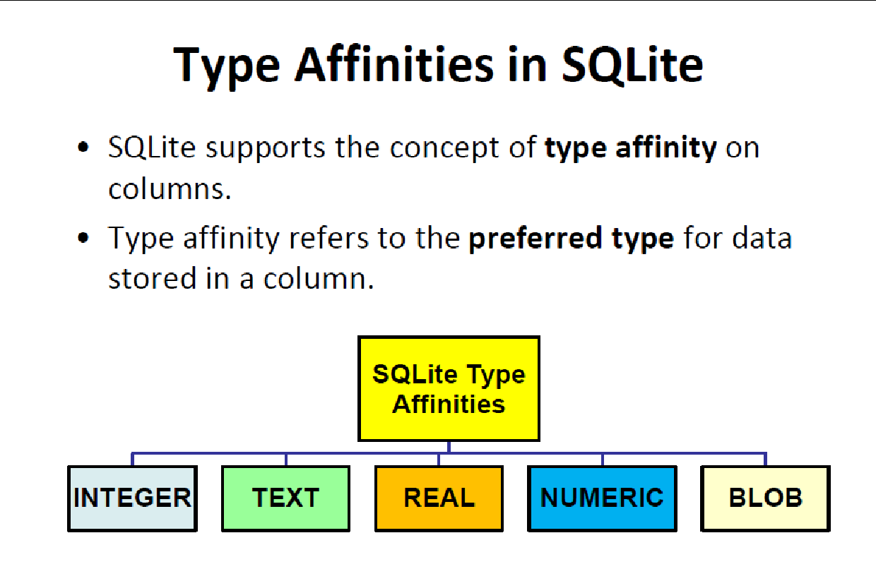

Slide 15
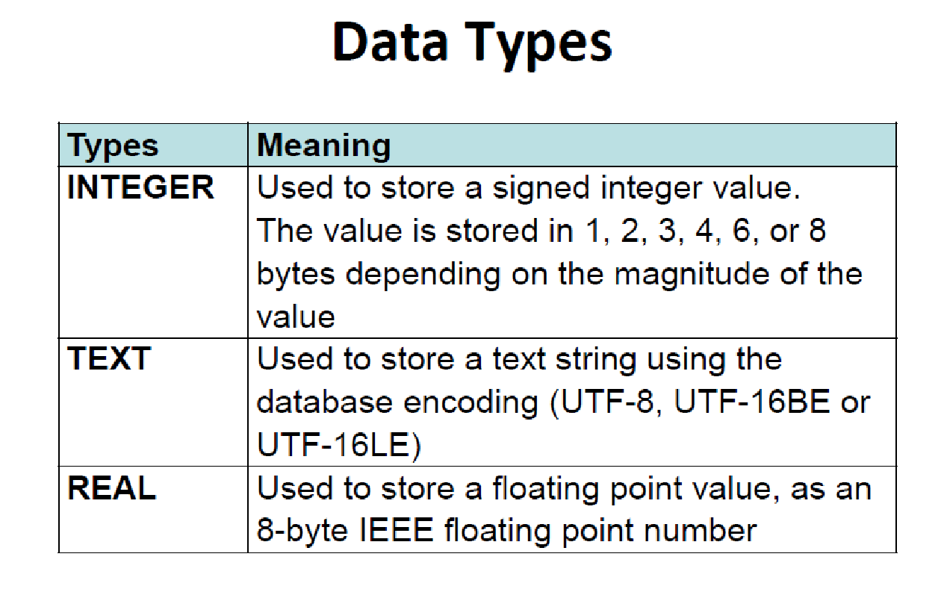

Slide 16
SQL
Data Definition Language (DDL)

Slide 17
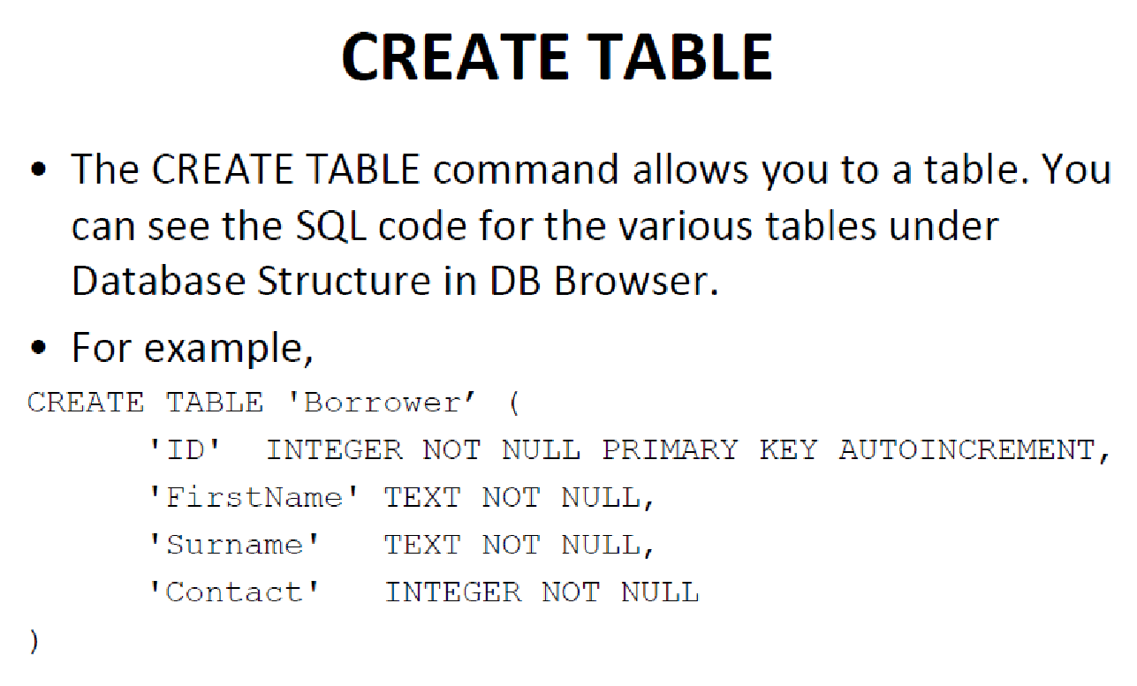
ATTRIBUTE NAME
DATA TYPE
CONSTRAINTS

Slide 18
CREATE syntax
CREATE TABLE table_name( column1_name COLUMN1_TYPE COLUMN1_CONSTRAINTS, column2_name COLUMN2_TYPE COLUMN2_CONSTRAINTS, … PRIMARY_KEY (column1_name, column2_name), FOREIGN_KEY (column_name) REFERENCE table_name (column_name)

Slide 19
NOT NULL
Single-attribute
CREATE TABLE book (
title TEXT,
authors TEXT,
publisher TEXT,
ISBN13 TEXT NOT NULL);

Slide 20
UNIQUE
Single-attribute
Multi-attribute
CREATE TABLE book (
title TEXT,
authors TEXT,
publisher TEXT,
ISBN13 TEXT(14) UNIQUE);
CREATE TABLE book (
title TEXT,
authors TEXT,
publisher TEXT,
ISBN13 TEXT(14),
UNIQUE(title, authors));

Slide 21
CHECK
CREATE TABLE book (
title TEXT,
authors TEXT,
publisher TEXT,
ISBN13 TEXT(14) CHECK(length(ISBN13)=14));

Slide 22
PRIMARY KEY
Single-attribute
Multi-attribute
CREATE TABLE book (
title TEXT,
authors TEXT,
publisher TEXT,
ISBN13 TEXT(14) PRIMARY KEY);
CREATE TABLE book (
title TEXT,
authors TEXT,
publisher TEXT,
ISBN13 TEXT(14),
PRIMARY KEY (ISBN13));
CREATE TABLE book (
title TEXT,
authors TEXT,
publisher TEXT,
ISBN13 TEXT(14),
PRIMARY KEY (title, authors));

Slide 23
DROP
To remove a table (and all the data in it).
DROP TABLE student;

Slide 24
SQL
Data Manipulation Language (DML)

Slide 25
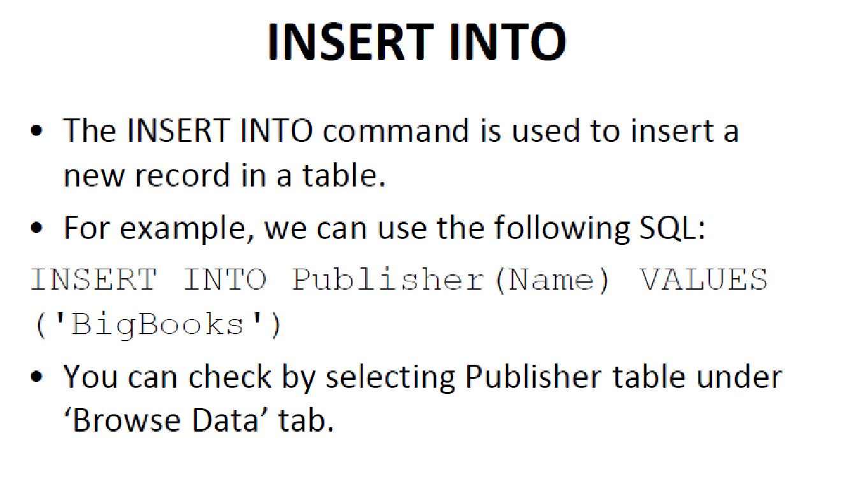

Slide 26
INSERT syntax
INSERT INTO table_name(column1_name, column2_name, ...) VALUES(column1_value, column2_value, ...);
Another form:
INSERT INTO student
VALUES ( 'JIE JIE', 'A123456X', 3,
'2014-01-01', 'School of Computing',
'Computer Science');

Slide 27
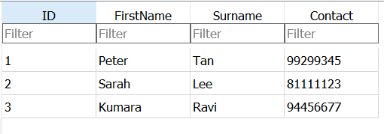
UPDATE syntax
UPDATE table_name SET
column1_name = column1_expression,
column2_name = column2_expression,
...
WHERE where_expression;
UPDATE Borrower SET Contact = 98764326
WHERE ID=2;
UPDATE Borrower
SET FirstName = FirstName || ID ;
CONCATENATE OPERATOR

Slide 28
DELETE
To remove all data in a table.
To remove selected data in a table.
DELETE FROM student;
DELETE FROM student WHERE department = 'Computer Science';
DELETE FROM table_name WHERE condition;
Sample Statement
(Simplified) Syntax

Slide 29
SELECT
To return all data in a table
To return selected columns in a table
SELECT * FROM student;
SELECT * FROM table_name;
Sample Statement
(Simplified) Syntax
SELECT name, year FROM student;
SELECT col_name1,col_name2,
…, col_nameN
FROM table_name;
Sample Statement
(Simplified) Syntax

Slide 30
SELECT
To return certain rows in a table
Using a wildcard %
SELECT * FROM student
WHERE department = 'Computer Science';
SELECT * FROM table_name WHERE condition;
SELECT * FROM student
WHERE department = 'Computer Science’AND gender = “F”;
(Simplified) Syntax
Sample Statement
SELECT * FROM student
WHERE department LIKE %COMPUTER%';

Slide 31
SELECT
To return certain rows in a table
Using a wildcard %
SELECT * FROM student
WHERE department = 'Computer Science';
SELECT * FROM table_name WHERE condition;
SELECT * FROM student
WHERE department = 'Computer Science’AND gender = “F”;
(Simplified) Syntax
Sample Statement
SELECT * FROM student
WHERE department LIKE %COMPUTER%';

Slide 32
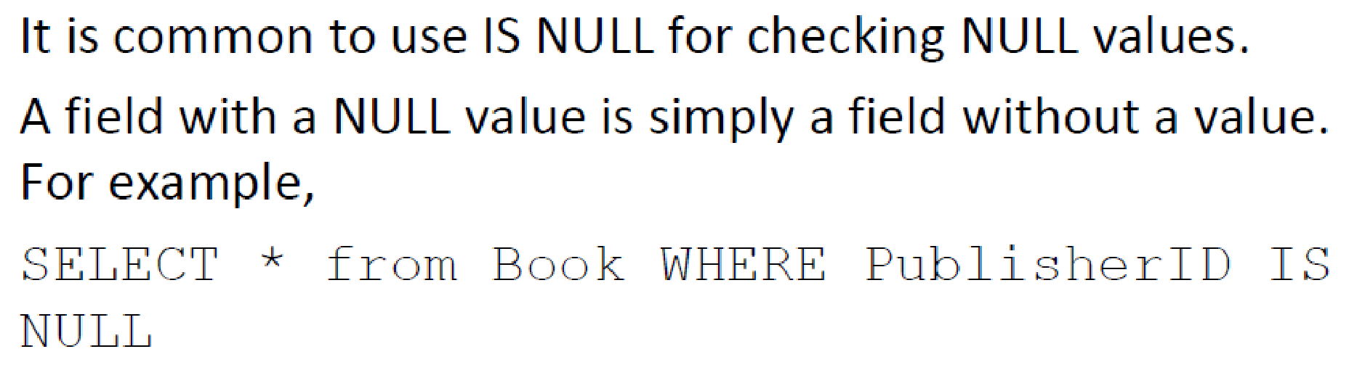
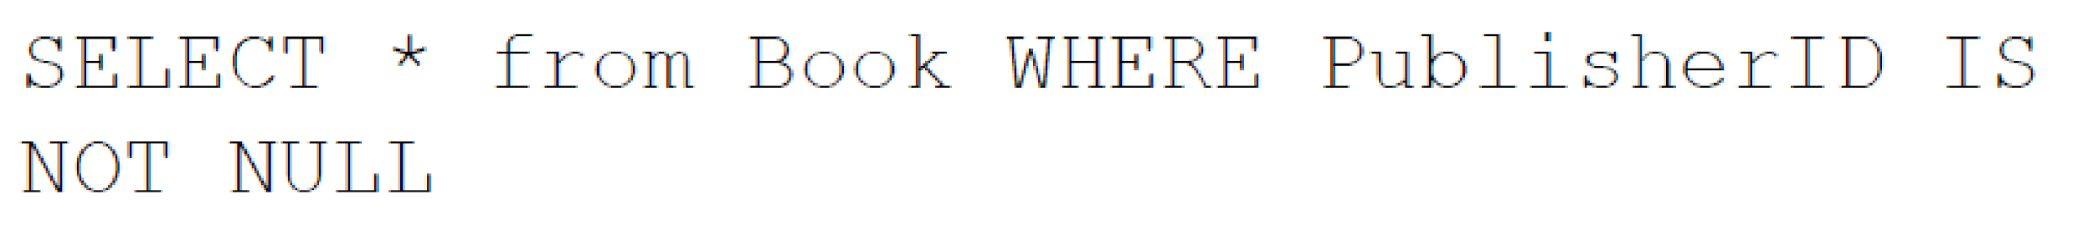
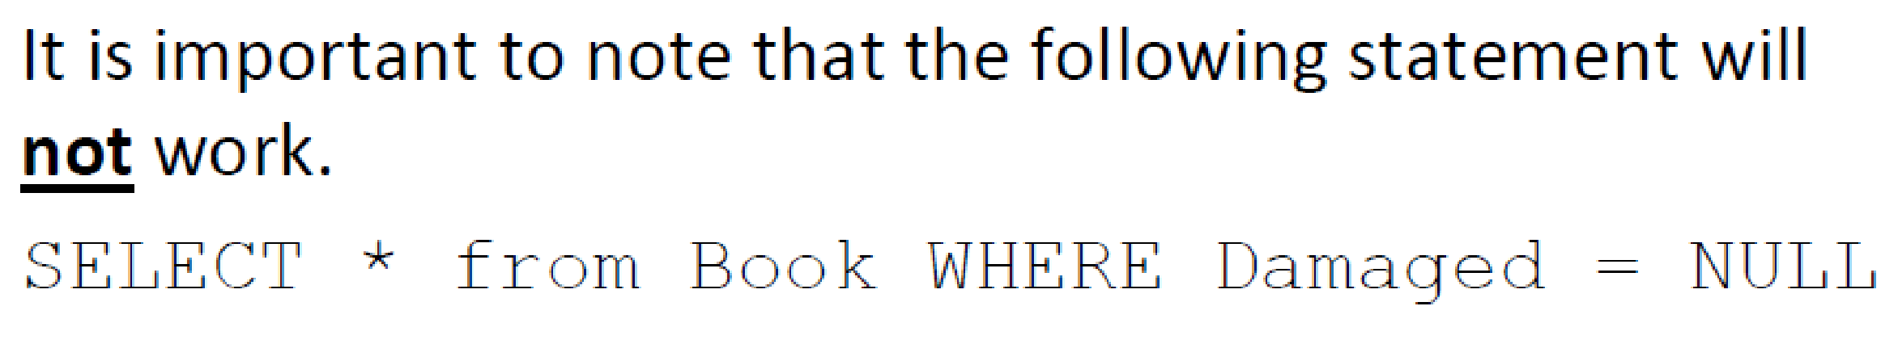
SELECT

Slide 33
Sorting Results
List the loan records in ascending order of ISBN13.
SELECT name, ISBN13 FROM loan ORDER BY isbn13 ASC;
Loan
name | ISBN13
Jie Jie | 978-0262513593
Xie Xin | 978-0262033848
Jie Jie | 978-0123744937
name | ISBN13
Jie Jie | 978-0123744937
Xie Xin | 978-0262033848
Jie Jie | 978-0262513593

Slide 34
SQL
Advance Data Manipulation Language (DDL)
Multi-table SELECT

Slide 35
Multi-table SELECT Statements
Find the name of the student who borrowed "Introduction to Algorithms".
Loan
name | ISBN13
Jie Jie | 978-0262513593
Xie Xin | 978-0262033848
Jie Jie | 978-0123744937
Book
title | authors | publisher | ISBN13
The Future of Learning Institutions in a Digital Age | Cathy N. Davidson, David Theo Goldberg | The MIT Press | 978-0262513593
Introduction to Algorithms | Thomas H. Cormen, TEXTles E. Leiserson, Ronald L. Rivest, Clifford Stein | The MIT Press | 978-0262033848
The Digital Photography Book | Scott Kelby | Peachpit Press | 978-0321474049
Computer Organization and Design | David A. Patterson, John L. Hennessy | Morgan Kaufmann | 978-0123744937

Slide 36
Multi-table SELECT Statements
Find the name of the student who borrowed "Introduction to Algorithms".
OR USING INNER JOIN
SELECT loan.name FROM book, loan WHERE book.isbn13 = loan.isbn13 AND book.title = 'Introduction to Algorithms';
SELECT loan.name FROM book
INNER JOIN loan
ON book.ISBN13 = loan.ISBN13
WHERE book.title = “Introduction to Algorihms”

Slide 37
Multi-table SELECT Statements
One way to understand / evaluate this query is:
Perform a cross product on the two tables
Choose all the rows that satisfy the condition
Remove attributes that are not selected
SELECT loan.name
FROM book, loan WHERE book.isbn13 = loan.isbn13 AND book.title = 'Introduction to Algorithms';

Slide 38
Multi-table SELECT Statements
Perform a cross product on the two tables
FROM book, loan
title | authors | publisher | ISBN13
The Future of Learning Institutions in a Digital Age | Cathy N. Davidson, David Theo Goldberg | The MIT Press | 978-0262513593
Introduction to Algorithms | Thomas H. Cormen, TEXTles E. Leiserson, Ronald L. Rivest, Clifford Stein | The MIT Press | 978-0262033848
The Digital Photography Book | Scott Kelby | Peachpit Press | 978-0321474049
Computer Organization and Design | David A. Patterson, John L. Hennessy | Morgan Kaufmann | 978-0123744937
name | ISBN13
Jie Jie | 978-0262513593
Xie Xin | 978-0262033848
Jie Jie | 978-0123744937
book. title | book. authors | book. publisher | book. ISBN13 | loan. name | loan. ISBN13
The Future … | … | … | 978-0262513593 | Jie Jie | 978-0262513593
The Future … | … | … | 978-0262513593 | Xie Xin | 978-0262033848
The Future … | … | … | 978-0262513593 | Jie Jie | 978-0123744937
Introduction … | … | … | 978-0262033848 | Jie Jie | 978-0262513593
Introduction … | … | … | 978-0262033848 | Xie Xin | 978-0262033848
Introduction … | … | … | 978-0262033848 | Jie Jie | 978-0123744937
The Digital … | … | … | 978-0321474049 | Jie Jie | 978-0262513593
The Digital … | … | … | 978-0321474049 | Xie Xin | 978-0262033848
The Digital … | … | … | 978-0321474049 | Jie Jie | 978-0123744937
Computer … | … | … | 978-0123744937 | Jie Jie | 978-0262513593
Computer … |  | … | 978-0123744937 | Xie Xin | 978-0262033848
Computer … | … | … | 978-0123744937 | Jie Jie | 978-0123744937

Slide 39
Multi-table SELECT Statements
Perform a cross product on the two tables
FROM book, loan
title | authors | publisher | ISBN13
The Future of Learning Institutions in a Digital Age | Cathy N. Davidson, David Theo Goldberg | The MIT Press | 978-0262513593
Introduction to Algorithms | Thomas H. Cormen, TEXTles E. Leiserson, Ronald L. Rivest, Clifford Stein | The MIT Press | 978-0262033848
The Digital Photography Book | Scott Kelby | Peachpit Press | 978-0321474049
Computer Organization and Design | David A. Patterson, John L. Hennessy | Morgan Kaufmann | 978-0123744937
name | ISBN13
Jie Jie | 978-0262513593
Xie Xin | 978-0262033848
Jie Jie | 978-0123744937
book. title | book. authors | book. publisher | book. ISBN13 | loan. name | loan. ISBN13
The Future … | … | … | 978-0262513593 | Jie Jie | 978-0262513593
The Future … | … | … | 978-0262513593 | Xie Xin | 978-0262033848
The Future … | … | … | 978-0262513593 | Jie Jie | 978-0123744937
Introduction … | … | … | 978-0262033848 | Jie Jie | 978-0262513593
Introduction … | … | … | 978-0262033848 | Xie Xin | 978-0262033848
Introduction … | … | … | 978-0262033848 | Jie Jie | 978-0123744937
The Digital … | … | … | 978-0321474049 | Jie Jie | 978-0262513593
The Digital … | … | … | 978-0321474049 | Xie Xin | 978-0262033848
The Digital … | … | … | 978-0321474049 | Jie Jie | 978-0123744937
Computer … | … | … | 978-0123744937 | Jie Jie | 978-0262513593
Computer … |  | … | 978-0123744937 | Xie Xin | 978-0262033848
Computer … | … | … | 978-0123744937 | Jie Jie | 978-0123744937

Slide 40
Multi-table SELECT Statements
Choose all the rows that satisfy the condition (JOIN condition)
WHERE book.isbn13 = loan.isbn13 …
book. title | book. authors | book. publisher | book. ISBN13 | loan. name | loan. ISBN13
The Future … | … | … | 978-0262513593 | Jie Jie | 978-0262513593
The Future … | … | … | 978-0262513593 | Xie Xin | 978-0262033848
The Future … | … | … | 978-0262513593 | Jie Jie | 978-0123744937
Introduction … | … | … | 978-0262033848 | Jie Jie | 978-0262513593
Introduction … | … | … | 978-0262033848 | Xie Xin | 978-0262033848
Introduction … | … | … | 978-0262033848 | Jie Jie | 978-0123744937
The Digital … | … | … | 978-0321474049 | Jie Jie | 978-0262513593
The Digital … | … | … | 978-0321474049 | Xie Xin | 978-0262033848
The Digital … | … | … | 978-0321474049 | Jie Jie | 978-0123744937
Computer … | … | … | 978-0123744937 | Jie Jie | 978-0262513593
Computer … |  | … | 978-0123744937 | Xie Xin | 978-0262033848
Computer … | … | … | 978-0123744937 | Jie Jie | 978-0123744937

Slide 41
Multi-table SELECT Statements
Choose all the rows that satisfy the condition
WHERE book.isbn13 = loan.isbn13 and
title = 'Introduction to Algorithms'
book. title | book. authors | book. publisher | book. ISBN13 | loan. name | loan. ISBN13
The Future … | … | … | 978-0262513593 | Jie Jie | 978-0262513593
The Future … | … | … | 978-0262513593 | Xie Xin | 978-0262033848
The Future … | … | … | 978-0262513593 | Jie Jie | 978-0123744937
Introduction … | … | … | 978-0262033848 | Jie Jie | 978-0262513593
Introduction … | … | … | 978-0262033848 | Xie Xin | 978-0262033848
Introduction … | … | … | 978-0262033848 | Jie Jie | 978-0123744937
The Digital … | … | … | 978-0321474049 | Jie Jie | 978-0262513593
The Digital … | … | … | 978-0321474049 | Xie Xin | 978-0262033848
The Digital … | … | … | 978-0321474049 | Jie Jie | 978-0123744937
Computer … | … | … | 978-0123744937 | Jie Jie | 978-0262513593
Computer … |  | … | 978-0123744937 | Xie Xin | 978-0262033848
Computer … | … | … | 978-0123744937 | Jie Jie | 978-0123744937

Slide 42
Multi-table SELECT Statements
Remove attributes that are not selected
Another way to write the SQL:
SELECT loan.name FROM book INNER JOIN loan ON book.ISBN13 = loan.ISBN13 WHERE book.title = “Introduction to Algorihms”
SELECT loan.name
book. title | book. authors | book. publisher | book. ISBN13 | loan. name | loan. ISBN13
Introduction… | … | … | 978-0262033848 | Xie Xin | 978-0262033848

Slide 43
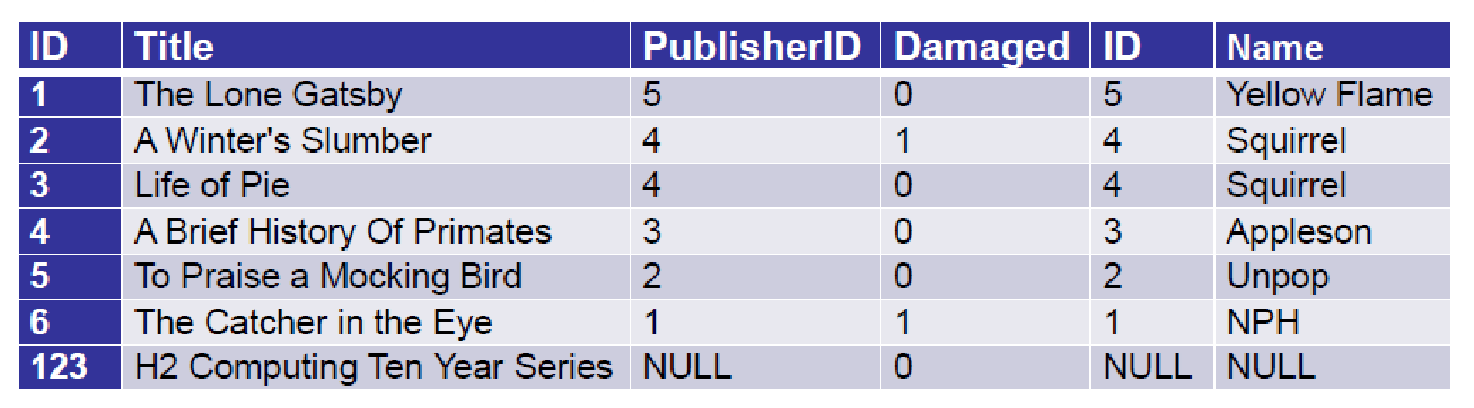
Left Outer Join
SELECT * FROM Book LEFT OUTER JOIN Publisher
ON Book.PublisherID = Publisher.ID
ID | Name
1 | NPH
2 | Unpop
3 | Appleson
4 | Squirrel
5 | Yellow Flame
ID | Title | PublisherID | Damaged
1 | The Lone Gatsby | 5 | 0
2 | A Winter's Slumber | 4 | 1
3 | Life of Pie | 4 | 0
4 | A Brief History Of Primates | 3 | 0
5 | To Praise a Mocking Bird | 2 | 0
6 | The Catcher in the Eye | 1 | 1
123 | H2 Computing Ten Year Series | NULL | 0
Book
Publisher

Slide 44
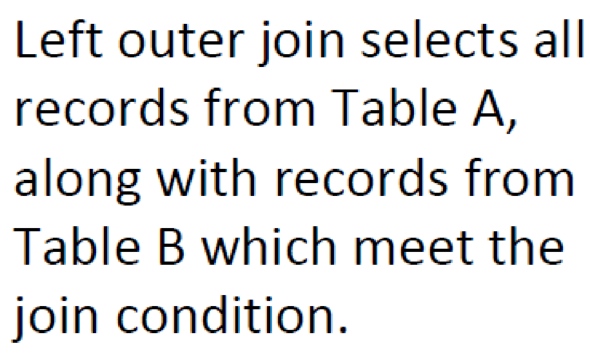
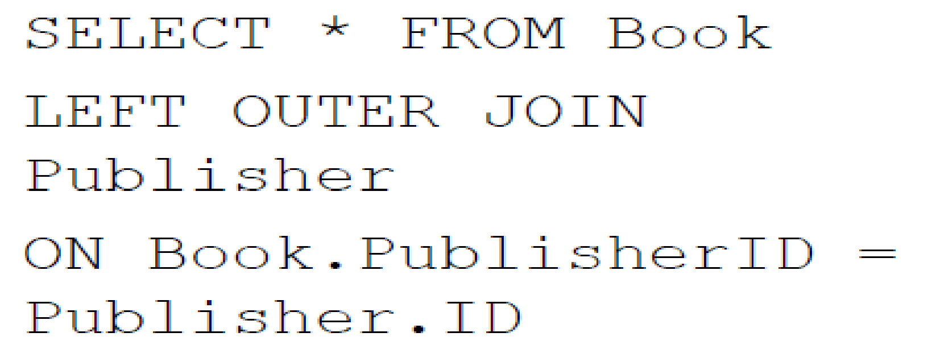
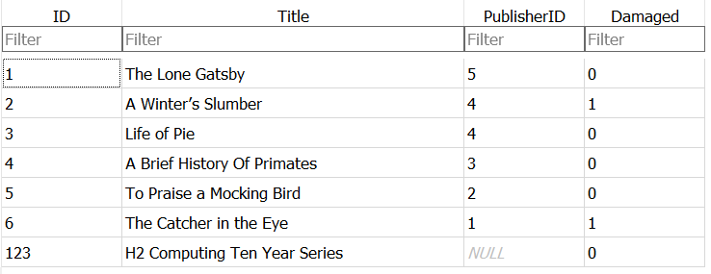
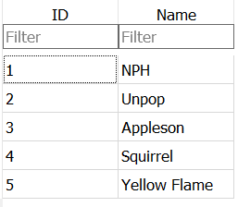
Left Outer Join
Book
Publisher

Slide 45
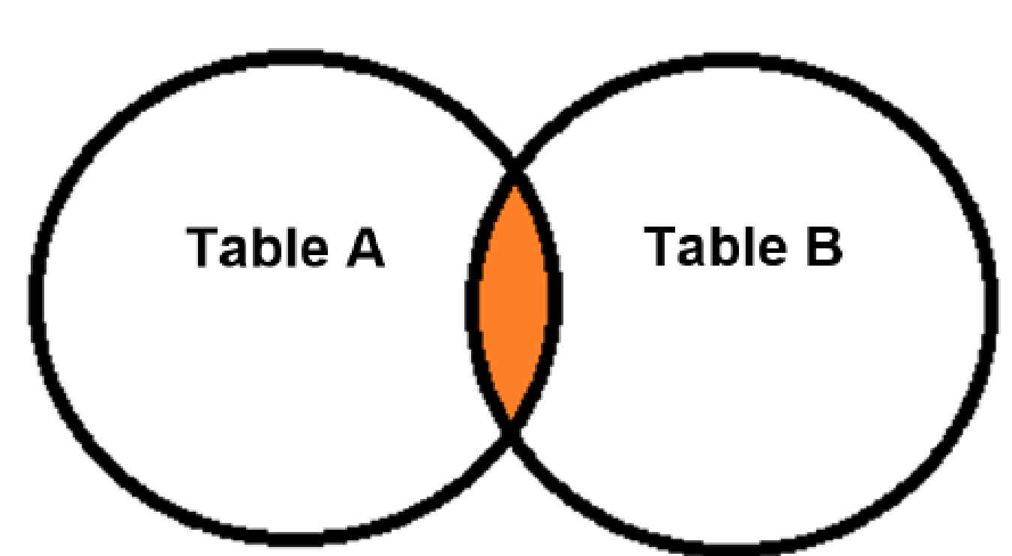
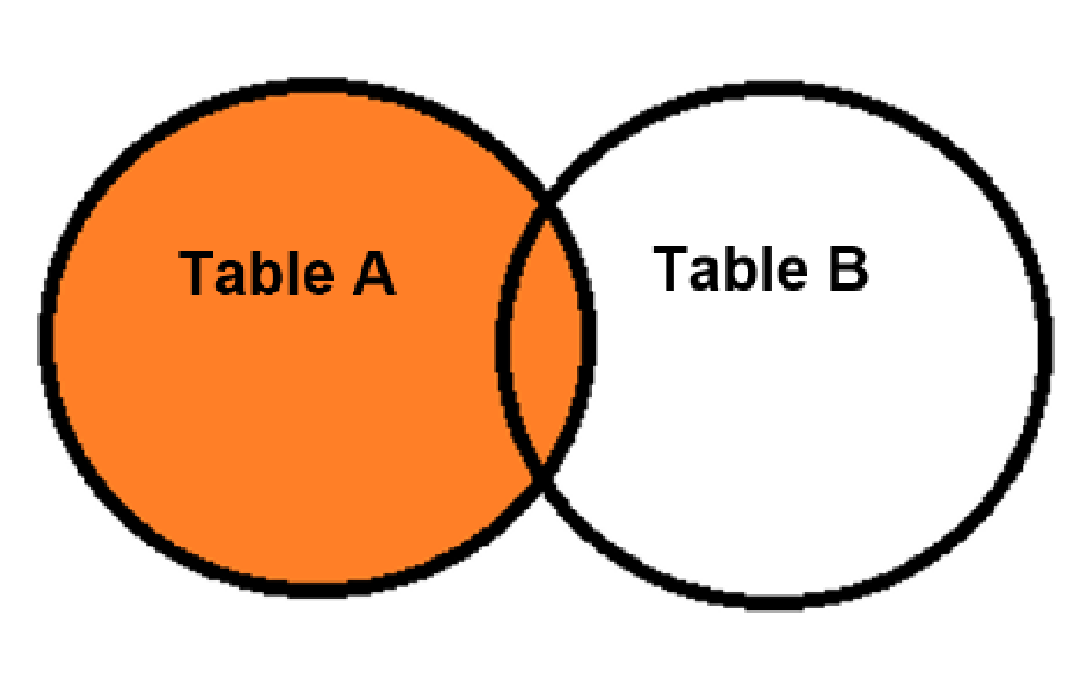
Joins

Slide 46
Aggregate Queries: COUNT
Find the total number of books.
Aggregate queries use aggregate functions to combine results over entire tables or columns.
Example: COUNT(), SUM(), MAX(), MIN(), AVG()
SELECT COUNT(*) FROM book;
COUNT(*)
4

Slide 47
Aggregate Queries: Grouping
Find the number of books borrowed by each student.
The GROUP BY clause creates groups before the aggregation.
Loan
name | ISBN13
Jie Jie | 978-0262513593
Xie Xin | 978-0262033848
Jie Jie | 978-0123744937
SELECT name, COUNT(isbn13)
FROM loan
GROUP BY name;
name | ISBN13
Jie Jie | 978-0262513593
Jie Jie | 978-0123744937
Xie Xin | 978-0262033848
name | COUNT(isbn13)
Jie Jie | 2
Xie Xin | 1

Slide 48
Limiting Results
List the first 3 books.
SELECT * FROM book LIMIT 3;
title | authors | publisher | ISBN13
The Future of Learning Institutions in a Digital Age | Cathy N. Davidson, David Theo Goldberg | The MIT Press | 978-0262513593
Introduction to Algorithms | Thomas H. Cormen, TEXTles E. Leiserson, Ronald L. Rivest, Clifford Stein | The MIT Press | 978-0262033848
The Digital Photography Book | Scott Kelby | Peachpit Press | 978-0321474049

Slide 49
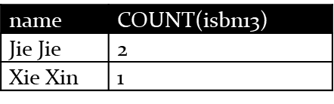
Aggregate Queries: Condition
Find the students who borrowed more that one book.
The HAVING clause specifies conditions on groups.
Loan
SELECT name, COUNT(isbn13)
FROM loan
GROUP BY name
HAVING COUNT(isbn13) > 1;
name | ISBN13
Jie Jie | 978-0262513593
Xie Xin | 978-0262033848
Jie Jie | 978-0123744937
name | COUNT(isbn13)
Jie Jie | 2

