Slide 1
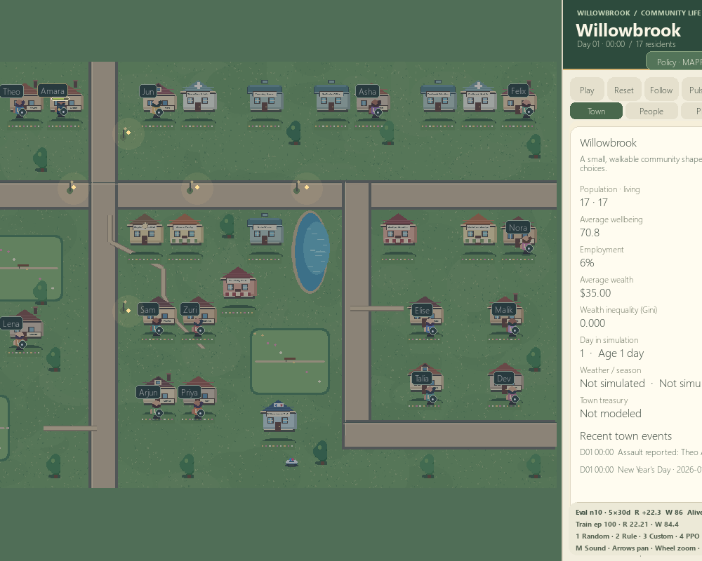
AI TOWN
A multi-agent reinforcement learning town
Project overview, simulation data, research evidence, and a play tutorial
RL UNIVERSITY COURSE
Willowbrook · 17 citizens · 50 × 32 world grid
Policies choose daily activities; the simulation records the outcomes.
AI TOWN / PROJECT + PLAYER GUIDE
Notes:
Introduce Willowbrook as both a playable town simulation and a reproducible RL research environment. The screenshot shows the current expanded 17-citizen map. It is generated game art, not a photograph.
Sources: README.md; docs/Architecture.md

Slide 2
PROJECT AT A GLANCE
A town that is both a game and a research environment
17
8
28
1 hour
named policy-controlled citizens
life activities available to each policy
normalized values in each citizen observation
represented by each environment step
The project question
A watchable town sits on top of a headless, testable environment. The same state transitions run with or without the game window.
Can a learned shared policy balance work, health, food, rest, and social needs across a small society?
AI TOWN / 02
Notes:
Frame the intended scope. The map is current at population 17; evaluation artifacts described later were collected under an earlier population-10 configuration.
Sources: README.md; docs/RL Formulation.md

Slide 3
SYSTEM DESIGN
Policy decisions change the town; rendering only shows the result
OBSERVATION
POLICY
ENVIRONMENT
VIEWER
Needs · cash · work
location · time · traits
Choose one life action
for each citizen
Apply needs, movement,
economy and rewards
Draw the town, people,
inspectors and trends
Headless training and evaluation
The Pygame app asks a policy for actions; it contains no reward or world-transition rules.
train.py → checkpoint → evaluate.py
AI TOWN / 03
Notes:
Explain the module boundary: simulation state and transitions, PettingZoo environment, policy/training/evaluation, Pygame viewer and separate analytics. Navigation is deterministic support and does not choose activities.
Sources: docs/Architecture.md; docs/RL Formulation.md

Slide 4
DATASET AND PROVENANCE
The data are generated by the simulator—not imported from people
No external human-behaviour dataset is bundled with this project.
01
02
03
04
Configuration
Rollout generation
Training batches
Evaluation records
YAML sets population, map, economy, rewards, calendar and random seeds.
A seeded town produces hourly observations, policy actions, rewards and transitions.
PPO/MAPPO update from trajectories; optimization diagnostics are written as JSONL.
Held-out runs save per-episode outcomes as JSON; summaries and graphs are derived from those files.
What is saved?
results/*.json · per-episode metrics and run metadata
logs/train_*.jsonl · training diagnostics | models/*.pt · policy weights + metadata
AI TOWN / 04
Notes:
Use “synthetic procedural simulation data,” not “real-world dataset.” The environment generates rollouts on demand from the configured transition rules and seeded randomness. Training collects trajectories in memory; the repo retains aggregate training JSONL and machine-readable evaluation episodes, not a canonical pre-collected human dataset. Current town config has 17 citizens; retained evaluation snapshots cited later used 10.
Sources: README.md; config/default.yaml; docs/Architecture.md; docs/Testing and Experiments.md

Slide 5
RL FORMULATION
Each citizen observes local state and picks one of eight activities
28 FLOATS
DISCRETE ACTIONS
Needs · money · employment
time · position · shop stock
vacancies · food · personality
pending activity
0
Work
1
Sleep
2
Eat
3
Socialise
4
Recreation
5
Shop
6
Exercise
7
Find employment
MAPPO training
Decentralized shared actor at execution · centralized critic sees 17 × 28 = 476 values during training
A* navigation moves to the chosen activity; action masks prevent activity switching while travelling.
AI TOWN / 05
Notes:
Explain one environment step as one simulated hour. The critic input is 476 values only for the current default population (17). Checkpoints trained at population 10 retain a 280-value centralized critic; evaluation reconstructs that critic while the shared actor still consumes local 28-value observations.
Sources: docs/RL Formulation.md; config/default.yaml

Slide 6
REWARD DESIGN
The reward mixes wellbeing with survival and sustainable economics
WELLBEING CHANGE
Health · energy · lower hunger · happiness · lower stress · social satisfaction
STARVATION & SURVIVAL
Penalty as hunger rises; continuing penalty after death
WORK
Small bonus for employed citizens under the specified low-cash condition
FINANCIAL STABILITY
Capped money change; wealth cannot generate unlimited reward
EMPLOYMENT
One-time bonus when a citizen becomes newly employed
Reward weights are configurable in config/default.yaml. Outcomes and reward totals are separate: a larger reward is not automatically a healthier town.
AI TOWN / 06
Notes:
Emphasize reward transparency and that an outcome dashboard is not an RL training diagnostic. Wellbeing is the mean of six normalized needs; individual components and weights are documented. Crime reports do not affect state, action or reward.
Sources: docs/RL Formulation.md; config/default.yaml; docs/Architecture.md

Slide 7
TRAINING AND EVALUATION
Compare learned policies with transparent baselines
RANDOM
RULE
PPO
MAPPO
Uniform random legal action
Hand-written needs heuristic
Shared actor + local critic
Shared actor + centralized critic
Sanity baseline
Interpretable baseline
Learned checkpoint
Learned checkpoint
Reproducible experiment shape
100 training episodes × 30 days → saved checkpoint → matched held-out seeds
Training and graphics are separate; deployment identifies which policy is active.
AI TOWN / 07
Notes:
PPO and MAPPO use a shared categorical actor with clipping, GAE, entropy regularization, value regression and gradient clipping. Training defaults in the current config are 100 episodes in documented runs, 30 days, CPU. The transparent baselines are never labelled as trained RL.
Sources: docs/RL Formulation.md; docs/Testing and Experiments.md

Slide 8
RECORDED EVIDENCE
Saved results show strong MAPPO wellbeing in one evaluation snapshot
Mean wellbeing / survival across 15 matched environment seeds
Random
52.9
0% survive
Rule
65.7
100% survive
PPO
67.6
98% survive
MAPPO
88.0
98% survive
3 training seeds per learned method
Across those checkpoints: PPO wellbeing 67.63–73.96, survival 98.0–98.7%; MAPPO wellbeing 88.01–89.59, survival 98.0–100%.
Earlier 10-citizen town configuration · 30-day episodes · evaluation seeds 1001–1005 and 7001–7010. Exploratory, not a superiority or convergence claim.
AI TOWN / 08
Notes:
Exact values are from results/post_navigation_fix/summary.csv. Bars show Rule and Random plus primary PPO seed 29 and primary MAPPO seed 23. Outcomes average 15 environment seeds (1001–1005 and 7001–7010); training used one checkpoint per row. The lower note adds ranges across three training seeds per method. The config snapshot used population 10; do not describe these as current 17-citizen-town results. Means and seed variation are descriptive.
Sources: results/post_navigation_fix/summary.csv; docs/Testing and Experiments.md; README.md

Slide 9
RESEARCH WORKFLOW
Keep outcome data, training diagnostics, and checkpoints distinct
Evaluation outcomes
results/*.json
One row per episode: seed, horizon, reward, wellbeing, survival, employment, needs and inequality.
Training diagnostics
logs/train_*.jsonl
Episode/update measures used to inspect optimization; not town outcome metrics.
Policy artifact
models/*.pt
Actor/critic parameters plus algorithm and training metadata.
Summary + plots
results/summary.csv · research_dashboard.html
Derived from retained runs; dashboard labels seed, horizon and source.
Run matched seeds and the same horizon/config before comparing policies.
AI TOWN / 09
Notes:
Show result JSON before any aggregate figure. Evaluation outcome files record per-episode results and config/checkpoint metadata; JSONL training traces are not evidence of town welfare. The HTML dashboard is generated locally from saved result JSON and training logs.
Sources: README.md; docs/Testing and Experiments.md; docs/Architecture.md

Slide 10
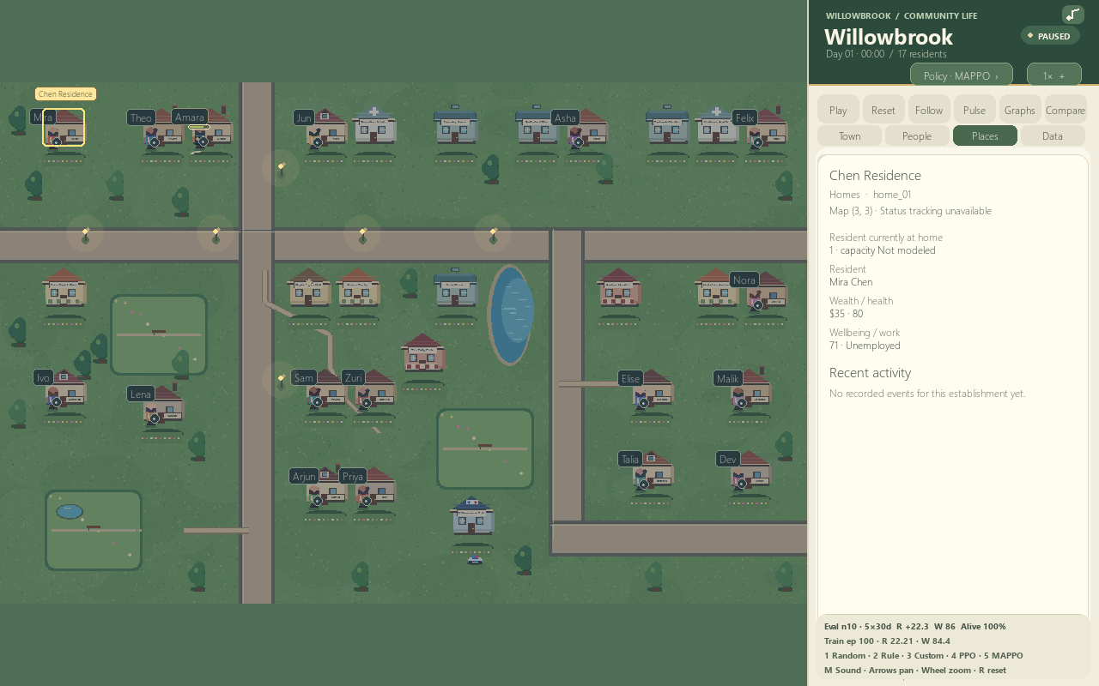
PLAYER TUTORIAL · LAUNCH
Start the demo and let the town run
1 Open PowerShell in the project folder
cd "F:\RL Project"
2 Start the saved MAPPO demo
python -m ai_town.app --mode mappo
The window opens paused. Press Play or Space to advance time. Reset returns to the start.
CURRENT VIEWER: 17 CITIZENS
AI TOWN / 10
Notes:
The project venv should be activated before launch. This exact command uses the saved project MAPPO checkpoint if available. The screenshot shows a citizen inspector and current 17-citizen UI. The project loads a saved policy for MAPPO mode; if the checkpoint is missing, use --mode rule for an explicitly labelled baseline.
Sources: README.md; docs/Academic Defense Guide.md

Slide 11
PLAYER TUTORIAL · CONTROLS
Use the HUD to inspect, compare, and control the simulation
Play / Space
Click a citizen
Start or pause the town
Open needs, activity, money and timeline
Reset / R
Click a building
Restart the simulation
Open the building inspector
1× · 2× · 5× · 10×
Town · People · Places · Data
Cycle simulation speed
Switch viewer sections
Follow / F
Graphs
Keep the selected citizen in view
Open the local research dashboard
Mouse wheel: zoom over the map; scroll the event timeline when pointer is over the inspector. Right-drag or arrow keys pan.
AI TOWN / 11
Notes:
Additional controls: A opens town analytics, B toggles all wellbeing bars, C compare, Tab changes comparison citizen, M toggles synthesized sound. Policy keys 1 Random, 2 Rule, 3 checkpoint policy, 4 PPO, 5 MAPPO. The visible HUD is preferable for the first playthrough.
Sources: README.md; ai_town/view_controls.py

Slide 12
PLAYER TUTORIAL · WHAT TO OBSERVE
Follow one citizen, then zoom out to the town-level story
01
02
03
04
Select
Trace
Compare
Zoom out
Click a named citizen. Read needs, current activity, employment and cash.
Scroll the life timeline to see prior choices, rewards, earnings and purchases.
Use Compare to put two residents side by side; switch the comparison citizen with Tab.
Open Town Pulse / Data to review wellbeing, economy, social and event trends.
Read the evidence carefully
Crime and calendar events are visible story telemetry. Current crime reports do not cause theft, injury, dispatch, or reward changes. The police officer is a real policy-controlled citizen, but no dispatch mechanic is modeled.
Town visual: cozy top-down map · Data pages: outcome trends · Graphs: saved experiment dashboard
AI TOWN / 12
Notes:
This tutorial sequence helps the audience connect individual actions to town-level outcomes. Clarify the scope of incidents: ambient reports are narrative telemetry, not modeled crime mechanics. The officer works like other citizens under the shared policy and targets the Safety Office for Work.
Sources: README.md; docs/Architecture.md; docs/Academic Defense Guide.md

Slide 13
QUICK START
Reproduce the run from a clean Windows PowerShell setup
For an RL run
01
py -3.13 -m venv .venv
python train.py --algorithm MAPPO
--episodes 100 --seed 23 --days 30
--output models/mappo.pt
02
.\.venv\Scripts\Activate.ps1
03
python -m pip install --upgrade pip
python evaluate.py --mode learned
--checkpoint models/mappo.pt --episodes 5
--days 30 --seed 1001
04
python -m pip install -e ".[dev]"
05
python -m ai_town.app --mode mappo
python -m experiments.research_dashboard
Training/evaluation use finite configured horizons; the live viewer can continue past Day 30.
AI TOWN / 13
Notes:
These are the exact documented Windows setup and project commands. Training can take time on CPU. To compare algorithms, evaluate every policy using the same config, days, and seeds. Run `python -m pytest -q` for the project test suite.
Sources: README.md; docs/Testing and Experiments.md

Slide 14
RESEARCH INTEGRITY
What the project can—and cannot—claim today
Established in the repository
Keep these limits visible
Headless PettingZoo-compatible environment
Retained comparison used 10 citizens; current game has 17
Seeded configuration and reproducible entry points
Only a few independent training seeds per algorithm
PPO/MAPPO checkpoints and explicit baseline policies
Results are descriptive—not proof of convergence or superiority
Saved per-episode metrics and training traces
Crime incidents are visual reports, not consequential dynamics
Best next research step: rerun matched evaluations on the current 17-citizen configuration, then report per-seed outcomes and training-seed variation.
AI TOWN / 14
Notes:
This slide prevents old metrics from being misrepresented as results for the expanded town. Existing maps and policy changes can alter outcomes. Results need regeneration after reward, need, navigation, economy, population or configuration changes.
Sources: README.md; docs/Testing and Experiments.md; docs/RL Formulation.md

