Slide 1
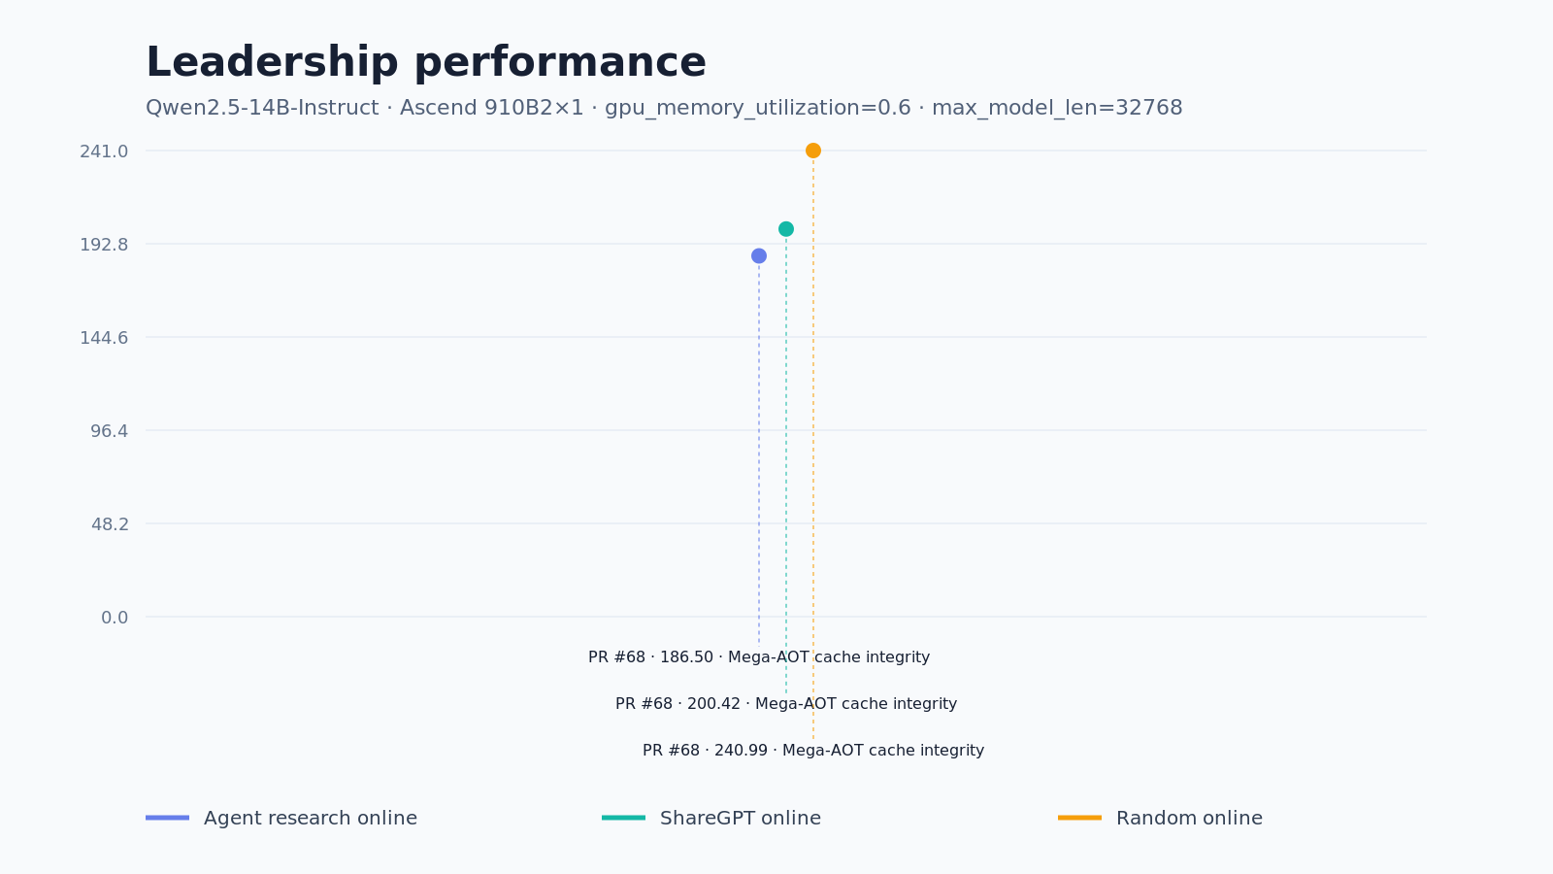
snapshot 2026-11-09T06:58:04Z · registry 1.3.12 a50a864545d1

