Slide 1

LEX/FLEX
Scanner Generator in C

Slide 2

Check Positive or Negative
Presented By
Student Name Student ID
Eyad Hesham Almallah 200010290
Habiba Helmy Emam 200012093
Farah Atef Ayad 200013197
Mayar Magdy 200013290
Under Supervision
Dr \ Nehal A. Mohamed
T.A.\ Toka Abdelhamed

Slide 3
Outline
Introduction
Phases of Compiler
Lexical Analyzer
Software Tools
Inputs of Scanner
Outputs of Scanner
Conclusion
References

Slide 4
Introduction
Compilers are essential software tools that translate high-level programming languages into machine-readable code, enabling computers to execute programs. By undergoing a series of phases like lexical analysis, syntax parsing, semantic analysis, optimization, and code generation, compilers convert abstract code structures into efficient machine code. This succinct introduction aims to highlight the critical role and intricate processes involved in compilers, essential for software development across various computing platforms.

Slide 5
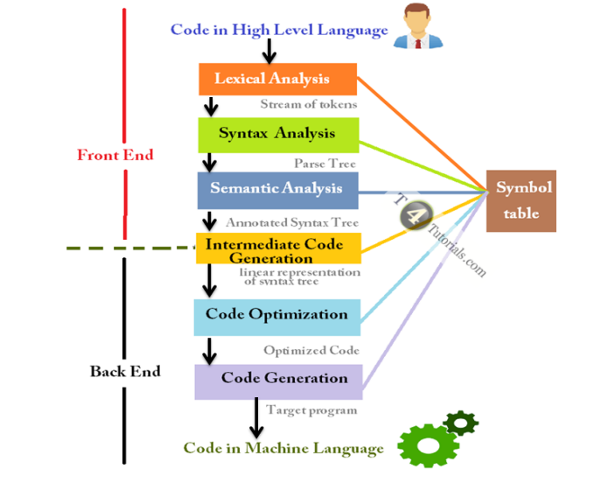
Phases of Compiler
Lexical Analysis (Scanning): This phase involves breaking the source code into tokens.
Syntax Analysis (Parsing): This phase involves analyzing the structure of the source code based on the rules of the programming language's grammar.
Semantic Analysis: This phase checks the source code for semantic correctness.
Intermediate Code Generation: In this phase, the compiler translates the source code into an intermediate representation.
Code Optimization: This phase involves improving the intermediate code to make it more efficient.
Code Generation: This phase translates the optimized intermediate code into the target machine language or bytecode.

Slide 6
Lexical Analyzer
The Lexical Analyzer, also known as a scanner or tokenizer, is the first phase of the compiler frontend. It breaks down the source code into a sequence of tokens. Tokens are the smallest units of a programming language, such as keywords, identifiers, operators, and literals. The Lexical Analyzer removes comments and whitespace and identifies each token along with its corresponding lexeme.

Slide 7
Software Tools
TINY compiler: is a simple programming language designed for educational purposes.
Flex Software: is a powerful tool for generating lexical analyzers (scanners) for programming languages.
C-Minus Language: is a simple subset of the C programming language, designed for educational purposes.

Slide 8
Inputs of Scanner
include <stdio.h>
int main() {
double num;
printf( Enter a number: );
scanf( %lf , &num);
if (num <= 0.0) {
if (num == 0)
printf(You entered 0);
else
printf(You entered a negative number);
}
else
printf(You entered a positive number);
return 0;
}

Slide 9
Outputs of Scanner
1: ID, name= include
1: operator, less than: <
1: ID, name= stdio
1: ERROR: .
1: ID, name= h
1: operator, greater than: >
3: reserved word: int
3: ID, name= main
3: left parenthesis: (
3: right parenthesis: )
3: left curly bracket: {
5: ID, name= double
5: ID, name= num
5: semi colum: ;
6: ID, name= printf
6: left parenthesis: (
6: ID, name= Enter
6: ID, name= a
6: ID, name= number
6: ERROR: :
6: right parenthesis: )
6: semi colum: ;
7: ID, name= scanf
7: left parenthesis: (
7: ERROR: %
7: ID, name= lf
7: comma: ,
7: ERROR: &
7: ID, name= num
7: right parenthesis: )
7: semi colum: ;
8: reserved word: if
8: left parenthesis: (
9: ID, name= num
9: operator, assign: ==
9: NUM, val= 0
9: right parenthesis: )
10: ID, name= printf
10: left parenthesis: (
10: ID, name= You
10: ID, name= entered
10: NUM, val= 0
10: right parenthesis: )
10: semi colum: ;
11: reserved word: else
12: ID, name= printf
12: left parenthesis: (
12: ID, name= You
12: ID, name= entered
12: ID, name= a

Slide 10
Outputs of Scanner
12: ID, name= negative
12: ID, name= number
12: right parenthesis: )
12: semi colum: ;
13: right curly bracket: }
14: reserved word: else
15: ID, name= printf
15: left parenthesis: (
15: ID, name= You
15: ID, name= entered
15: ID, name= a
15: ID, name= positive
15: ID, name= number
15: right parenthesis: )
15: semi colum: ;
17: reserved word: return
17: NUM, val= 0
17: semi colum: ;
18: right curly bracket: }
19: EOF

Slide 11
Conclusion
compilers and lexical analyzers are essential for software development, translating high-level code into machine-readable instructions. Compilers meticulously process code through various stages, ensuring efficient execution across platforms. Meanwhile, lexical analyzers break down source code into tokens, facilitating this process. Together, they enable programmers to express complex logic, driving innovation in the digital sphere.

Slide 12
References
• geeks
• ChatGPT
• Compiler Constructions (Kenneth c. Louden)
• Compilers Principles & techniques and Tools

Slide 13


