Slide 1
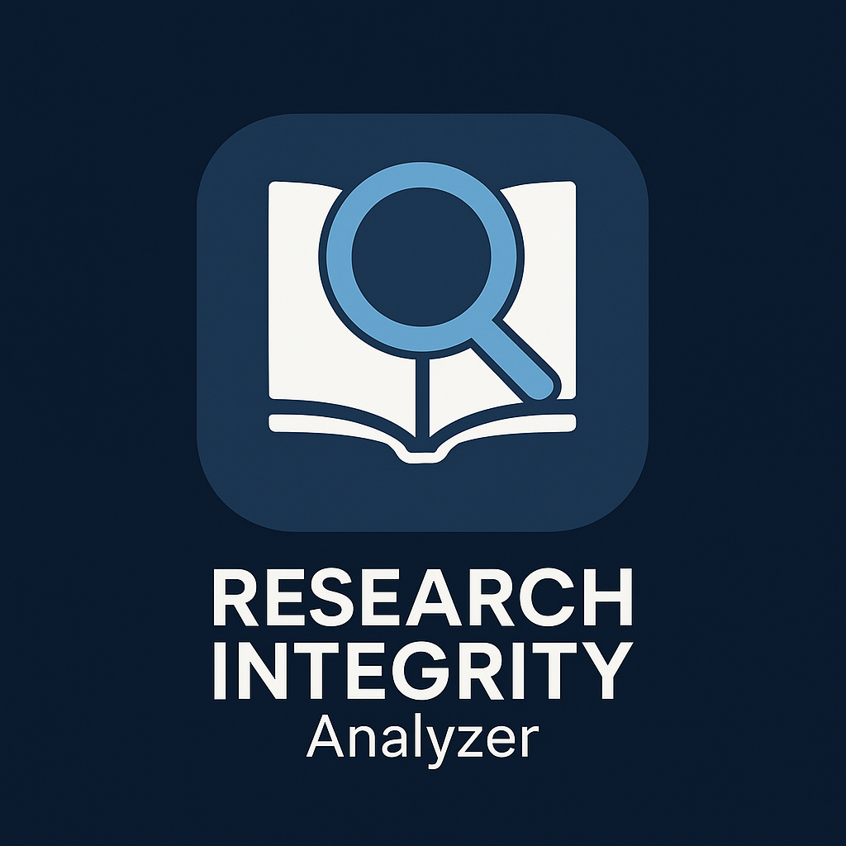
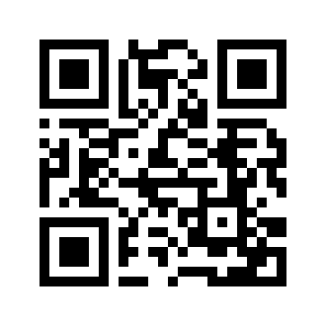
Join the Research Integrity App Project
We’re building a web and mobile app that analyzes scientific papers and detects potential
conflicts of interest between authors, institutions, and funding sources.
The goal: make research transparency accessible to everyone.
The frontend is done — a working PWA already running on iPhone.
Now we’re looking for a backend / iOS developer to help connect the analysis engine and launch it officially.
It’s a non-profit project; publication and hosting costs are covered. If you’re interested in science, AI, and meaningful projects, get in touch.
Contact: Scan the QR code or message on WhatsApp → +34 681 864 143
Research Integrity Analyzer • Non-Profit Collaboration Project

