Slide 1
Online Shopping Cart
Documentation.
By: V.Thusyanthy

Slide 2
Overview
ER Diagram
Use Case Diagram
Class Diagram
Login Page Design
Login page
Login page design
Forgot password page
Forgot Password verification code page
Reset Password page
Member Registration Design
Customer Registration
Product List Design
Product list
Product list Design

Slide 3
Continue…
Product Cart Page Design
Product Cart Page
Product Cart Page Design
Place Order Page Design
Place Order Page
Place Order Page Design
Payment Page Design
Payment Page
Payment Page Design
Payment History Page Design
Payment History Page
Payment History Page Design

Slide 4
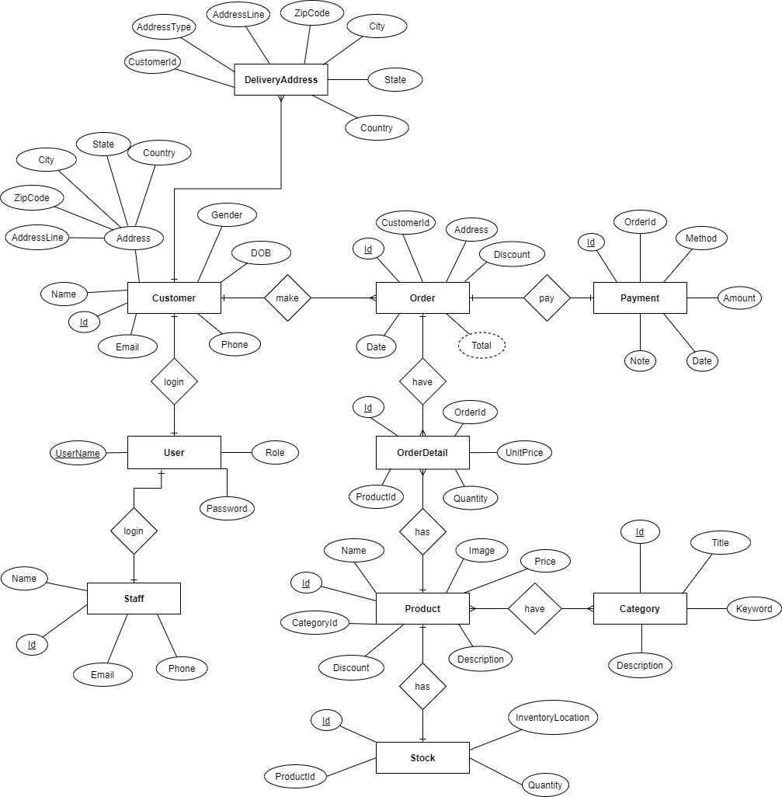
ER Diagram

Slide 5
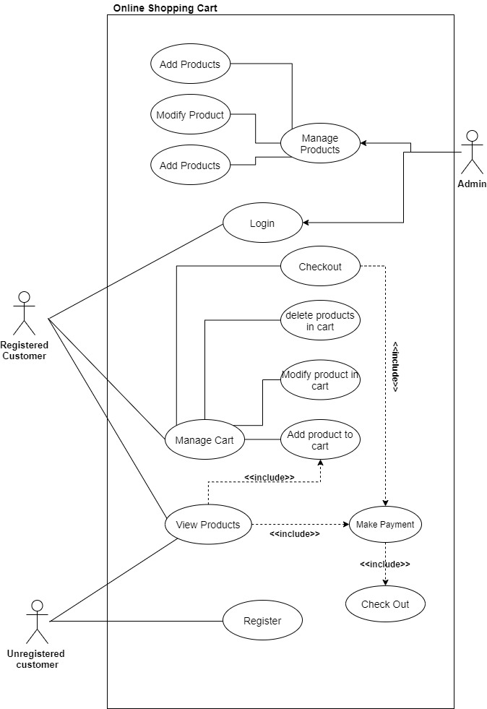
Use case Diagram

Slide 6
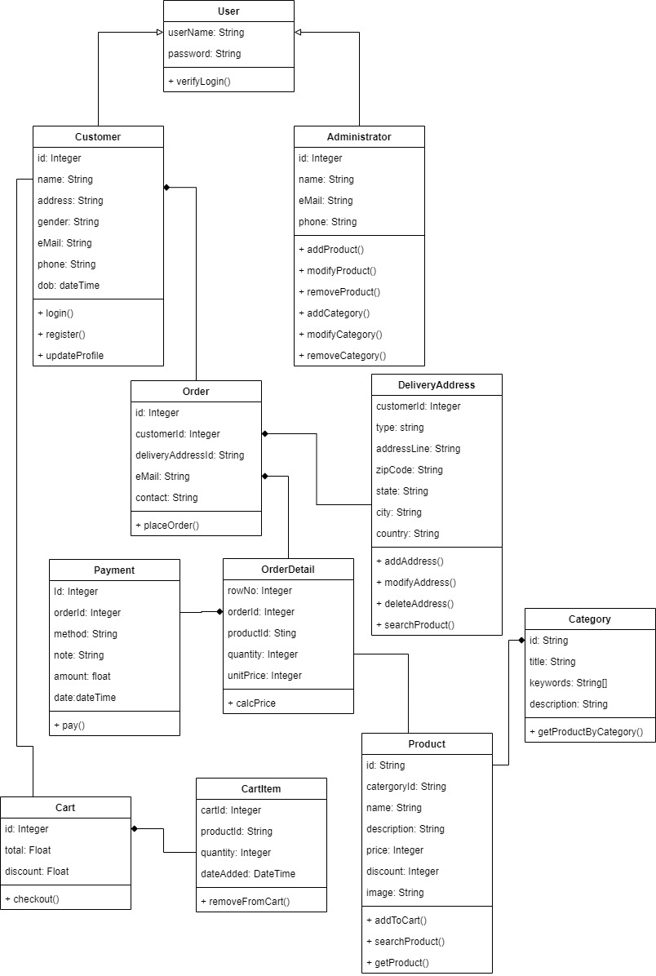
Class Diagram

Slide 7
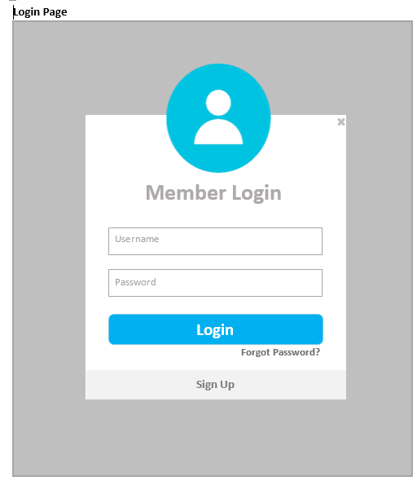
Login Page

Slide 8
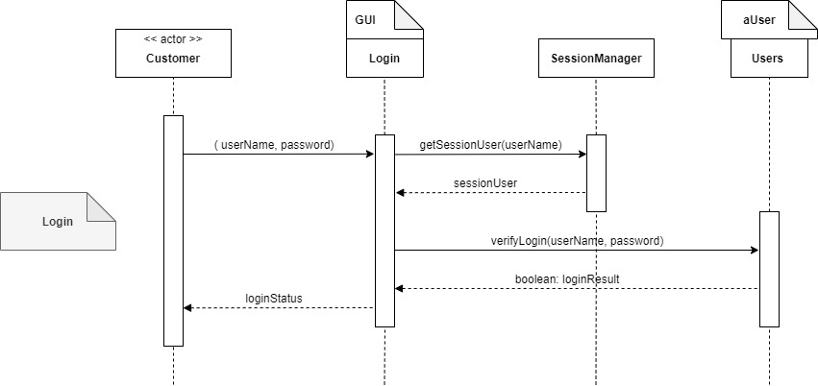
Login Design

Slide 9
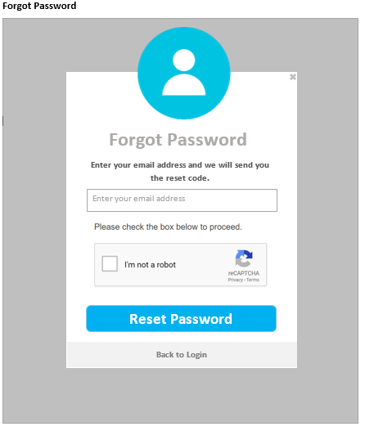
Forgot Password Page

Slide 10
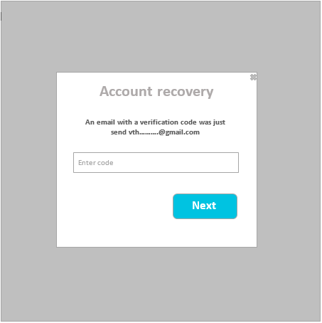
Forgot Password Verification Code Page

Slide 11
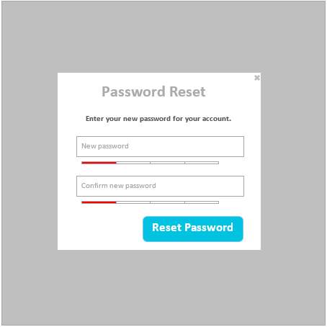
Reset Password Page

Slide 12
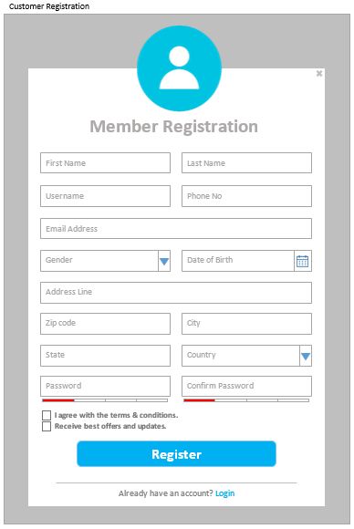
Customer Registration

Slide 13
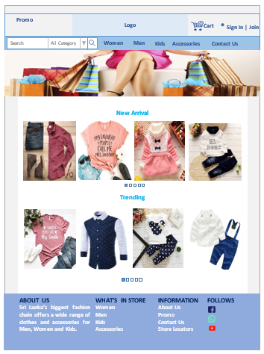
Product List

Slide 14
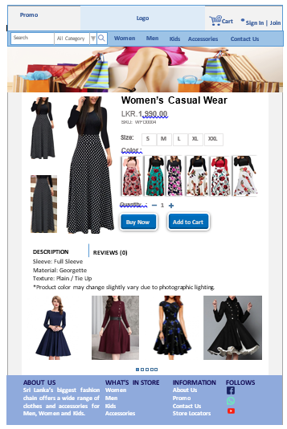

Slide 15
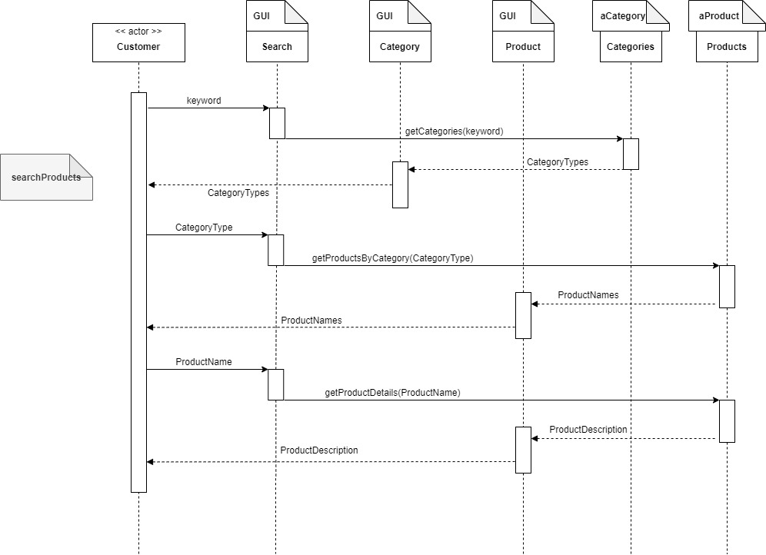
Product List Design

Slide 16
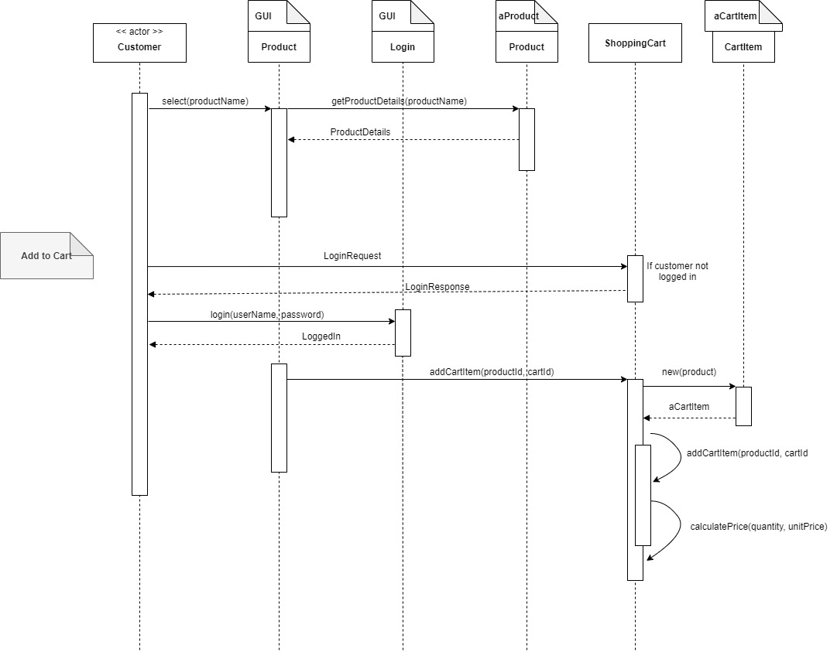
Product Cart Page Design

Slide 17
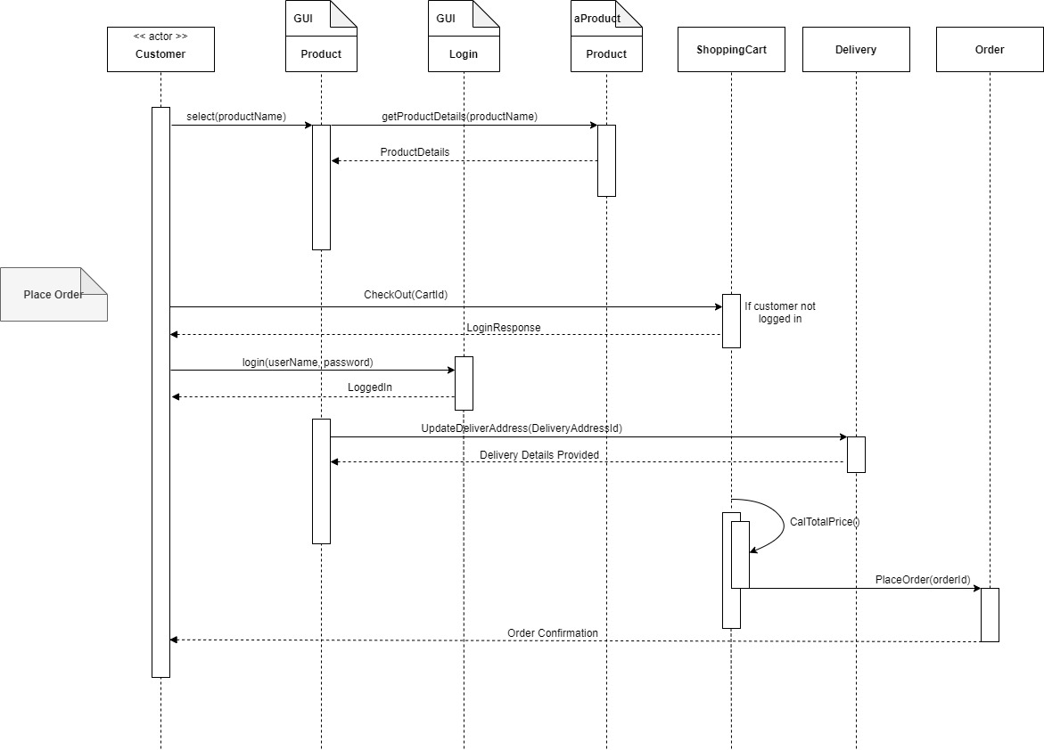
Place Order Page Design

Slide 18
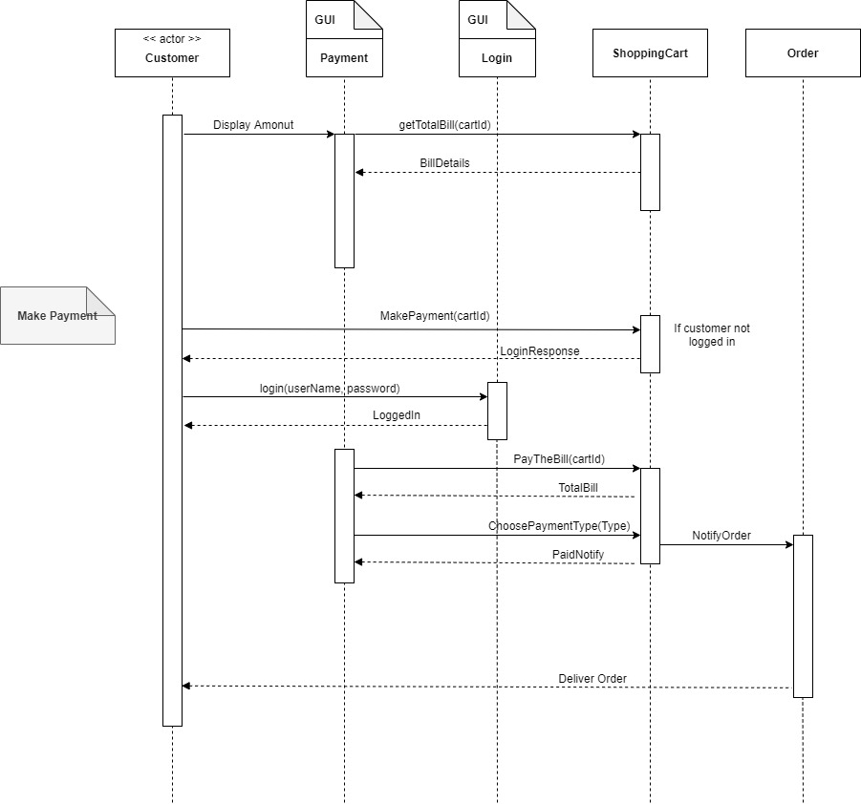
Payment Page design

Slide 19
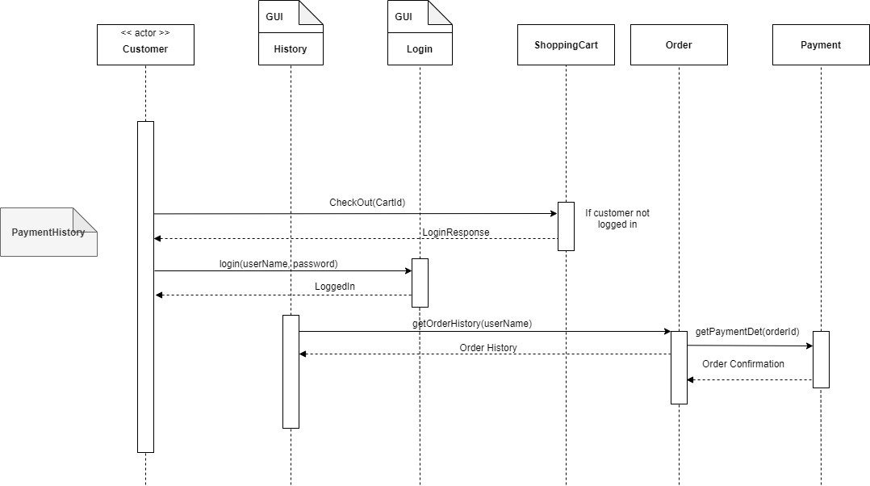
Payment History Design

