Slide 1
Online Shopping Cart
Documentation.
By: V.Thusyanthy

Slide 2
Overview
ER Diagram
Use Case Diagram
Class Diagram
Login Page Design
Login page
Forgot password page
Forgot Password verification code page
Reset Password page
Member Registration Design
Customer Registration
Staff Registration
Product List

Slide 3
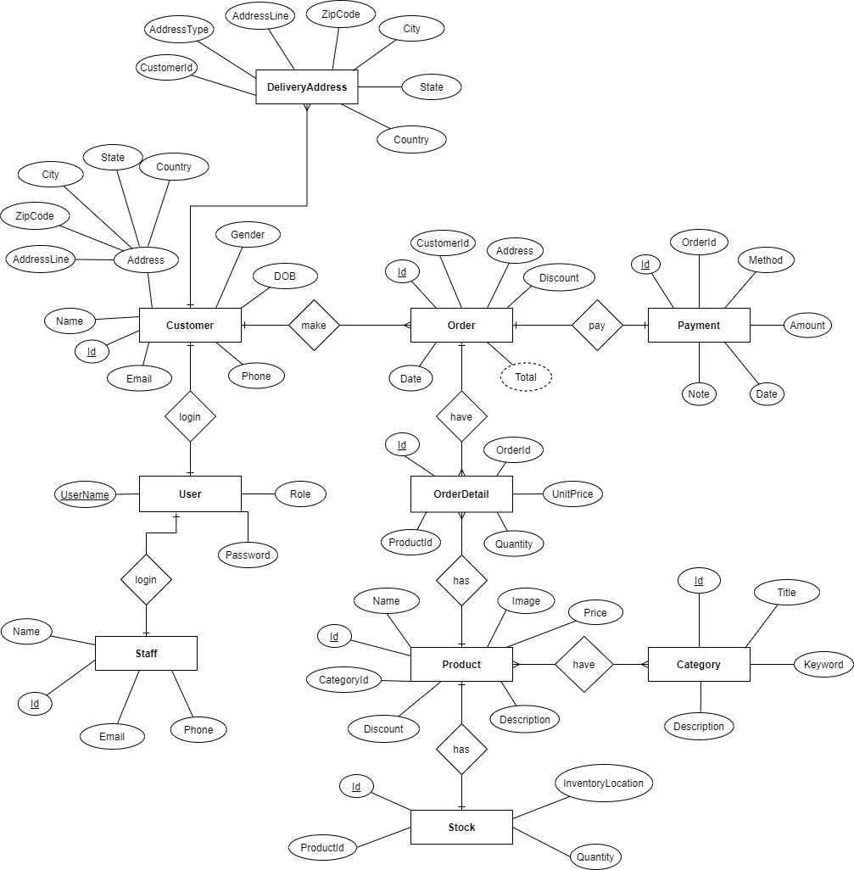
ER Diagram

Slide 4
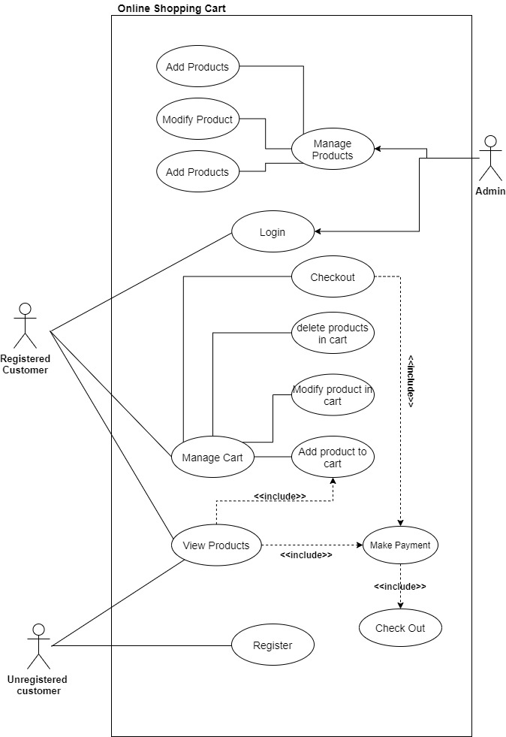
Use case Diagram

Slide 5
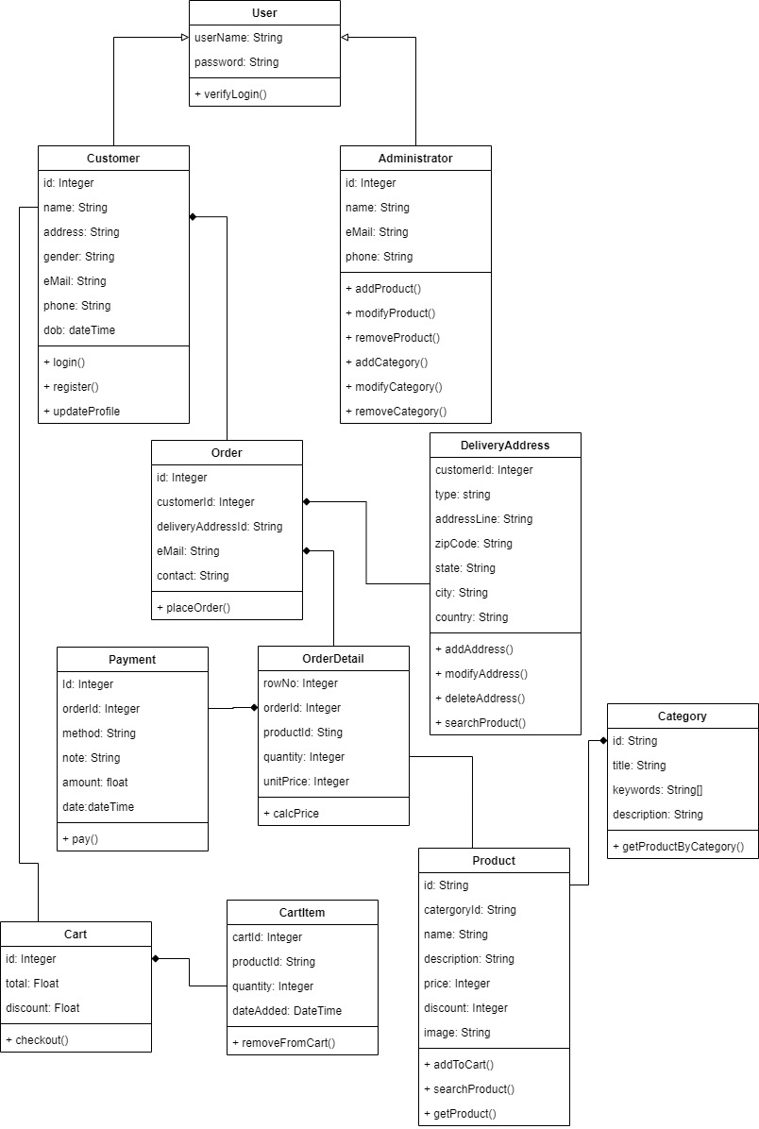
Class Diagram

Slide 6
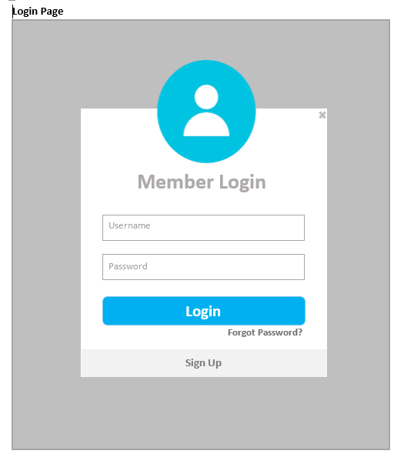
Login Page

Slide 7
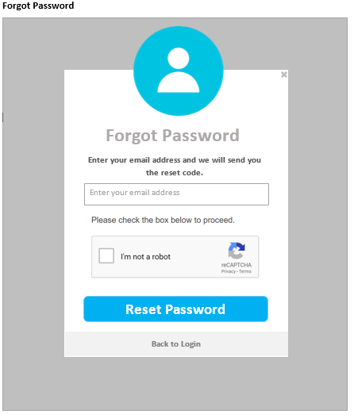
Forgot Password Page

Slide 8
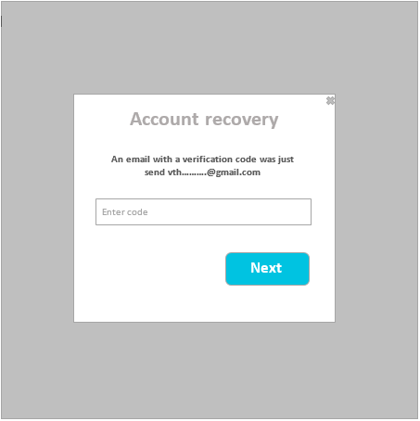
Forgot Password Verification Code Page

Slide 9
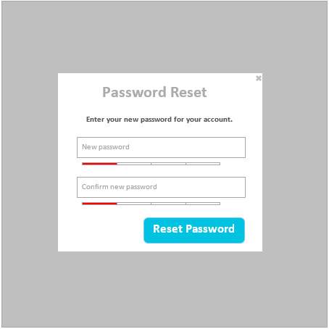
Reset Password Page

Slide 10
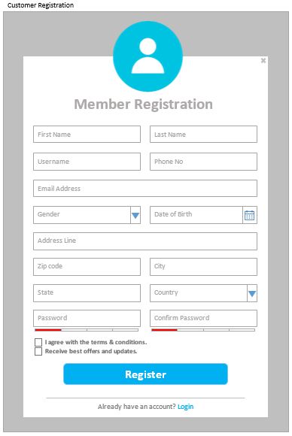
Customer Registration

Slide 11
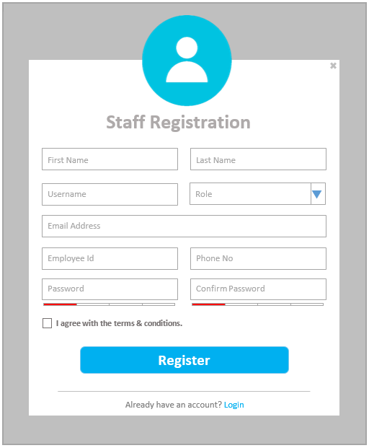
Staff Registration

Slide 12
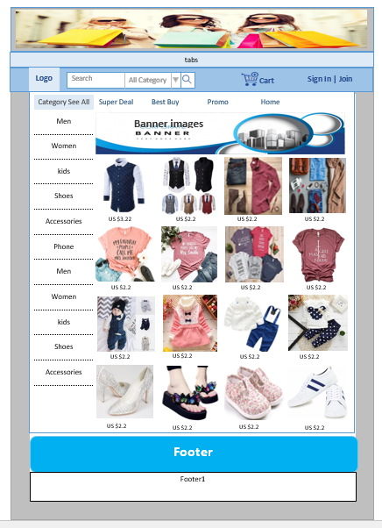
Product List

