Slide 1
Online Shopping Cart
Documentation.
By: V.Thusyanthy

Slide 2
Overview
ER Diagram
Use Case Diagram
Class Diagram
Login Page Design
Login page
Login page design
Forgot password page
Forgot Password verification code page
Reset Password page
Member Registration Design
Customer Registration
Staff Registration
Product List Design
Product list
Product list Design

Slide 3
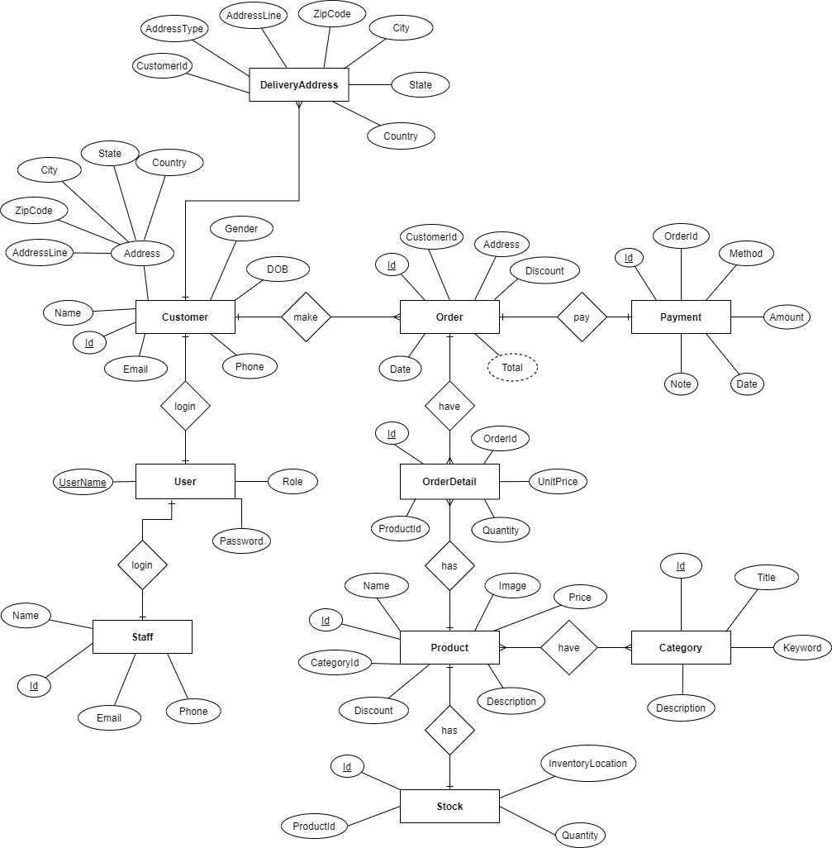
ER Diagram

Slide 4
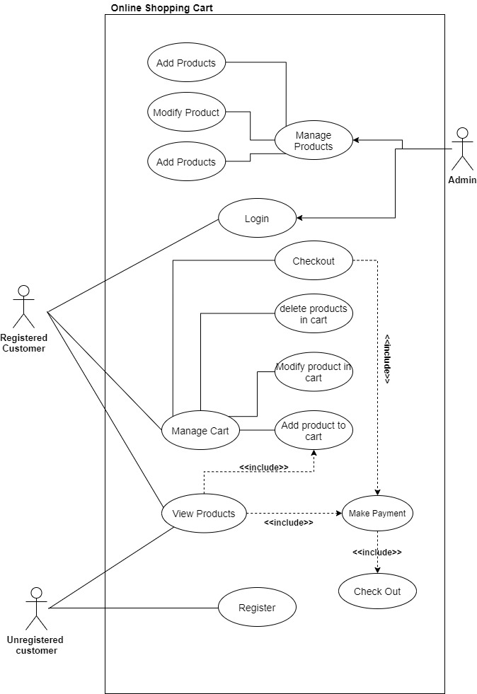
Use case Diagram

Slide 5
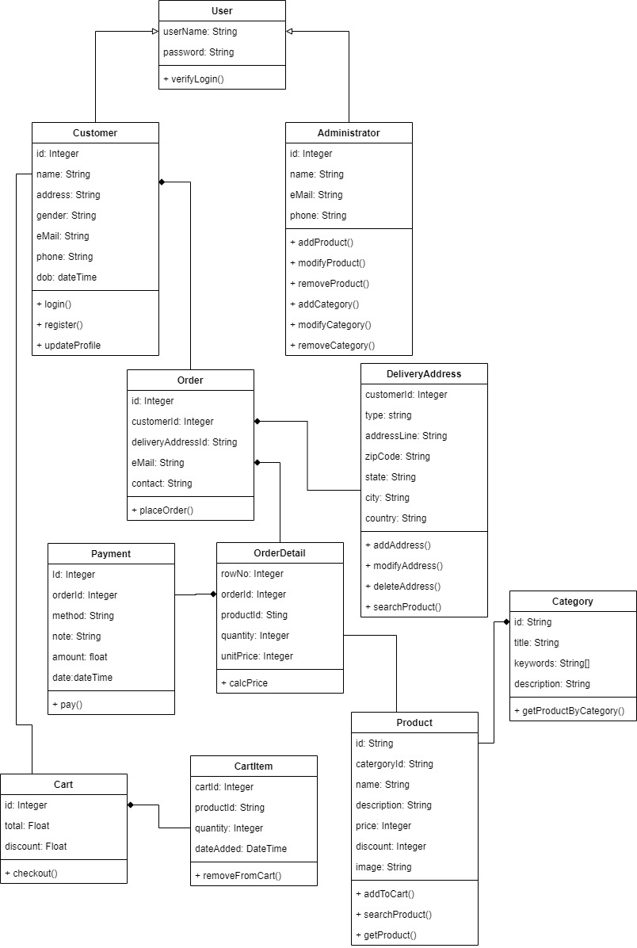
Class Diagram

Slide 6
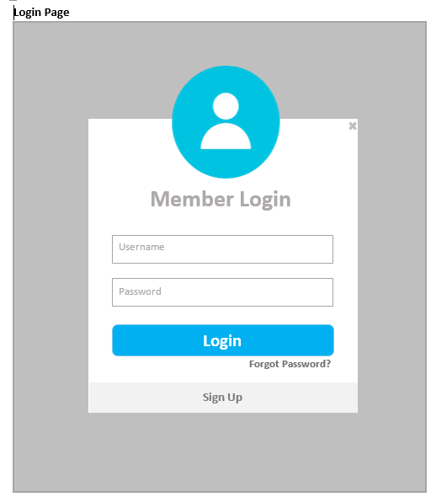
Login Page

Slide 7
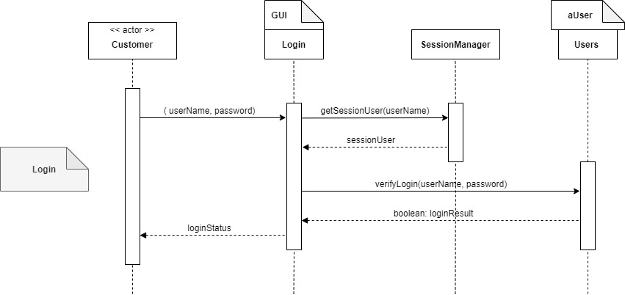
Login Design

Slide 8
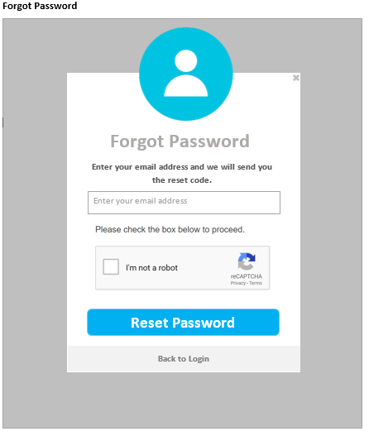
Forgot Password Page

Slide 9
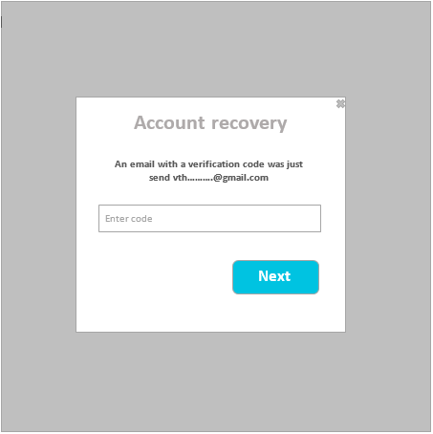
Forgot Password Verification Code Page

Slide 10
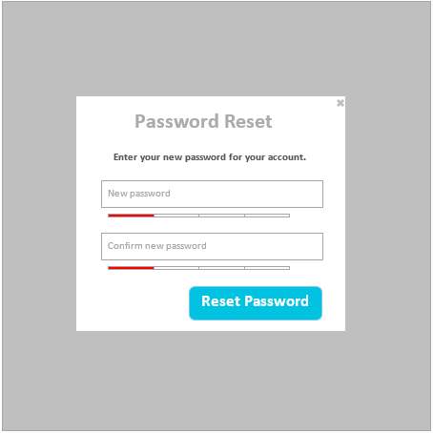
Reset Password Page

Slide 11
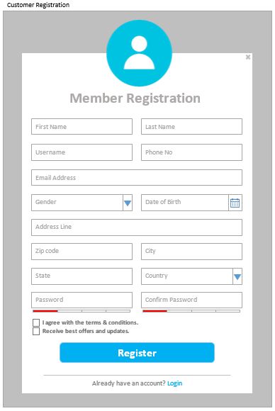
Customer Registration

Slide 12
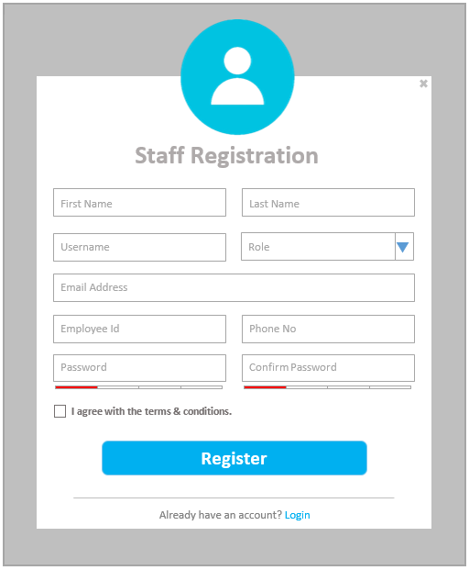
Staff Registration

Slide 13
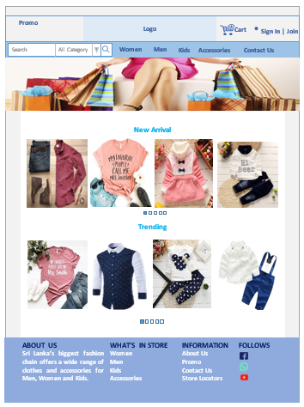
Product List

Slide 14
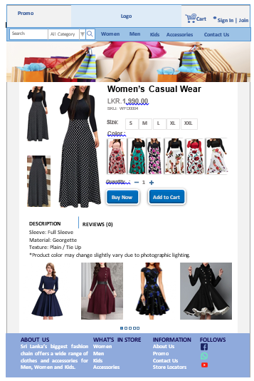

Slide 15
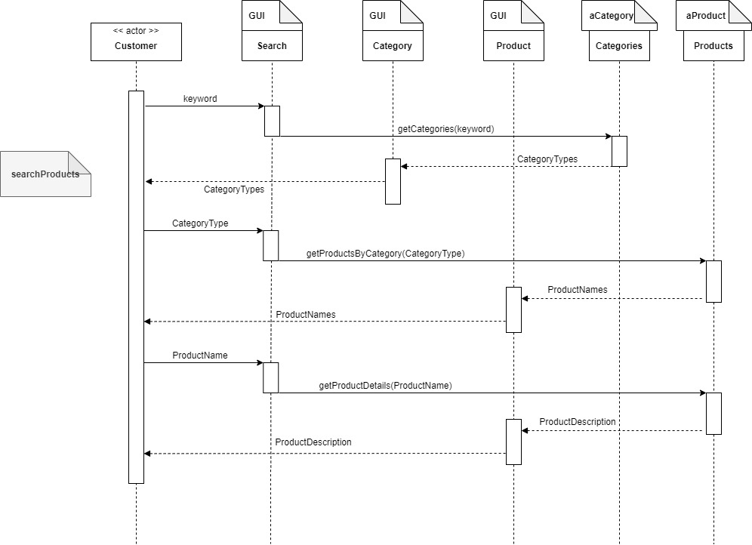
Product List Design

