Slide 1
Online Shopping Cart
Documentation.
By: V.Thusyanthy

Slide 2
Overview
ER Diagram
Use Case Diagram
Class Diagram
Login Page Design
Login page
Forgot password page
Forgot Password verification code page
Reset Password page

Slide 3
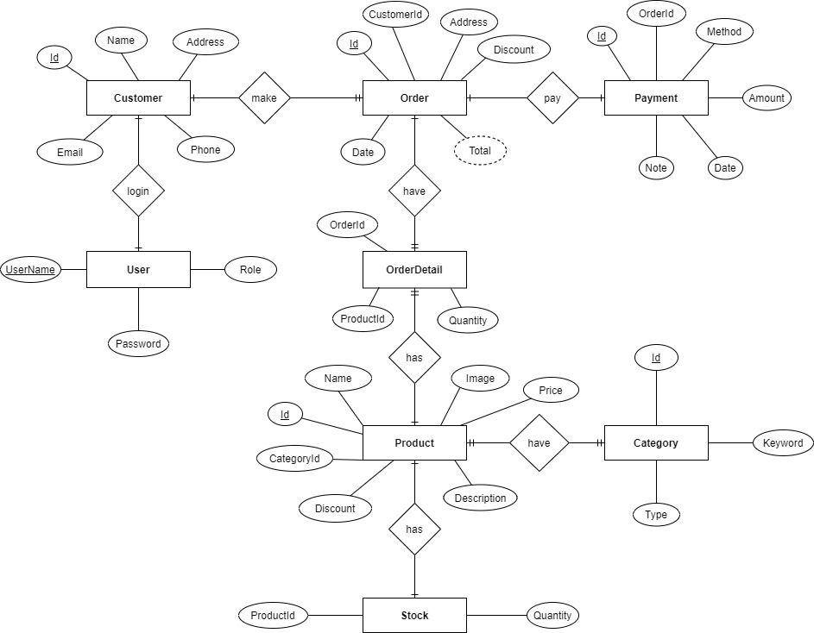
ER Diagram

Slide 4
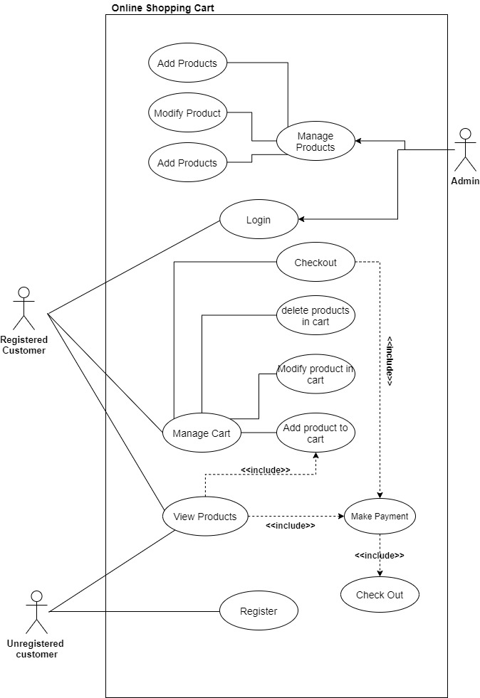
Use case Diagram

Slide 5
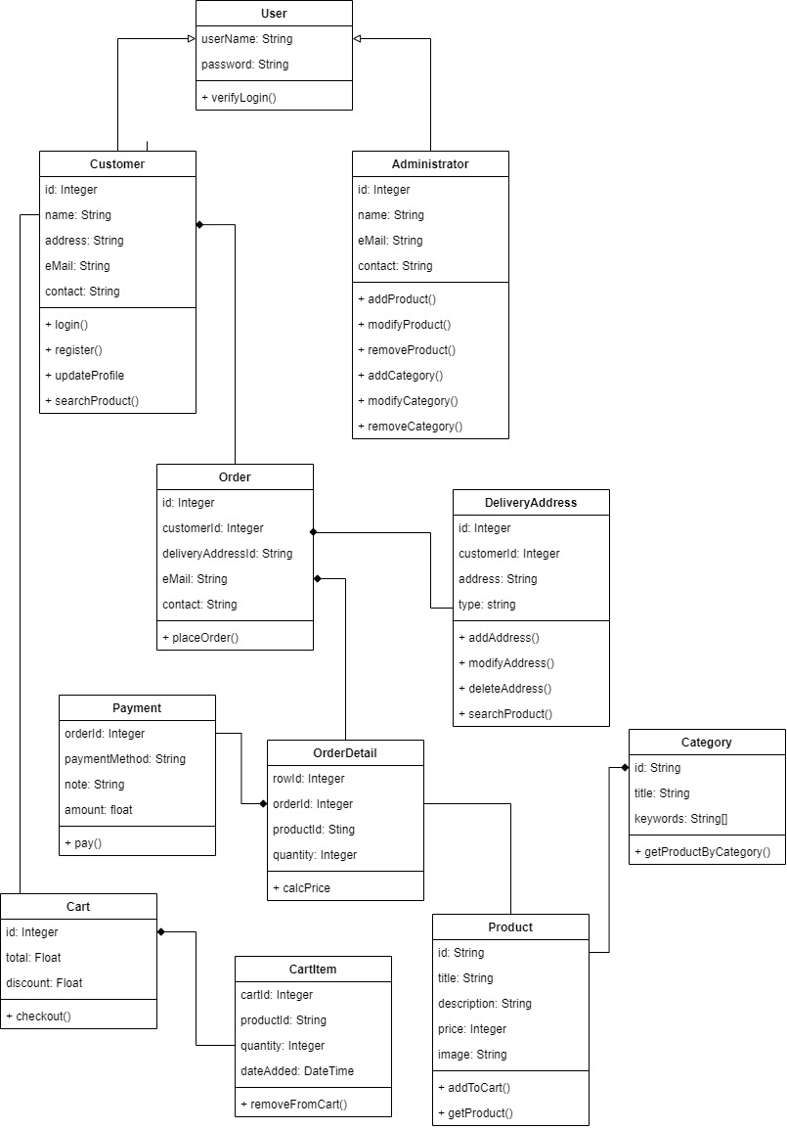
Class Diagram

Slide 6
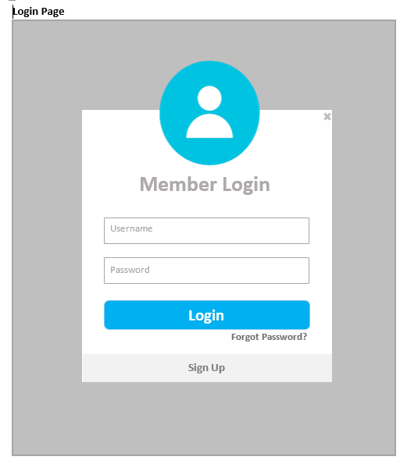
Login Page

Slide 7
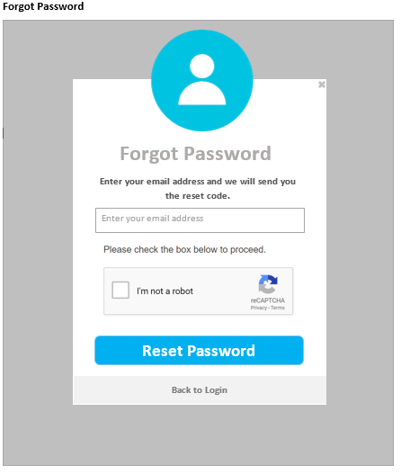
Forgot Password Page

Slide 8
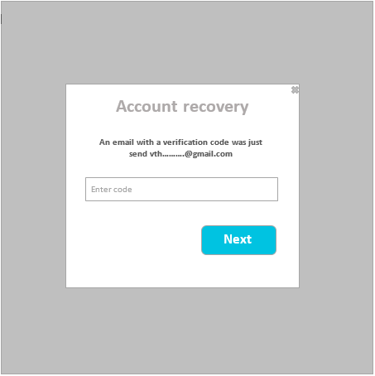
Forgot Password Verification Code Page

Slide 9
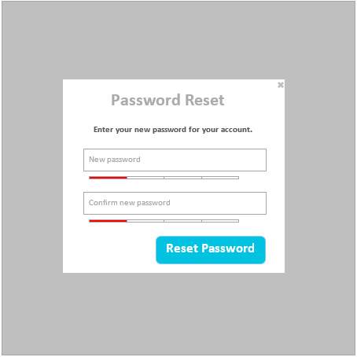
Reset Password Page

