Slide 1



A Virtual Vehicular Communications Unit as a Cloud-Native Network Function
PI 2022/2023
Milestone 3
Ana Paradinha 102491
João Matos 103341
Filipe Antão 103470
Paulo Pinto 103234
Tiago Carvalho 104142

Slide 2

Project Overview
Virtual Environment
Digital Twins
Cloud-Native Network Function
for CCAM applications
of 5G-enabled VCUs
to make available a virtual VCU

Slide 3
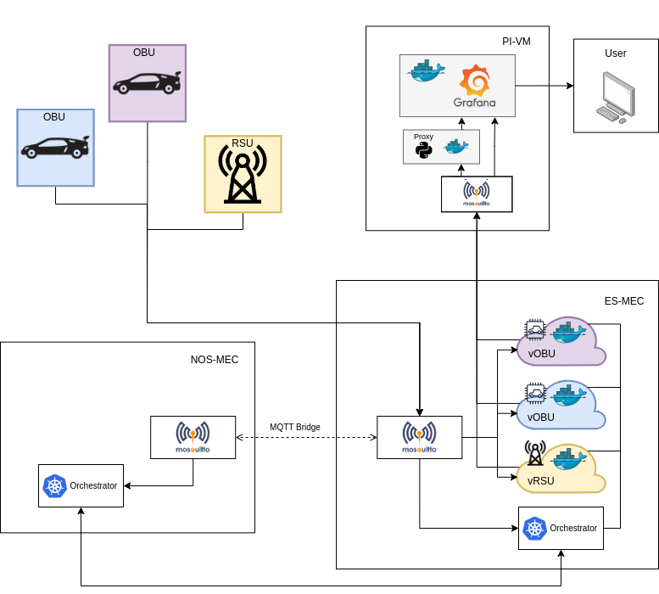
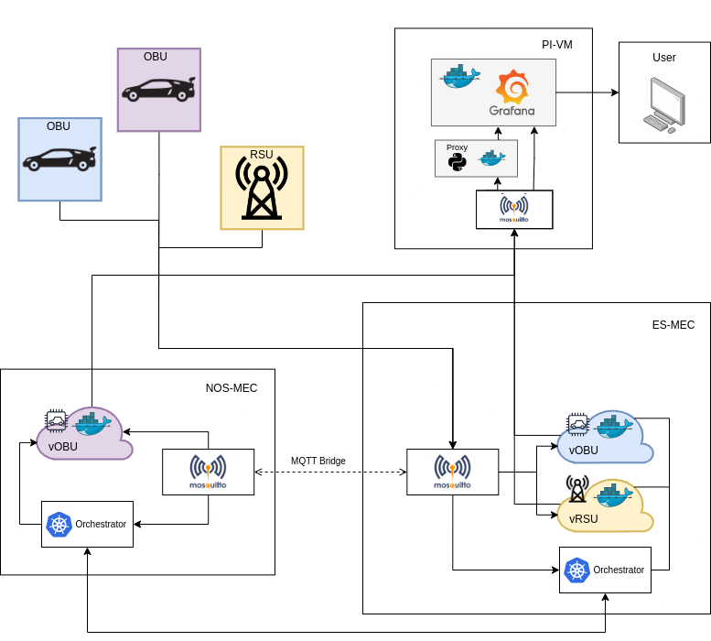
System Architecture

Slide 4
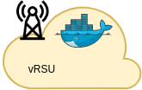
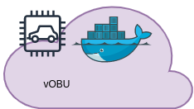
Docker container
vVCU
VCU
Device installed in a vehicle or roadside infrastructure
Shares data with other VCU’s in the area
vVCU
Software-based VCU
vVCU Docker image
Portability and consistency
Ease of deployment

Slide 5
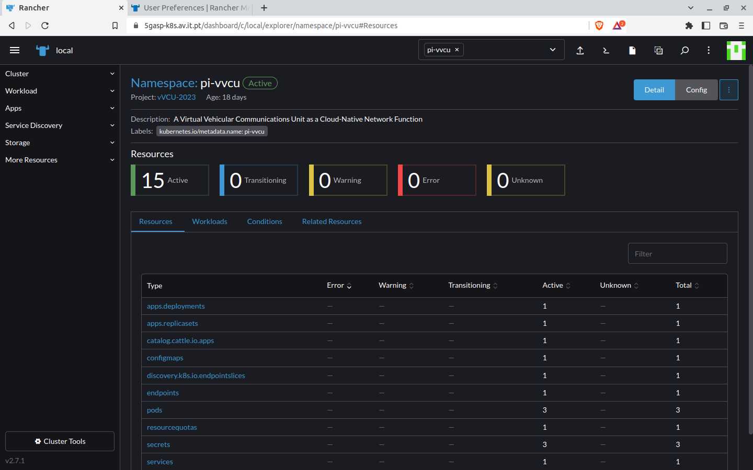
Kubernetes Cluster
Portability, consistency
Declarative-based approach
Scaling, load balancing, self-healing

Slide 6
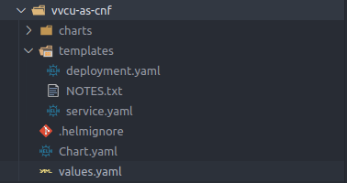
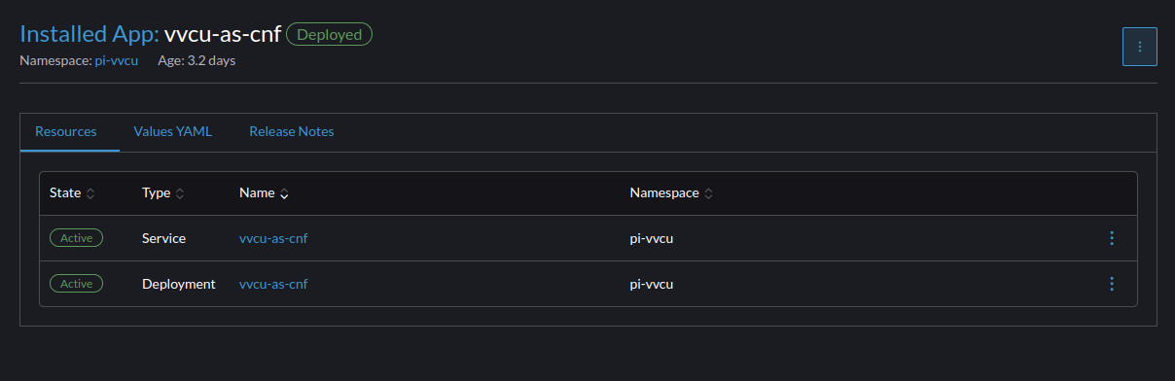
Helm Chart
Package format for K8s applications
Ease of deployment

Slide 7
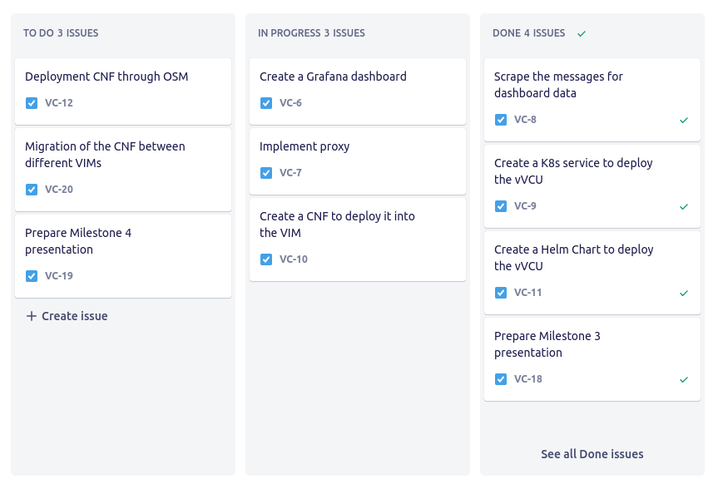
Progress
Task progression
New tasks
Problems during development

Slide 8
Future Work
Orchestrator
Migration
With the helm chart completed, we will start working on the orchestrator
Testing the developed CNF through migration between different MECs

Slide 9
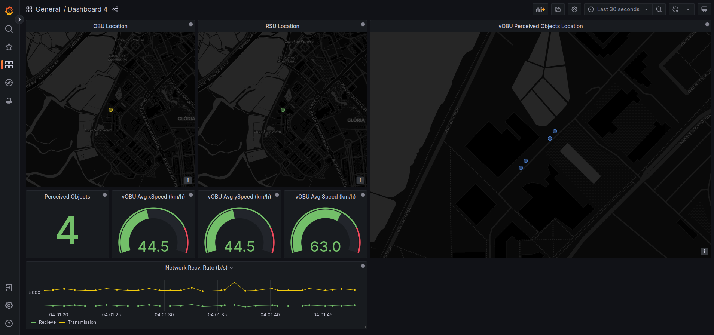
Grafana Interface Demo

Slide 10
Interface Next Steps
Scalability
Migration
With the interface completed, we will start working on displaying more data
Testing migration between different MECs will be visible in the interface

Slide 11
Thanks!
For more info about our project, check out our website
https://vvcu-as-cnf.github.io/website/

