Slide 1



A Virtual Vehicular Communications Unit as a Cloud-Native Network Function
PI 2022/2023
Milestone 2
Ana Paradinha 102491
João Matos 103341
Filipe Antão 103470
Paulo Pinto 103234
Tiago Carvalho 104142

Slide 2

Project Overview
Virtual Environment
Digital Twins
Cloud-Native Network Function
for CCAM applications
of 5G-enabled VCUs
to make available a virtual VCU

Slide 3
Functional Requirements
Cloud-Native Network Function
Load Balancing Heuristic
User Friendly Interface
The different vVCUs should be deployed in a CNF
To prevent network congestion, a load balancer should be implemented
Allows us to visualize the information from the different vVCUs

Slide 4
Non Functional Requirements
Decoupling
Modularity
Minimal dependency between components
Separated components that can be broken into smaller ones
Extensibility
Security
Easily extended and expandable solution
Secure connectivity between all solution's components

Slide 5
Use Cases
A complement to the development of autonomous driving technologies
5G allows for real time traffic control in any place covered by our solution
Maneuver coordination
Traffic Control

Slide 6
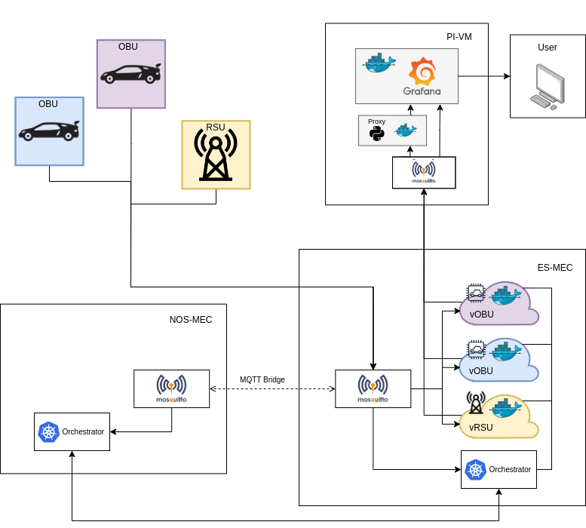
System Architecture

Slide 7
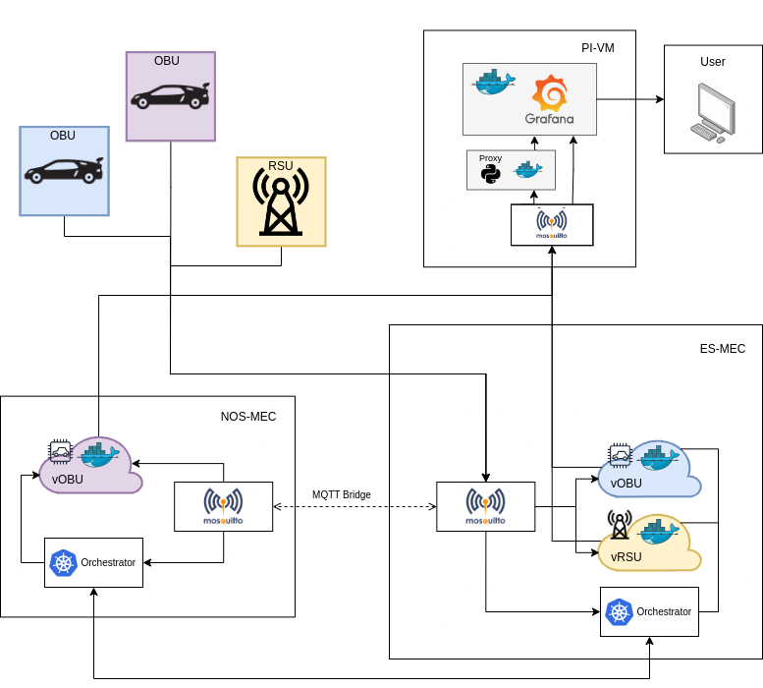
System Architecture

Slide 8
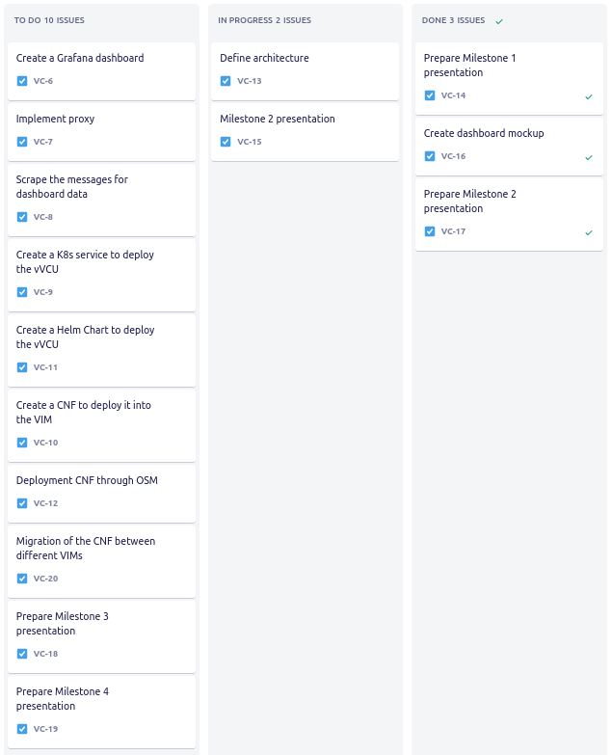
Tasks

Slide 9
State of Art
“Validation and Benchmarking of CNFs in OSM for pure Cloud Native applications in 5G and beyond”, Adrián Pino, Pouria Khodashenas, Xavier Hesselbach, Estefanía Coronado, Shuaib Siddiqui
“A roadside and cloud-based vehicular communications framework for the provision of C-ITS services”, Emanuel Vieira, João Almeida, Joaquim Ferreira, Tiago Dias, Ana V. Silva, Lara Moura

Slide 10
State of Art
Papers related with 5G, Cloud Native Functions and Virtual Network Functions
“Kube5G: A Cloud-Native 5G Service Platform”, Osama Arouk, Navid Nikaein
“Cloud Native 5G Virtual Network Functions: Design Principles and Use Cases”, Sofiane Imadali, Ayoub Bousselmi

Slide 11
State of Art
Papers related with 5G, Cloud Native Functions and Virtual Network Functions
“Cloud Native 5G: an Efficient Orchestration of Cloud Native 5G System”, Abderaouf Khichane, Ilhem Fajjari , Nadjib Aitsaadi, Mourad Gueroui
“A Design of MANO System for Cloud Native Infrastructure”, Jangwon Lee; Younghan Kim

Slide 12
State of Art
Papers related with the use of Digital twins and Autonomous driving
“Collaboration as a Service: Digital-Twin-Enabled Collaborative and Distributed Autonomous Driving”, Yilong Hui, Xiaoqing Ma, Zhou Su, Nan Cheng, Zhisheng Yin, Tom H. Luan, Ye Chen
“Real-Time Digital Twins:Vision and Research Directions for 6G and Beyond”, Ahmed Alkhateeb, Shuaifeng Jiang, and Gouranga Charan

Slide 13
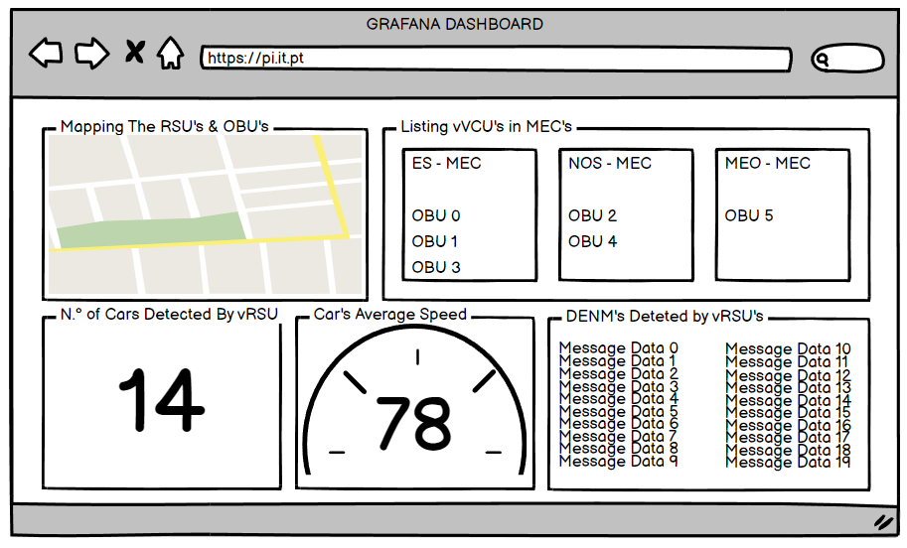
Dashboard
Mockup

Slide 14
Thanks!
For more info about our project, check out our website
https://mankings.github.io/vVCU-as-CNF/

