Slide 1
IndicDoc Verify
Project title: IndicDoc Verify: Deep-Learning Layout Analysis for Pre-Print Checking of Indian Question Papers and Their Translations
Team: Riddhi Patil (39), Mariam Badure (40), Prashant Jha (41), Aditya Soni (42)
Course: DL Mini Project (Expt. 11, SDG-based)
Department of Artificial Intelligence and Machine Learning
St. Francis Institute of Technology (SFIT)
Project guide: Dr. Joanne Gomes
Academic year / semester: 2026–27, Semester V (TE AIML)

Slide 2
Content
Literature Survey Summary Table
Research Gaps
Problem Statement and Objectives
Proposed System, Methodology and Novelty
System Block Diagram
Dataset Description and Pre-processing
Deep Learning Model Architecture
Tools, Technologies and Environment
Implementation Details
Experimental Setup and Training
Results and Performance Evaluation
Comparison with Baseline / Existing Methods
Sample Outputs and Demonstration
Challenges and Limitations
Conclusion and Future Scope
References

Slide 3
Literature Survey Summary Table
Ref | Author | Problem | Dataset | Method | Limitation
[1] | Nath et al., 2025 | Layout parsing of Indian-language pages | IndicDLP: 119,806 pages, 12 languages, 42 labels incl. questions and options | Benchmark of YOLOv10x, DocLayout-YOLO, RoDLA, DINO, DiT, Florence-2 | Detects regions only; nobody uses the question labels to check papers
[2] | Kasuba et al., 2025 | Page-level handwritten Indic text recognition | CHIPS, ~25K pages, 10 languages | DBNet word detection + 6 recognisers (CRNN, PARSeq, ...) | User must name the language; text only
[3] | Mondal et al., 2026 | Multilingual table detection | UniTabBank: 55K pages, 82K tables, 28 languages | Semi-automatic labelling; YOLOv11 detector | Borderless tables and degraded scans fail
[4] | Pal et al., 2024 | Table question answering, low-resource Indic | BanglaTabQA 2M, HindiTabQA 643K | SQL-generated QA; fine-tuned mBART / M2M / Llama | Wikipedia tables only
[5] | Xu et al., 2021 | Multilingual document understanding | 30M docs; XFUND, 7 languages | LayoutXLM: text + layout + image transformer | No Indian language
[6] | Kasuba et al., 2025 | Grounding answers on the page | MGVG: 70 circulars, 509 QA pairs | OCR + Llama-3.1-8B + region matching | OCR-dependent; single page
[7] | Bhattacharyya et al., 2025 | Hindi OCR with vision-language models | 1.1M printed Hindi words + pages | LoRA-tuned GOT-OCR 2.0 | Hindi only; mixed-language lines are hard
[8] | Dumada & Shah, 2026 | Devanagari table extraction | 500+ Devanagari documents | Structure + Tesseract content, weighted fusion | No ablation; self-reported
[9] | Babayeva et al., 2025 | Translating a test into other languages with an LLM | Force Concept Inventory, many languages | GPT-4o translation + back-translation + human review | Every item still checked by hand; no page structure
[10] | Rei et al., 2022 | Translation quality estimation without a reference | WMT 2022 QE shared task | CometKiwi: multilingual encoder predicts quality per sentence | Plain sentences: no question numbers, options or marks

Slide 4
Research Gaps
# | Gap in existing work | How this project addresses it
G1 | Exam papers are translated into up to 13 languages and vetted only by hand; errors reach candidates | An automatic pre-print check of every language version against the source
G2 | Translation-quality tools [9, 10] read plain sentences: blind to question numbers, options, marks, figures | Compare versions question by question using the page layout itself
G3 | Indic layout models [1] detect questions and options, but this is not used to check papers | Use the detector's question / option regions (AP@50 0.81–0.90) as the backbone of the checker
G4 | Indic OCR misreads Latin digits in mixed text [7]; a checker of numbers needs every digit right | A "number pass": two OCR models must agree on every number
Court e-filing checks already exist (Supreme Court + IIT Madras), so we chose what nobody automates yet: checking a question paper and its translations.

Slide 5
Problem Statement and Objectives
Problem: exam papers are translated into Hindi and regional languages and checked only by hand; errors reach lakhs of candidates.
Main objective: an offline DL system that flags errors in a paper and every difference from its source version, before printing.
Specific objectives:
Detect questions, options, answers with a layout detector (compare 3).
Read text with reliable numbers in 12 languages.
Check numbering, duplicates, options, marks, parity, repeats.
Measure on a benchmark; ship app + API in Docker.
Expected output: verdict + each finding with question and page (HTML / JSON).
It has already happened
Exam | What went wrong
NEET-UG 2018 | 49 questions wrong in the Tamil version; HC ordered 196 grace marks, SC set it aside
KPSC KAS 2024 | 59 errors in the Kannada paper; re-exam for ~2 lakh candidates, errors again
APPSC Group-I | 51 of 120 questions alleged mistranslated into Telugu; SC notice
UGC-NET Jun 2026 | Translation errors + questions repeated from old papers; re-test 9–10 Sep
MBBS (NTRUHS) 2026 | The same MCQ printed twice; AP HC ordered a compensatory mark

Slide 6
Proposed System, Methodology and Novelty
Workflow (input to output):
Paper in: PDF / scans + source version
Find structure: DocLayout-YOLO: questions, options
Read text: Indic OCR + English number pass
Build questions: number, stem, options, marks, figures
Check: structure, parity, repeats, format
Report: verdict + findings on the page
Deep learning: DocLayout-YOLO finds every question, option and answer (AP@50 0.81–0.90).
Novelty 1 – parity without translation: numbers, options, marks and figures must match in every language.
Novelty 2 – number pass: two OCR models must agree on every digit.
USP: the only tool we found that checks a paper against its translations, offline, in 12 languages.

Slide 7
System Block Diagram
USER
Streamlit app
Verify Paper tab
REST API
POST /verify
Docker
offline
INPUT
Render pages
PDF at 200 dpi
Source version
optional
Bank, profile
old papers, rules
DEEP LEARNING
Layout detector
DocLayout-YOLO
Post-process
threshold, de-duplicate
Question regions
questions, options
TEXT
Indic OCR
Tesseract
Number pass
digits must agree
Build questions
stem, options, marks
CHECKS, OUTPUT
Structure, repeats
numbering, marks, bank
Translation parity
align versions
Report
verdict, HTML / JSON
Grey: deep-learning stage. The source version follows the same path.

Slide 8
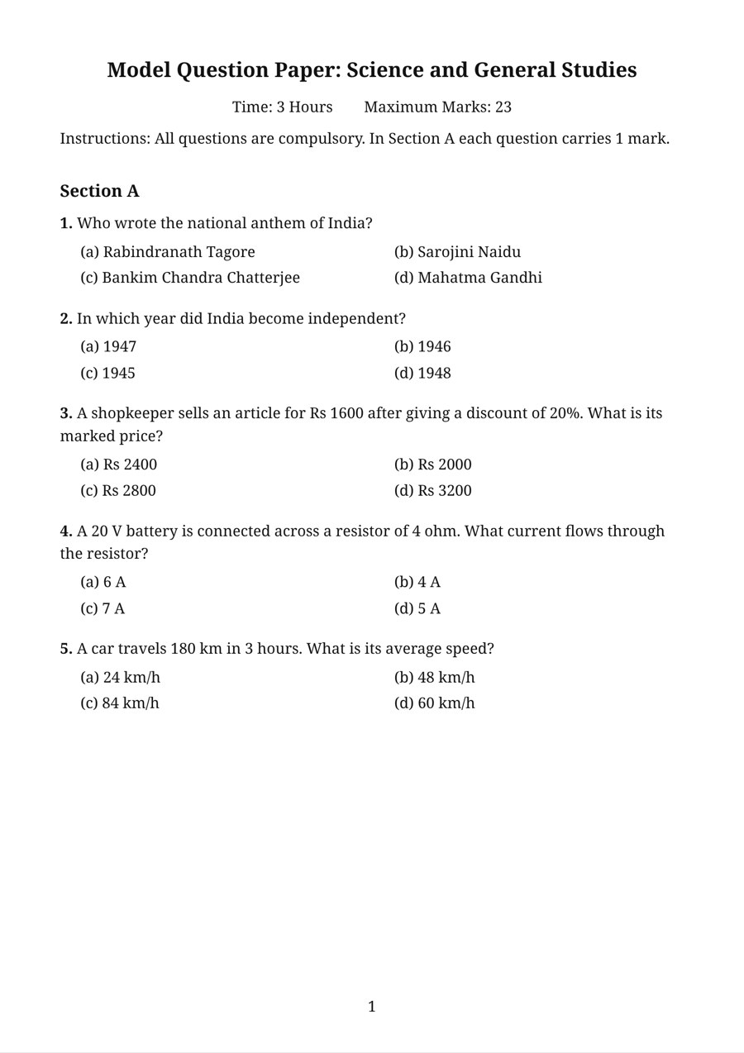
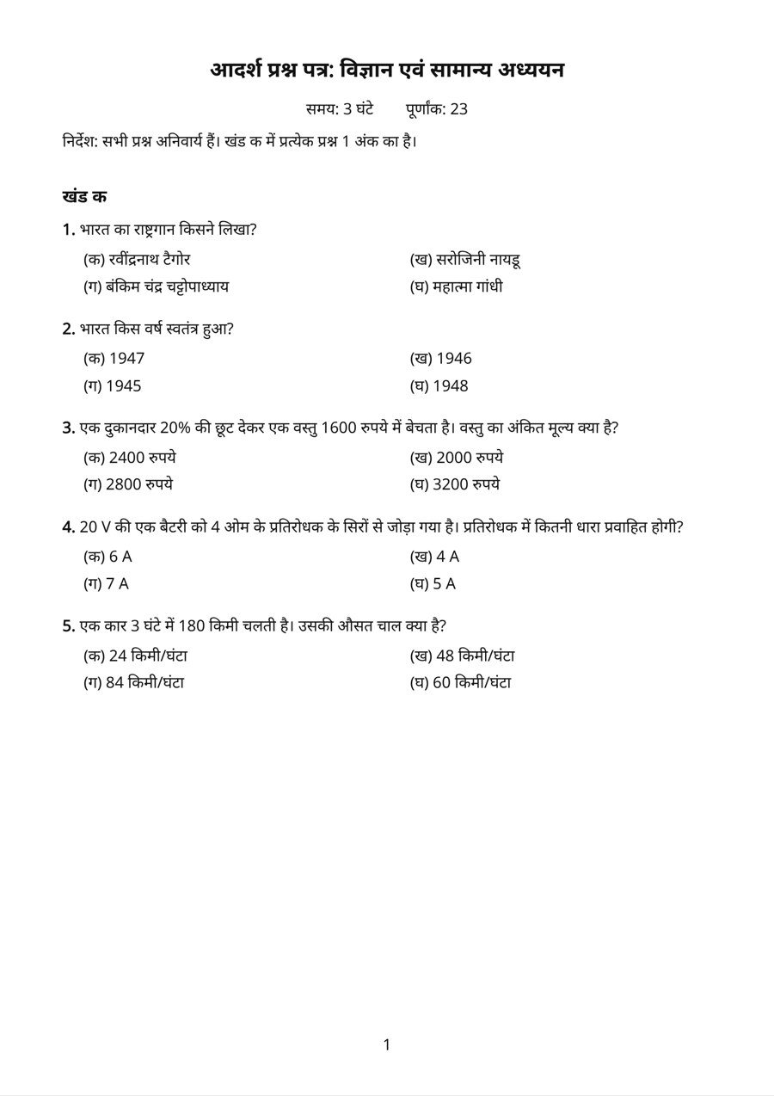
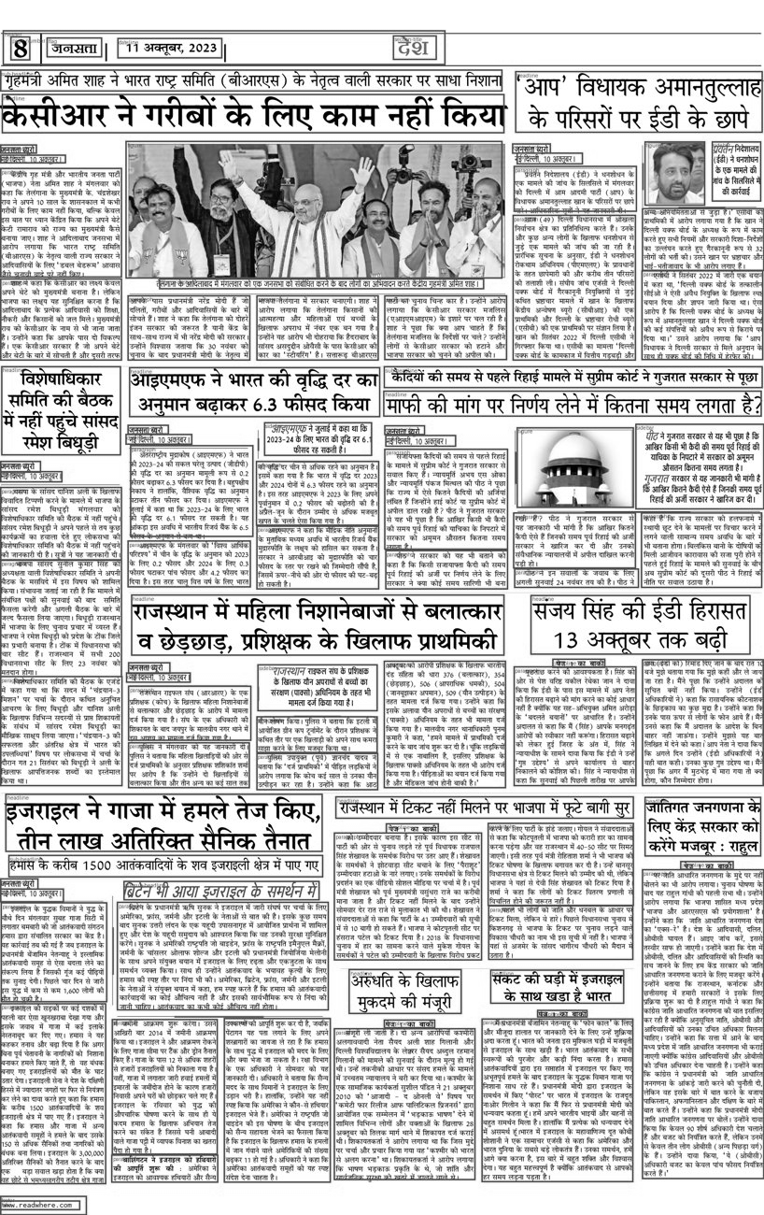
Dataset Description and Pre-processing
Dataset and source: IndicDLP (ICDAR 2025), Hugging Face / AIKosh; 12 languages, 42 labels.
Samples: 3,317 pages, 49,995 boxes, 42 classes.
Split: train 2,293 / val 342 / test 682 pages.
Benchmark: 132 English–Hindi/Tamil paper pairs, 108 with one injected error.
Pre-processing: COCO → YOLO labels, 640 / 1024 px; PDFs at 200 dpi.
Augmentation: mosaic, HSV, scale (YOLO); jitter, blur (R-CNN).
Challenges: class imbalance (paragraph ≈ 32%); no public data of real errors.
English source
Hindi version
IndicDLP page
Actual data used

Slide 9
Deep Learning Model Architecture
Selected: DocLayout-YOLO, 20.0 M params, pretrained on IndicDLP by its authors. Input page image → output boxes with 42 labels. Modified: 42-class heads.
DocLayout-YOLO, 20.0 M (used)
Input
1024² page
Backbone
CSP + GL-CRM
Neck
PAN
Head
NMS-free
Output
42 classes
YOLOv8s, 11.2 M (ours)
Input
640² page
Backbone
CSPDarknet C2f
Neck
PAN-FPN
Head
anchor-free
Output
42 classes
Faster R-CNN, 41.5 M (baseline)
Input
640–1024 px
Backbone
ResNet-50
Neck
FPN
RPN + RoIAlign
proposals
Box head
42 + bg

Slide 10
Tools, Technologies and Environment
Component | Details to report
Programming language | Python 3.11 (ML, checks, app, API); JavaScript (Node) for the benchmark renderer
DL framework | PyTorch 2 with torchvision; Ultralytics 8 (YOLOv8); doclayout-yolo 0.0.4
Development environment | VS Code / terminal, Git + GitHub, pytest (unit tests for every check)
Libraries | pycocotools, OpenCV, Pillow, NumPy, pandas, Matplotlib, PyMuPDF; Tesseract 5 (tessdata_best, 12 scripts); tesseract.js for the benchmark
Hardware | Apple M1 Pro GPU via PyTorch MPS (training, evaluation); CPU container for the benchmark; CPU in Docker
Dataset tools | Hugging Face Hub + fsspec (partial Parquet reads); COCO / YOLO converters; Playwright + Noto fonts to render benchmark papers
Interface / deployment | Streamlit app (Verify Paper tab) + FastAPI (/verify); Docker + docker-compose, offline

Slide 11
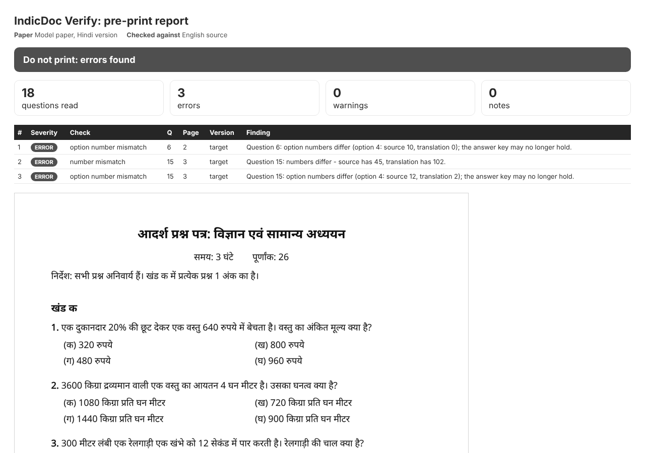
Implementation Details
Built: checker (ml/verify), OCR + number pass, 2 trained detectors, benchmark, app, API.
Data loading: IndicDLP Parquet → COCO; PDFs at 200 dpi.
Model: pretrained DocLayout-YOLO; YOLOv8s, Faster R-CNN fine-tuned.
Loss / optimiser: CIoU + DFL + BCE; SGD lr 0.005, batch 4.
Inference: layout → OCR → questions → checks → report.
Interface: Streamlit tab + POST /verify.
out = predict_single(model, page, "doclayout")
doc = extract_document(page, out, "hin",
number_pass=True)
report = verify(hindi_pages,
source_pages=english_pages)
Report produced by the system

Slide 12
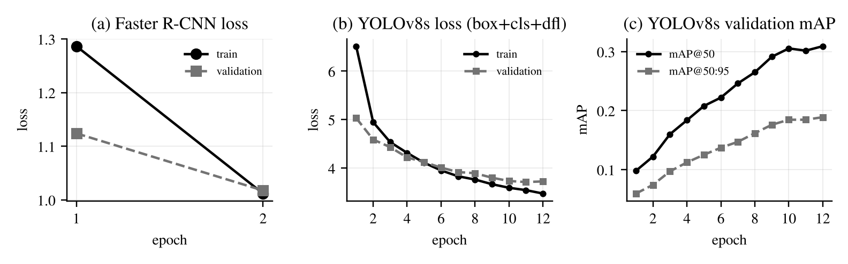
Experimental Setup and Training
Data: train 2,293 / val 342 / test 682; benchmark 132 + 48 dev pairs.
Faster R-CNN: batch 4, SGD 0.005, 2 epochs, 76 min. YOLOv8s: 640 px, batch 8, 12 epochs, 60 min (M1 Pro GPU).
Experiments: layout mAP; robustness to scan damage; verification benchmark; ablations.
Training / validation curves (measured)

Slide 13
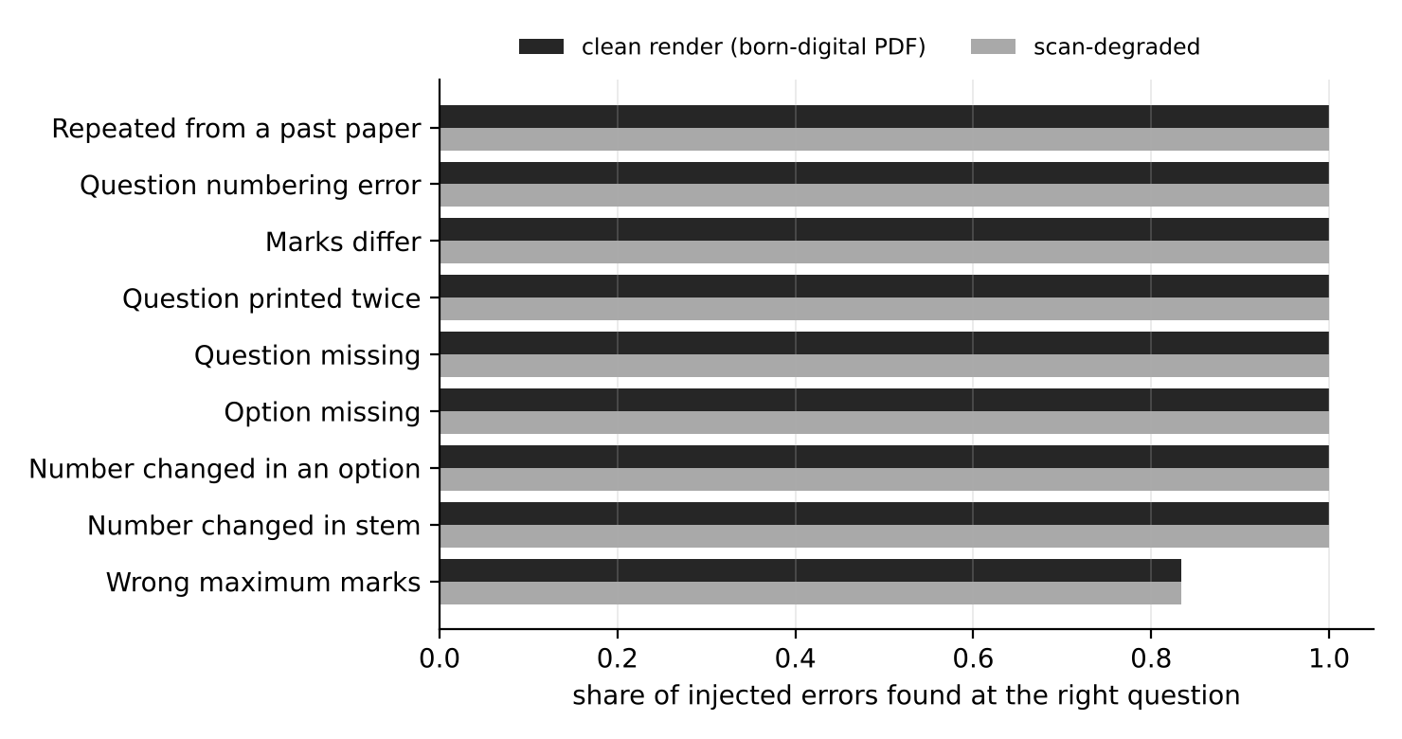
Results and Performance Evaluation
Model | mAP@50 | mAP@50:95 | Precision | Recall | F1
DocLayout-YOLO | 0.759 | 0.575 | 0.848 | 0.775 | 0.810
YOLOv8s (ours) | 0.259 | 0.165 | 0.603 | 0.508 | 0.551
Faster R-CNN (ours) | 0.148 | 0.079 | 0.510 | 0.435 | 0.469
98% of injected errors found at the right question (born-digital); 98% on scans.
3.0 false alarms per clean pair (born-digital).
132/132 papers: every question recovered.
Question labels AP@50: 0.81–0.90.
Errors found per error type

Slide 14
Comparison with Baseline / Existing Methods
Detector | mAP@50 | mAP@50:95
Faster R-CNN (baseline) | 0.148 | 0.079
YOLOv8s (ours) | 0.259 | 0.165
DocLayout-YOLO (used) | 0.759 | 0.575
Existing approach | Checks paper? | Compares versions?
Manual vetting | by hand | by hand
Answer-sheet AI | no | no
MT quality estimation | no structure | sentences
IndicDoc Verify | yes | question by question
Verification | Found | False alarms
Full system | 98% | 4.5
No number pass | 77% | 13.8
No layout options | 98% | 11.5
Noisy layout | 98% | 7.5
Metric: COCO mAP (layout); errors found and false alarms (verification).
Proposed approach improves: YOLOv8s > baseline; number pass is the largest gain.

Slide 15
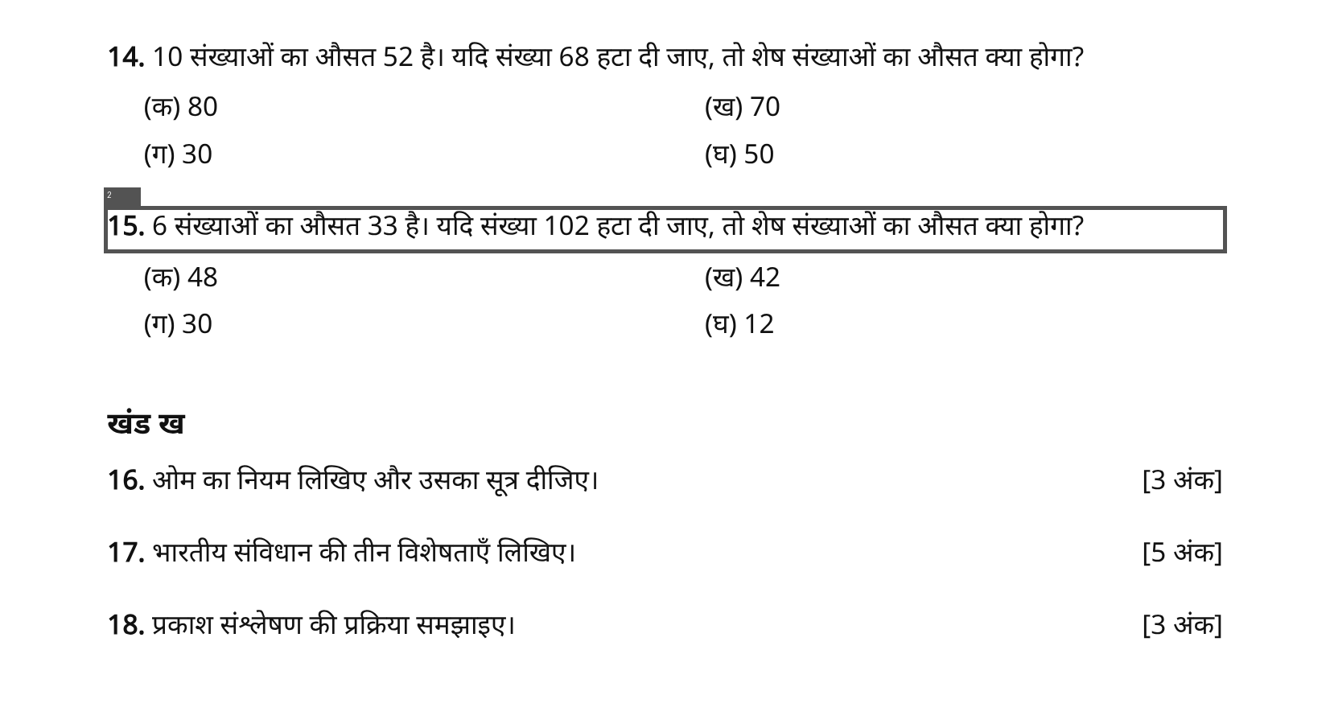
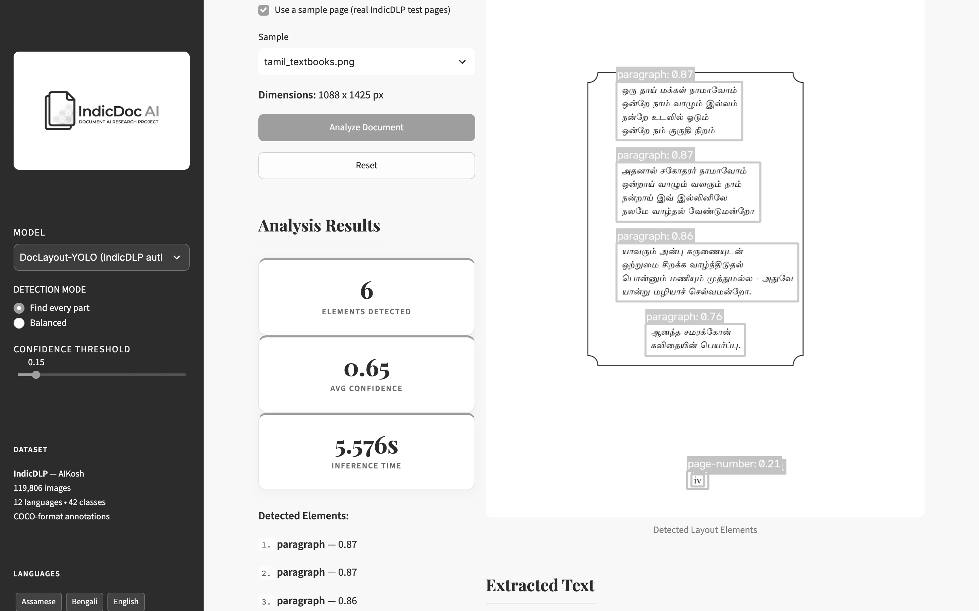
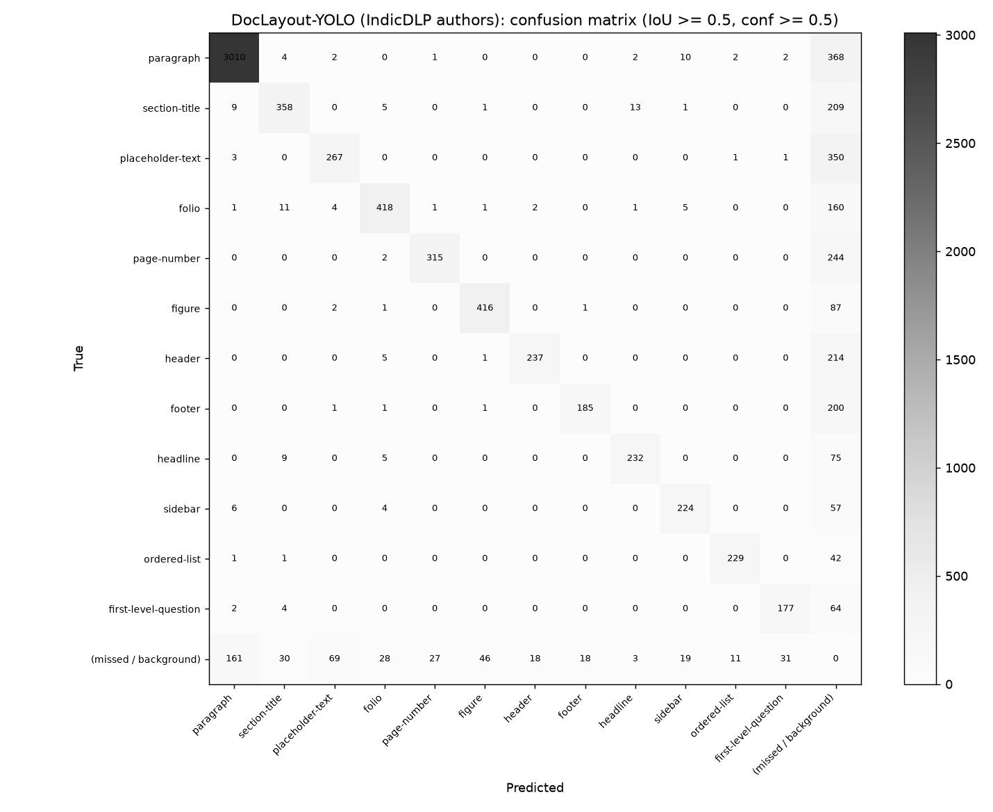
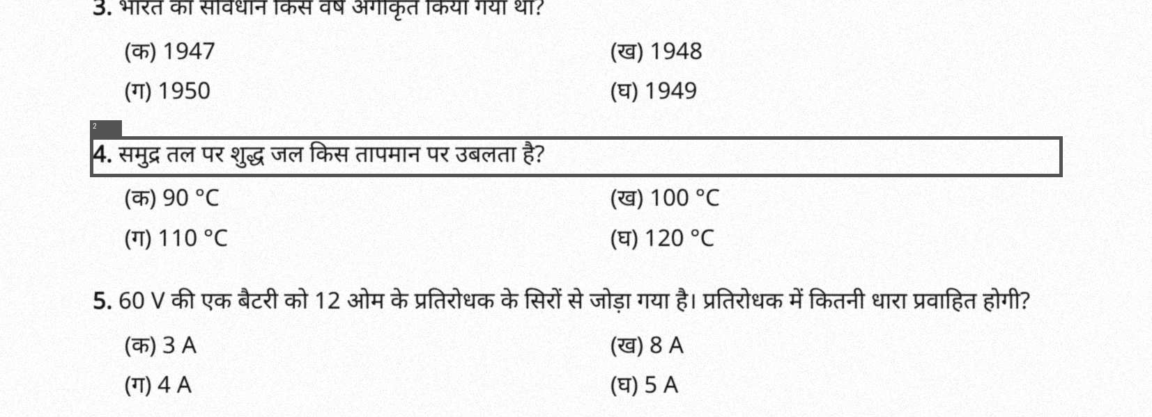
Sample Outputs and Demonstration
Running app (Tamil page)
Confusion matrix
Correct: changed number found and outlined
Incorrect: a false alarm on a degraded scan

Slide 16
Challenges and Limitations
OCR misreads digits in Indic text ("1947" → "947"): solved with the number pass.
No public data of real errors: we built a benchmark with injected errors.
Meaning is not checked yet: a dropped word needs a cross-lingual model.
Limited compute: our detectors trained ~1 hour on 2.3K pages, so the product uses the released model.

Slide 17
Conclusion and Future Scope
Conclusion
Implemented: layout detection, OCR with number pass, checks, report, app, API, Docker.
Results: 98% of errors found; best layout model 0.759 mAP@50.
All four objectives met.
Future scope
Pilot with an exam body on real papers.
Meaning check (cross-lingual model).
Better Indic OCR; answer-key check.
More document profiles (circulars, forms).

Slide 18
References
O. Nath, S. Kukkala, M. Khapra, R. K. Sarvadevabhatla, "IndicDLP: A Foundational Dataset for Multi-Lingual and Multi-Domain Document Layout Parsing," ICDAR 2025.
B. V. Kasuba et al., "PLATTER: A Page-Level Handwritten Text Recognition System for Indic Scripts," arXiv:2502.06172, 2025.
A. Mondal et al., "UniTabBank: A Large Scale Multi-Lingual, Multi-Layout, Multi-Type, Multi-Format Dataset for Table Detection," WACV 2026.
V. Pal, E. Kanoulas, A. Yates, M. de Rijke, "Table Question Answering for Low-resourced Indic Languages," arXiv:2410.03576, 2024.
Y. Xu et al., "LayoutXLM: Multimodal Pre-training for Multilingual Visually-rich Document Understanding," arXiv:2104.08836, 2021.
B. V. Kasuba, P. Chaudhuri, G. Ramakrishnan, "DRISHTIKON: Visual Grounding at Multiple Granularities in Documents," arXiv:2506.21316, 2025.
S. Bhattacharyya et al., "Adapting Vision-Language Models for Hindi OCR," IIIT Hyderabad, 2025.
A. R. Dumada, S. G. Shah, "Incorporate Structure and Content for Devanagari Table Extraction," IJSAT 17(1), 2026.
M. Babayeva, J. Dunlap, M. Snětinová, R. Widenhorn, "Translating the Force Concept Inventory in the Age of AI," arXiv:2508.13908, 2025.
R. Rei et al., "CometKiwi: IST-Unbabel 2022 Submission for the Quality Estimation Shared Task," WMT 2022.
Z. Zhao et al., "DocLayout-YOLO: Enhancing Document Layout Analysis through Diverse Synthetic Data and Global-to-Local Adaptive Perception," arXiv:2410.12628, 2024.
Y. Chen et al., "RoDLA: Benchmarking the Robustness of Document Layout Analysis Models," CVPR 2024.
S. Verma et al., "MILU: A Multi-task Indic Language Understanding Benchmark," NAACL 2025.
G. Jocher, A. Chaurasia, J. Qiu, "Ultralytics YOLOv8," 2023.
J. Ansel et al., "PyTorch 2: Faster Machine Learning Through Dynamic Python Bytecode Transformation and Graph Compilation," ASPLOS 2024.
S. Ren, K. He, R. Girshick, J. Sun, "Faster R-CNN," NeurIPS 2015 (the baseline architecture; the only pre-2021 source).
Other: Dataset: huggingface.co/datasets/ai4bharat/indicdlp (AIKosh); Weights: zenodo.org/records/15881917; Tesseract OCR 5 (tessdata_best), tesseract.js 7; Cases: The News Minute (NEET 2018), Deccan Herald / ETV Bharat (KPSC 2024-25), India Legal (APPSC), The Week / SCC Online (UGC-NET 2026), Medical Dialogues (MBBS 2026); Code: github.com/va-ada/IndicDoc-AI

