Slide 1
Architecture

Slide 2
Architecture OF LINUX
Linux it is composition of kernel, shell and application programs that is software's.
Without the components linux will not complete.
We can see the architecture diagram of Linux its help us to access the Hw, but in sequential mannerly.
In this way we can access the service of Hw

Slide 3
Working of Architecture
Architecture of Linux operating system The architecture of Linux is depends on below components.
APPLICATION PROGRAMS
SHELL
HARDWARE
KERNEL

Slide 4
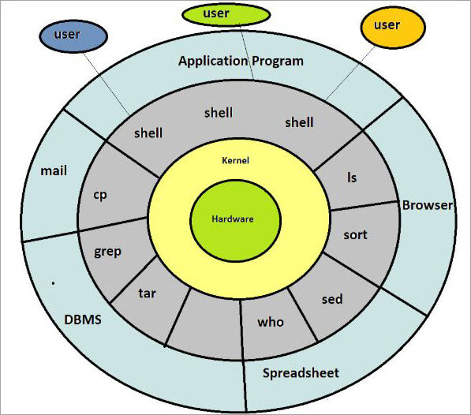

Slide 5
Hardware :-
HHD, RAM, CPU, Keyboard, Mouse, Printer, Scanner etc.
Kernel :-
Kernel is heart of linux os.
Kernel is interact with HW and Shell.
Its provide HW service to shell.
Responsible for memory management, File management ,task scheduling.
Shell :-
1] Shell is interact with user and kernel.
2] Execute the user command kernel.

Slide 6
How Shell works?
When we enter commands through the keyboard, it gathers input from you and executes programs based on that input. When a program finishes executing, it displays that program's output. OR the shell thoroughly examines the keyboard input for special characters. If it finds any, it rebuilds a simplified command-line, and finally communicate with the Kernel to see that the command is executed.

Slide 7
More Info of Kernel
Kernel is core (main) part of Linux operating system.
It is collection of routine communicate with hardware directly.
3. It loads into memory when Linux is booted.
Kernel provides support to user programs through system call.
Kernel manages Computer memory, schedules processes, decides priorities of processes and performs other tasks.
Kernel does lot of work even if no application software is running.

