Slide 1
System Architecture Overview
High-level overview of core distributed components
API Gateway routing and authentication
Microservice mesh communicating over gRPC

Slide 2
Performance Metrics
Service | P99 Latency | Throughput
Auth Service | 12ms | 5,400 QPS
Ingestion Pipeline | 45ms | 22,000 QPS

Slide 3
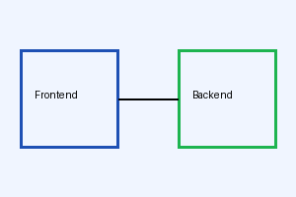
Deployment Workflow
Notes:
Ensure to highlight the sub-50ms latency across all production regions.

