Slide 1
Titanic Survival Prediction
CI345 Machine Learning Final Project
Arsilbhai Salimbhai Vahora Efrain Jacobo Cheikhna Cheikh Sidatte Diop

Slide 2
Problem Statement
Binary Classification Problem
• Predict if a passenger survived the Titanic disaster (yes/no)
• Key features: sex, age, passenger Class
• Historical dataset with social & economic insights
• Goal: Build accurate classification models and gain meaningful insights

Slide 3
Dataset Overview
• 1,309 passengers (rows)
• 5 columns: names, survived (target), sex, age, passenger Class
• Missing values: ~263 in age (~20%)
• Target distribution: ~38% survived (imbalanced)
• Data types: 1 numeric, 3 categorical

Slide 4
DA Findings
Key Insights:
• Females: ~74% survival rate vs ~19% for males
• 1st class passengers had significantly higher survival
• Children & women are prioritized ("women and children first")
• Sex and passenger Class are the strongest predictors

Slide 5
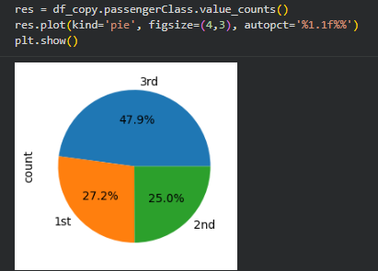
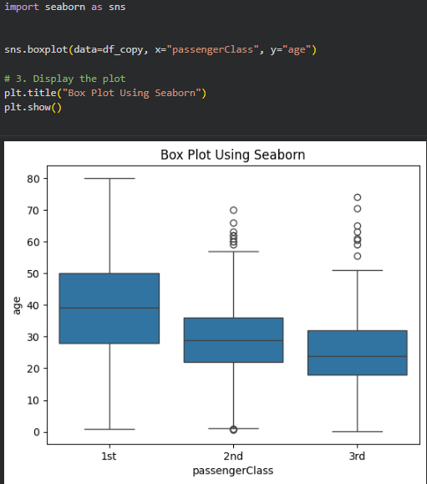
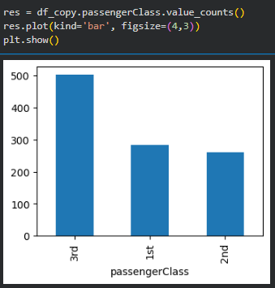
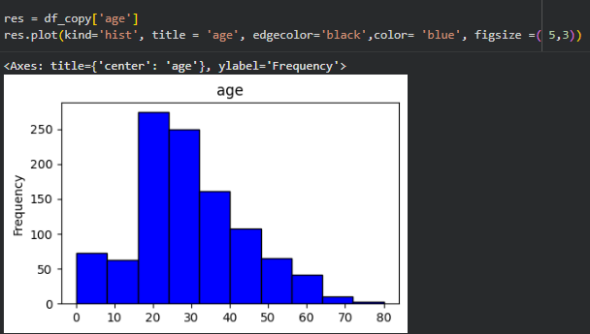
Visualizations
Important Visualizations:
Survival Rate by Passenger Class (Pie Chart)
Survival Rate by Passenger Class (Bar Chart)
Age Frequency (Histogram)
Age Distribution by Passenger Class(Box plot)

Slide 6
Data Preprocessing
• Dropped irrelevant "names" column
• Label Encoding: sex (male=0, female=1)
• Label Encoding: passengerClass
• Median imputation for missing age values
• Train-test split (70/30)

Slide 7
Classifiers
3 Classification Algorithms:
1. K-Nearest Neighbors (KNN) - k= 3,5,7
Tested with k = 3, k = 5, and k = 7
Best result with k = 5 (Accuracy ≈ 74%)
2. Decision Tree Classifier
Used default parameters with random state being 42
3. Linear Discriminant Analysis (LDA)

Slide 8
Results
Model Performance:
• KNN (k=5): Accuracy ≈ 74%
• Decision Tree: Accuracy ≈ 73%
• LDA: Accuracy ≈ 72%
More information about the classification reports & confusion matrices are available in the code

Slide 9
Comparison
Model Comparison Table:
Model | Accuracy | Precision | Recall | F1
--------------- |--------------|-------------|---------|----
KNN | 0.74 | ~0.74 | ~0.73 | ~0.73
Decision Tree | 0.73 | ~0.73 | ~0.72 | ~0.72
LDA | 0.72 | ~0.71 | ~0.71 | ~0.71
KNN had best results overall

Slide 10
Conclusions
• Sex and passenger class are shown to be key survival factors
• The classification models successfully captured historical patterns
• This aligns with known Titanic history ("women and children first")
• Future work: Ensemble methods, additional features
• Thank You! Questions?

