Slide 1
CardioTriage AI
Machine Learning Phase — Detailed Walkthrough
From raw cardiac records to a deployed risk-and-phenotype engine (Steps A1–A8)
920
3
0.91
0.96
patients
models compared
ROC-AUC
recall (tuned)
BS Artificial Intelligence · Combined Assessment (Intro to AI + Machine Learning)

Slide 2
CONTEXT
Where the Machine Learning Phase Fits
1 · Data & ML
ML risk engine — predicts per-patient risk probability + phenotype
This deck covers Layer 1
Phase A builds the ML risk engine — Steps A1–A8.
Its outputs (risk probability + phenotype) become the inputs every layer above consumes.
The LLM never makes a medical call alone — it coordinates deterministic tools.
2 · Classical AI core
A* search · CSP allocator · forward-chaining knowledge base
3 · Orchestration
Gemini + LangChain agent — decides which tool to call & explains
4 · Presentation
Interactive web triage board (ranking, paths, allocations)
CardioTriage AI · Machine Learning Phase
2

Slide 3
DATA
The Dataset — UCI Heart Disease (combined)
920 patients × 16 clinical columns.
Pooled from four hospitals (multi-site).
Target 'num' (0–4) → binarized: 0 = no disease, 1–4 = disease.
Contains real missing values — handled honestly, not dropped.
Outcome balance
304
293
Cleveland records
Hungary records
200
123
VA Long Beach records
Switzerland records
CardioTriage AI · Machine Learning Phase
3

Slide 4
ROADMAP
Eight Steps, One Pipeline
A1
Inspect
A2
Preprocess
A3
Explore
A4
Baseline
shape, types, missingness
clean · encode · scale · split
EDA: what separates sick
Logistic Regression
A5
Compare
A6
Tune
A7
Cluster
A8
Save
RF & Gradient Boosting
bias-variance · reg · threshold
K-means risk phenotypes
persist + bridge to AI
CardioTriage AI · Machine Learning Phase
4

Slide 5
STEP A1
Load & Inspect the Data
Read the CSV into a pandas DataFrame — change nothing yet.
Confirmed 920 rows × 16 columns; identified each column's meaning & type.
Target distribution: 411 healthy vs 509 diseased (after binarizing).
Surfaced the missing-value map (right) — the central challenge.
Missing values by column (%)
Key finding
ca (66%) and thal (53%) are missing for over half of patients — too valuable to drop, too sparse to ignore. This drove the A2 strategy.
CardioTriage AI · Machine Learning Phase
5

Slide 6
STEP A2
Preprocessing — Leakage-Safe Pipeline
Binarize target: num 1–4 → 1 (disease present).
Drop id (row number) and dataset (hospital — a confound).
Fix hidden missingness: chol = 0 is impossible → 172 cases set to missing.
Add ca_missing / thal_missing flags so the model knows a value was estimated.
Median/mode impute · one-hot encode · standardize — all inside one Pipeline.
Fit on TRAIN only, apply to TEST → no information leaks across the split.
736 / 184
0.553 / 0.554
stratified train / test
disease rate · train vs test
15 → 27
0
features after encoding
missing values remaining
Why leakage matters
If fill-values or scales were learned from the whole dataset, the test score would be inflated and dishonest.
CardioTriage AI · Machine Learning Phase
6

Slide 7
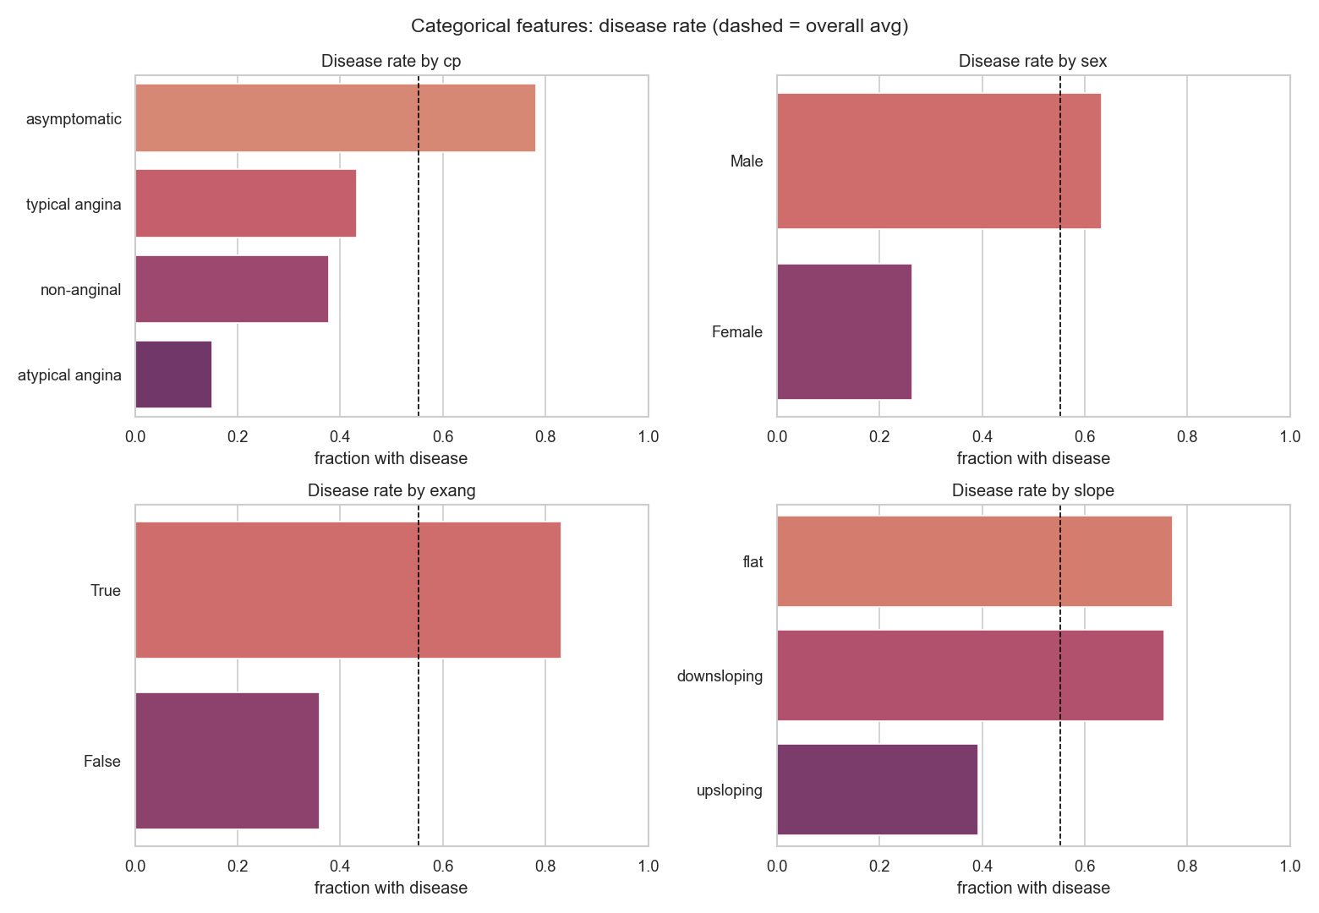
STEP A3
Exploratory Analysis — What Separates Sick from Healthy
Mean value by outcome (training set)
Feature | Disease | Healthy | Signal
thalch (max HR) | 128.2 | 149.1 | strong
oldpeak | 1.3 | 0.4 | strong
ca (vessels) | 1.1 | 0.2 | strong
age | 56.2 | 50.4 | moderate
chol | 254 | 240 | weak
trestbps | 134 | 130 | weak
Silent danger
Asymptomatic chest pain shows the HIGHEST disease rate (78%) — the 'silent' group screening can miss.
CardioTriage AI · Machine Learning Phase
7

Slide 8
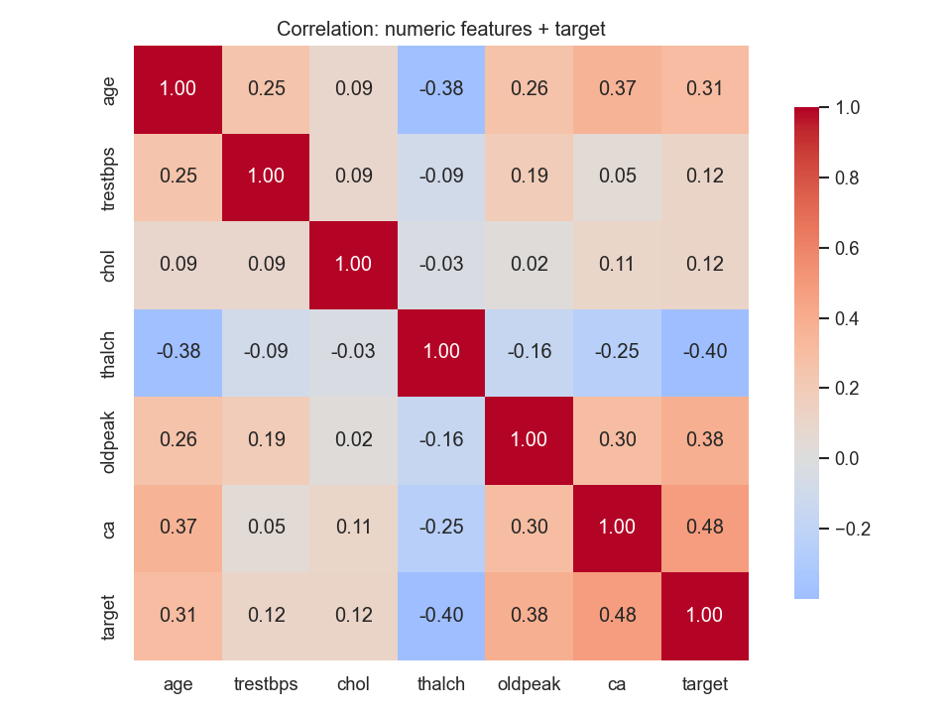
STEP A3
Feature Correlation with Disease
Strength of link with disease
ca, thalch, oldpeak, age are the strongest signals.
chol & BP correlate weakly — famous ≠ predictive.
No pair exceeds 0.38 → low multicollinearity (good for the baseline).
CardioTriage AI · Machine Learning Phase
8

Slide 9
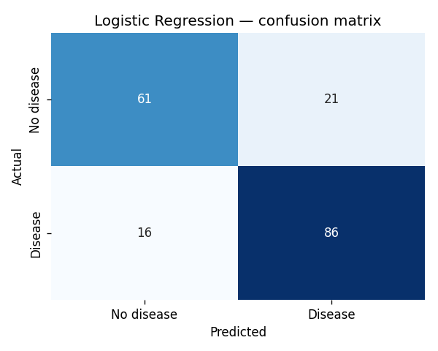
STEP A4
Baseline Model — Logistic Regression
0.799
0.804
Accuracy
Precision
0.843
0.744
Recall
Specificity
0.823
0.897
F1
ROC-AUC
Read it clinically
Caught 86 of 102 sick patients; 16 missed cases (false negatives) are the target for tuning. Train 0.836 vs test 0.799 → small gap, a healthy baseline.
CardioTriage AI · Machine Learning Phase
9

Slide 10
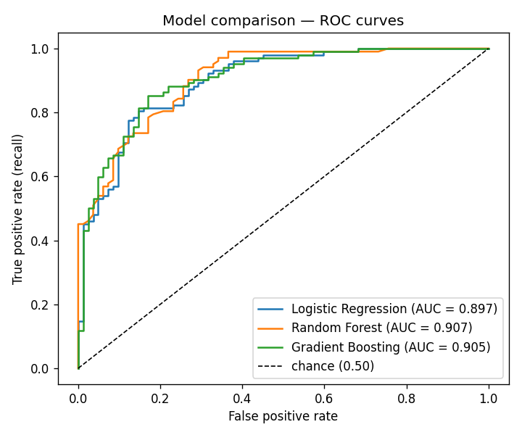
STEP A5
Three Models Compared
Model | Acc | Recall | Spec | F1 | AUC | Train
Logistic Regression | 0.799 | 0.843 | 0.744 | 0.823 | 0.897 | 0.836
Random Forest | 0.810 | 0.863 | 0.744 | 0.834 | 0.907 | 1.000
Gradient Boosting ✓ | 0.821 | 0.892 | 0.732 | 0.847 | 0.905 | 0.916
ROC curves
Both ensembles beat the baseline — real non-linear interactions exist.
Random Forest hit a perfect 1.000 on training → clear overfitting.
Winner: Gradient Boosting — best recall (0.892), F1 and accuracy; AUC tied for top.
CardioTriage AI · Machine Learning Phase
10

Slide 11
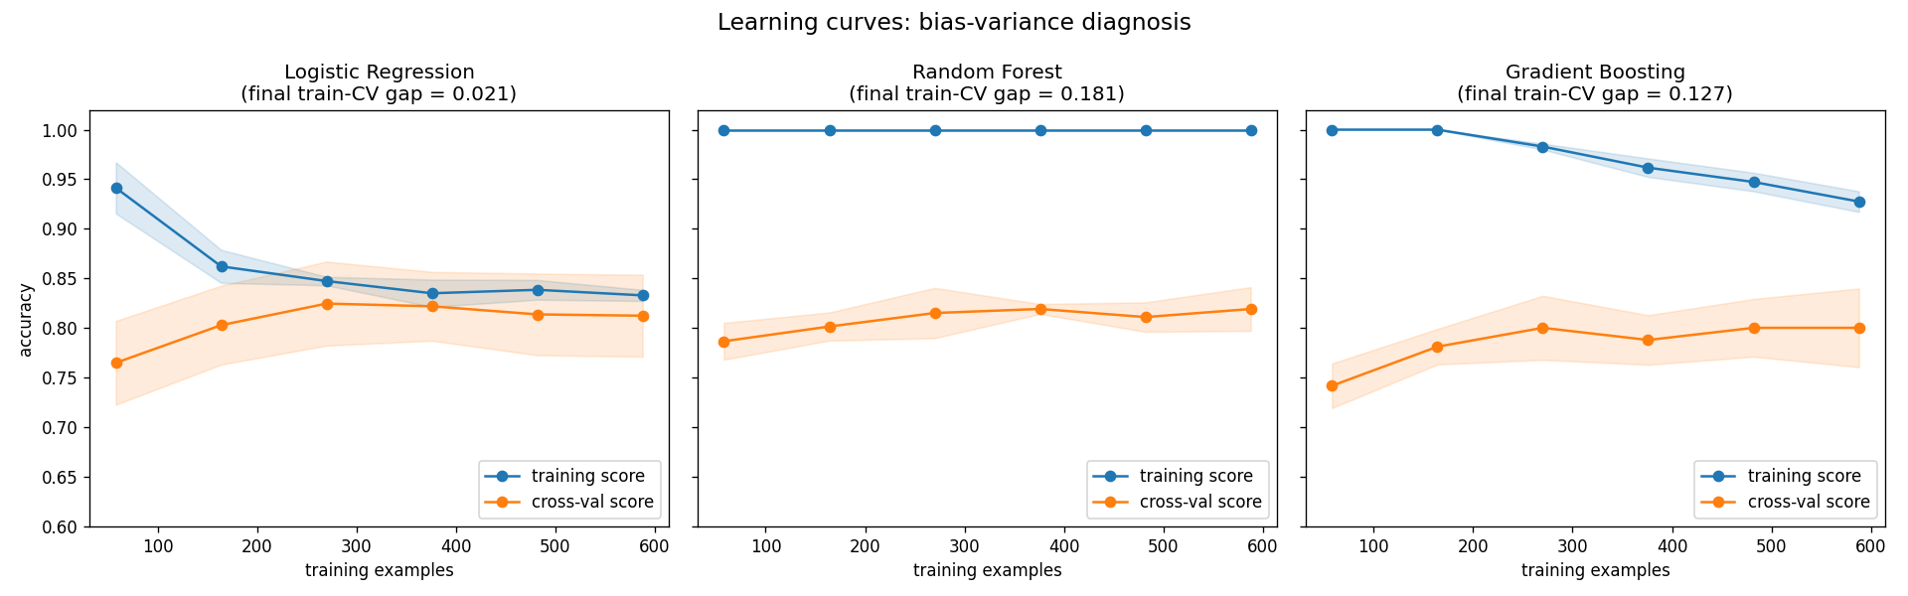
STEP A6a
Bias–Variance Diagnosis (Learning Curves)
Logistic Regression
Random Forest
Gradient Boosting
gap 0.021
gap 0.181
gap 0.127
Mild bias, low variance — curves meet; more data won't help.
Severe overfitting — train pinned at 1.000 while CV lags.
Moderate, still converging — regularization should help.
CardioTriage AI · Machine Learning Phase
11

Slide 12
STEP A6b
Regularization — Shrinking the Variance Gap
Train–CV accuracy gap: before vs after
Random Forest: gap crushed 0.189 → 0.040 (depth & leaf limits).
Gradient Boosting: gap halved 0.124 → 0.074 — and CV accuracy rose.
Logistic Regression is bias-limited: regularization couldn't help it.
L1 (lasso) drove 11 of 27 coefficients to exactly zero — automatic feature selection.
The lesson
The cure depends on the diagnosis: high variance → constrain complexity; high bias → add capacity.
CardioTriage AI · Machine Learning Phase
12

Slide 13
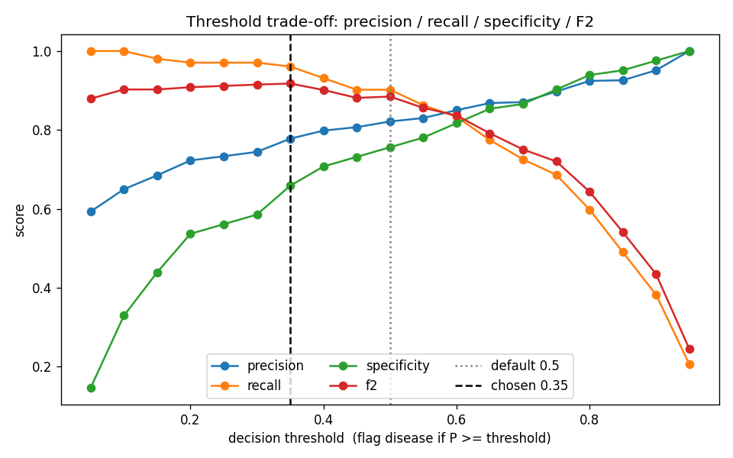
STEP A6c
Threshold Tuning — Prioritizing Recall
Default 0.50 vs tuned 0.35
Metric | 0.50 | 0.35
Missed cases (FN) | 10 | 4
Recall | 0.902 | 0.961
Precision | 0.821 | 0.778
Specificity | 0.756 | 0.659
−60%
Why lower?
A missed heart disease ≫ a false alarm. We accept 8 extra alarms to catch 6 more real cases.
missed cases
CardioTriage AI · Machine Learning Phase
13

Slide 14
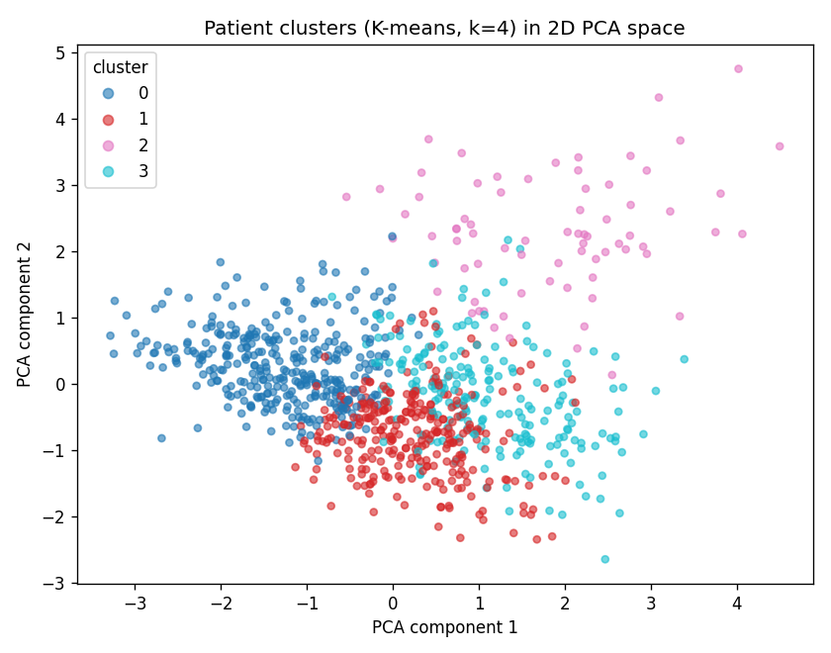
STEP A7
Risk Phenotypes — K-means (k = 4)
Pri | n | Disease | Phenotype
1 | 74 | 0.84 | Advanced multi-vessel disease
2 | 211 | 0.74 | Hypertensive-hypercholesterolemic
3 | 292 | 0.66 | Reduced-exertion / low max-HR
4 | 343 | 0.28 | Younger lower-risk
Clusters in 2D (PCA view)
Unsupervised: target hidden during fitting, used only to interpret.
Chose k=4 for clinical granularity (silhouette was flat) — a transparent judgment call.
Each phenotype gives the AI agent a priority hint beyond raw probability.
CardioTriage AI · Machine Learning Phase
14

Slide 15
STEP A8
Persist & Bridge to the AI Phase
Saved artifacts (models/)
model_api.assess(patient)
risk_model.joblib — regularized Gradient Boosting pipeline (refit on all 920).
phenotype_model.joblib — K-means impute+scale+cluster.
metadata.json — threshold 0.35, feature list, phenotype map, test metrics.
HIGH-risk patient
probability : 0.976 → high-risk
phenotype : Advanced multi-vessel (priority 1)
LOW-risk patient
probability : 0.013 → cleared
phenotype : Younger lower-risk (priority 4)
0.961
0.908
0.826
Recall
ROC-AUC
Accuracy
Held-out test metrics @ threshold 0.35
One clean call returns risk + phenotype — the launchpad for Phase B.
CardioTriage AI · Machine Learning Phase
15

Slide 16
RESULTS
Phase A — Headline Results
0.908
0.961
4 / 102
4
ROC-AUC
Recall (tuned)
Missed cases
Risk phenotypes
Recall across models
What we delivered
Best model: regularized Gradient Boosting.
Full leakage-safe pipeline, reused across every step.
Tuned for safety: only 4 missed cases out of 102.
Four interpretable phenotypes to guide triage.
One-call interface bridging ML → AI.
CardioTriage AI · Machine Learning Phase
16

Slide 17
RIGOR
Beyond the Baseline — Did We Leave Accuracy on the Table?
Three independent attempts to beat Gradient Boosting, all cross-validated
Approach | CV AUC | Test AUC | Test Acc | Test Recall | Outcome
Gradient Boosting (chosen) ✓ | 0.875 | 0.908 | 0.826 | 0.961 | baseline
+ Hyperparameter search (+ KNN) | 0.882 | 0.910 | 0.815 | 0.961 | AUC ↑ = noise
+ Feature engineering | 0.876 | 0.913 | 0.837 | 0.961 | best test acc, CV flat
+ Neural network (MLP) | 0.885 | 0.898 | 0.832 | 0.941 | recall ↓, no gain
One ceiling, confirmed three ways
Every approach lands in the same 0.82–0.84 accuracy / ~0.90 AUC band. Where a single test split looked better (feature engineering, 0.837), 5-fold cross-validation did NOT confirm it — the tell-tale sign of noise, not signal. We kept Gradient Boosting for its best held-out recall and AUC, the metrics that matter for triage.
CardioTriage AI · Machine Learning Phase
17

Slide 18
EDGE
Why This Project Has a Clear Edge
Cross-validated AUC is flat across every method
What sets this work apart
Benchmarked 6 approaches — 3 model families + tuning + engineered features + a neural net. Most projects stop at one.
Used cross-validation to reject test-set noise — refused to chase a fragile 0.837 accuracy.
Proved the data's ceiling with evidence, not assumption.
Optimized recall (clinical safety) over vanity accuracy.
Leakage-safe pipeline end-to-end; fully reproducible.
Examiners reward understanding WHY, not just HOW — this project shows both.
CardioTriage AI · Machine Learning Phase
18

Slide 19
Machine Learning Phase: Complete
A trained, evaluated, deployable cardiac-risk engine.
Inspected, cleaned, and encoded 920 records — leakage-safe.
Compared three models; chose Gradient Boosting on recall & AUC.
Diagnosed bias/variance, regularized, and tuned the threshold for safety.
Discovered four clinical risk phenotypes with K-means.
Saved the model and exposed assess(patient) for the AI phase.
Next
Say “start the AI phase” to build A* search, the CSP allocator, the knowledge base, and the Gemini + LangChain agent — all on top of assess().
CardioTriage AI · BSAI Combined Assessment

