Slide 1
PYNQ DPU Overlay on KRIA for AI Inference

Slide 2
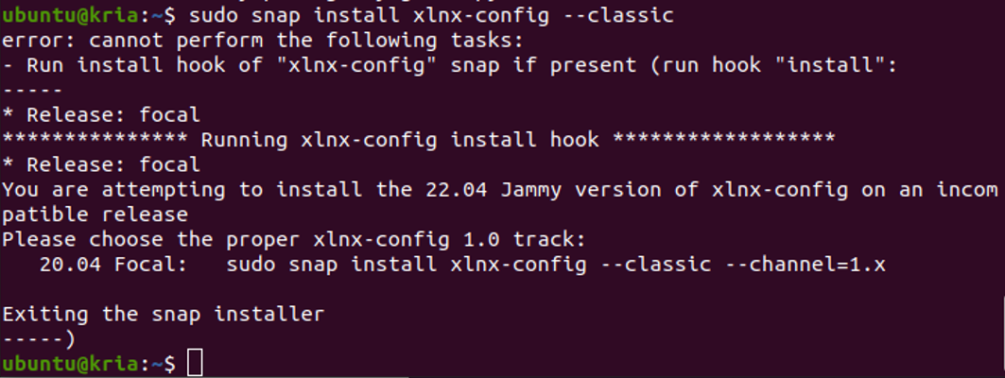
Install PYNQ-DPU Overlay
KV260
Download Ubuntu 20.04 and put it in SDcard through balenaetcher
Boot Ubuntu 20.04 from KV260
Update Ubuntu package
sudo apt update
sudo apt upgrade
Install Xilinx system management snap package ---> sudo snap install xlnx-config --classic –channel=1.x

Slide 3
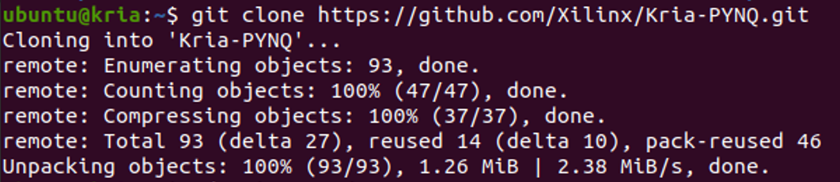
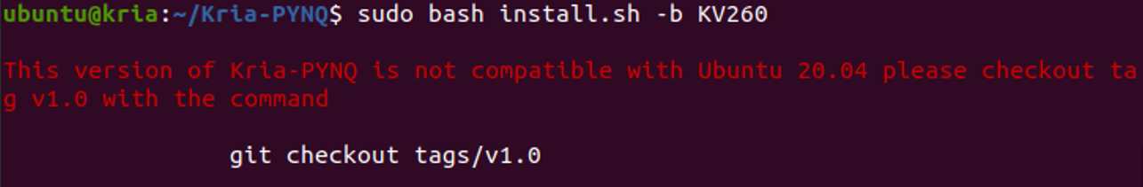
Install PYNQ-DPU Overlay
KV260
Download the full package from Xilinx Kria-PYNQ github
Install PYNQ package

Slide 4
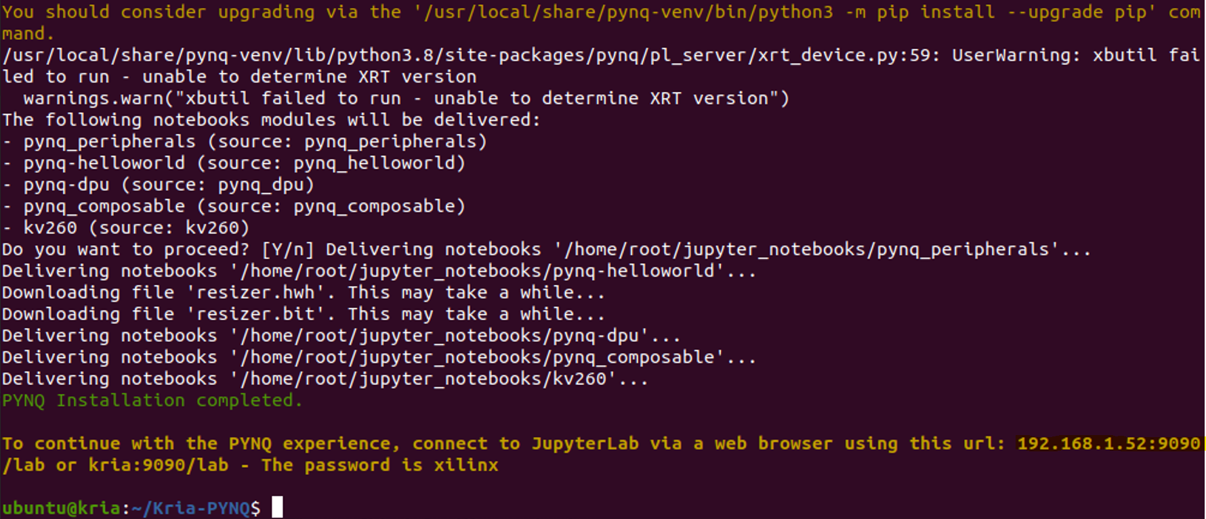
Install PYNQ-DPU Overlay
KV260
PYNQ-DPU has been installed successfully

Slide 5
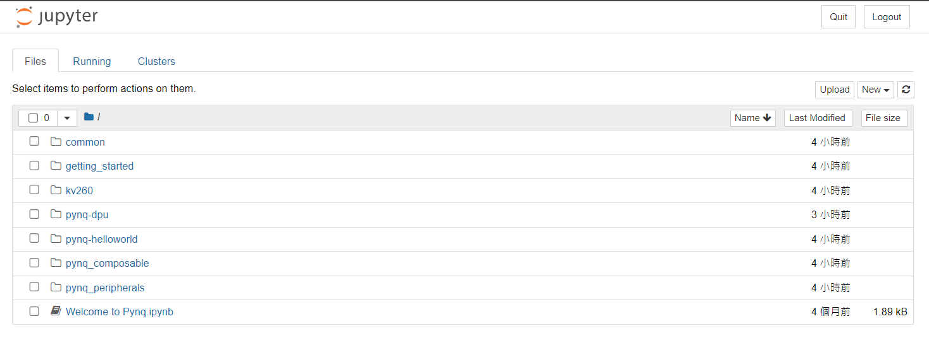
Install PYNQ-DPU Overlay
KV260
Open Jupyter notebook on web browser

Slide 6
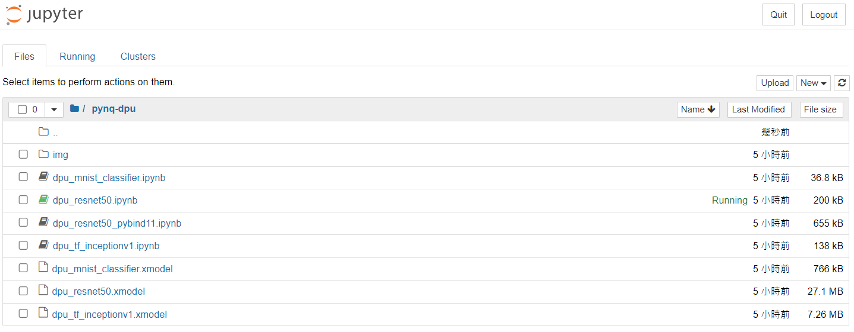
PYNQ-DPU Quick Start

Slide 7
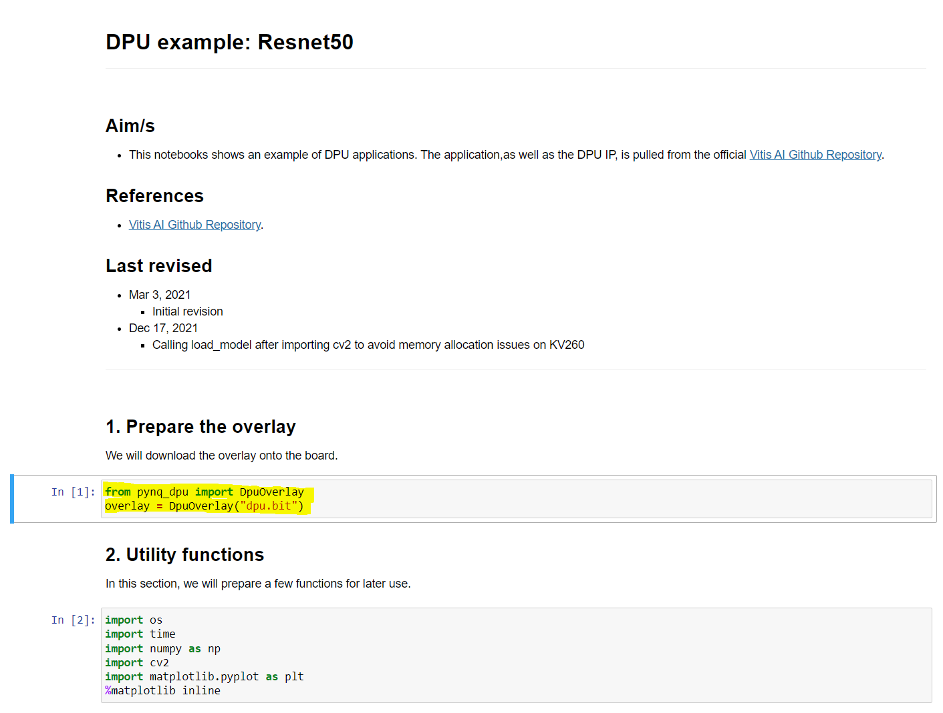
PYNQ-DPU Quick Start
dpu_resnet50.ipynb

Slide 8
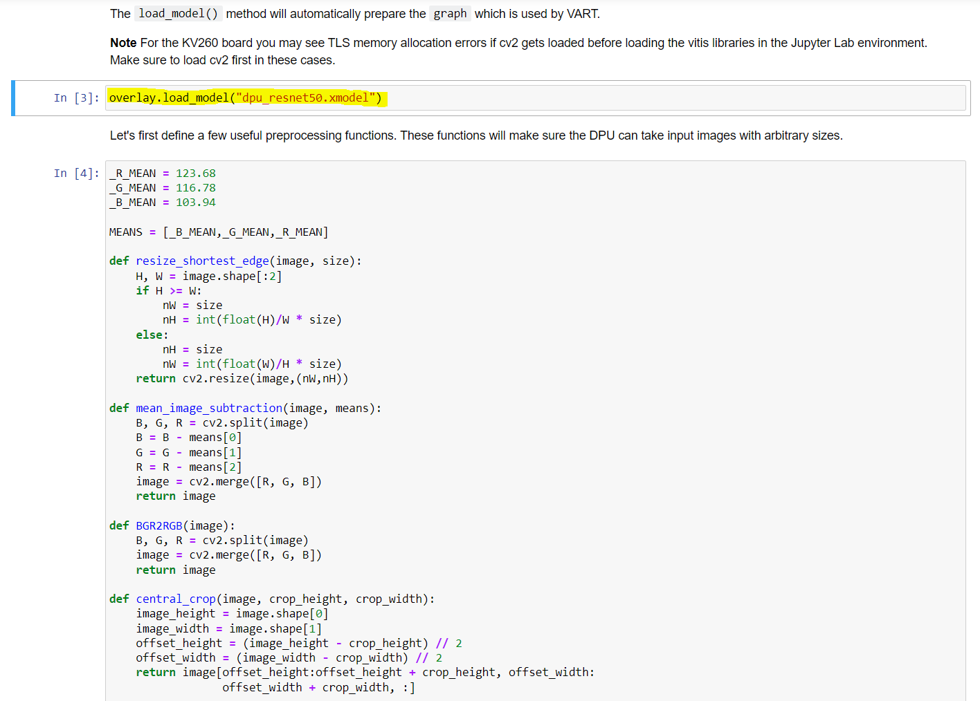
PYNQ-DPU Quick Start
dpu_resnet50.ipynb

Slide 9
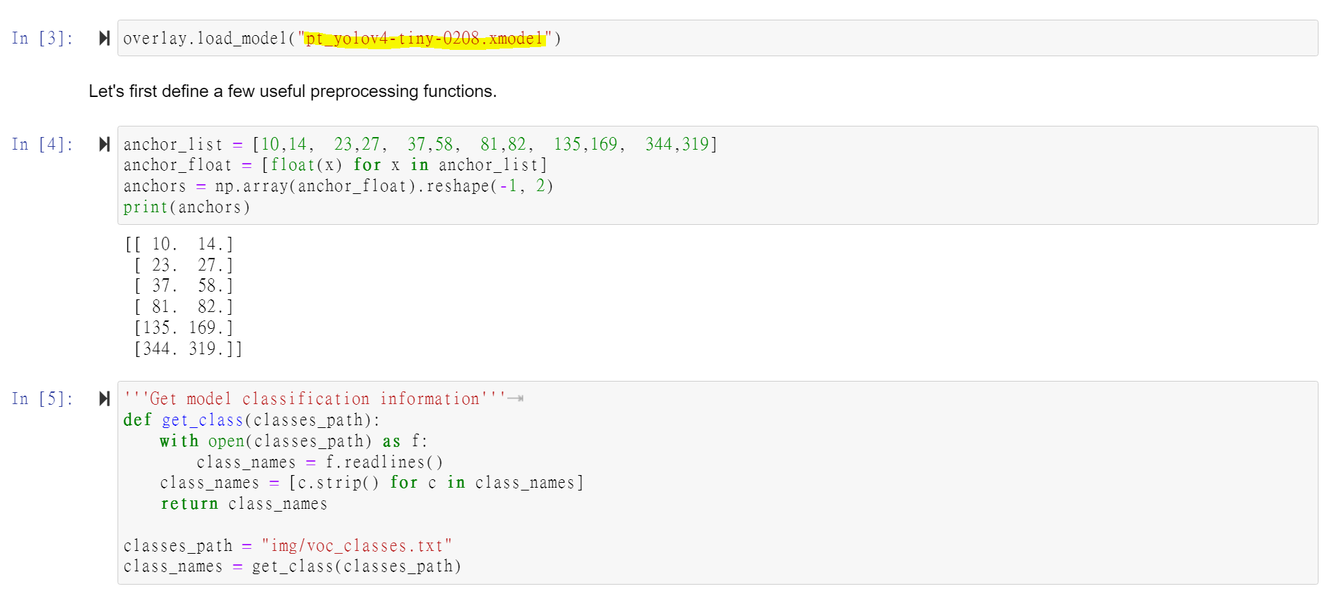
PYNQ-DPU Quick Start
Custom Model－YoloV4-tiny

Slide 10
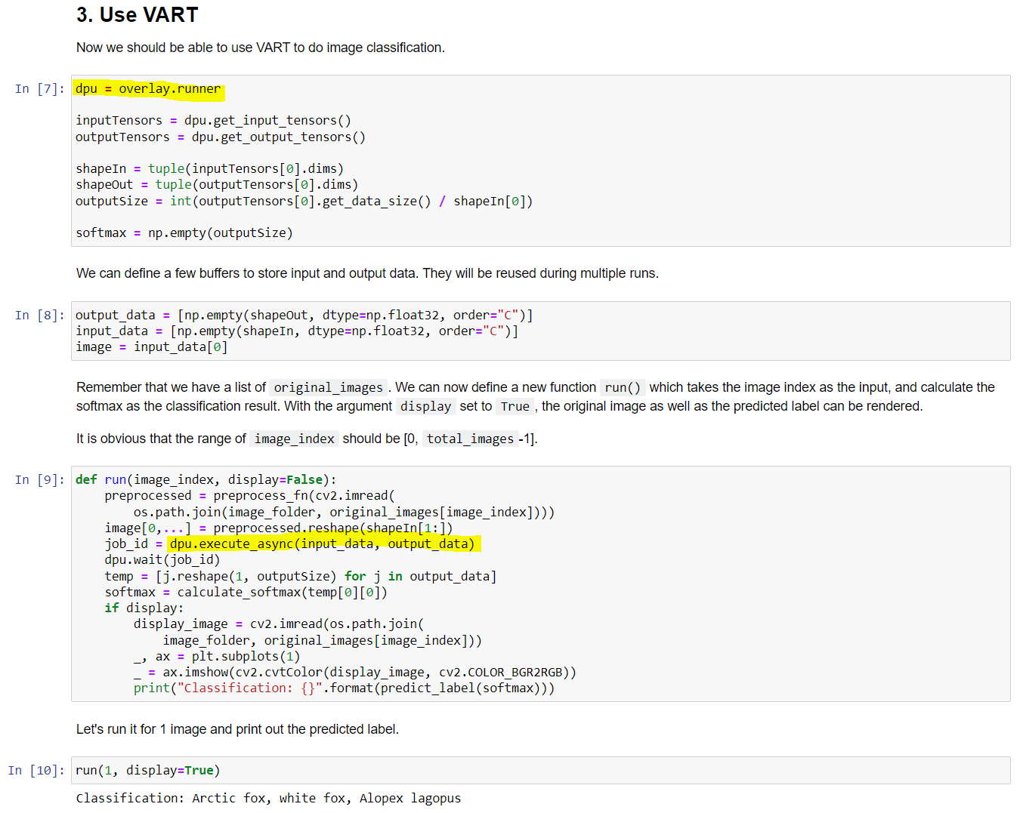
PYNQ-DPU Quick Start
dpu_resnet50.ipynb

Slide 11
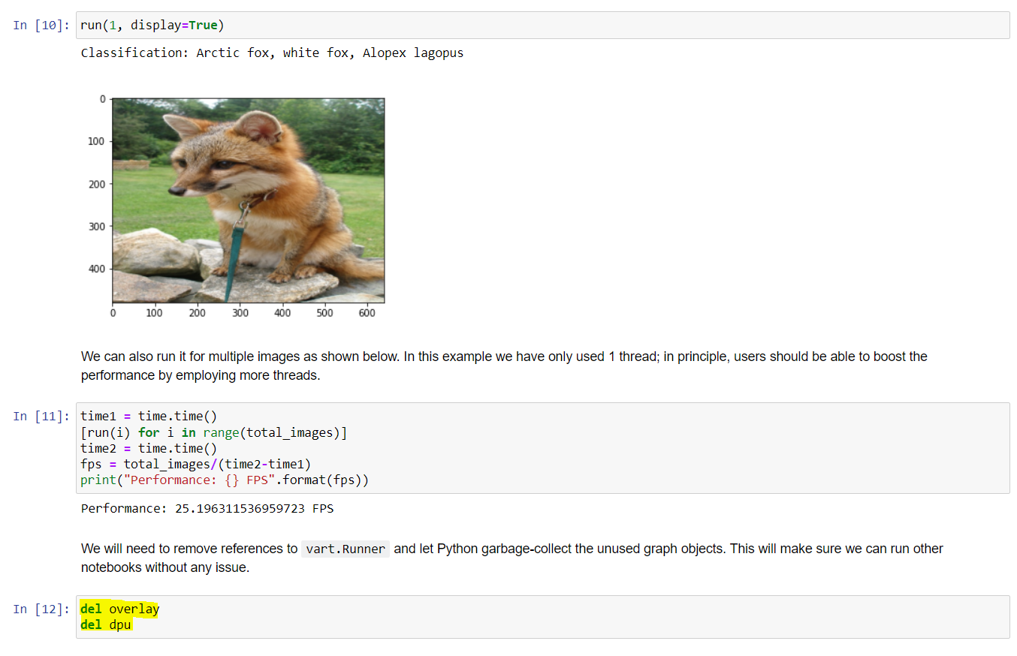
PYNQ-DPU Quick Start
dpu_resnet50.ipynb
Result

Slide 12
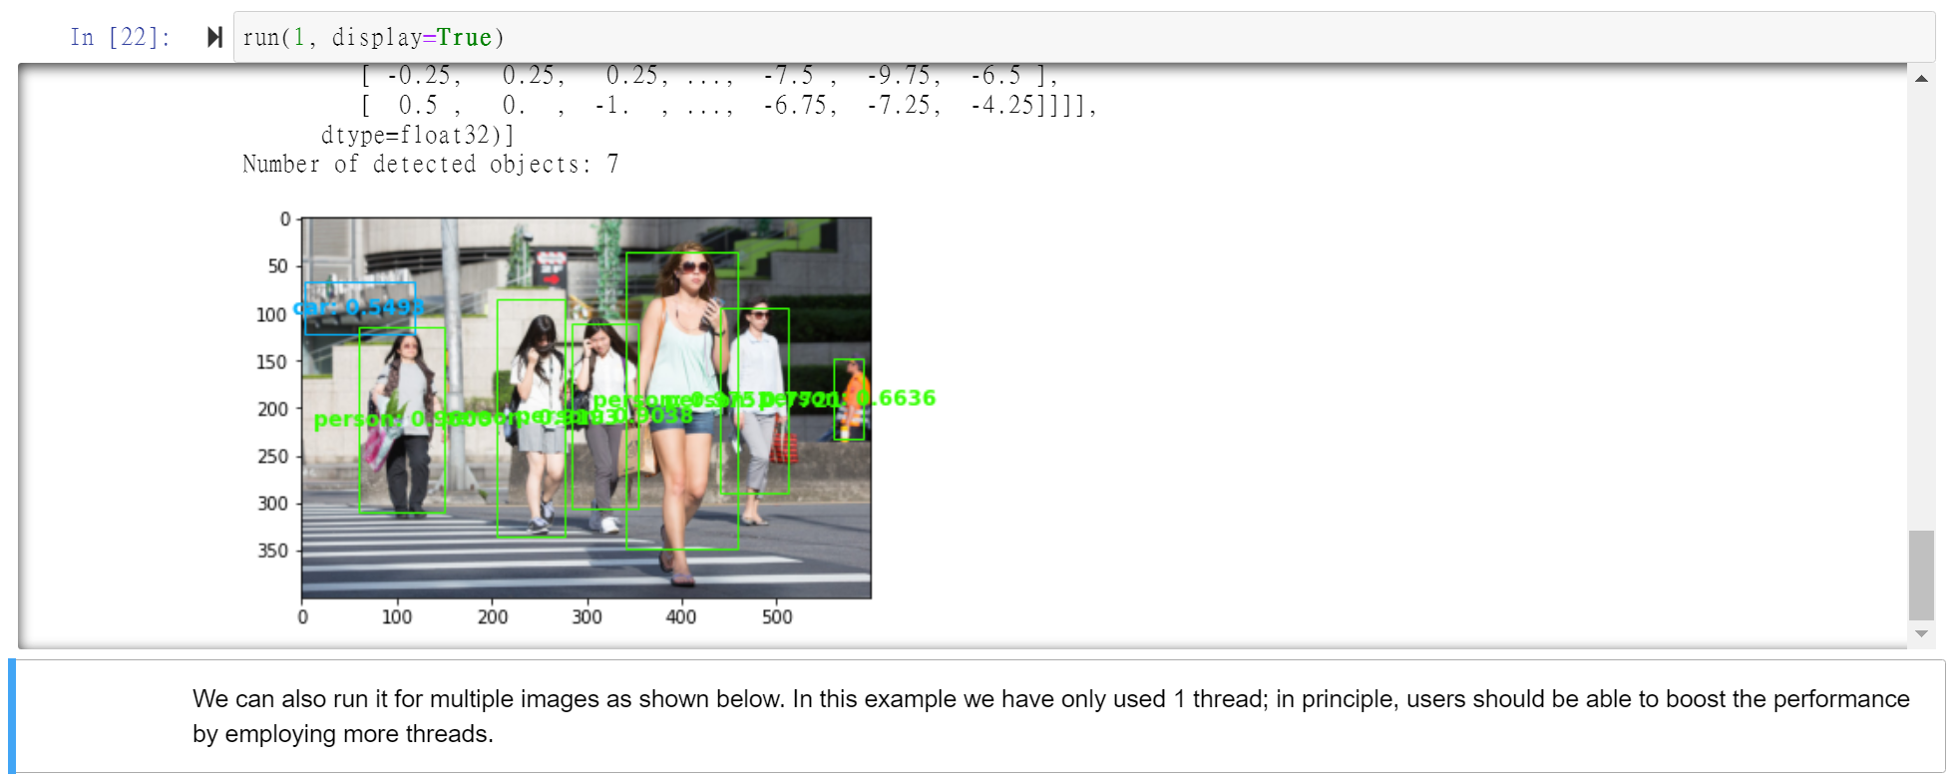
PYNQ-DPU Quick Start
Custom Model Result－YoloV4-tiny

Slide 13
Thank you very much for your attention!

