Slide 1

Network Monitoring Project
Asadullah M Syed
Prathyusha Pateel
Vaani Radhakrishnan

Slide 2
Introduction
Background: A network operator is interested in allocating pressure sensors on nodes to detect pipe bursts in its water distribution network
Objective: Mitigating security risks in a water distribution network through strategic placement of sensors
Network in Kentucky:
Composition: 1123 pipes, 811 nodes
Daily Capacity: 2.09 million gallons, serving 5,010 customers
Detection Matrix : Binary matrix F of size 1123 X 811, where each element Fe,v signifies whether a sensor at node v can detect a burst in pipe e.

Slide 3
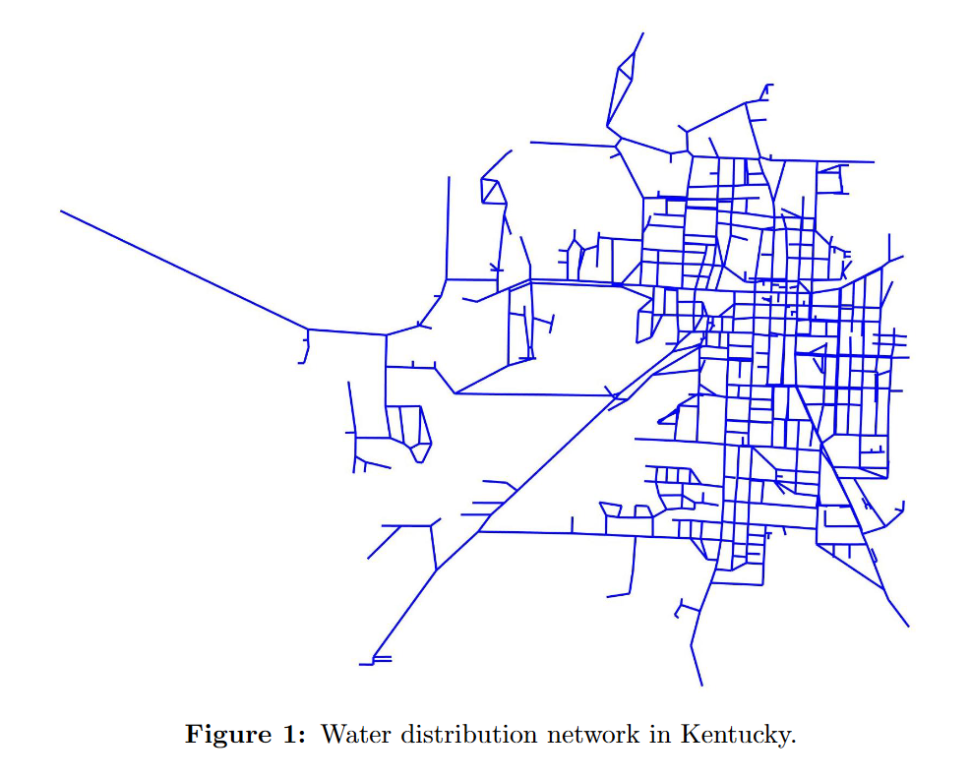

Slide 4
Problem 1: Identify the minimum number of sensors and their locations to ensure that if a pipe bursts, at least one sensor will detect it

Slide 5


Decision Variables:
We define a binary variable -
states if a sensor is placed at node v or not.
Objective Function for Integer Program:
Minimizing the number of sensors used -
Constraints:
There must be at least one sensor to detect if a pipe bursts. We represent this as: sum product of detection capability with sensor location must be greater than 1 -

Slide 6

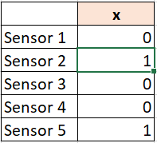
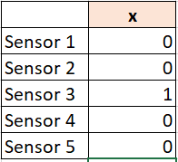
Example:
= (1*0) + (1*1) + (0*0) + (0*0) + (1*1) = 2
= (1*0) + (1*0) + (0*1) + (0*0) + (1*0) = 0
Results:​
By solving the problem computationally, we see that:​
The minimum number of sensors that can be installed while ensuring that a pipe burst will be detected by at least one sensor is 19.​
The sensor locations/node numbers are: [16, 58, 78, 104, 105, 156, 206, 277, 392, 394, 424, 430, 438, 483, 705, 712, 748, 786, 798]​

Slide 7
Problem 2: Identify the location of b sensors that maximizes the expected number of pipe bursts that are detected

Slide 8
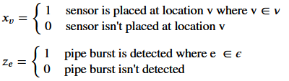

Decision Variables:
We define two binary variables -
Objective Function for Integer Program:
Maximize the expected number of pipe bursts that are detected when each pipe bursts independently with a probability of 0.1 -
Constraints:
The sum product of detection capability with sensor location must be greater than -
The total number of sensors available is b -

Slide 9
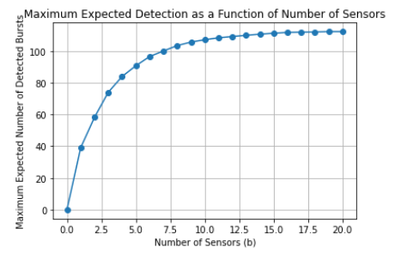
Results:
Assuming b ∈ {0, . . . , 20}, we iterate over every possible b value and record the optimal value of the problem as a function of b.
We see that we need at least 19 sensors to detect all pipe bursts (all 1123 pipes)
The sensor locations/node numbers for each value of b is recorded, an example of this result is:
Sensor locations for b= 19 is: [2, 16, 27, 104, 205, 233, 267, 277, 312, 392, 483, 489, 620, 651, 705, 712, 720, 722, 748]

Slide 10
Problem 3: For a faster solution, sequentially and myopically select sensor locations

Slide 11
Overview:
Myopically select the node which detects the maximum expected number of pipe bursts for all pipes that haven't been detected yet. Iterate over the number of sensors available.
Sensor placement will follow a sequential selection process.
Algorithm Design:
Step 1 – Select node which detects the maximum expected number of pipe bursts. Place sensor at the selected node.
Step 2 – Remove all pipes that have been detected through the above sensor placement
Step 3 – If all pipes are detected or the number of sensors have run out, stop. Otherwise, repeat Step 1 and Step 2

Slide 12
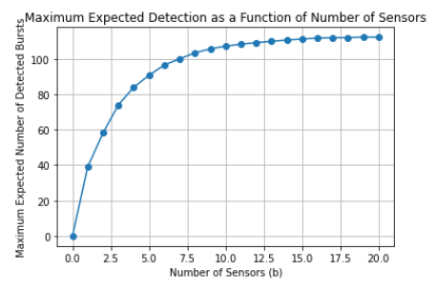
Results:
Assuming b ∈ {0, . . . , 20}, we iterate over every possible b value and record the resulting expected number of pipe bursts that are detected by that solution as a function of b.
Solution - When plotting the optimal value against the number of sensors, we see that at 20 sensors, the expected number of pipe bursts that are detected is lesser than the total number of pipes - 1123.
Time Taken – It takes less than 1 second to run

Slide 13
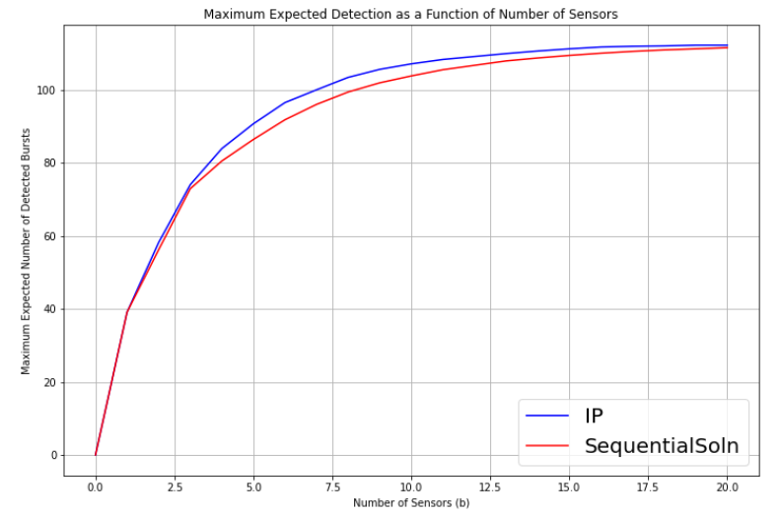
Comparison of Solutions:
We will compare the two solutions based on the optimal solution and time taken to run.
Time Taken -
IP: It takes ~5 mins to run
Sequential: It takes less than 1 second to run
Optimal Solution -
IP: It states that at least 19 sensors are needed to maximize the expected number of pipe bursts that are detected.
Sequential: It requires more than 20 sensors to maximize the expected number of pipe bursts that are detected.

Slide 14
Problem 4: Identify the position of b sensors to minimize the highest criticality of a pipe that is not detected by any sensor

Slide 15
Overview:
Some pipes are more critical than others, i.e the burst of a critical pipe can be more devastating than others. Criticality is measured by ∈ [0, 1] and each pipe is assigned a criticality.
Decision Variables:
We use the same two binary variables as previous parts -
Objective Function for Integer Program:
Minimize the highest criticality of a pipe that is not detected by any sensor -
To linearize this, we represent as k. The linearized objective function would be -
We also need to add as a constraint.

Slide 16
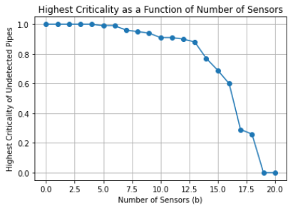
Constraints:
The sum product of detection capability with sensor location must be greater than -
The total number of sensors available is b -
Results:
Assuming b ∈ {0, . . . , 20}, we iterate over every possible b value and record the optimal value of the problem as a function of the number of sensors b.
After 19 sensors, the highest criticality of a pipe not detected by a sensor is 0, which means that all pipes with criticality > 0 are detected.
This is in line with the results from Problem 2.

Slide 17
Thank You!

