Slide 1
CoinSweeper

Slide 2

What is CoinSweeper?
It is a visual tool to introduce programming, that allows students to gradually transition from using natural language language commands, to more Pythonic constructs.
We aim to gamify this process through the visual component CoinSweeper – a bot in a grid that detects and picks up coins while navigating its way around obstacles.

Slide 3
Levels
So far, we have 4 levels.
0: Move and Turn
1: Assignment & Arithmetic
1.5: Pen Up/Down
2: Boolean Expressions

Slide 4
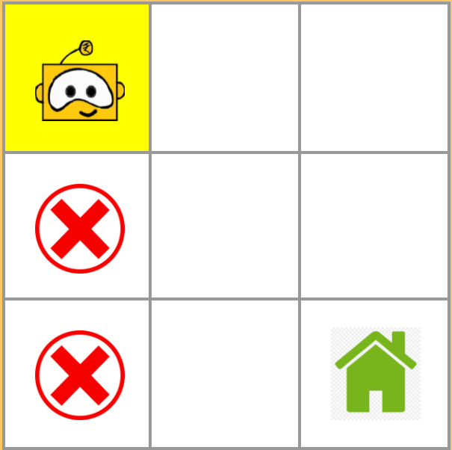
LEVEL 0
Problem 1: Go Home
Navigate the bot through a maze of obstacles and reach home.

Slide 5
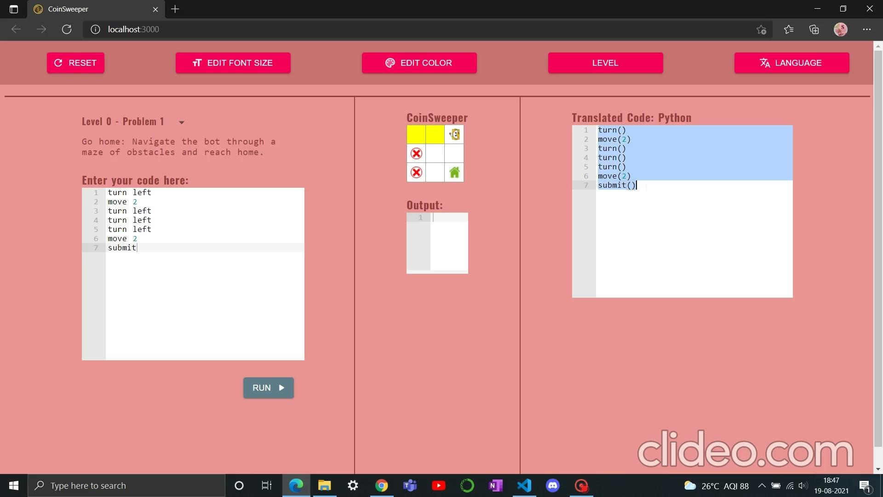

Slide 6
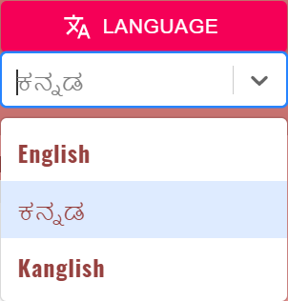
Languages Available
The language options currently made available are:
English
Kannada
Kanglish (conversational or casual Kannada language written in the English script).

Slide 7
LEVEL 0 (Kannada)
Problem 1: Go Home
Navigate the bot through a maze of obstacles and reach home.

Slide 8
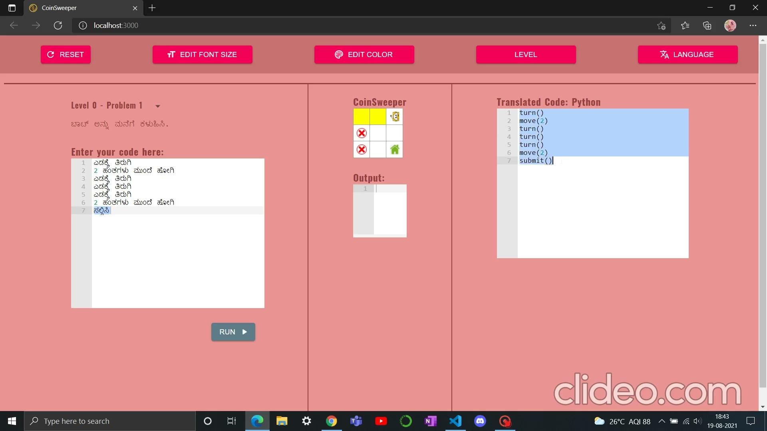

Slide 9
Current Status
CoinSweeper is currently under development, and any changes can be tracked via this page.
Right now, we have a simple UI that allows a user to choose problems from a dropdown, and all the commands can be used at any level (there is no restriction).
Eventually, we hope to have level maps, and introduce each command at the corresponding level through a tutorial/teaching guide.

