Slide 1


CHECKOUT COMMAND
(GIT)
Presented By : Vaanya.

Slide 2
AGENDA
To understand properly what checkout command is? And what is the working?
UNDERSTANDING GIT AND CHECKOUT COMMAND.
HOW TO USE CHECKOUT COMMAND.
CHECKOUT -(BASIC COMMANDS)
.

Slide 3
UNDERSTANDING GIT & CHECKOUT COMMAND.
GIT is a type of version control system that makes it easier to track changes to files. GIT provides features like branches and merges. GIT has a remote repository which is stored in a server and a local repository which is stored in the computer of each developer.
CHECKOUT command is the one which works upon 3 major components files, commits and branches.The GIT checkout command can be used to create a new branch. With the help of thic command one can switch b/w different branches.
Trusted
Innovative
Popular
Sed lacinia purus non metus scelerisque, non fermentum.
Sed lacinia purus non metus scelerisque, non fermentum.
Sed lacinia purus non metus scelerisque, non fermentum.

Slide 4

HOW TO USE CHECKOUT COMMAND?
The GIT checkout command is commonly used with tha GIT branch command . First you use a GIT branch command to create a new branch then , you can use GIT checkout command to to start pushing commits to the new branch you have created.
SYNTAX : $ Git checkout <branchname>.
3,967
518
12,057
9,381
OUR CLIENTS
PROJECTS RUNNING
FOLLOWERS
LIKES
Sutiable for any kind presentation
Sutiable for any kind presentation
Sutiable for any kind presentation
Sutiable for any kind presentation

Slide 5
CHECKOUT - (BASIC COMMANDS)
NEW BRANCHES -
Git checkout -b <new-branch>
Git checkout -b <new-branch> <existing-branch>
SWITCHING BRANCHES -
Git checkout <branchname>
GIT CHECKOUT A REMOTE BRANCH -
Git checkout <remotebranch>

Slide 6

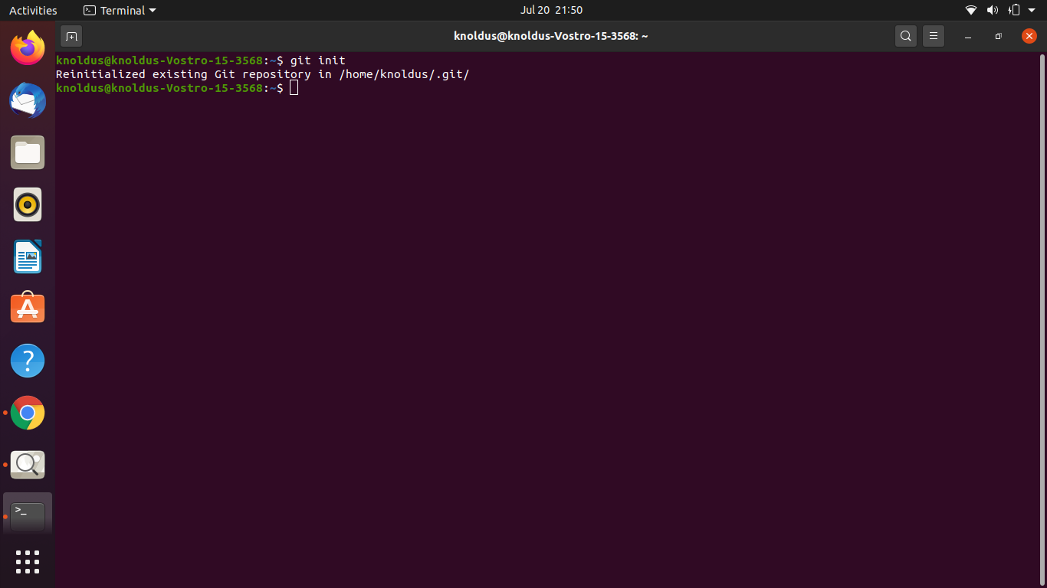
PRACTICAL WORK...

Slide 7
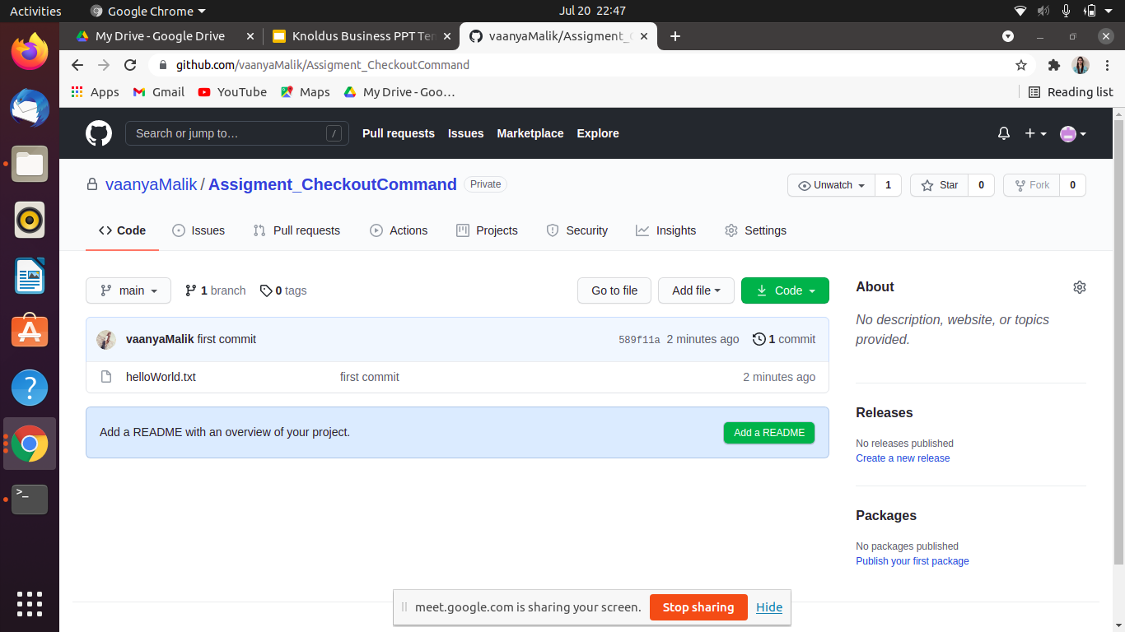
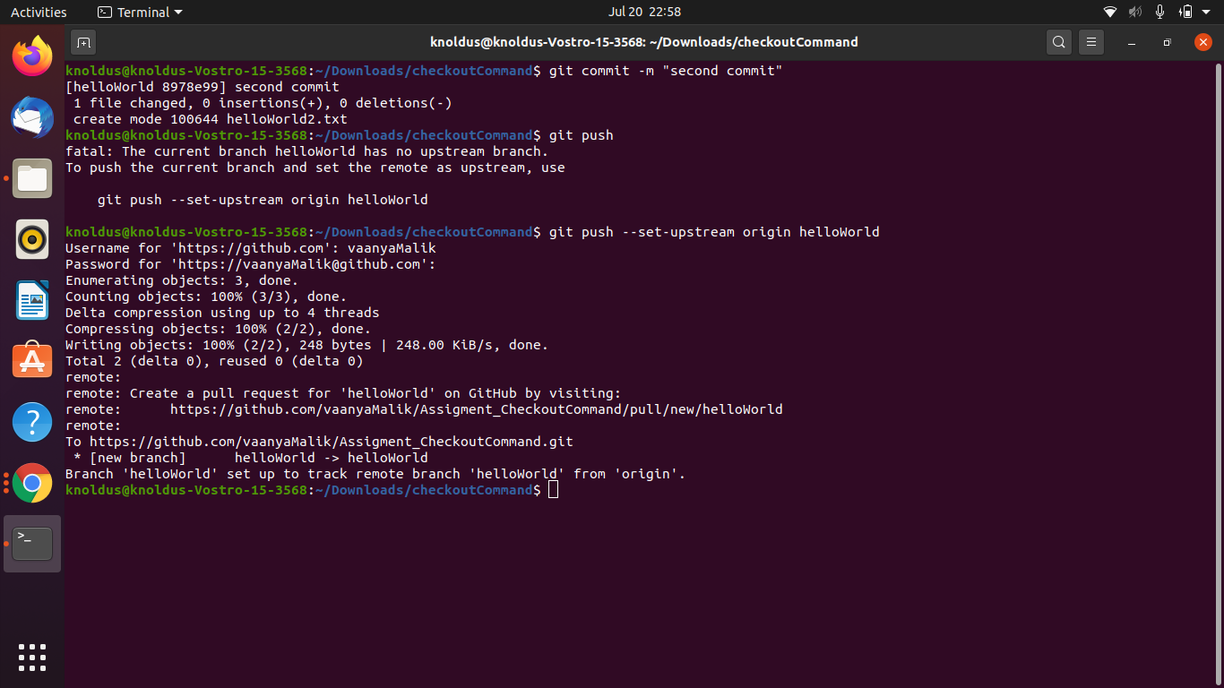
PRACTICAL WORK (CONT.)
.

Slide 8
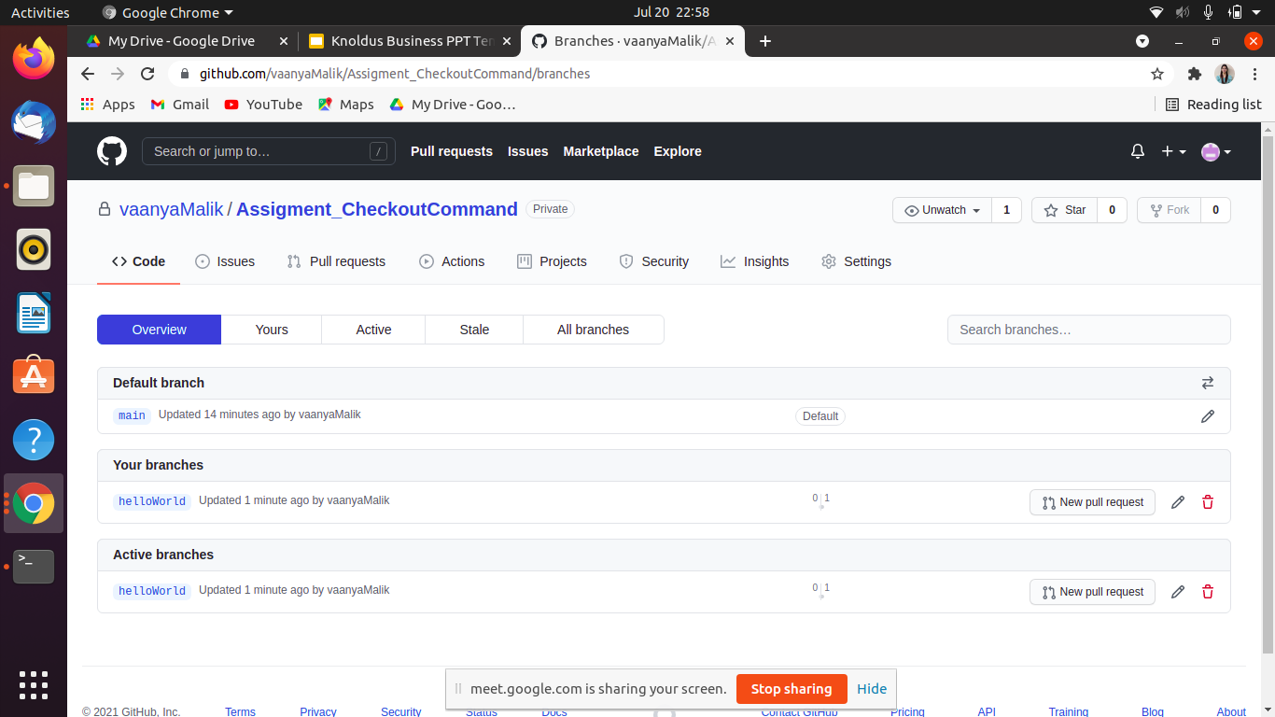
PRACTICAL WORK (CONT.)
Description
.
Description
Description
Description

Slide 9
Thank You!

