Slide 1
2898 ए.डी: ది ಫೈನಲ್ டிரோப்
2898AD- The Final Drop

Slide 2
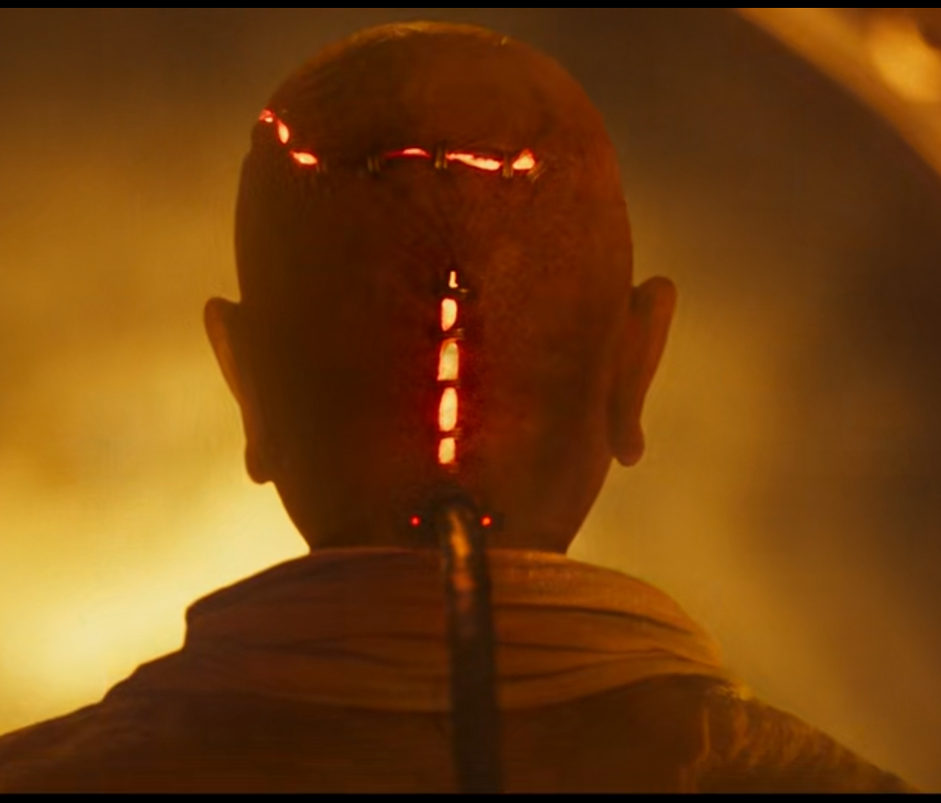
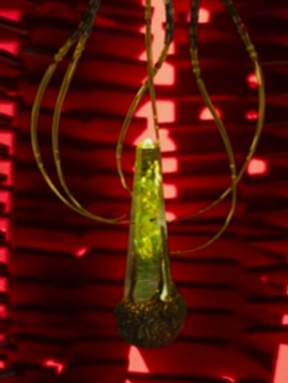
SUPREME
SERUM

Slide 3
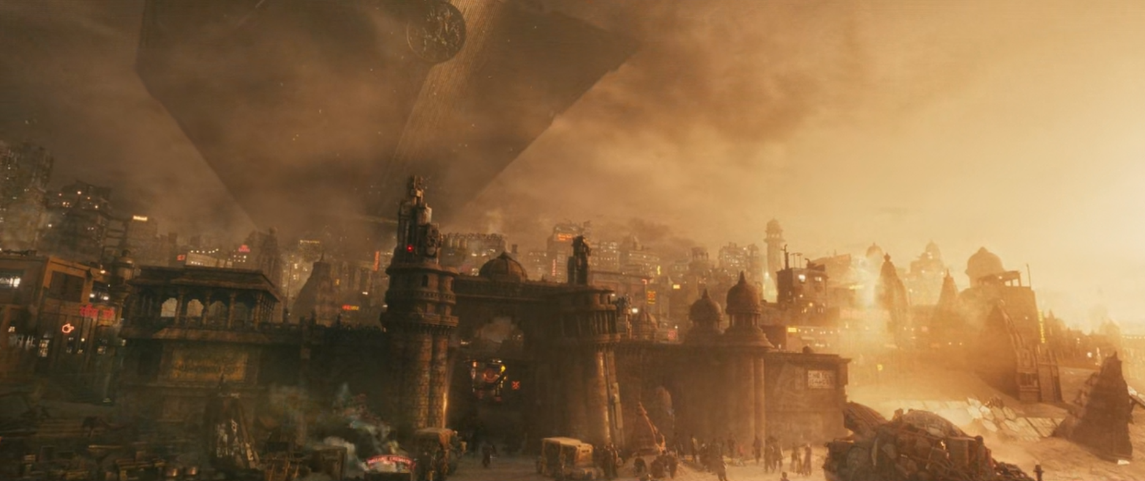
K
KASHI

Slide 4
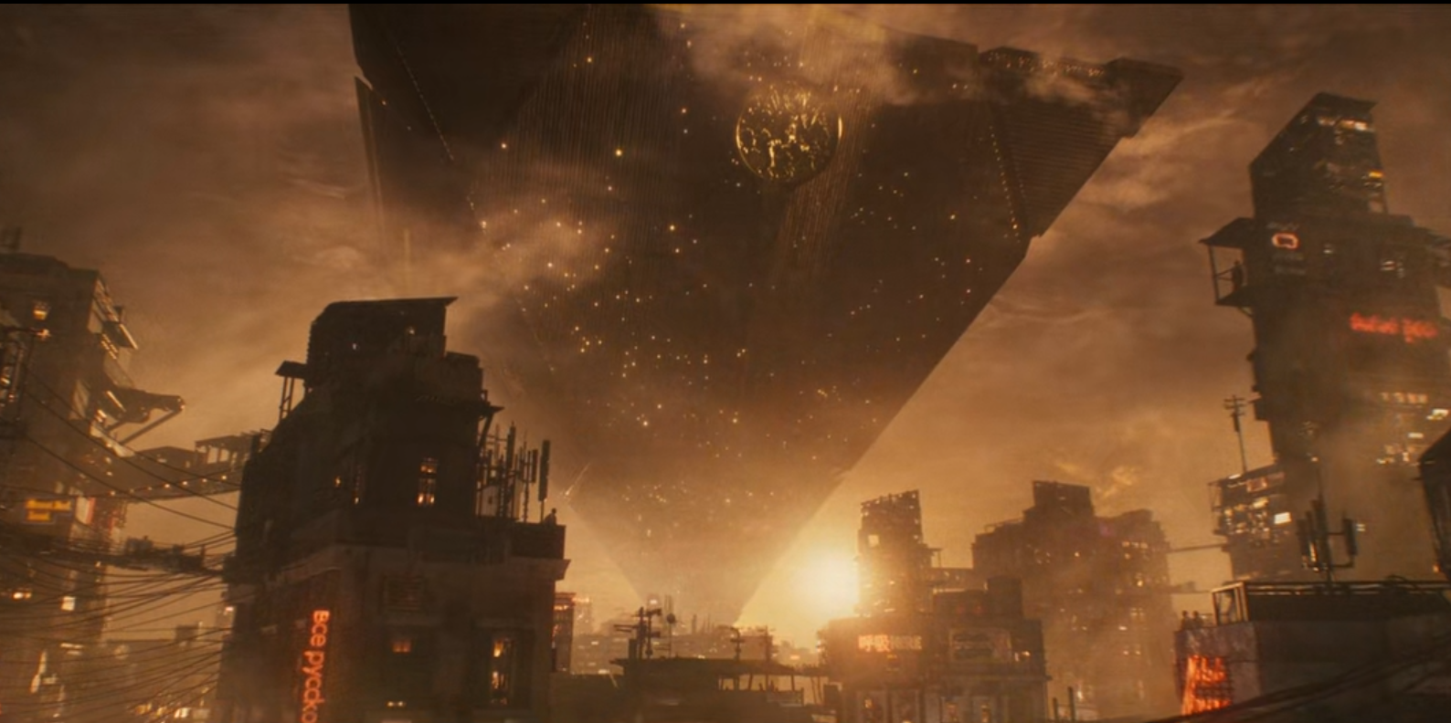
COMPLEX

Slide 5
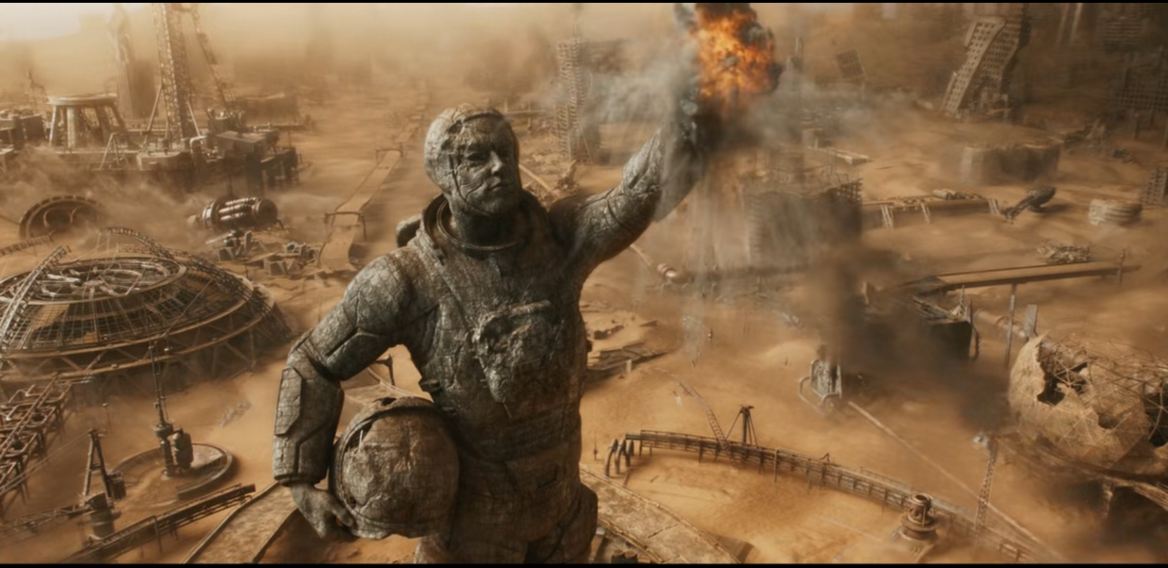
NEW WORLD

Slide 6
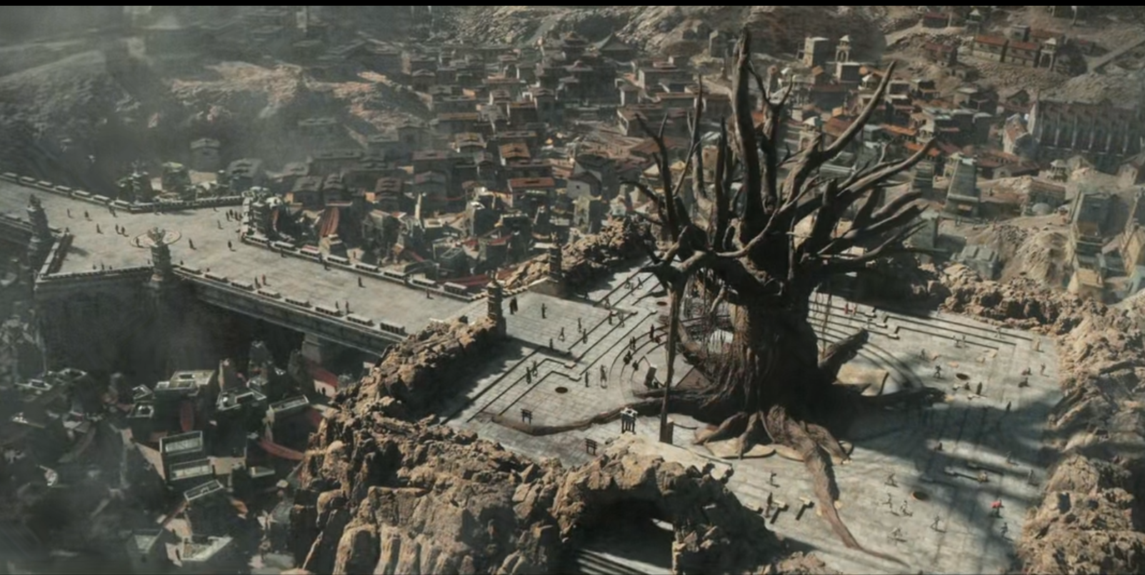
SHAMBALA

Slide 7
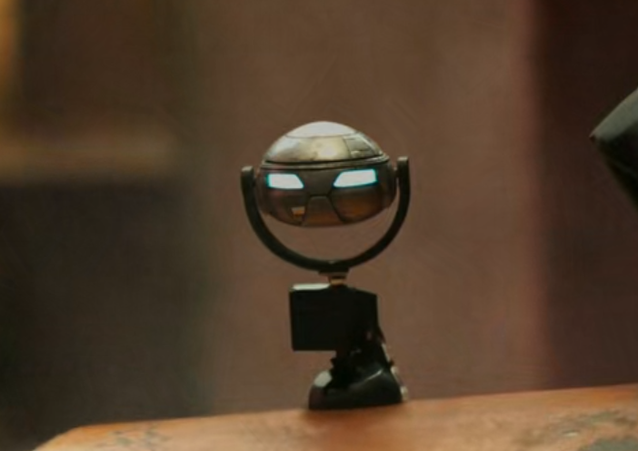
BUJJI

Slide 8
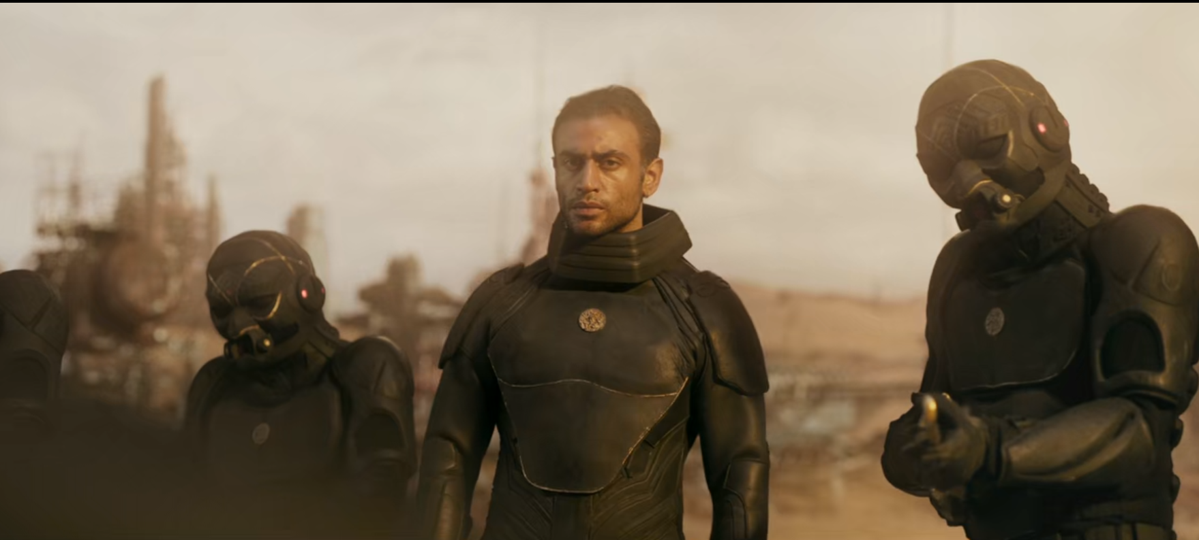
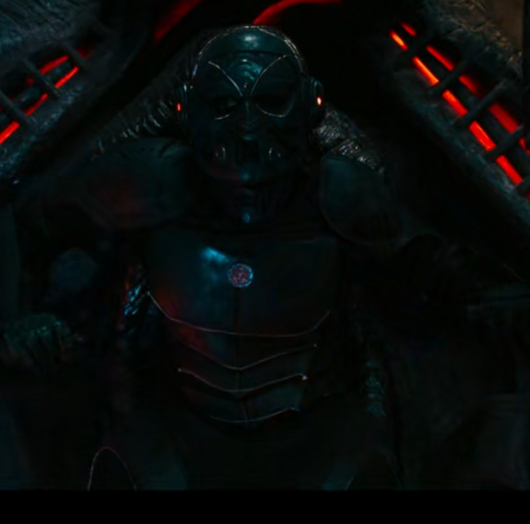
RAIDERS(ARMY OF COMPLEX)

