Slide 1
Amrita Vishwa Vidyapeetham, Amaravati Campus
Nuclear Plant Inspection Robot
Presented by,
Name of the Student | Roll No.
B Vaasita | AV.SC.U4AIE24008
K Nikshitha | AV.SC.U4AIE24024
S Khyathisree | AV.SC.U4AIE24052
Under the Guidance of
Dr Ravishankar Prakash Desai

Slide 2
Introduction
Why Nuclear Plant Inspection Matters:
Nuclear power plants are among the most hazardous environments. Manual inspection exposes workers to lethal radiation and toxic gases, making autonomous robotic inspection a critical safety requirement.
Our Solution: An autonomous AI multi-robot monitoring system developed in VPython 3D using two ground robots and a drone for aerial monitoring, wireless data sharing, battery management, and automated emergency response.
Key Innovation: Robot 1 detects hazards and retreats to a safe zone, while Robot 2 (shielded) inspects the danger area. Both communicate with the drone and share real-time sensor data.

Slide 3
Problem Statement, Objectives and Programming Language
Problem Statement | Objectives | Programming Language
Nuclear power plants operate in highly hazardous environments involving radiation, toxic gases, and extreme conditions Manual inspection exposes workers to serious health and safety risks There is a need for an autonomous system that can continuously monitor and respond to emergencies without human intervention | Design an AI-based autonomous monitoring system using robots and drones Simulate real-time detection of hazards such as gas leaks, radiation, and temperature rise Implement multi-robot coordination for inspection and emergency response Integrate battery management system for efficient and continuous operation | Python is used as the core programming language for system implementation VPython is used for 3D visualization and simulation of the plant environment Enables real-time animation of robots, drone, sensors, and monitoring system

Slide 4
Methodology
3D Environment Design - Built using VPython (box, cylinder, sphere) with 4 zones, buildings, pipes, safe zone, assembly point, and charging base in a realistic layout.
Phase-Based State Machine - A scenario timer controls 6 phases, automatically changing robot behavior, sensor values, and visual effects to simulate emergencies.
Autonomous Patrol Logic - Robot 1 follows predefined waypoints, avoids restricted areas, and performs inspection at the pump station. Drone patrols aerially and tracks the robot.
Wireless Communication - Robot and drone communicate via signal-based system (strong/weak/lost), affecting real-time data synchronization.
Multi-Robot Coordination - Robot 1 detects hazards and retreats, while Robot 2 (shielded) enters danger zones and performs gas suppression.
Battery & Sensor Simulation - Battery levels decrease over time, and sensors generate dynamic data. Live graphs display temperature, radiation, gas, battery, and alerts.

Slide 5
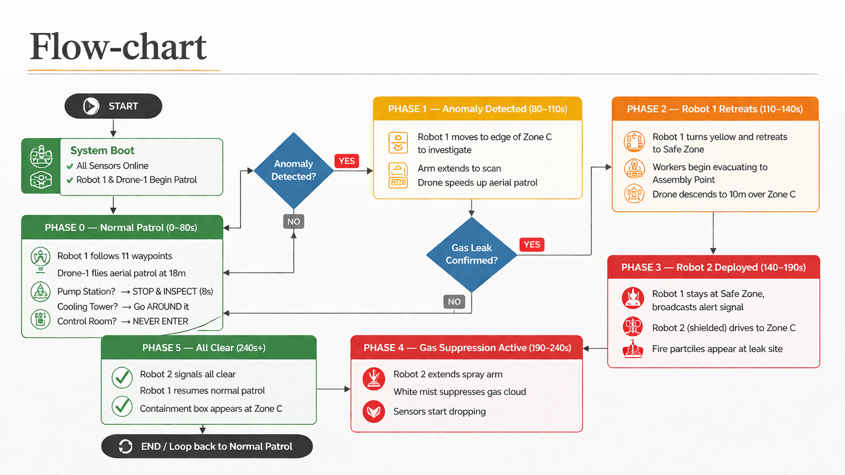
Flow-chart

Slide 6
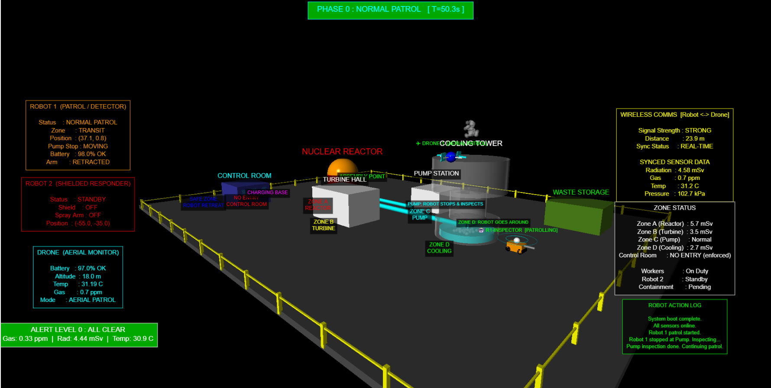
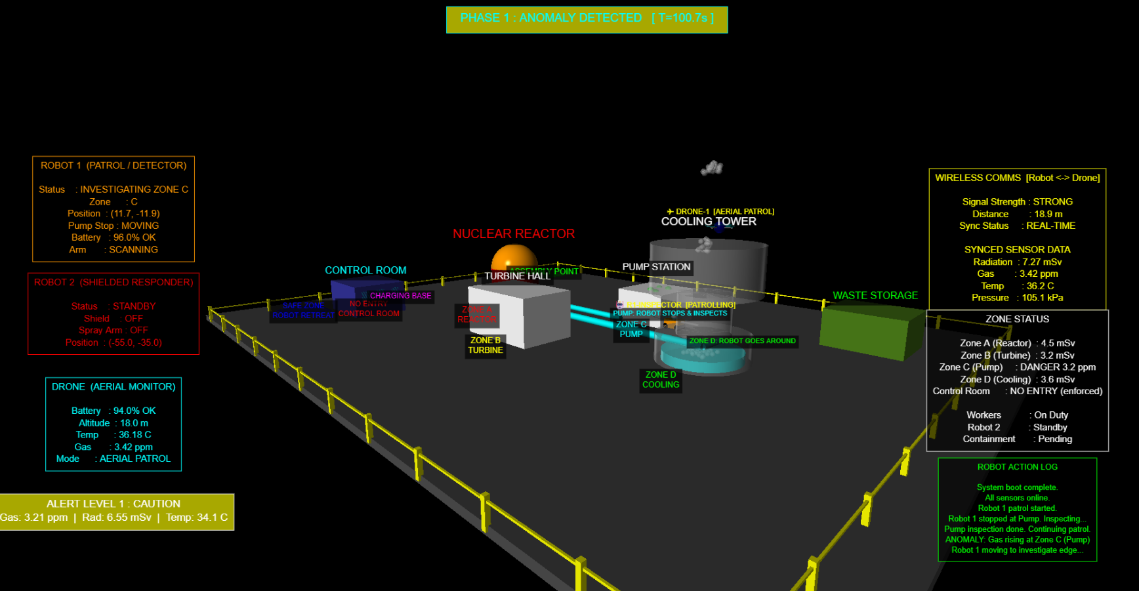
Simulation Result

Slide 7
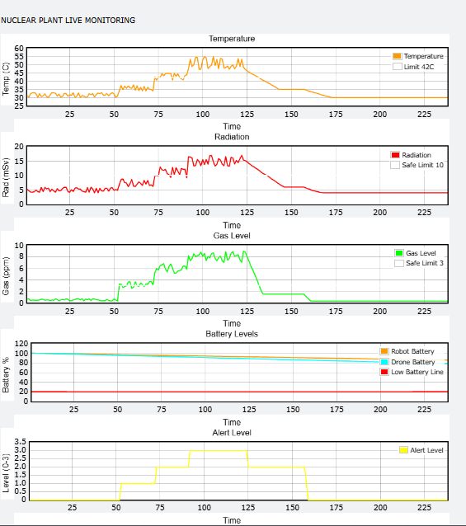
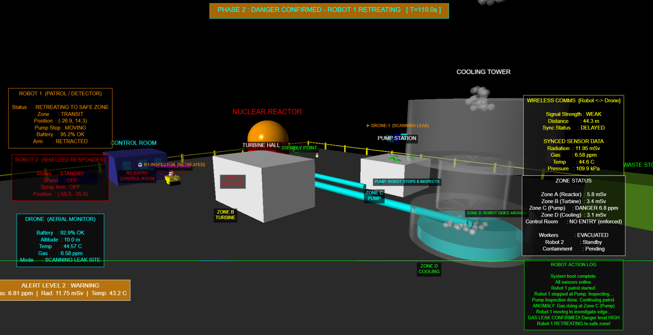
Simulation Result

Slide 8
Conclusion
AI-based autonomous monitoring system for nuclear plant safety
Demonstrated real-time hazard detection and response using robots and drone
Achieved effective coordination and communication between system components
Reduced the need for human intervention in hazardous environments
Provided a realistic simulation of emergency handling and recovery

Slide 9
References
Briones, L., Bustamante, P., & Serna, M. A., “Wall-Climbing Robot for Inspection in Nuclear Power Plants,” Robotics and Autonomous Systems, 1994.Available: https://www.researchgate.net/publication/224669024_Wall-climbing_robot_for_inspection_in_nuclear_power_plants
Mitsubishi Heavy Industries, “MEISTeR robot for Fukushima nuclear plant inspection,” 2012. Available: https://www.mhi.com/products/energy/meister.html
Yamamoto, H., “Development of Inspection Robot for Nuclear Power Plant,” IEEE Conference, 2000. Available: Open IEEE Paper (Document 894847)
Puppala, S., Hossain, I., Alam, J., & Talukder, S., “Optimus-Q: AI-Based Adaptive Robot for Nuclear Power Plant Monitoring,” arXiv, 2025. Available: https://arxiv.org/abs/2511.15614
Xie, H., Huang, L., & Wu, W., “Indoor Positioning System for Mobile Robots in Nuclear Power Plants,” arXiv, 2020. Available: https://arxiv.org/abs/2011.07771
Kim, J., Ruan, T., & Contreras, C., “Human-Robot Collaboration for Inspection in Nuclear Facilities,” arXiv, 2025. Available: https://arxiv.org/abs/2508.11404

Slide 10
Thank You

