Slide 1
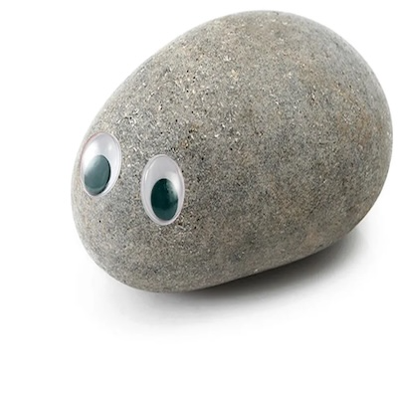


Front End Development
Featuring a Rock, Paper, Scissors Tutorial!
Disclaimer: It’s been a while since I developed any websites. I focus on general principles and basic concepts.

Slide 2
Design - Quick Notes (1)
Good design is a heavily researched topic with many resources.
There are common design principles which you can follow.
Intuitive Design
If users are confused about how to use your app, it is not designed well enough.
Accessible design helps everyone.
Do not leave design as a last thought.

Slide 3
Design – Quick Notes (2)
“Two of the most important characteristics of good design are discoverability and understanding.
Discoverability: Is it possible to even figure out what actions are possible and where and how to perform them?
Understanding: What does it all mean? How is the product supposed to be used? What do all the different controls and settings mean?”
The Design of Everyday Things, Don Norman

Slide 4
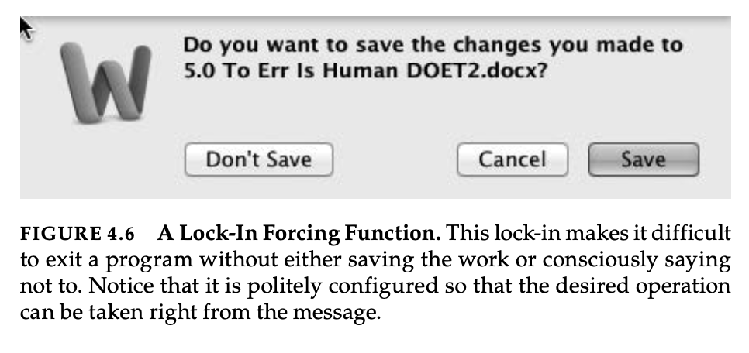
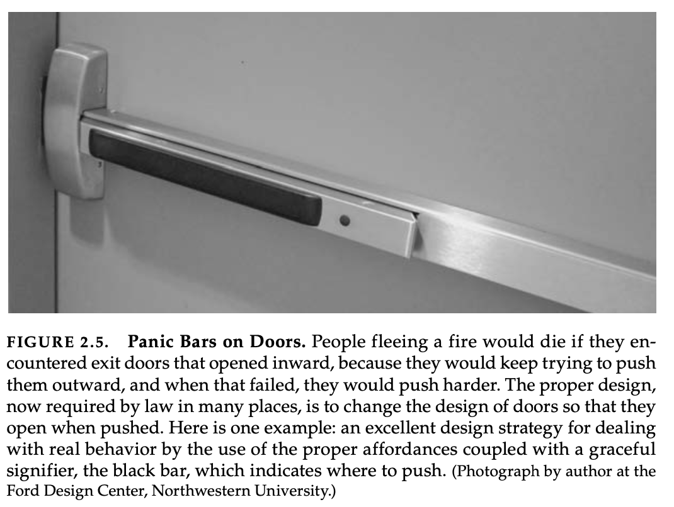
Design - Make Failure Impossible!
Especially for anything high stakes, make error close to impossible.
Examples from The Design of Everyday Things

Slide 5
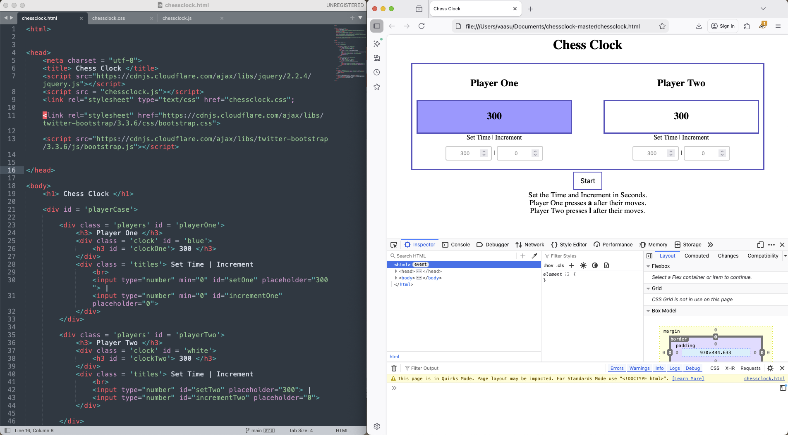
Simple Web Dev Environment
Traditionally, we have three components: HTML, CSS, and JavaScript
On Left. Editor with three tabs open.
- example.html
- example.css
- example.js
On Right. Webpage open in local browser with developer console.

Slide 6
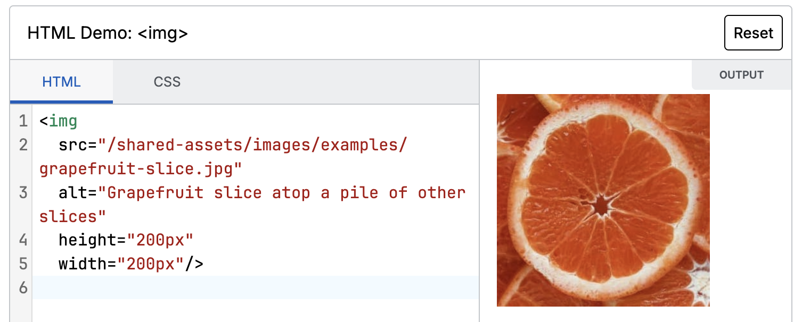
HTML: Elements and Tags
Elements are the basis of HTML pages. List of Many Element Types
Elements usually have start and end tags.
Within the tags you can specify ids, classes, and other attributes depending on the type of element.
Example: With the image tag, you can specify a path to the image file and the size of the image. Try it Out.

Slide 7
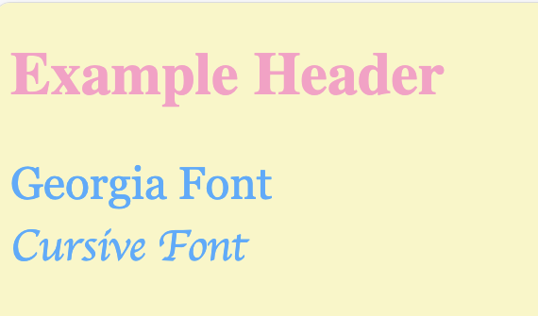
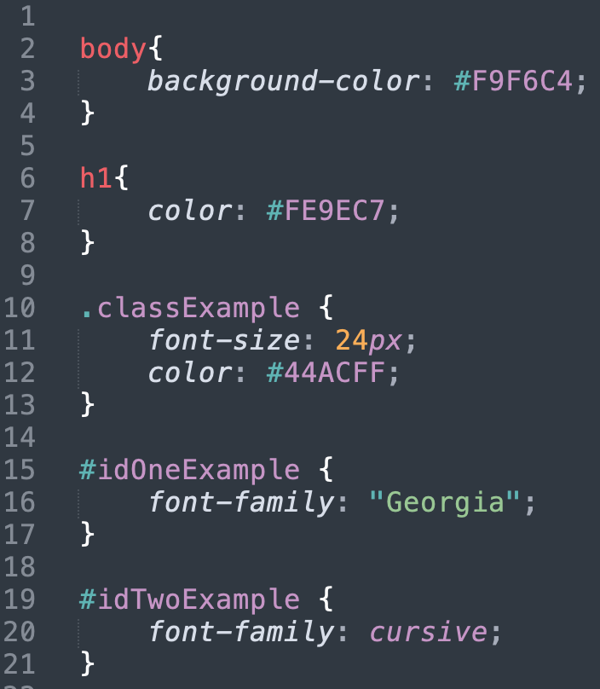
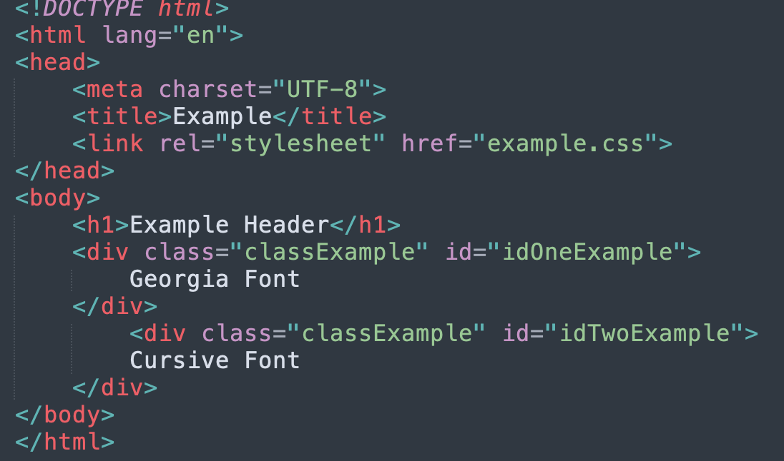
Cascading Style Sheets (CSS)
Use selectors to apply attributes to specific elements.
Notes:
1. We set the background-color to cream. 2. We set the header color to pink. 3. All elements with the ”classExample” class will have font size 24 and the blue color. 4. We changed the type of font for individual divs with their own id.

Slide 8
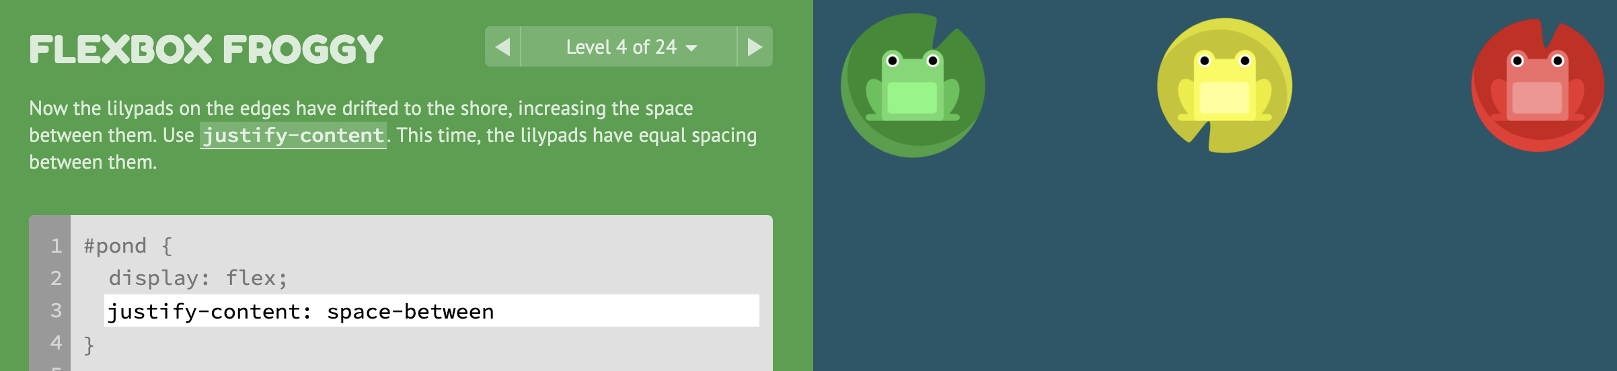
Positioning Elements
Flexbox: Flexbox Froggy
Remember to check how your web page looks for mobile users and varied browser sizes. (Browser Inspectors have tools for this.)

Slide 9
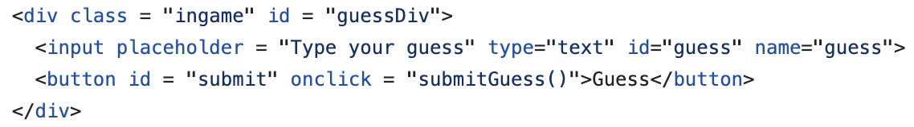
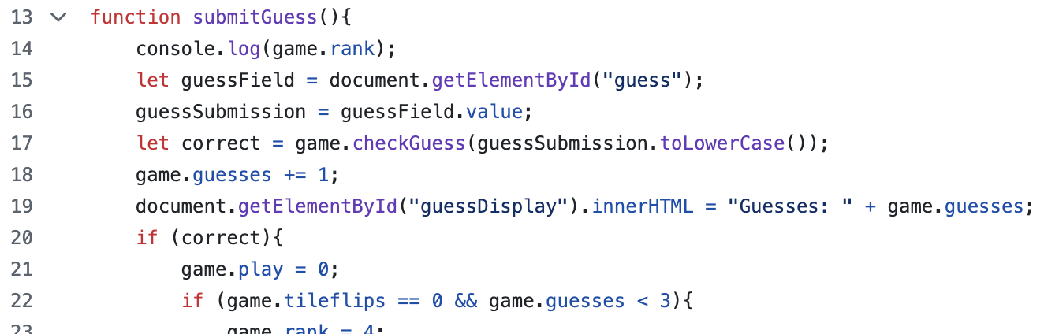
JavaScript Functions
You can use JavaScript to add some interactivity to your website.
Example: Do something when you press a button.
1) In our HTML file, we add an onclick function to the relevant the button.
2) Then, in our linked JavaScript file, we write the function. Note: We can dynamically change our HTML elements too.

Slide 10
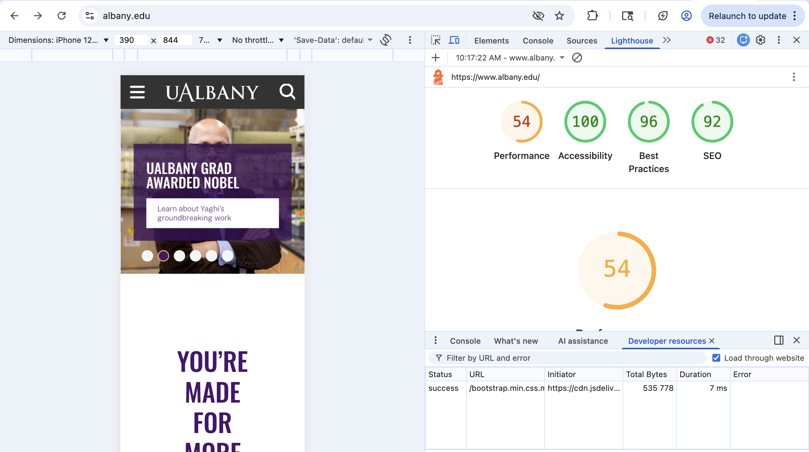
Developer Console
Browsers have built in tools (often found with “Inspect” or “Developer Console”).
Have many useful tools for web development.
Example: Chrome Browser has Lighthouse Audit to check site Performance, Accessibility, Best Practices, and Search Engine Optimization.

Slide 11

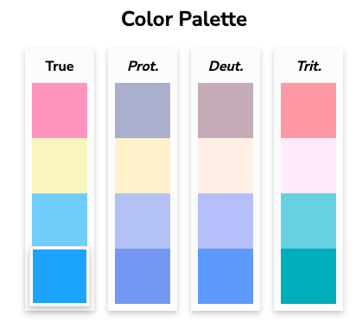
Colors!
Helpful Resource for Choosing a Color Palette: Color Hunt
Tool to Check Accessibility: Coloring for Colorblindness
Text should have clear contrast.
If you’re using this palette, it may be hard for some users to distinguish pink from light blue.
Design buttons, text, etc. with this in mind (e.g. don’t place pink text on a light blue background).
Or consider another palette.
Pink
Cream
Light Blue
Blue
Palette Source

Slide 12
Popular Tools / Resources
Bootstrap
Github Pages
jQuery
MDN
Node.js
React
WebStorm

Slide 13
Hands-On Learning – Rock, Paper, Scissors!
1. Download or clone this repository. https://github.com/vaasut/rps
2. Open up the HTML, CSS, and JavaScript files in an editor. Open the HTML file in a web browser. Try using the webpage, so you understand how it works.
3.Read through the three files, and make some small changes to them. Whenever you change a file, you can reload the webpage to see the changes.
4. Personalize and improve the site. The README file has suggestions to get started.

