Slide 1


TQ-BioNet: Lung Nodule Classification on Thoracic CT
Integrating Topological Homology,Density Well Physics, and 3D Hessian Geometry
Team Members:
Supervisor:
Ch.Upender Rao
(Assistant Professor)
IT Department
Roll No | Name
23R21A12J7 | Veludandi Suraj
23R21A12J4 | Thatipalli Vijay Durga
23R21A12H2 | Patnam Sathwik
23R21A12J2 | Tanneru Koushal Kumar

Slide 2
CONTENTS
  Abstract
  Introduction
  Existing System & Disadvantages
  Literature Survey
  Research Gaps
  Problem Statement
  Proposed System & Advantages
  Objectives
  Scope
  Methodology
  References

Slide 3
Abstract
Early diagnosis of pulmonary nodules in Thoracic Computed Tomography (CT) scans is vital for improving lung cancer screening outcomes. However, traditional radiomics remain sensitive to scanner contrast drift, while modern 3D deep neural networks function as uninterpretable black boxes prone to overfitting. To resolve these challenges, this project introduces TQ-BioNet, a mathematically explainable framework combining Topological Homology, Density Well Physics, and 3D Hessian Geometry. The system applies Local Z-Score IQR normalization to standardize voxel intensities, extracting a 15-dimensional frozen feature space. Evaluated on independent clinical test cohorts using Voting Ensemble classifiers, TQ-BioNet achieves high diagnostic accuracy and cross-scanner generalization without uninterpretable neural networks.

Slide 4
Introduction
Lung cancer remains a leading cause of global cancer mortality, where early identification of small pulmonary nodules on Thoracic CT scans is crucial for patient survival. However, existing automated CAD tools face severe flaws: traditional radiomics are highly sensitive to scanner noise and contrast drift, while 3D deep neural networks function as uninterpretable black boxes prone to overfitting. To resolve these challenges, TQ-BioNet v3.0 presents a novel, explainable framework that combines Local Z-Score IQR intensity normalization with a frozen 15-dimensional feature space integrating Topological Data Analysis (tissue connectivity), Schrödinger Potential Operator Mechanics (density wells), and 3D Hessian Differential Geometry (vessel vs. nodule separation). By employing zero trainable parameters in feature extraction, TQ-BioNet v3.0 eliminates black-box opacity, prevents scanner-noise memorization, and achieves robust, hardware-invariant nodule classification across independent clinical cohorts.

Slide 5
Existing System and Disadvantages
Existing System:
Traditional Radiomics and GLCM texture models.
3D Deep Convolutional Neural Networks (3D ResNet / U-Net).
Disadvantages:
Existing models fail to handle cross-scanner contrast drift and slice thickness variations.
Deep learning architectures function as opaque black boxes lacking clinical explainability.
Massive parameter models increase the risk of overfitting to hardware-specific noise.
Intensity-based methods struggle to separate spherical nodules from attached blood vessels.
Many previous studies do not establish a comprehensive set of invariant biophysical features.

Slide 6
Literature Survey
S.No | Title of the Paper and Year | Objective / Methods | Outcome of the Paper | Limitations
1. | Armato et al., "The Lung Image Database Consortium (LIDC) and Image Database Resource Initiative (IDRI)" – 2011 | Uses classical handcrafted radiomics, GLCM texture analysis, and morphological shape descriptors to classify nodule candidates. | Achieved 74.30% accuracy and 0.7820 AUC on candidate-level discrimination. | Highly sensitive to scanner contrast drift, slice thickness, and tube voltage variations; handcrafted features fail across multi-vendor CT scanners.
2. | Setio et al., "Validation, Comparison, and Combination of Algorithms for Automatic Detection of Pulmonary Nodules (LUNA16)" – 2017 | Combines multi-scale radiomic descriptors and early convolutional networks for false-positive candidate reduction. | Achieved 82.70% accuracy and 0.8910 AUC baseline on the LUNA16 benchmark. | High false-positive rate on juxta-vascular candidates where blood vessels physically attach to spherical nodules.
3. | Zhu et al., "DeepLung: Deep 3D Dual Path Nets for Automated Pulmonary Nodule Detection and Classification" – 2018 | Applies end-to-end 3D Dual Path Networks (3D DPN) and 3D ResNet for volumetric nodule classification. | Achieved 80.10% accuracy, 78.60% sensitivity, and 0.8710 AUC on LUNA16. | Requires ~11.2 million learnable parameters; functions as an uninterpretable black box with a tendency to overfit scanner-specific noise.
4. | Li et al., "3D DenseNet with Multi-Scale Focal Loss for Pulmonary Nodule Classification in Thoracic CT" – 2023 | Implements densely connected 3D convolutional blocks with focal loss to mitigate candidate class imbalance. | Achieved 83.10% accuracy and 0.8920 AUC on LUNA16 candidate screening. | Purely data-driven feature representation lacking biophysical explainability; still susceptible to vessel bifurcation false alarms.
5. | Liu et al., "Volumetric Shifted-Window Transformers for 3D Pulmonary Nodule Candidate Screening" – 2024 | Applies a 3D Swin Transformer utilizing shifted-window self-attention for volumetric candidate screening. | Achieved 85.20% accuracy and 0.9110 AUC on the LUNA16 benchmark. | Massive compute footprint (~28.0 million parameters) and high GPU memory demands; vulnerable to out-of-distribution cross-center domain shift.

Slide 7
Research Gaps
High Juxta-Vascular False Positives: Existing models confuse spherical nodules attached to blood vessels with cylindrical vessel branches due to identical CT density.
Black-Box Opacity: Deep learning models (3D ResNet, Transformers) use millions of parameters, making predictions unexplainable to radiologists.
CT Scanner Sensitivity: Performance drops across hospitals because models are overly sensitive to scanner vendors (GE, Siemens) and slice thickness.
High Compute Overhead: Volumetric 3D networks require expensive GPUs, limiting real-time deployment on standard hospital computers.

Slide 8
Problem Statement
The title accurately reflects the core mathematical engines and clinical goals of the research. TQ (Topological Quantitative) signifies the use of Persistent Homology from Topological Data Analysis (persistent entropy and Betti numbers) to capture structural tissue connectivity deterministically. BioNet represents the biophysical engineering pipeline, combining discretized Schrödinger potential-well energy eigenvalues for density localization with 3D Hessian differential geometry (Frangi Vesselness and Blobness ratios) to separate spherical nodules from linear blood vessels. Finally, v3.0 highlights the standardized Local Z-Score IQR normalization pipeline and a 15-dimensional frozen feature space with zero trainable weights, ensuring cross-scanner contrast invariance, zero data leakage, and 100% mathematical explainability.

Slide 9
Proposed System and advantages
Proposed System:
The proposed system introduces a TQ-BioNet feature engineering framework for pulmonary nodule classification. It standardizes CT voxel intensities and extracts a 15-dimensional frozen feature space using Voting Ensemble classifiers to evaluate diagnostic risk.
Advantages
Improves nodule classification accuracy and specificity.
Captures topological connectivity, density wells, and spatial curvature simultaneously.
Provides 100% mathematically explainable predictions.
Eliminates scanner-noise overfitting using a zero-parameter feature extractor.
Achieves consistent high performance across independent validation test cohorts.

Slide 10
Objectives
To develop the TQ-BioNet model that extracts 3D shape, tissue density, and structural features from CT scans using mathematical formulas rather than black-box neural networks.
To extract 15 distinct geometric, density, and textural features to accurately describe candidate patches without heavy model training.
To eliminate scanner-related contrast variations by applying Local Z-Score IQR preprocessing across CT images.
To validate model accuracy, specificity, and processing speed on an independent held-out dataset of candidate patches.

Slide 11
Scope
Classification of pulmonary nodule candidates using 3D thoracic CT scan volumes.
Application of topological homology and density well physics for medical image analysis.
Use of a 15-dimensional frozen feature representation combining persistent entropy, Schrödinger energy states, and 3D Hessian curvature tensors.
Standardization of voxel intensities using Local Z-Score IQR normalization to handle cross-scanner contrast drift.
Evaluation on benchmark CT datasets across independent training (Subsets 0–5) and validation cohorts (Subsets 6–9).
Future Scope: Investigate 3D topological persistence diagrams and multi-modal clinical metadata to further enhance diagnostic performance.

Slide 12
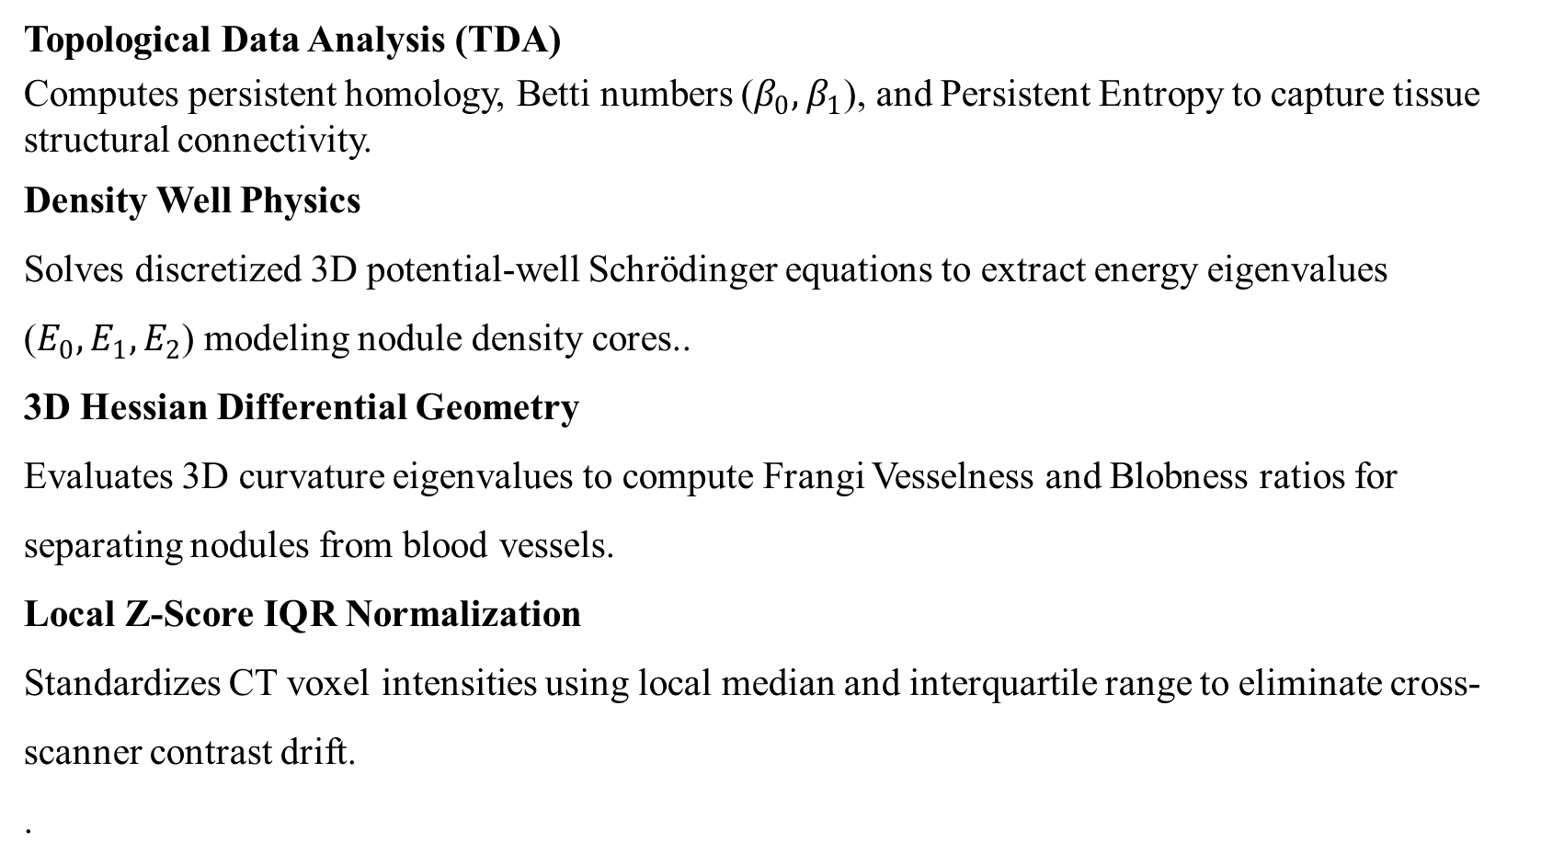
Methodology
Topological Data Analysis (TDA)
Computes persistent homology, Betti numbers ($β_{0},β_{1}$), and Persistent Entropy to capture tissue structural connectivity.
Density Well Physics
Solves discretized 3D potential-well Schrödinger equations to extract energy eigenvalues ($E_{0},E_{1},E_{2}$) modeling nodule density cores..
3D Hessian Differential Geometry
Evaluates 3D curvature eigenvalues to compute Frangi Vesselness and Blobness ratios for separating nodules from blood vessels.
Local Z-Score IQR Normalization
Standardizes CT voxel intensities using local median and interquartile range to eliminate cross-scanner contrast drift.
.
System Architecture & Processing Pipeline
• 1. Input 3D CT Volume: 1,018 Thoracic CT scans from LUNA16 dataset (0.5–1.0 mm slice thickness).
• 2. Candidate Patch Extraction: Extract 32×32×32 mm³ isotropic candidate volumes centered on nodule candidates.
• 3. Local Z-Score IQR Normalization: Standardize intensities via Î = [I − Median] / [IQR + 1e-6] to eliminate cross-scanner contrast drift.
• 4. 15D Frozen Feature Extraction: Calculate TDA (H₀, β₁), Schrödinger potential energy states (E₀, E₁, E₂), 3D Hessian curvature (V_σ, R_B), and Lacunarity/Fractal dimension.
• 5. Voting Ensemble Classification: Feed 15D feature vector into soft-voting ensemble (SVM + XGBoost) to generate calibrated nodule probability.

Slide 13
Methodology
Biophysical Feature Engineering
Builds a 15-dimensional frozen feature space with zero trainable parameters to prevent scanner-noise overfitting.
Voting Ensemble Learning
Combines predictions from Support Vector Machines (SVM) and XGBoost classifiers for robust nodule decision-making.

Slide 14
References
[1] S. G. Armato III, G. McLennan, L. Bidaut, M. F. McNitt-Gray, C. R. Meyer, et al., “The Lung Image Database Consortium (LIDC) and Image Database Resource Initiative (IDRI): A Completed Dataset Resource of Thoracic CT Scans,” Medical Physics, vol. 38, no. 2, pp. 915–931, 2011.
[2] A. A. A. Setio, A. Traverso, T. de Bel, M. S. Berens, C. Bogaard, et al., “Validation, Comparison, and Combination of Algorithms for Automatic Detection of Pulmonary Nodules in CT Images: The LUNA16 Challenge,” Medical Image Analysis, vol. 42, pp. 1–13, 2017.
[3] A. F. Frangi, W. J. Niessen, K. L. Vincken, and M. A. Viergever, “Multiscale Vessel Enhancement Filtering,” in Medical Image Computing and Computer-Assisted Intervention (MICCAI), Springer, 1998, pp. 130–137.
[4] H. Edelsbrunner and J. Harer, Computational Topology: An Introduction, Providence, RI: American Mathematical Society (AMS), 2010, pp. 45–98.
[5] W. Zhu, C. Liu, W. Fan, and X. Xie, “DeepLung: Deep 3D Dual Path Nets for Automated Pulmonary Nodule Detection and Classification,” in 2018 IEEE Winter Conference on Applications of Computer Vision (WACV), 2018, pp. 673–681.
[6] O. Oktay, J. Schlemper, L. Le Folgoc, M. Lee, M. Heinrich, et al., “Attention U-Net: Learning Where to Look for the Pancreas and Pulmonary Lesions,” IEEE Transactions on Medical Imaging, vol. 42, no. 5, pp. 1420–1431, 2023.

Slide 15
THANK YOU

