Slide 1
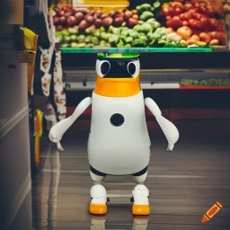
ECE4078 Intelligent robotics
AI art generated by https://www.craiyon.com/
(prompt: “a penguin robot shopping for fruits and vegetables in a supermarket”)
Lab 3-1: Training a Fruit&Veg Detector

Slide 2
ECE4078 Intelligent robotics
Week | Objectives | Milestones
1: C1-1 | Introduction and setup
2: M1-1 | Calibration, ARUCO markers | C1 due
3: M1-2 | SLAM
4: M1-3 | SLAM
5: M2-1 | Object recognition & localisation | M1 due
6: M2-2 | Object recognition & localisation
7: M3-1 | Navigation & Planning | M2 due
8: M3-2 | Navigation & Planning
9: C2 | Integration & Improvement | M3 due
10: Final | Trial run of final demo | C2 due
11: Final | Final demo | Final demo due
12: No lab | N/A | N/A
*

Slide 3
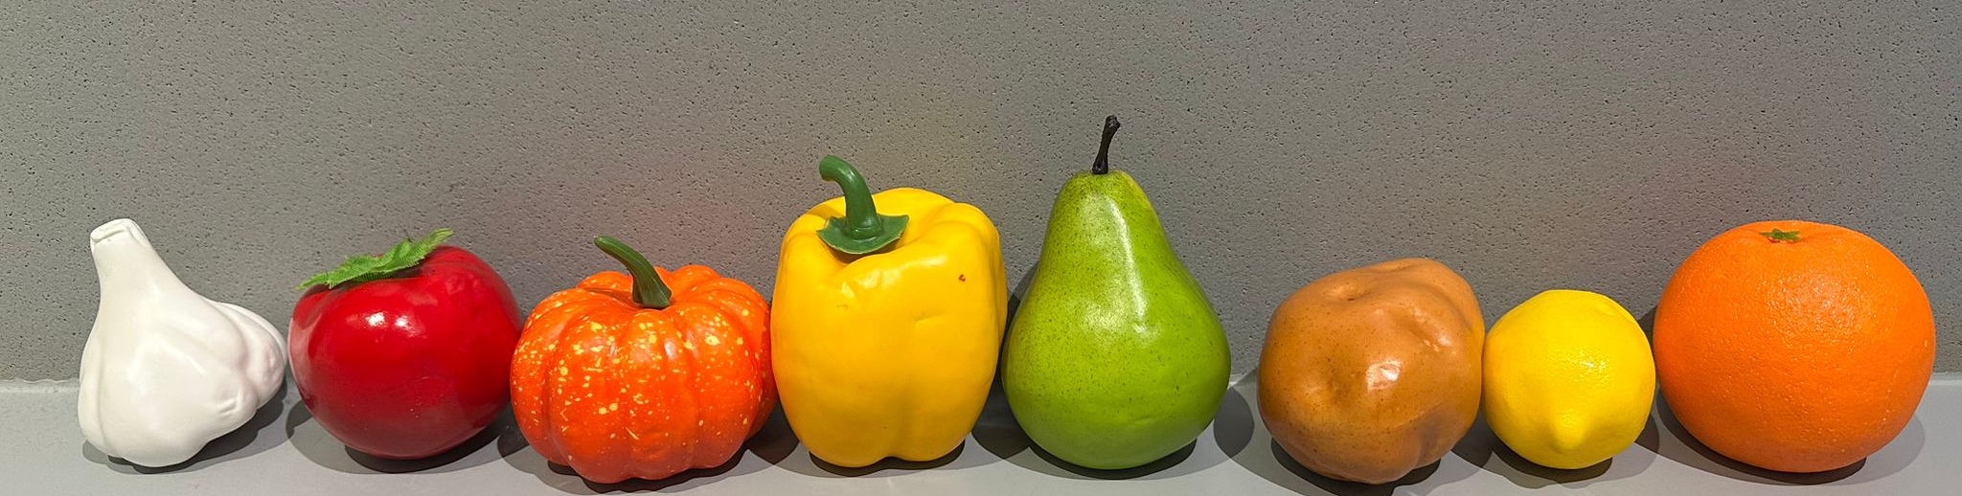
Milestone 2
Your PenguinPi can map the supermarket aisles and itself after M1, but how does it find the fruits and vegs to shop for? In M2, you’ll focus on object recognition and localization using machine learning.
There are 8 types of fruits and vegs selling at the supermarket. These fruits and vegs will be in an arena in addition to the 10 ARUCO markers (there may be duplicates or missing target types). There may be other distractor fruits, vegs, and other objects in the arena as well.
The target list includes garlic, tomato, pumpkin, capsicum, pear, potato, lemon and orange.
*we bought these fruit and veg models from Amazon if you want to get some yourself (NOT an endorsement for the vendor)

Slide 4
M2: Overview
Task 1: collecting a dataset of target fruits and vegs (Week 5)
Task 2: Training a YOLO model for object detection and segmentation (Week 5)
Task 3: Estimating object poses (Week 6)
Live demo marking of M2 in Week 7: detector performance + object pose estimation performance

Slide 5
M2: collecting data (wk5)
Task 1: collecting a dataset of target fruits and vegs (Week 5)
Do these during the lab session:
Take photos of each target object using PenguinPi’s camera (operate.py allows you to drive the robot around, press “i” to save an image) from various angles and under various lighting conditions, use a simple background (e.g., a white paper) for easy background randomisation later
Measure the dimensions of each target object (in meters), which you’ll need for estimating their location in wk6 (update target_dimensions_dict in TargetPoseEst.py)

Slide 6
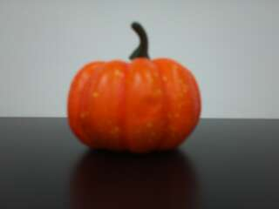
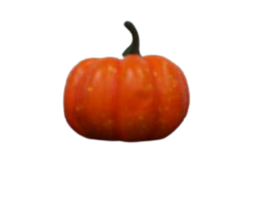
M2: collecting data (wk6)
Developing a training dataset using photos you take (can be done outside of the lab)
Step 1.1: remove background in the photos you took (use this tool or anything else you prefer)
Step 1.2: add random background (see image_background_randomiser), you can add other variances to increase diversity in the training dataset, such as object orientations or sizes

Slide 7
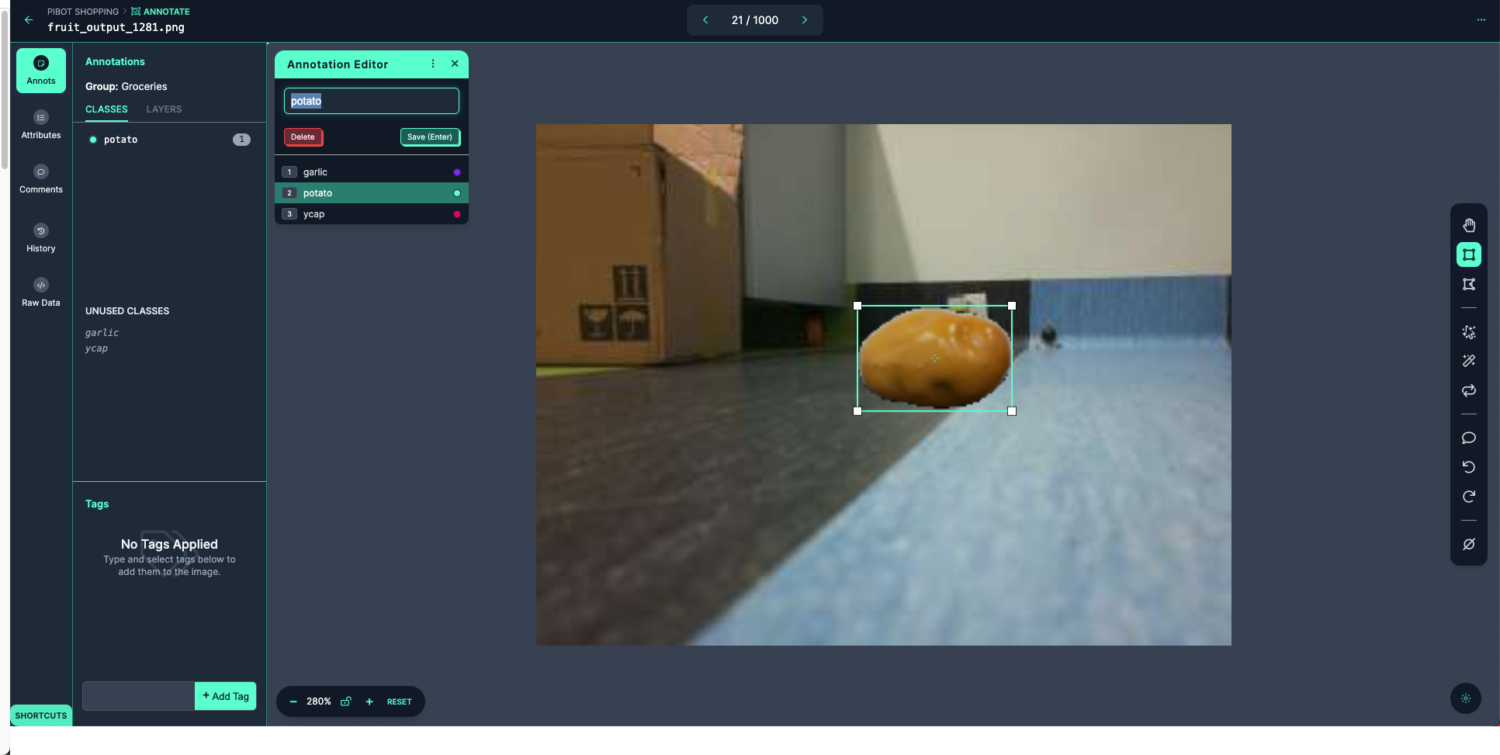
M2: collecting data (wk6)
Developing a training dataset using photos you take (can be done outside of the lab)
Step 1.3: annotate your dataset
We recommend Roboflow as it’s free and the annotation can be exported in YOLO training format. There is also an assisted labelling feature to help speed things up
Make sure your bounding boxes are tight around the object, as the bounding box size is used for target pose estimation

Slide 8
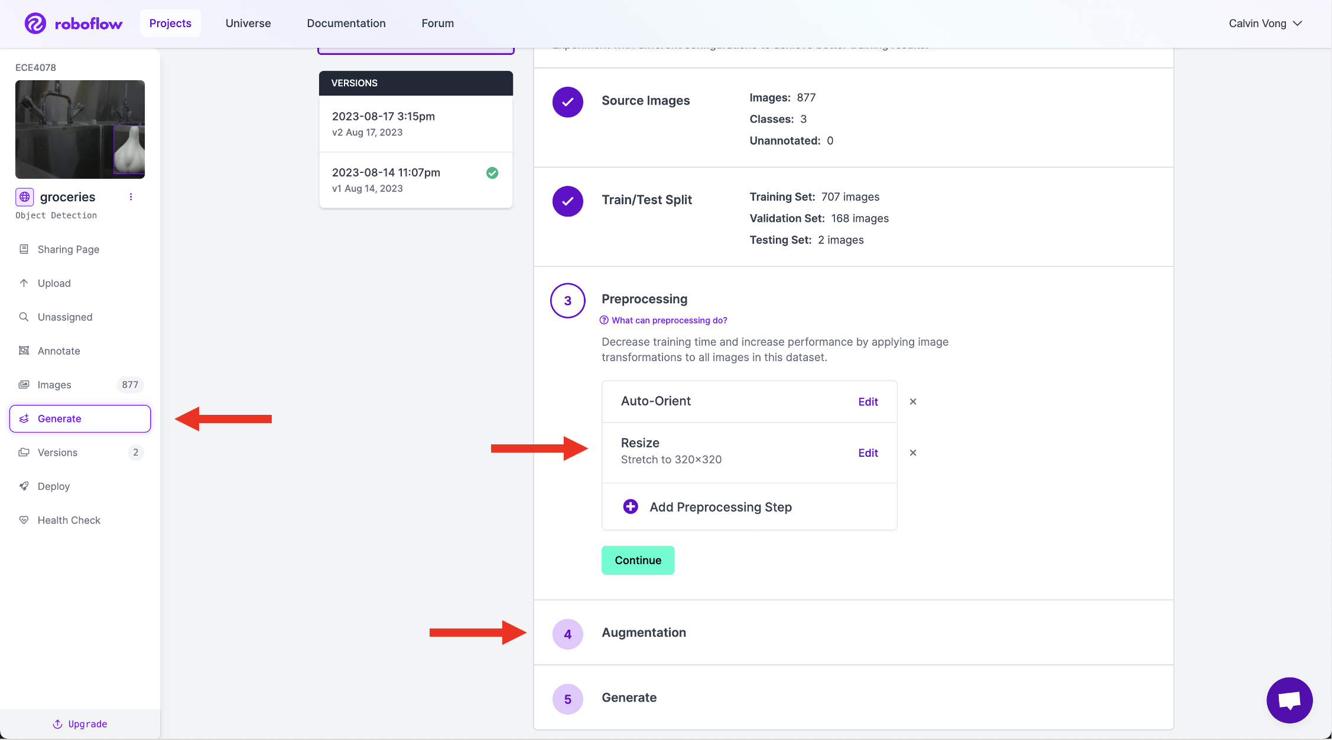
M2: collecting data (wk6)
Developing a training dataset using photos you take (can be done outside of the lab)
Step 1.4: generating the dataset in YOLO format (Roboflow)
You can use the image augmentation options of Roboflow to increase diversity in the dataset

Slide 9
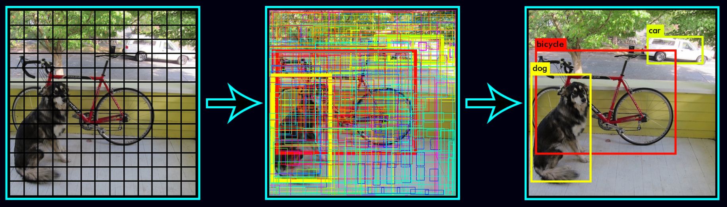
M2: Training YOLO (wk5)
Task 2: Training the network (Week 5)
YOLO: “You Only Look Once”, one the most popular image segmentation and classification model
Install YOLOv8: python -m pip install ultralytics
Please follow YOLOv8_training_notebook.ipynb for training YOLO with your collected dataset
You can train your model using Google Colab or on your local machine (don’t train it inside the VM)

Slide 10
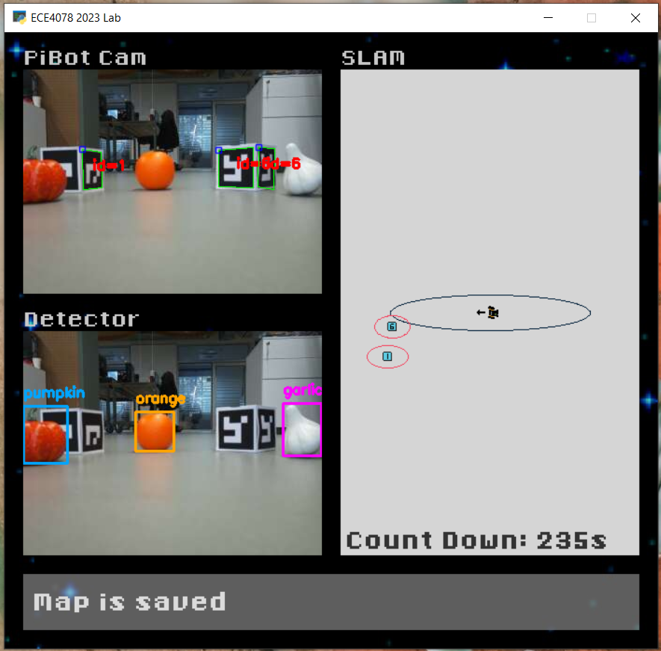
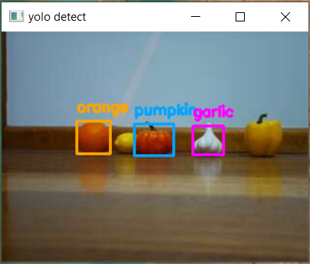
M2: Training YOLO (wk5)
Example YOLO detector
(can only recognize garlic, orange, pumpkin)
Hints:
Tuning confidence threshold: any bounding box above this threshold is considered valid
Add a wide range and aggressive amounts of noise / distortion to your training images so that it can handle potential lighting conditions and disturbances in the real world

Slide 11
M2: Estimating Object Location (wk6)
Task 3: Estimating object poses (Week 6)
Given YOLO’s bounding boxes, true dimensions of the objects, and the robot’s pose (estimated by SLAM) at the time of observation, calculate the X-Y coordinates of the object in the arena
You will modify “TargetPoseEst.py”
M2 evaluation: live demo marking in Week 7
Will talk more about these next week
While you are waiting for your turn to be marked (or if you have already been marked), please begin setting up your M2 work. This may include tasks such as installing required dependencies, brainstorming with your team on how to approach the M2 problem, updating your team’s private git repository, etc.

Slide 12
M1 marking
Please check GitHub for the marking procedure. M1 is marked as a group assignment.
You have a total of 15 minutes for setup, demonstration and submission. Each team will have 10 minutes of viva.
There will be one marking arena running M1.
You can perform as many runs as you like, as long as you can finish within the time limit.
Please do not loiter around the marking arena unless it’s your group’s turn.
You are only allowed to generate one SLAM map per run.
Each run has a max of 3 allowed collisions.
You must immediately start SLAM in the specified position and orientation marked in the arena.
Remember to rename the maps so the later runs don’t overwrite your earlier runs.

Slide 13
M1 marking
We’ll mark all the generated SLAM maps you submit and take the best result for your M1 mark:
slam_rating = ((0.2 - Aligned_RMSE)/(0.2 - 0.02))
slam_score = (base^slam_rating - 1)/(base -1) * 80 where base = 16
Total M1 mark = (slam_score + (NumberOfFoundMarkers x 2) - (NumberOfCollisions x 5)) * NumberOfFoundMarkers/NumberOfMarkers
0 ≤ M1 total score ≤ 100

Slide 14
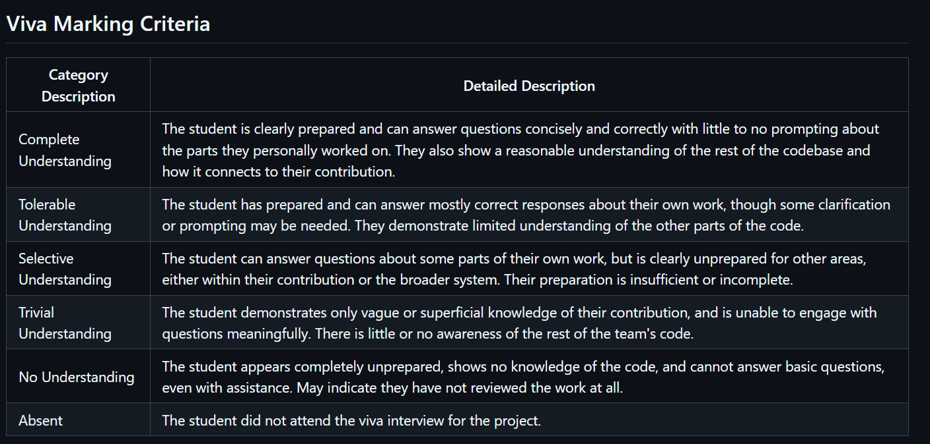
M1 marking

