Slide 1
SIH1702 · MINISTRY OF LAW & JUSTICE, GOVERNMENT OF INDIA
AI-Powered "Bail Reckoner"
An Intelligent Legal Assistance System for Streamlining
Bail Eligibility and Application
The system computes what the statute already provides — and shows the working.
It does not predict bail outcomes and it does not model judicial discretion.
Vallamalla Abhishek Prakash
Revuru Arya
Modhumpally Arvind
Boru Vimala
237Y1A66C5
237Y1A66D0
237Y1A66C9
237Y1A66I3
B.Tech CSE (AI & ML) · Batch 9 · MLRS24-169 · Marri Laxman Reddy Institute of Technology and Management, Hyderabad · Major Project 2026–27
Notes:
Problem statement SIH1702, raised by the Ministry of Law & Justice. The title and scope are assigned, not chosen — the innovation has to live in the solution.

Slide 2
THE PROBLEM
India’s prisons mostly hold people who have not been convicted
5,11,542
4,53,769
112.7%
3,71,440
inmates in 1,333 jails
sanctioned capacity
national occupancy rate
are undertrial prisoners
What the numbers mean
Occupancy fell to a decade low of 112.7% — but only because capacity grew, not because fewer people are held pre-trial.
Delhi is the most overcrowded State/UT at 194.6%; Meghalaya follows at 163.5%.
9,028 undertrials — 2.4% of them — have been in custody more than five years without a conviction.
A large share are held not on the merits of their case, but because nobody computed what the law already allows.
Source: NCRB, Prison Statistics India 2024 (as on 31 December 2024). See references slide.
Notes:
Anchor every figure to the report year. Never say "75% of prisoners are undertrials" without the source and year.

Slide 3
THE GAP
Parliament already fixed this. The fix is not reaching people.
Section 479(3) BNSS places the duty on the jail Superintendent — not on the prisoner — to apply to the Court "forthwith" once the threshold is crossed.
951
334
0.26%
identified as
eligible, all India
actually granted
bail by a court
of undertrials were
even identified
The bottleneck is not judicial refusal. It is that the computation — which offence, which code, what maximum sentence, how long in custody, does s.479(2) bar it — is never performed. The Supreme Court has repeatedly directed States and UTs to act proactively; MHA issued an advisory in October 2024. The arithmetic still has to be done by someone.
Sources: PIB / MHA figures as on 26.11.2024; data.gov.in; NCRB PSI 2024. See references slide.

Slide 4
THE LAW WE ENCODE
Section 479 BNSS, 2023 — the statutory spine
s.479(1)
s.479(2)
s.479(3)
The entitlement
The exclusion
The duty — and our hook
Detention for one-half of the maximum prescribed sentence → release on bail.
First proviso: a first-time offender qualifies at one-third, released on bond. No CrPC predecessor.
Second proviso: continued detention only after hearing the Public Prosecutor, for reasons recorded in writing.
Third proviso: never longer than the maximum sentence itself.
Not available where death or life imprisonment is prescribed.
"…where an investigation, inquiry or trial in more than one offence or in multiple cases are pending against a person, he shall not be released on bail by the Court."
No equivalent existed in s.436A CrPC.
Applied by the Karnataka High Court in K. Ramakrishna v. ED (23 Nov 2024): 479(1) and 479(2) must be read conjointly.
The Superintendent of jail "shall forthwith make an application in writing to the Court" once the threshold is crossed.
A named officer. A computable moment. A required document.
Auto-drafting that application needs no judicial discretion — and is the strongest single feature available inside this problem statement.
Statutory text quoted from bare-act reproductions and cross-checked; to be verified against the official gazette before encoding. See references slide.

Slide 5
THE FINDING THAT CHANGES THE DESIGN
An engine that computes the fraction but ignores s.479(2)
will confidently tell people they are eligible when the statute says they are not.
1
Multi-offence FIRs are the norm
2
A wrong "eligible" is survivable
3
A wrong "ineligible" is not
Indian charge sheets routinely carry several sections, so the exception has been criticised as risking swallowing the rule.
The court catches it. It costs credibility, not liberty.
Nobody appeals a machine’s silence. The person simply stays inside.
Design consequence: s.479(2) is a hard gate evaluated before any threshold arithmetic is reported, and the system is built with no "ineligible" output state — only "no statutory entitlement identified on these inputs — human review required".
Notes:
This is the single most important slide for a legal evaluator. Asymmetric error handling is a design requirement, not a UX nicety.

Slide 6
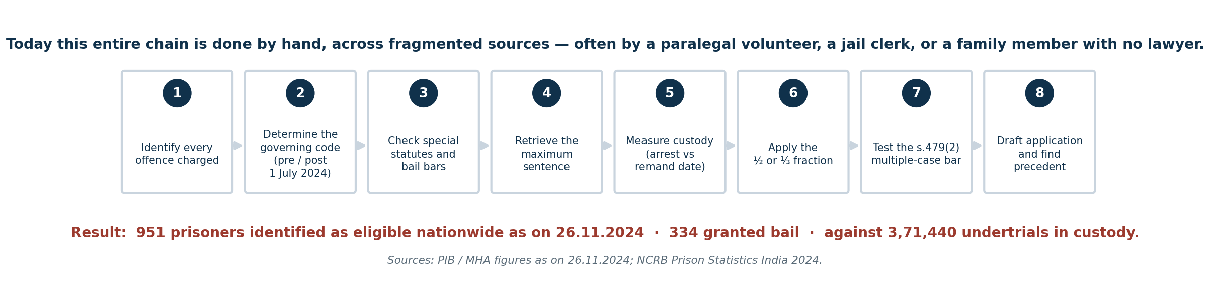
WHY IT DOES NOT HAPPEN
Eight steps, done by hand, for every single prisoner
Who actually does this
Where it breaks
What it costs
A DLSA paralegal volunteer, a jail clerk, a family member — frequently with no lawyer involved at all.
Charge sheets are scanned, partly handwritten, in regional languages. Date of arrest and date of remand differ, and the difference changes the arithmetic.
Every week of delay after the qualifying date is a week of custody the law did not require.

Slide 7
POSITIONING
What already exists — and the layer that does not
System | What it does | What it is
ICJS | Links police, prosecution, courts, prisons and forensics | Moves records
e-Prisons / BOMS | Prison management and bail-order management portals | Moves records
FASTER | Electronically transmits bail and release orders to jails | Moves orders, after bail is granted
UTRCs | District committees that review undertrials for release | Human process, needs candidate lists
e-Courts / NJDG | Judicial data infrastructure and case records | Moves records
System
What it does
What it is
The honest claim
It is not true that "no digital tool exists". Several national systems do, and an informed evaluator will know them.
What is true — and stronger — is that these systems transmit records and orders. None of them computes bail entitlement under Section 479. That reasoning layer is the contribution.
The Bail Reckoner is designed to consume ICJS-shaped data, sit behind e-Prisons, feed UTRC candidate lists, and discharge the s.479(3) duty — an integration target, not a competitor.

Slide 8
THE SOLUTION
A machine that does the bookkeeping of liberty.
It does not decide who deserves bail. It makes visible who is already entitled to it
and is still in custody because nobody did the arithmetic.
Extracts
Computes
Cites
Drafts
the offences and sections from the charge sheet
the s.479 entitlement deterministically, gate by gate
the provision behind every step and stamps the law version
the s.479(3) application for the jail Superintendent

Slide 9
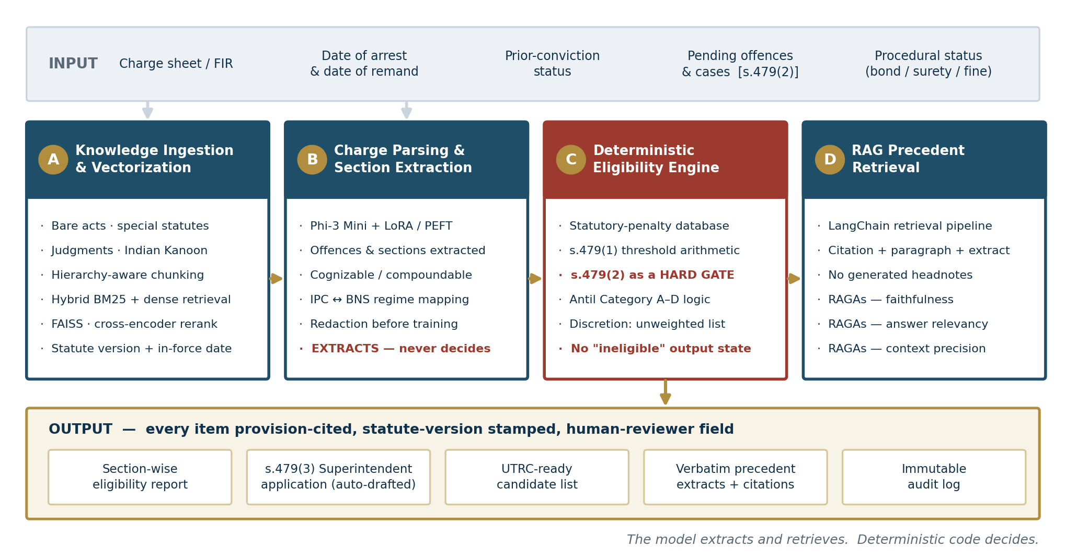
SYSTEM ARCHITECTURE
Four layers — the model extracts, deterministic code decides

Slide 10
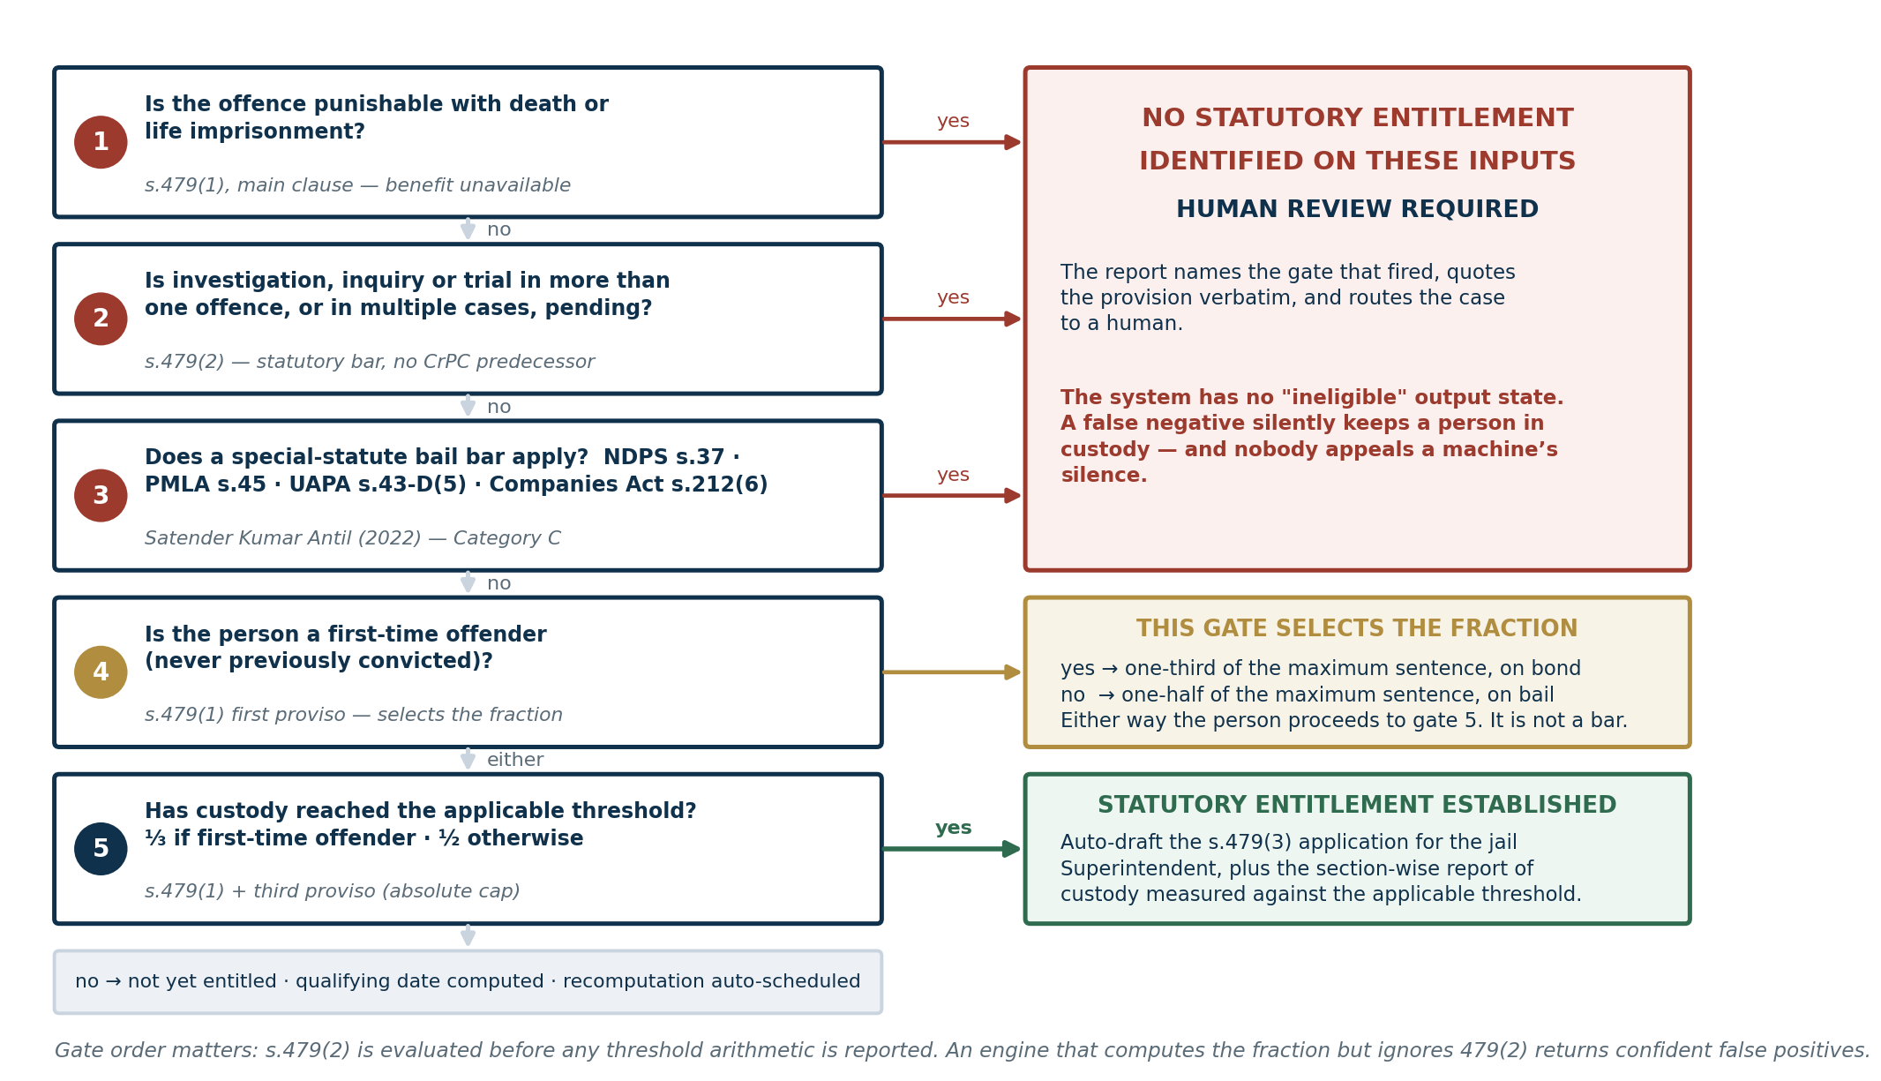
REASONING LAYER
The eligibility engine, gate by gate
Gates 1–3
Absolute statutory bars
Gate 4
Selects ⅓ or ½ — not a bar
Gate 5
The threshold arithmetic
Never emitted
An "ineligible" verdict

Slide 11
JUDICIAL FRAMEWORK
Satender Kumar Antil v. CBI (2022) as the rules-engine backbone
The Supreme Court has already produced a categorised bail framework. Building a bail rules engine without it means building the second version of something that exists in judicial form.
Imprisonment of 7 years or less, not in Categories B or D
Ordinary summons route; strong presumption toward release; s.479 arithmetic applied directly.
A
Death, life imprisonment, or more than 7 years
Death and life offences are excluded from s.479(1) by the main clause; otherwise merits-based, flagged for counsel.
B
Special Acts with stringent bail provisions — NDPS s.37, PMLA s.45, UAPA s.43-D(5), Companies Act s.212(6), POCSO
The statute-specific bar is raised as a blocking condition; s.479 benefit reported only with that test attached.
C
Economic offences not covered by special Acts
Merits-based; seriousness and quantum surfaced as facts, never scored.
D
Satender Kumar Antil v. CBI, judgment of 11 July 2022; on s.479 and PMLA see Badshah Majid Malik v. ED (SC, 27 December 2024). See references slide.

Slide 12
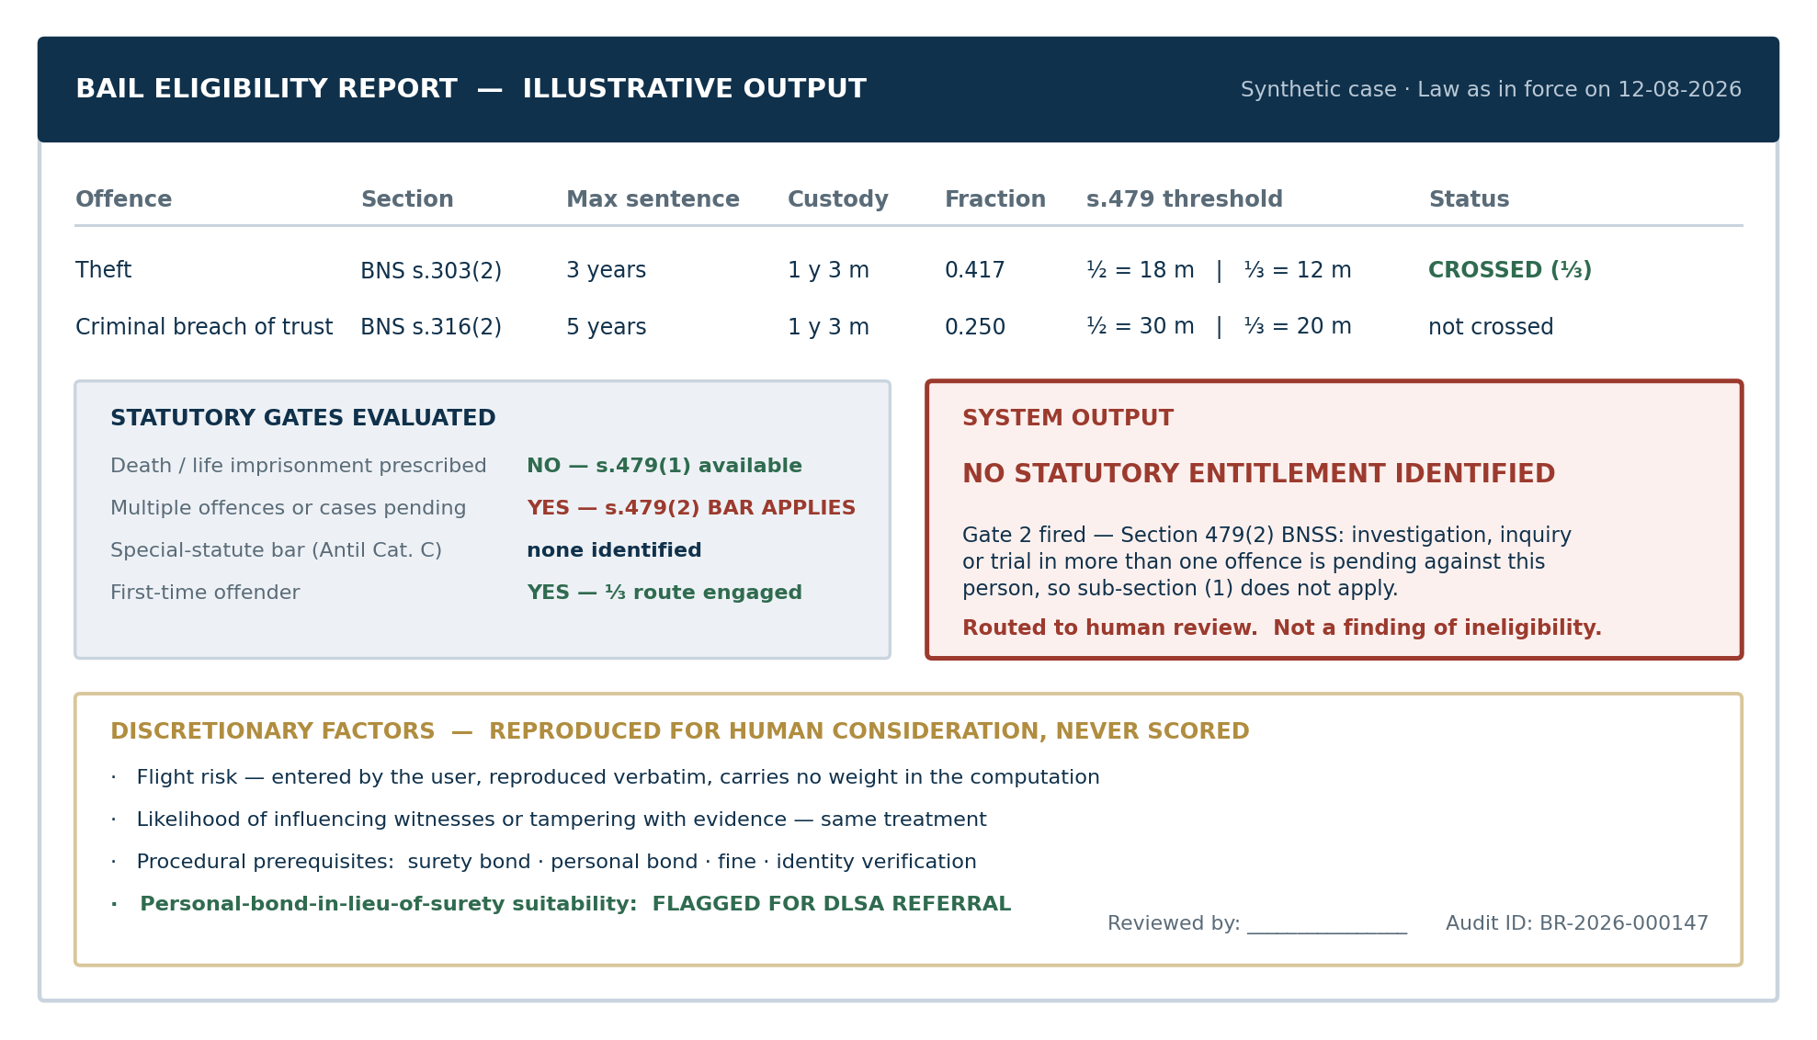
ILLUSTRATIVE OUTPUT
What the user actually receives
Show the working
The score is not the deliverable. The table is.
Cite the provision
Every gate names the sub-section it applied.
Stamp the version
The report can be re-derived months later.
Name a reviewer
Accountability sits with a person, not the tool.

Slide 13
IMPLEMENTATION
Technology stack
Languages & frameworks
Model & NLP
Python · LangChain · PyTorch
Hugging Face Transformers
PEFT / LoRA · Sentence-Transformers
FAISS · rank_bm25
Phi-3 Mini, LoRA/PEFT fine-tuned
Hierarchy-aware statutory chunking
Hybrid BM25 + dense retrieval
Cross-encoder reranking
Separate Indic translation layer
Reasoning & backend
Frontend, evaluation & governance
Deterministic Python rules engine
Versioned YAML/JSON decision table
No model in the decision path
FastAPI REST · PostgreSQL · MongoDB
React responsive dashboard
RAGAs retrieval evaluation
Golden-set correctness harness
Statute-version stamping
Audit log · on-premise option
Every legally operative step is executed by deterministic code. The language model is confined to extraction and retrieval — it is never in the decision path.
Notes:
Phi-3 Mini is chosen on compute grounds — the deployment target is a district legal-services office or a prison network, not a GPU cluster. Its weakness on Indic languages is handled by a separate translation layer, and that is stated rather than glossed.

Slide 14
EVALUATION PLAN
Two different claims, measured two different ways
RAGAs tells us whether the generated text is faithful to the retrieved context. It says nothing about whether the eligibility conclusion is legally correct.
Rules-engine correctness
A hand-built golden set of 150–200 cases with legally verified expected outputs, covering s.479(2) multiple-case scenarios, death/life exclusions, first-time-offender ⅓ cases and special-statute bars. Per-gate accuracy plus exact-match; every failure published.
Extraction quality
Precision, recall and F1 on offence and section extraction against a manually annotated held-out set.
Retrieval quality
RAGAs faithfulness, answer relevancy and context precision, plus Recall@k and MRR against queries with known statutory targets.
Read this carefully: these systems predict bail outcomes — a different task from computing a statutory entitlement, so the figures are not our target. What matters is the last bar: adding retrieval naively to the IBPS baseline reduced accuracy from 0.47 to 0.33. Retrieval augmentation is not free, and must be measured rather than assumed.
Operational metrics
End-to-end latency per case, abstention rate, and the proportion of cases routed to human review.
Sources: Kapoor et al., HLDC (Findings of ACL 2022); Srivastava et al., IBPS (arXiv:2508.07592). See references slide.

Slide 15
RESPONSIBLE-AI DESIGN
Built so that being wrong cannot cost someone their liberty
Facilitator, never decision-maker
Stated in the UI, in every report header, and in the API contract. The tool produces computations and citations for a human to act on.
1
No scoring of discretion
Flight risk and witness influence are checklist items reproduced verbatim, never weights. This also removes the principal fairness-audit surface — and undertrial populations skew toward marginalised communities.
2
Asymmetric error design
There is no "ineligible" output state. The negative case is "no entitlement identified — human review required", with every gate that fired shown.
3
Reproducibility and audit
Every output is stamped with the statute version and in-force date, the inputs used, a timestamp, and a named human-reviewer field. An immutable log records which rules fired.
4
Data protection (DPDP Act, 2023)
Charge-sheet material is sensitive personal data. Data minimisation, purpose limitation, defined retention, redaction before training, and an on-premise option so identifiable data need not leave the institution.
5
Scoped deployment claim: a pilot with one District Legal Services Authority and one district jail supporting UTRC workflow — not a national impact claim.

Slide 16
PRIOR ART
Related work — and how this project differs
WHAT IT IS
WHAT IT DOES
HOW WE DIFFER
HLDC — Hindi Legal Documents Corpus, Findings of ACL 2022
912,568 district-court documents; 176,849 bail documents; binary bail-outcome prediction; best reported ≈0.80 accuracy / 0.78 F1.
Predicts the outcome a judge reached. We compute a statutory entitlement. Used here as a public corpus for extraction training, not as an outcome model.
IBPS — Indian Bail Prediction System (arXiv:2508.07592)
150,430 High Court bail judgments across five High Courts; Phi-4 with QLoRA; outcome prediction with generated explanation; best accuracy 0.79.
Same distinction. Its finding that naive RAG degraded the baseline directly shapes our hybrid-retrieval and evaluation design.
IL-TUR (arXiv:2407.05399)
Benchmark suite for Indian legal text understanding and reasoning.
A source of evaluation methodology for the extraction layer.
ICJS · e-Prisons / BOMS · FASTER · UTRCs
National systems that link agencies, manage prisons and transmit bail and release orders.
They move records and orders. None computes entitlement. Integration targets, not competitors.

Slide 17
TEAM
Work plan and ownership
Vallamalla Abhishek Prakash
Revuru Arya
Modhumpally Arvind
Boru Vimala
237Y1A66C5 · Team lead
237Y1A66CD0 · Layer A
237Y1A66C9 · Layer B
237Y1A66I3 · Layers C & UI
Legal decision table: s.479 in full + Antil categories + special-statute bars
Golden test set design and review
Integration and documentation
Statutory corpus ingestion
Hierarchy-aware chunking
Hybrid BM25 + dense retrieval, FAISS
Statute versioning
Charge-sheet parsing
Phi-3 Mini LoRA/PEFT fine-tuning
Data sourcing and redaction
Extraction P/R/F1 report
Deterministic rules engine
s.479(3) application generation
React dashboard
Immutable audit log
Shared: Layer D RAG pipeline · RAGAs evaluation harness · golden-set labelling and cross-review. Every labelled case is checked by a second member before it enters the test set.

Slide 18
EXPECTED OUTCOMES
What we will be able to defend at the end of the project
Reproducible eligibility reports
Auto-drafted s.479(3) applications
First-time-offender identification
Section-wise, provision-cited, statute-version stamped, with a named reviewer field.
Ready for the jail Superintendent’s signature, plus UTRC-ready candidate lists.
Systematic surfacing of the one-third route, which remains under-invoked.
Verbatim precedent extracts
A plug-and-play REST API
Two separate reliability figures
Citation and paragraph, never a generated headnote.
Alignable with ICJS and e-Prisons deployments.
Rules-engine accuracy against the golden set, and RAGAs retrieval faithfulness.
What we will not claim: any accuracy figure without a labelled set behind it · any percentage reduction in bail delays without a pilot · that no such tool exists · that the system predicts bail outcomes. We are not building that, and we should not.

Slide 19
SOURCES — ALL RETRIEVED AND CHECKED AUGUST 2026
References
[1] BNSS 2023, s.479 — bare-act text: apnilaw.com/bare-act/bnss/section-479-… · indiankanoon.org/doc/87702491/
[2] Satender Kumar Antil v. CBI (11 July 2022) — indiankanoon.org/doc/7148380/ · livelaw.in/pdf_upload/577-satender-kumar-antil-…pdf
[3] Categories A–D explained — corporate.cyrilamarchandblogs.com/2022/08/bail-or-jail-…
[4] “When Exceptions Swallow The Rule: Problem With Section 479 BNSS” — livelaw.in/articles/when-exceptions-swallow-rule-problem-section-479-bnss-307288
[5] “Analysing the remedy of bail under Section 479 of BNSS” — barandbench.com/columns/analysing-the-remedy-of-bail-under-section-479-of-bnss
[6] K. Ramakrishna v. Directorate of Enforcement, Karnataka HC, 23 Nov 2024 — lawweb.in/2025/07/karnataka-hc-no-bail-us-4791-bnss-on.html
[7] Badshah Majid Malik v. ED, SC, 27 Dec 2024 — knallp.com/supreme-court-settles-the-applicability-of-section-479-of-bnss-to-pmla-prosecutions-…
[8] In Re: Inhuman Conditions in 1382 Prisons, W.P.(C) 406/2013, order 23 Aug 2024 — indiankanoon.org/doc/4389693/
[9] MHA Advisory No. 17013/20/2024-PR, 24 Oct 2024 — mha.gov.in/sites/default/files/PrisonBNSS_25102024.pdf
[10] PIB, “Release of Prolonged Under-Trial Prisoners” (951 identified / 334 granted bail as on 26.11.2024) — pib.gov.in/PressReleasePage.aspx?PRID=2117796
[11] Open Government Data — State/UT-wise eligible prisoners under s.479 BNSS as on 26-11-2024 — data.gov.in/resource/stateut-wise-number-eligible-prisoners-…
[12] NCRB, Prison Statistics India 2024 — drishtiias.com/daily-updates/daily-news-analysis/prison-statistics-india-report-2024 · dailyexcelsior.com/indias-prisons-reach-112-7-pc-occupancy-in-2024-…
[13] Law Commission of India, Report No. 268 (May 2017) — taxguru.in/wp-content/uploads/2017/06/Report-No.268.pdf
[14] Kapoor et al., “HLDC: Hindi Legal Documents Corpus”, Findings of ACL 2022 — aclanthology.org/2022.findings-acl.278.pdf · github.com/Exploration-Lab/HLDC
[15] Srivastava et al., “IBPS: Indian Bail Prediction System”, arXiv:2508.07592 — arxiv.org/html/2508.07592v2
[16] “IL-TUR: Benchmark for Indian Legal Text Understanding and Reasoning”, arXiv:2407.05399 — arxiv.org/html/2407.05399v1
[17] FASTER — livelaw.in/top-stories/faster-release-of-prisoners-after-bail-…-182327 · ICJS — scconline.com/blog/post/2025/12/20/allahabad-hc-…
[18] NALSA to SC: undertrials in jail despite bail — deccanherald.com/india/5000-undertrial-prisoners-in-jail-despite-being-granted-bail-…-1186583.html
[19] Digital Personal Data Protection Act, 2023 — meity.gov.in/static/uploads/2024/06/2bf1f0e9f04e6fb4f8fef35e82c42aa5.pdf
[20] Smart India Hackathon — sih.gov.in · SIH 2024 problem-statement list (entry SIH1702) — driems.ac.in/wp-content/uploads/2024/08/SIH_2024_PS.pdf
Full bibliographic entries with complete URLs are in the Extended Project Abstract, section 12.

