Slide 1
ETL
Auto-magic Data Lake Filler.
By Gene, Mike, Enerel

Slide 2
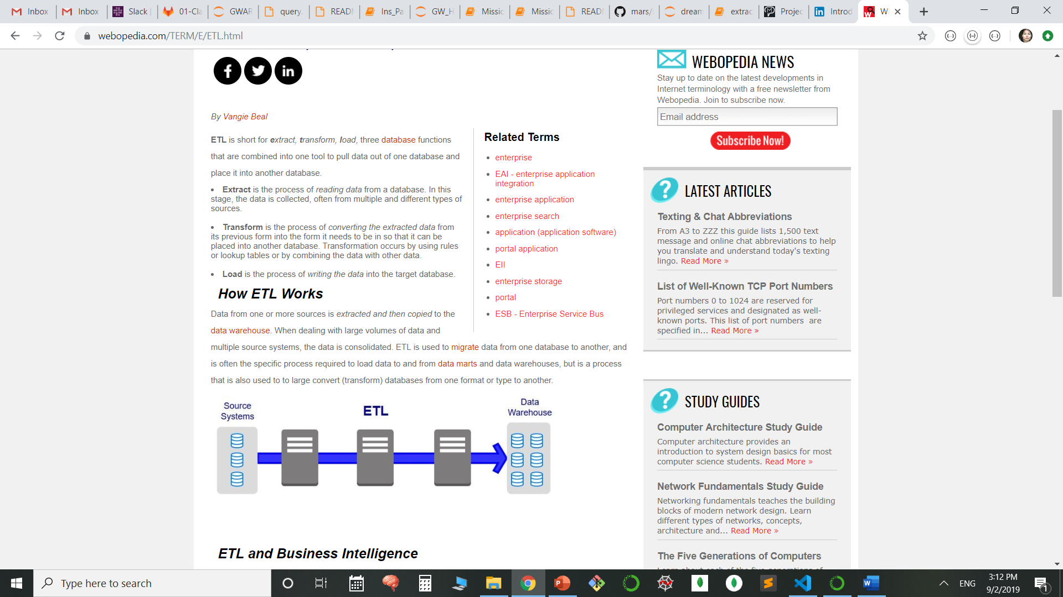
Introduction to ETL
ETL – Extract, Transform, and Load. It is a technique used to move data from one database (the source) to another database (the target).

Slide 3
Extract
This is the process of reading data from a database. In this stage, our data is collected with a *. wildcard, so multiple like files can be extracted in the same step. Different file types or sources can be extracted with separate Python programs.

Slide 4
Transform
This is the process of converting the extracted data from its previous form into the form it needs to be in so that it can be placed into another database.
Change the format of data before loading.
Cleaning the data, such as deduplicates.
Remove bad data or make it conform to rules.
Enforce data integrity of lookups and relationships.

Slide 5
Load
This is the process of writing the data into the target database. In the ADLF program we load into MongoDB with a one-minute repeating schedule, until the program is stopped by the user or all the files have processed.

Slide 6
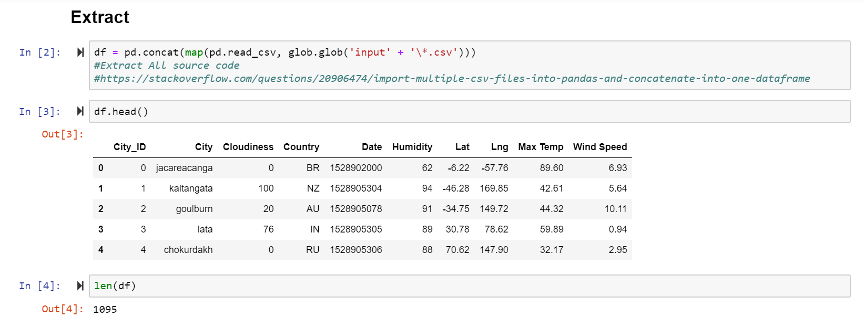
Extraction process
Figure1: extracted cities.csv and a duplicate cities2.csv file to Jupiter notebook with a *.csv wildcard.

Slide 7
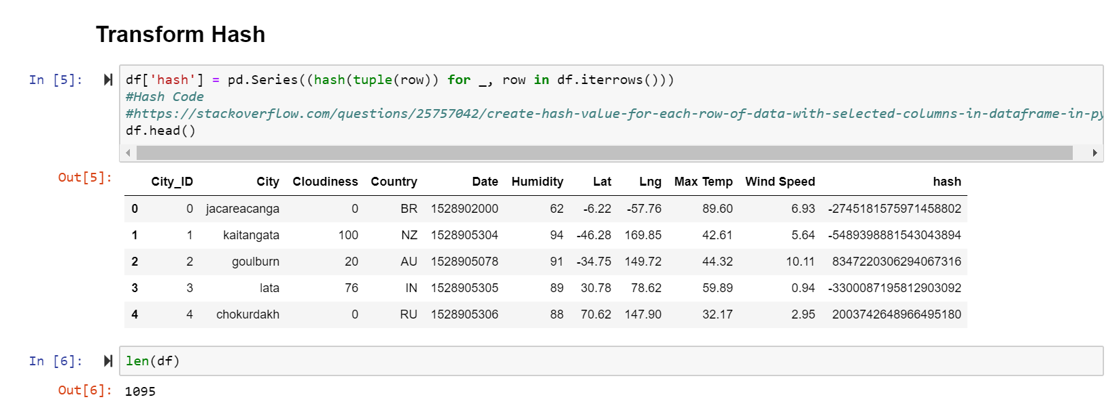
Transformation Hash Process
In this process, hash code column is added in order to create a truly unique row or record ID.

Slide 8
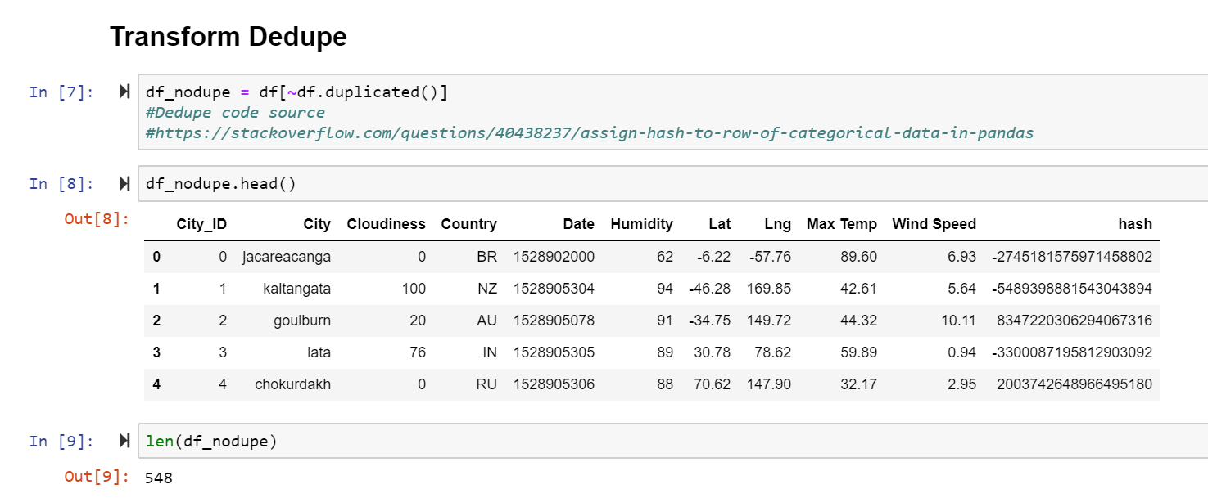
Transformation Dedupe Process
In this process, our Dataframe was deduped to 548 rows, from the original 1095 rows.

Slide 9
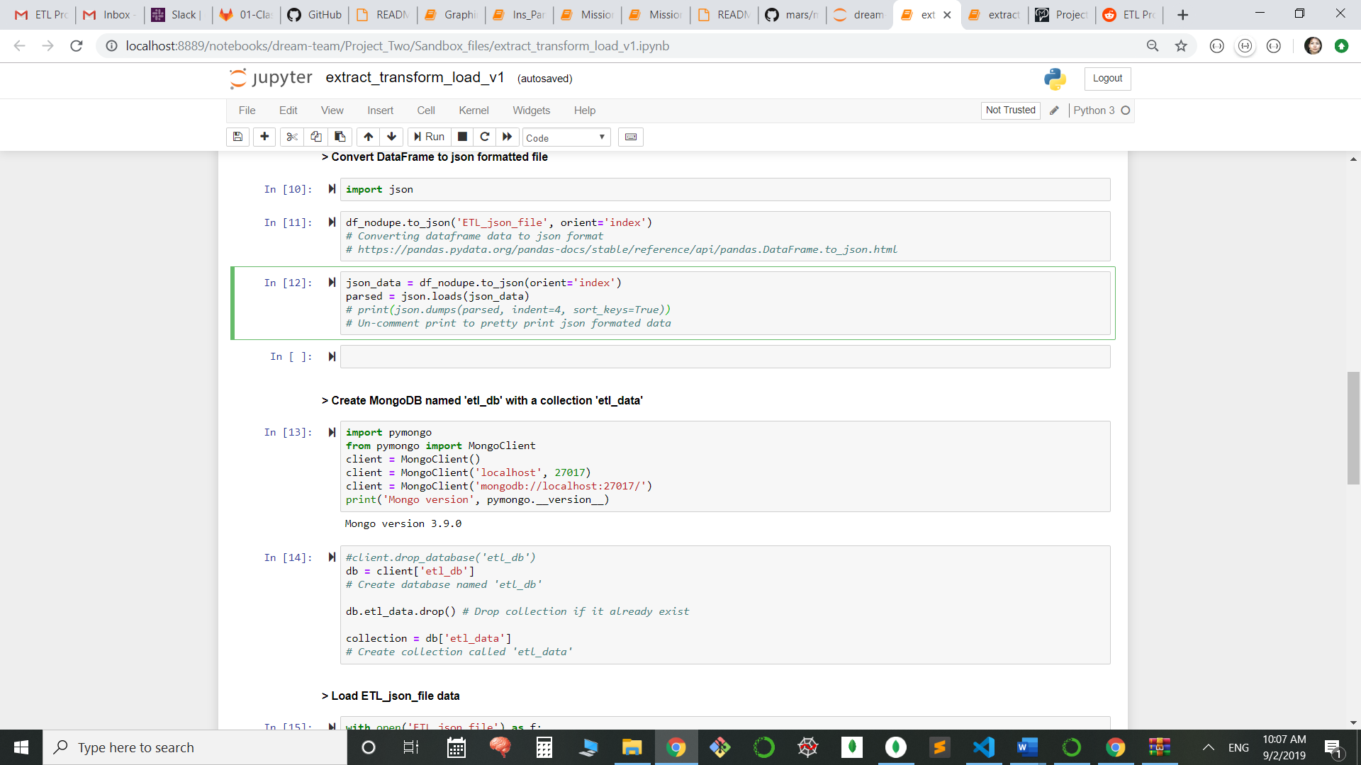
Loading process
Converted DataFrame to JSON formatted file

Slide 10
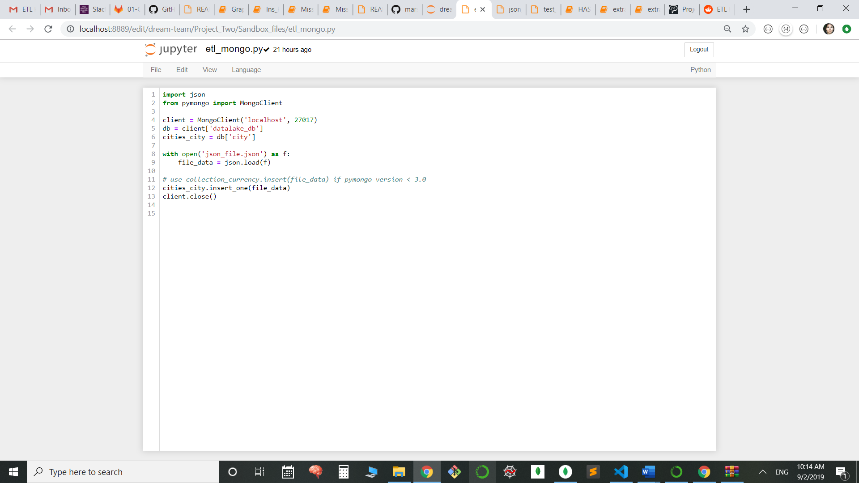
Loaded in MongoDB

Slide 11
Thank you

