Slide 1
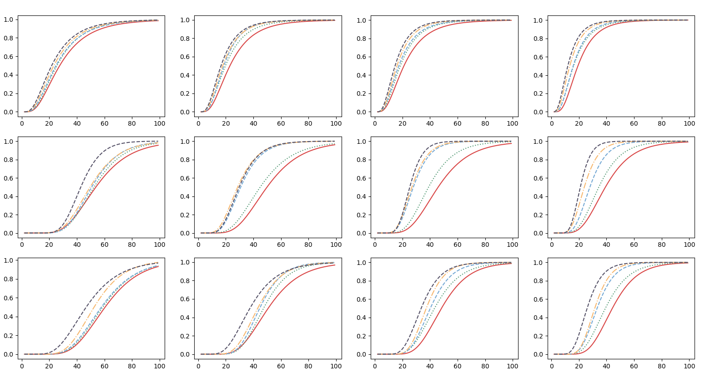
ALR =5%
ALR =10%
ALR =15%
ALR =20%
Serviceability
Damage Control
Ultimate

Slide 2
Serviceability
Damage Control
Ultimate
For each limit state there is a limiting corrosion level, at which the performance is reduced. For the serviceability limit state a corrosion level between 5% -10% appears to decrease the performance. For Damage control and Ultimate, this limit seems to be CL>10%. This is in well agreement with observed experiments in beams and columns at which a CL=10% or greater generated a lower performance, and in some cases a brittle response.

Slide 3
Serviceability
Damage Control
Ultimate
Similar responses can be observed if the results are observed by the axial load ratio parameter. It appears that axial load ratios of 10% and greater have a significant drop in the performance of the structure. Specially as the corrosion level is equal to or greater than 10%

Slide 4
The main take away from this analysis is that the recommendation substantiated by the experimental program, previous research, and now with the NLTHA. Is that CL=10% is an acceptable upper limit of acceptable level of corrosion. A much better outcome would be to specify a limit on corrosion level of 5%. Certainly on existing structures that were not designed to a performance level given a corrosion level a range of corrosion between 0%-10% would be acceptable if the structure is analyzed using NLTHA and accounting for the effective properties of the corroded RC structure.

