Slide 1
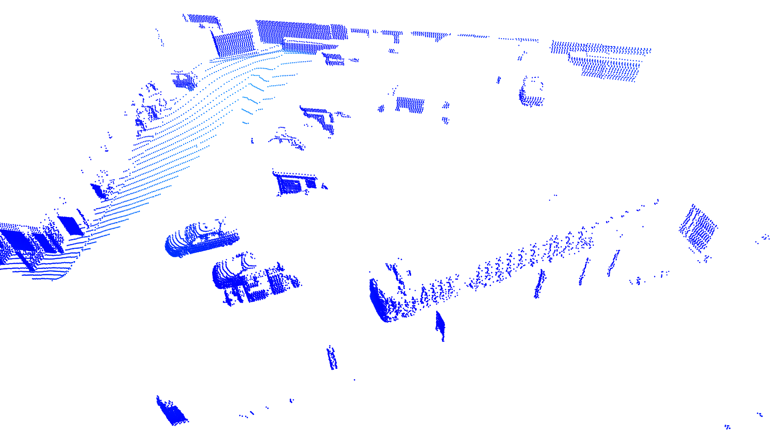
3D SceneFlow
Consecutive Point clouds
with ground removed
Per-point velocity
Per-point Motion Segmentation
Flow Optimization
(No training data)
Instance Segmentation
Robust Odometry estimation

Slide 2
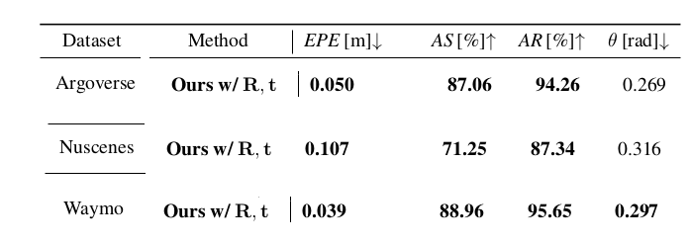
User
Libraries in pip, Python
Flows (velocities) without relying on object-class visual appearance
Set threshold for moving objects
Gather motion features, cluster with motion features for instances

Slide 3
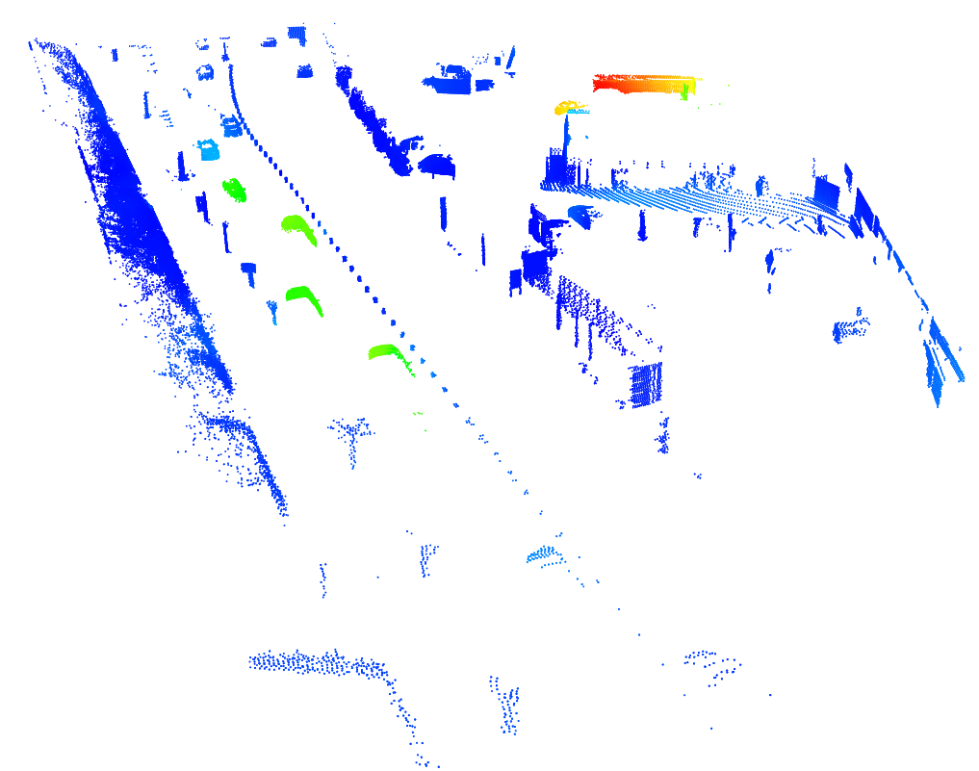
Flow magnitudes - 70 meter radius

Slide 4
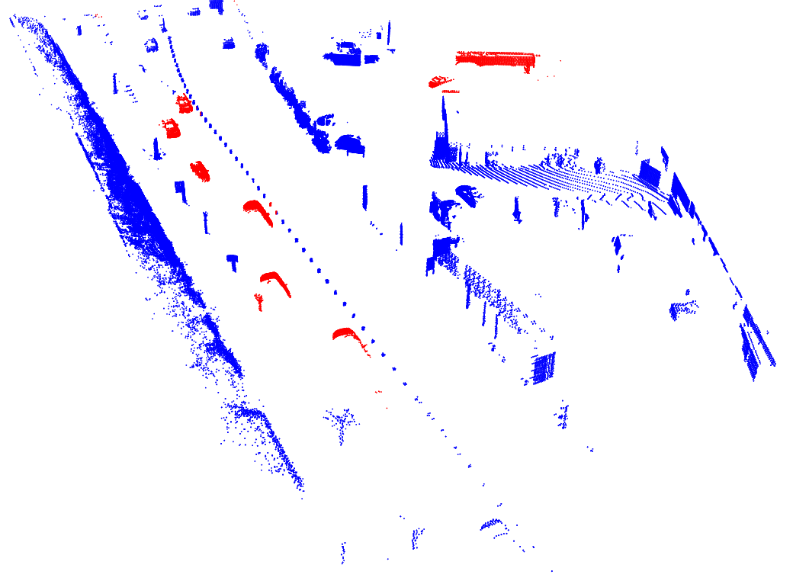
Motion Segmentation after speed thresholding

Slide 5
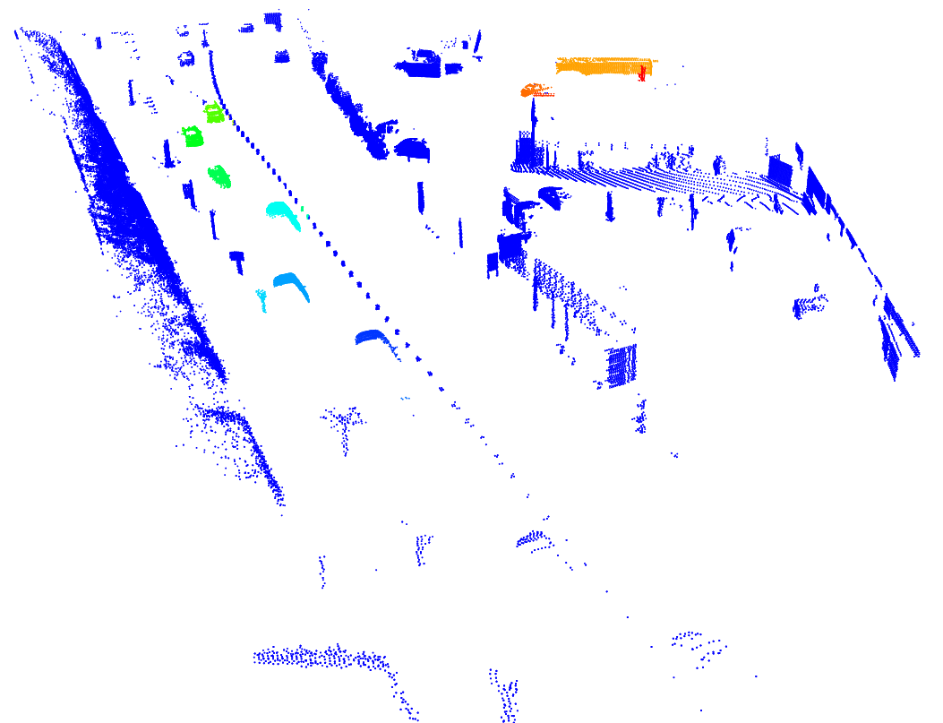
Moving Instance Segmentation

Slide 6
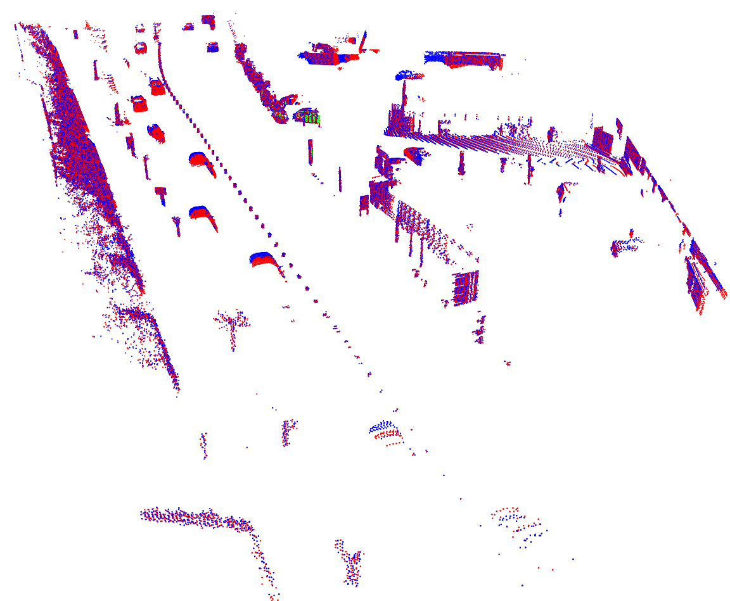
Odometry Estimation

Slide 7
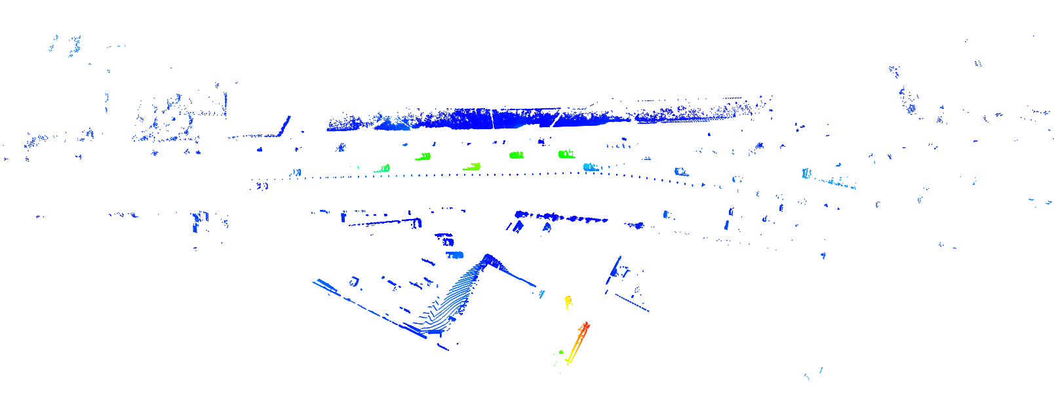
Frame in 150 meter radius

Slide 8
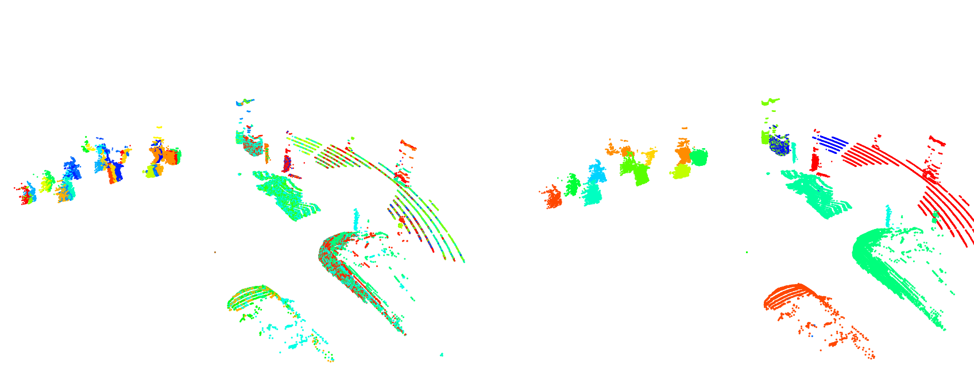
Joint Flow and Instances in 4D
Per-Frame instance
Joint Instances and Flow

Slide 9
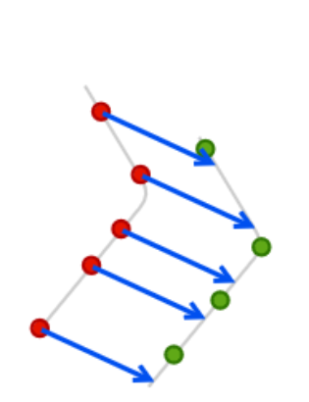
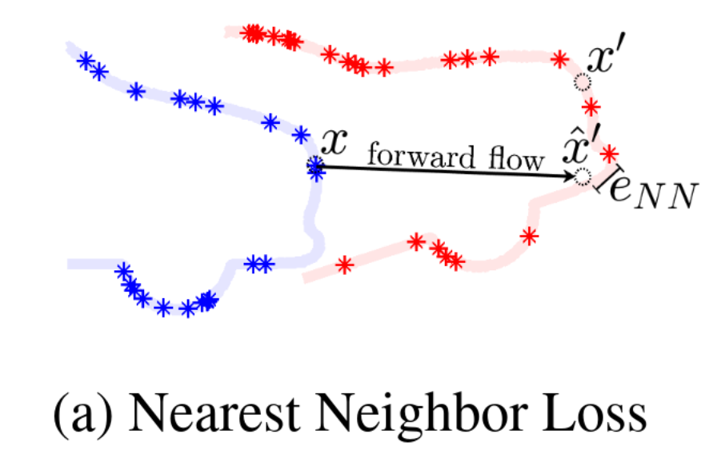
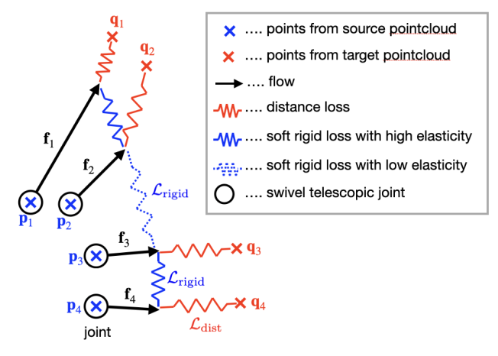
Transfer to new LiDAR data
Mittal 2020
Remove ground
As it is or tune params:
Learning rate - one that minimize the loss
K - increase for dense point clouds
Trade Speed (random subsampling, max iterations)

Slide 10
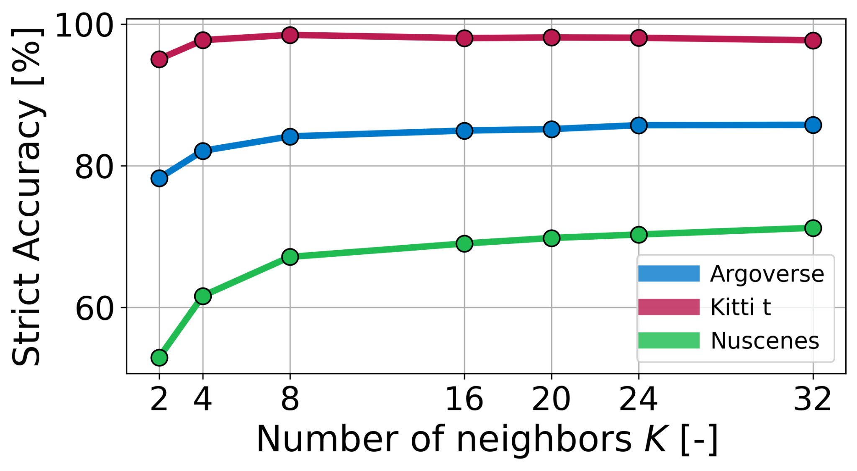
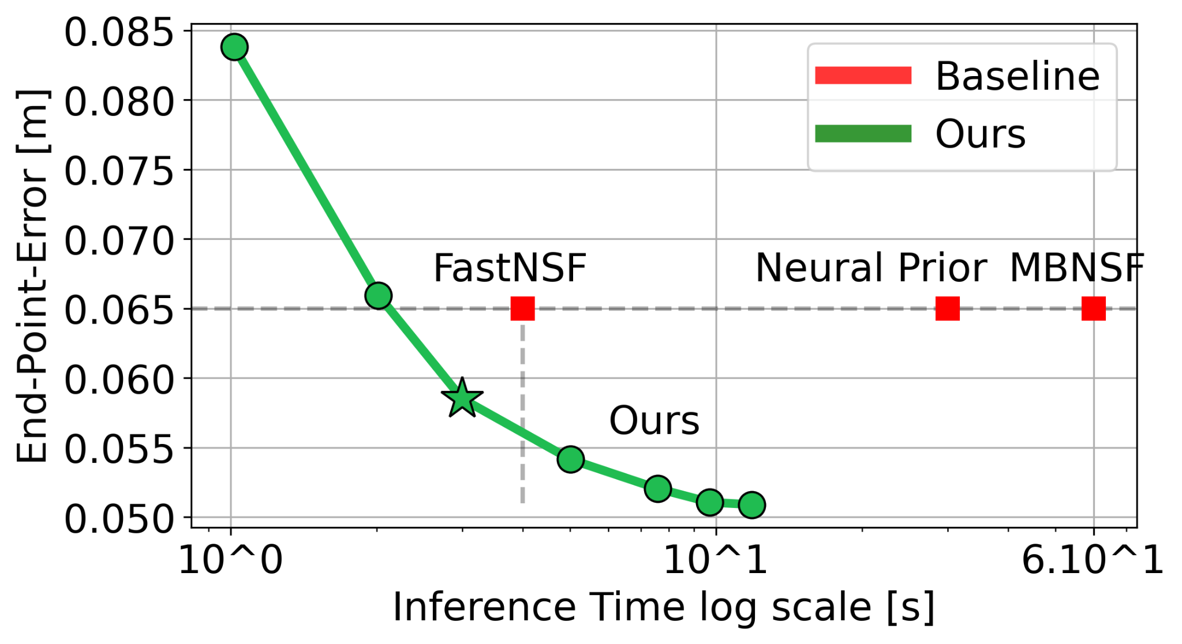
GPU Consumption
Radius: 150 meters, 200k points
FastNSF —> 4 seconds, 3.5 GB
Can produce labels for Big Neural Network for better and faster (~80 ms) performance.
K = 8 | 5 GB
K = 16 | 8 GB (5.7GB in 70 meters)
K = 32 | 18 GB
K = 64 | 32 GB

Slide 11
Intuitive Limitations
Neural Prior Architecture small for Pandar (2x points compared to Velodyne)
Not yet joint Instance and Flow optimization for better performance
Does not use whole sequence so might fail in greater distances
Odometry estimation also does not use sequence, therefore prefer KISS-ICP
Tuning moving (velocity) threshold

