Slide 1

Mathematical modelling for vaccine-preventable diseases
Further reading
Notes:
Introduce who we are

Slide 2
Further reading
Bayesian thinking
Statistical rethinking by Richard McElreath
A student’s guide to Bayesian statistics by Ben Lambert
Mathematical biology
Essential mathematical biology
Getting used to R
R handbook
R for data science
VIMC
Apply for affiliation
Learn more about fellowship visits
Look through VIMC publications

Slide 3
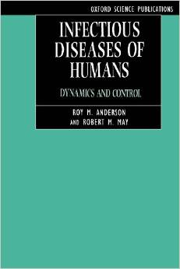
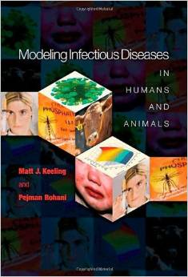

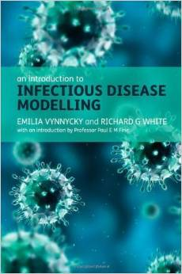
Mathematical Epidemiology Textbooks

Slide 4

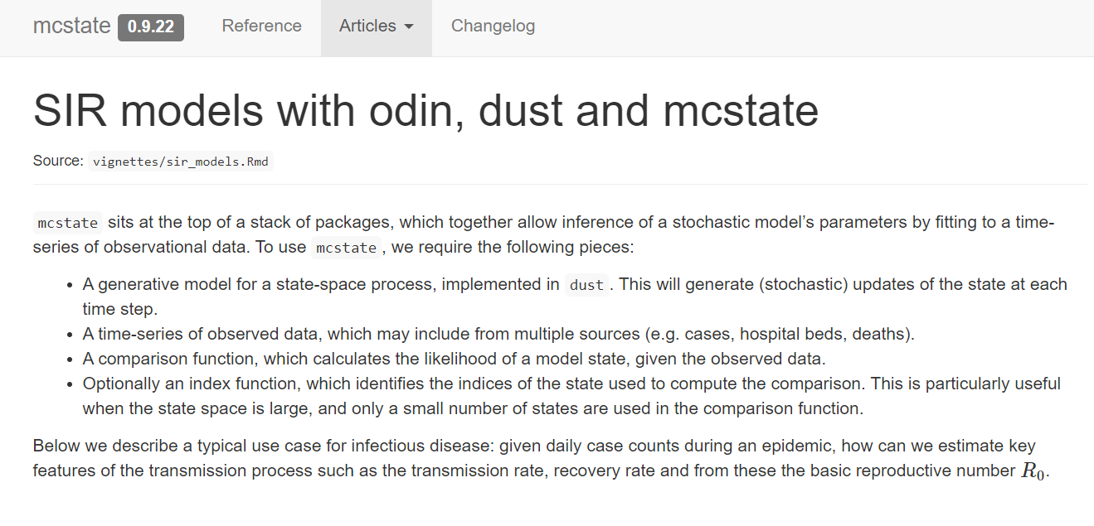
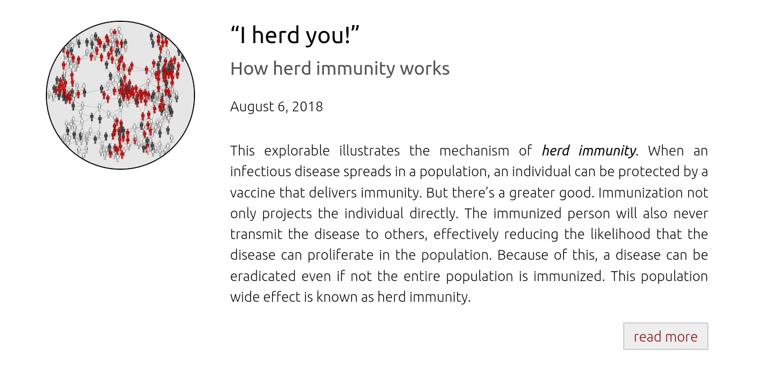
Other links
EpiModel
Mathematical Modeling of Infectious Disease Dynamics

