Slide 1

Mathematical modelling for vaccine-preventable diseases
Mathematics lecture 4
Probability
Andrew Conlan
Department of Veterinary Medicine
University of Cambridge
ajkc2@cam.ac.uk
With materials contributed by Matt Castle
Notes:
Introduce who we are

Slide 2
Probability
1. Probability
2. Random Variables
3. Distributions

Slide 3
Definitions
Formal way of describing processes with are in some way random or subject to chance
1. Classical Interpretation
“The number of favourable outcomes divided by
the number of possible outcomes”

Slide 4
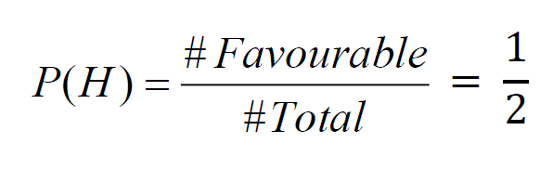

Coin Flipping
I flip a coin, what is the probability that it comes up heads?
If I flip a coin twice, what is the probability of getting two
heads?

Slide 5
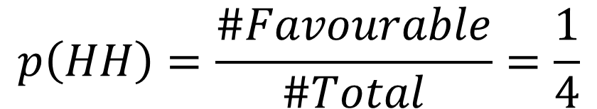
Coin Flipping
$$p\left(HH\right)=\frac{\#Favourable}{\#Total}=\frac{1}{4}$$
If I flip a coin twice, what is the probability of getting two heads?

Slide 6
Definitions
1. Classical Interpretation
“The number of favourable outcomes divided by the number of possible outcomes given that all outcomes are equally likely
Sometimes outcomes not equally likely…

Slide 7
Definitions
2. Frequentist Interpretation
“The proportion of favourable outcomes that
occur in a large number of trials”

Slide 8
Back to Flipping Coins
I flip a coin repeatedly, how does the long term
proportion of heads vary?

Slide 9
Definitions
2. Frequentist Interpretation
“The proportion of favourable outcomes that
occur in a large number of trials”
But what if we can’t perform a large number of
trials?...

Slide 10
Definitions
3. Subjective Interpretation
“A degree of belief that a particular outcome will
occur”
Can interpret a probability as a number
between 0 and 1 which represents our
belief in how likely an outcome is.
0=Impossible
1=Certain

Slide 11
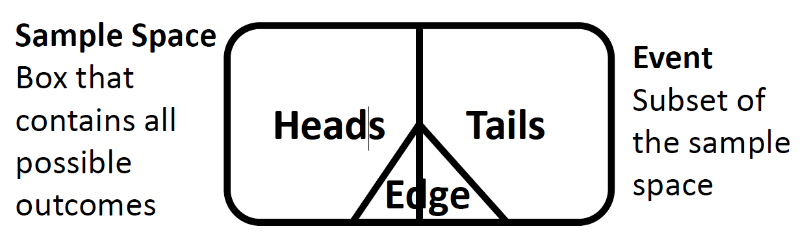
Events and Venn Diagrams
Events are what we calculate probabilities about
Venn Diagrams allow us to visualise events

Slide 12
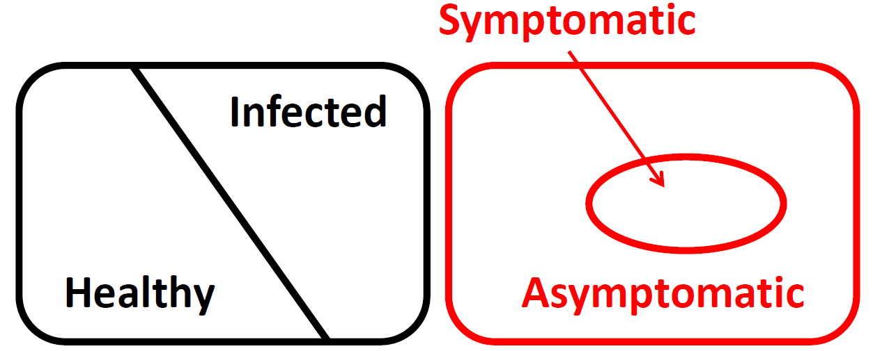
Events and Venn Diagrams
Choice of sample space is not unique
Events can overlap

Slide 13
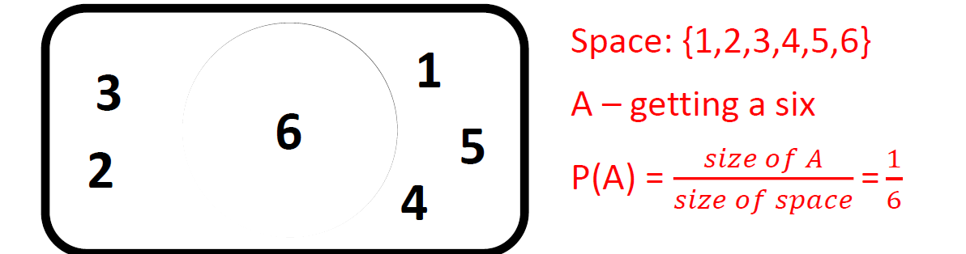
Notation
A: Name of event we are interested in
P(A): Probability that A occurs
P(A) is the ‘size’ of A relative to the ‘size’ of the sample space

Slide 14
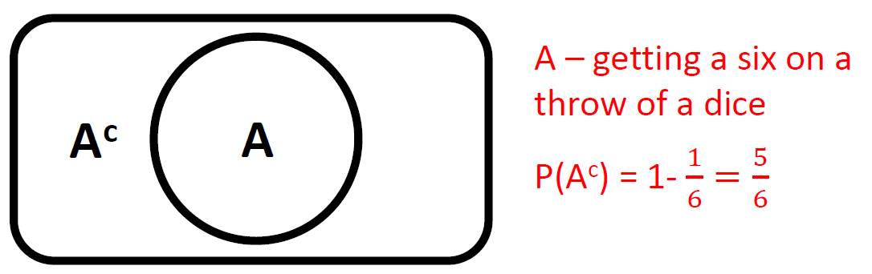
Notation - complements
Ac: Complement of A (everything not in A)
P(Ac) : 1-P(A)

Slide 15
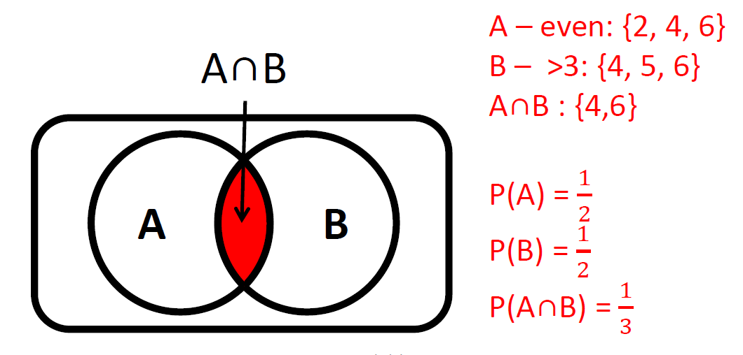
Notation - Multiple Events
A∩B–Intersection of A and B

Slide 16
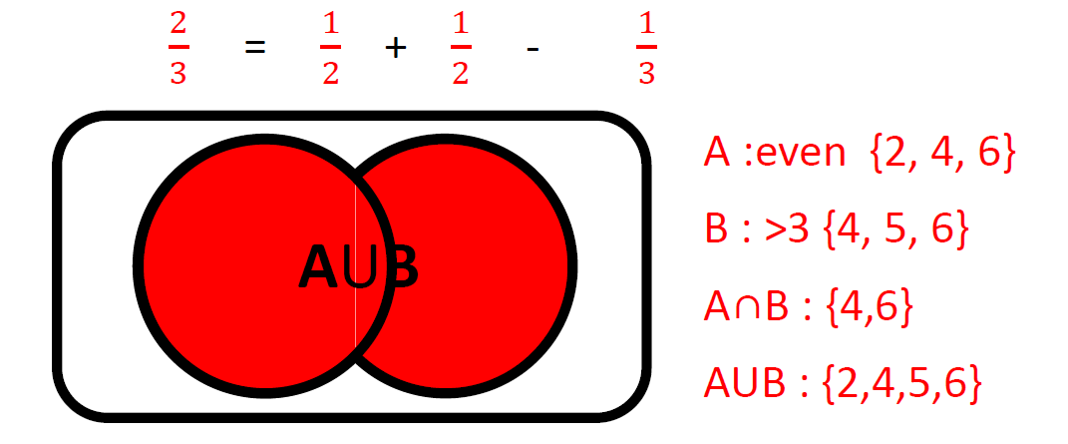
Notation - Multiple Events
AUB–Union of A and B(A or B occur)
P(AUB) = P(A) + P(B) –P(A∩B)

Slide 17
Conditional Probability
Sometimes events affect each other’s probabilities
Consider rolling a dice
What is P(get a 6)?
How does this change if you already know you rolled an even number?
In this case we say that the events are conditioned on each other

Slide 18
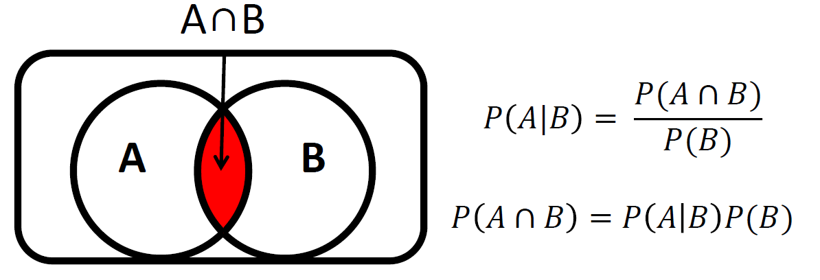
Conditional Probability
P(A|B)–Probability that A occurs given that B has already occurred
P(A|B) is the ‘size’ of A∩B relative to the ‘size’ of B

Slide 19
Independence
Sometimes events don’t affect each other.
𝑃(𝐴|𝐵)=𝑃(𝐴) 𝑃(𝐵|𝐴)=𝑃(𝐵)
We say that these events are independent
This makes it easy to calculate the probability of both events occurring:
𝑃(𝐴∩𝐵)=𝑃(𝐴|𝐵)𝑃(𝐵)
𝑃(𝐴∩𝐵)=𝑃(𝐴)𝑃(𝐵)

Slide 20
Random Variables
A random variable is a quantity whose value depends on the outcome of a random process (e.g. an experiment)
Consider rolling two dice (the random process)
Random Variable Definition Values
X The highest number {1,2,..,6}
Y The number of sixes {0,1,2}
Z The sum of the two dice {2,3,…,12}
A random variable taking a particular value is an event e.g.
X=4 and therefore has a probability P(X=4)

Slide 21
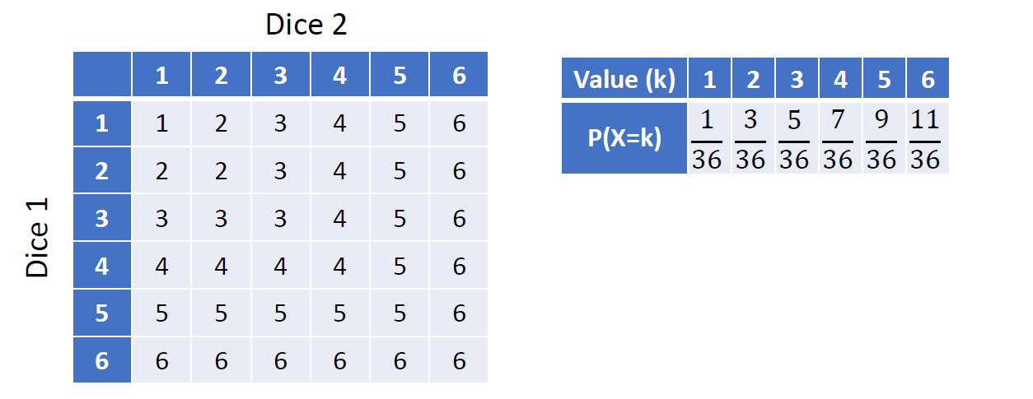
Example
X is the highest number obtained when throwing two dice.
X takes values from {1, 2, 3, 4, 5, 6}

Slide 22
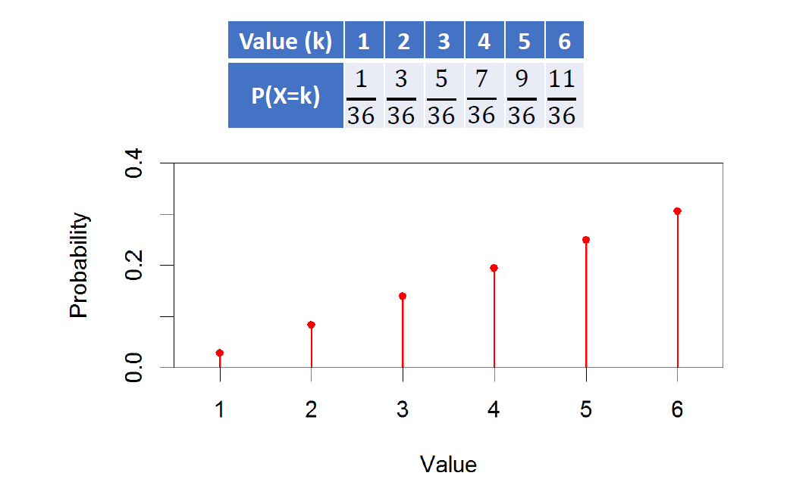
Probability Distributions

Slide 23
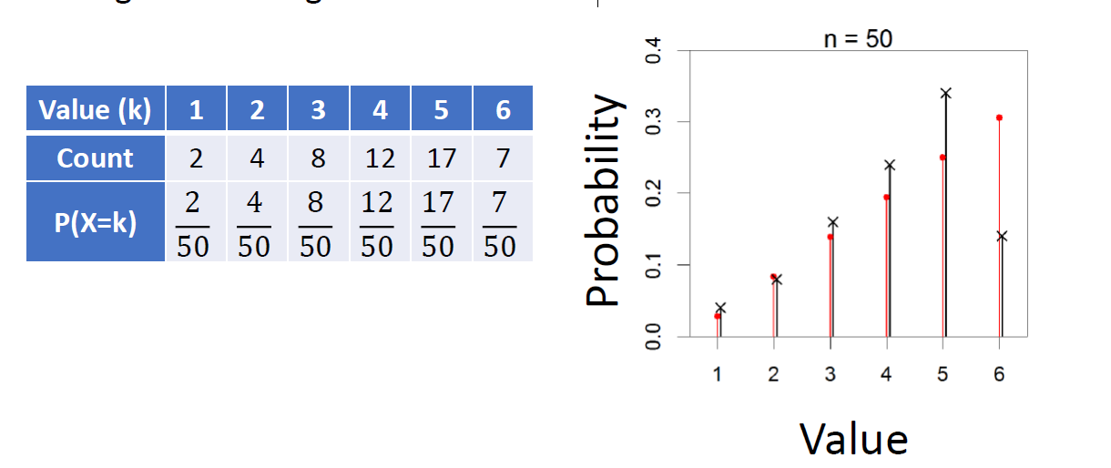
Probability Distributions
These can be derived experimentally as well as theoretically
Imagine throwing two dice 50 times

Slide 24
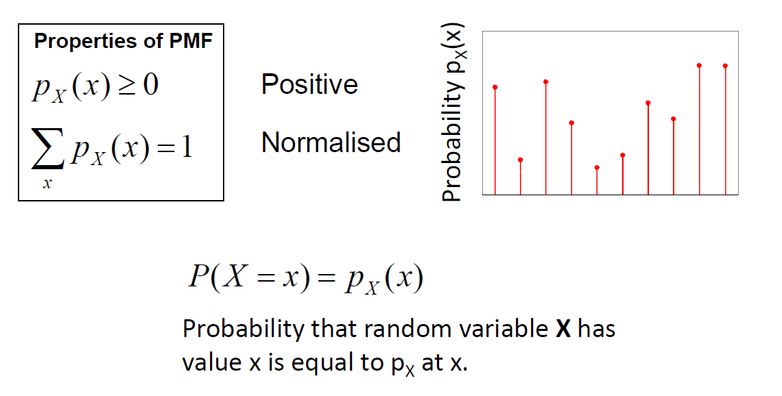
Probability Mass Functions (PMF)

Slide 25
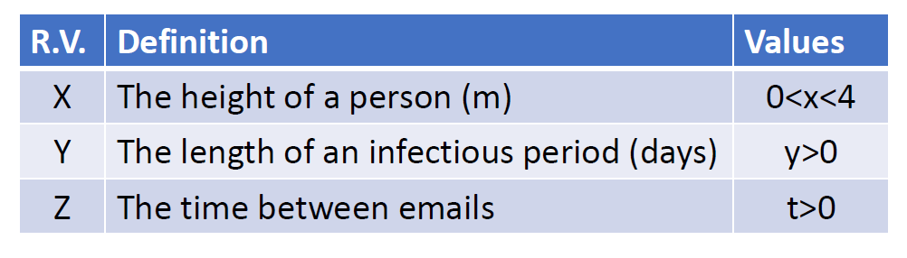
Discrete vs. Continuous
A random variable is a quantity whose value depends on the outcome of a random process
The value can be a continuous number
Continuous random variables need to be treated slightly differently from discrete random variables

Slide 26
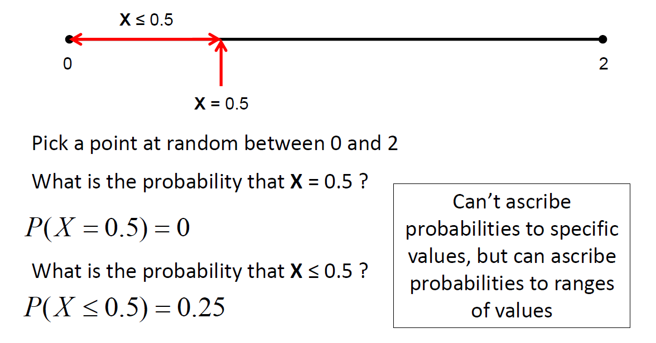
Continuous Random Variables

Slide 27
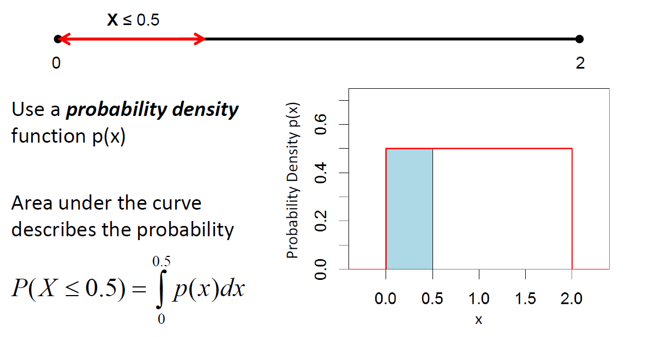
Continuous Random Variables

Slide 28
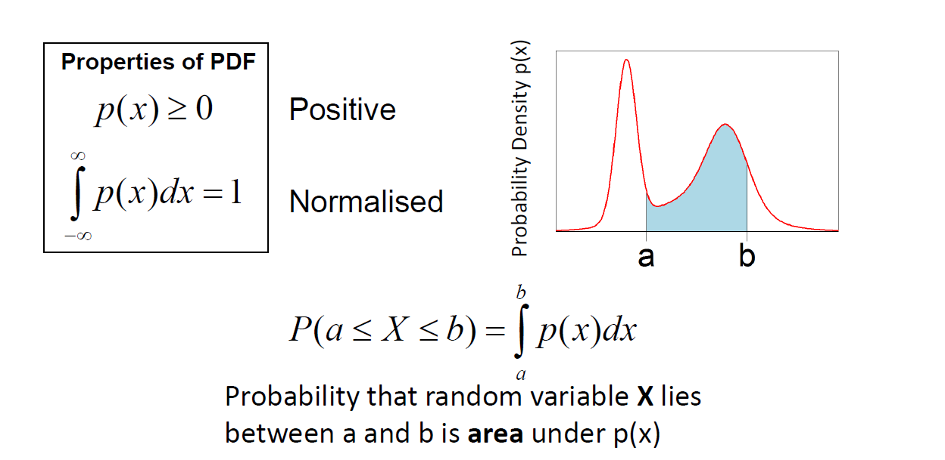
Probability Density Functions (PDF)

Slide 29
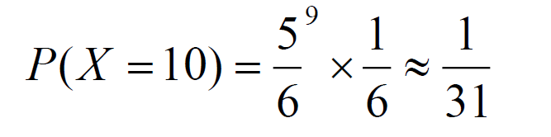
Probability Distributions
For simple experiments we can derive equations that explicitly calculate the values of a probability distribution
What’s the probability of having to roll a dice 10 times before getting a six? (i.e. I get a six on my 10th throw)
P(get a six) = 1/6
P(not get a six) = 5/6
Need to “not get a six” 9 times and then “get a six”

Slide 30
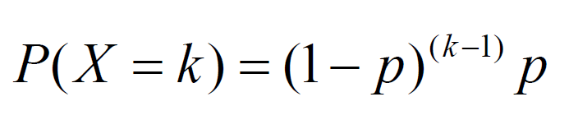
Geometric Distribution
Consider an experiment which consists of only two possible outcomes (Success, Failure)
P(Success) = p
P(Failure) = (1-p)
Let X be the number of trials until my first success
What’s the probability of having to complete k trials?
need k-1 “failures” and then 1 “success”

Slide 31
Distribution Summary
Binomial (Discrete)
Normal (Continuous)
Gamma (Continuous)
Exponential (Continuous)
Uniform (Continuous)

Slide 32
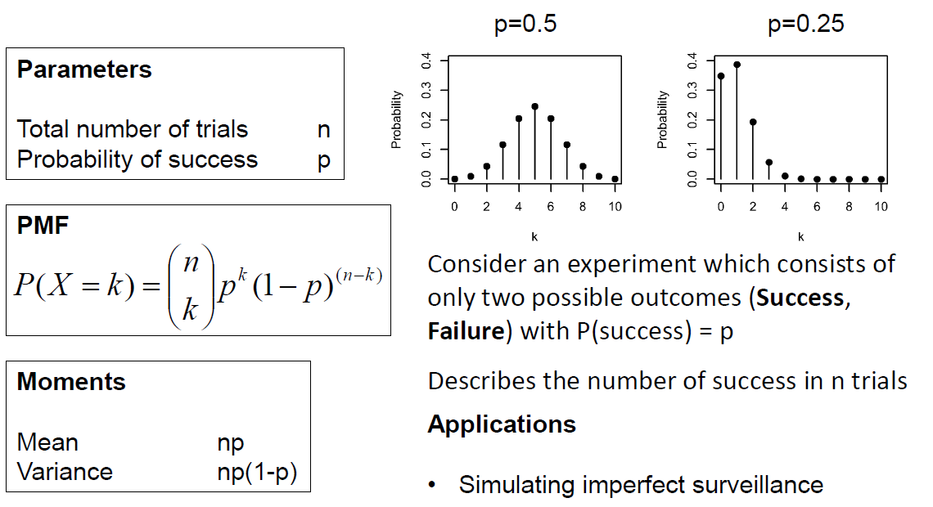
Binomial distribution

Slide 33
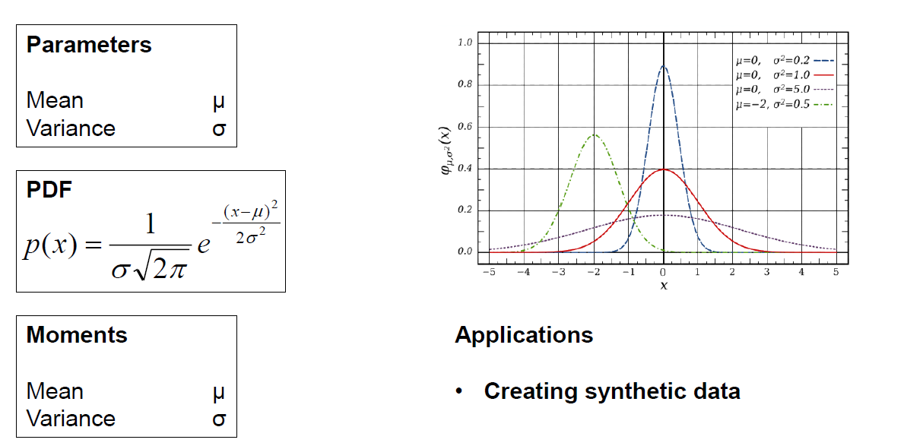
Normal (Gaussian) Distribution

Slide 34
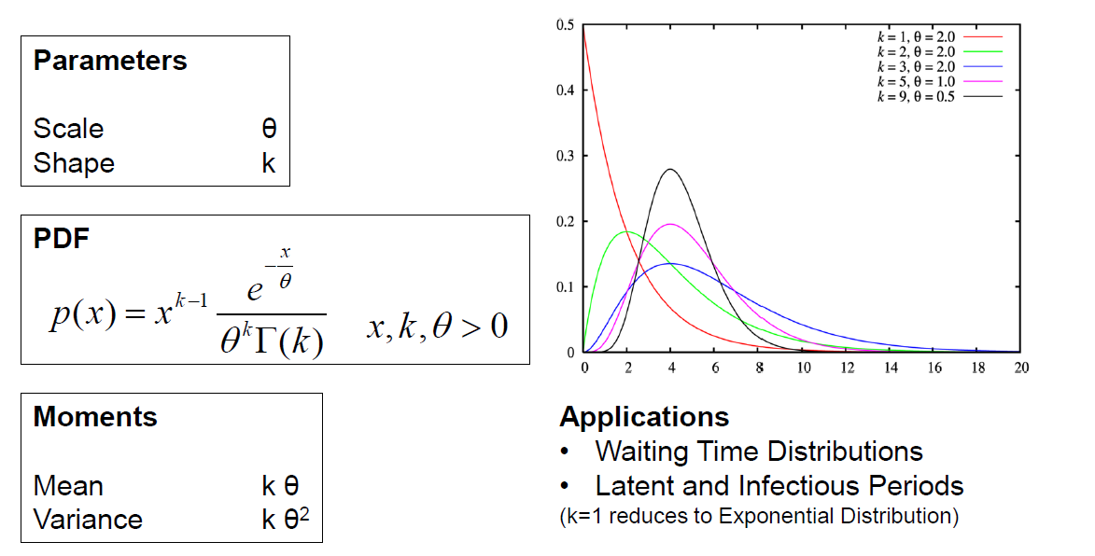
Gamma Distribution

Slide 35
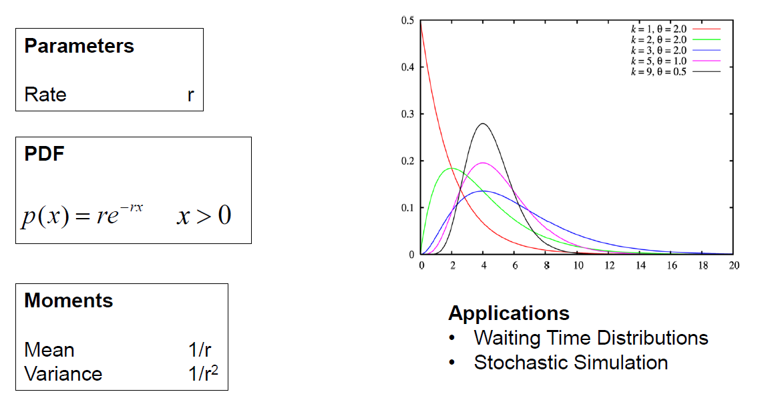
Exponential Distribution (k=1)

Slide 36
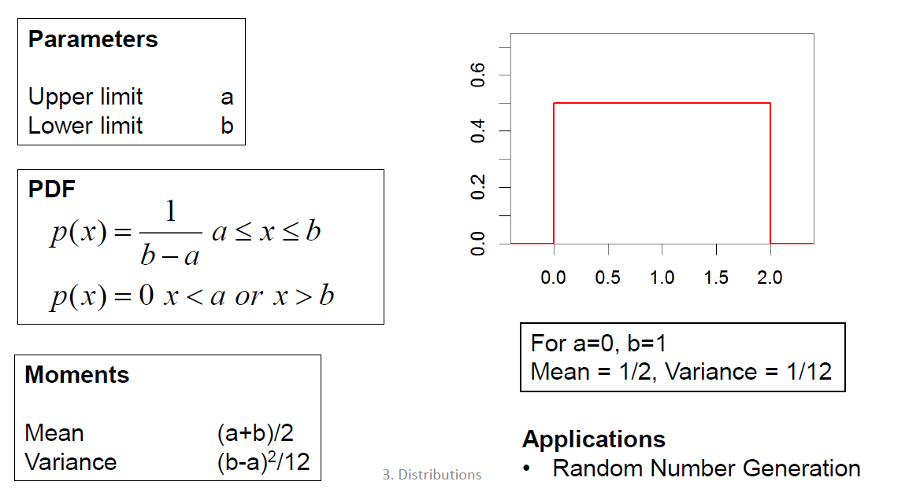
Uniform Distribution

Slide 37
Probability Recap
Probability
Definitions
Venn Diagrams
Mathematics
Random Variables
Continuous
Discrete
Distributions

