Slide 1

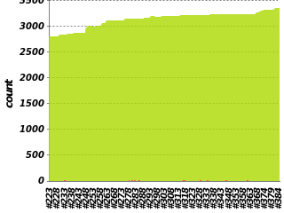





Tuleap users
Community
Dashboarding
yum update
1mn down time
once a month
git push
RPMs
Build
automation
Feeback

