Slide 1




AI-Powered Chatbot using Azure AI Studio
Problem Statement
Organizations often struggle with efficiently retrieving information from large sets of documents. Traditional keyword-based search methods can be inaccurate, time-consuming, and frustrating for users. A smarter solution is needed—one that understands natural language queries and delivers precise, context-aware answers.
This project aims to build an AI-powered chatbot using Azure AI Studio, which leverages AI search, GPT models, and Python to create a document-based Q&A system. The chatbot will allow users to ask questions in natural language and receive accurate responses based on specific uploaded documents. Additionally, it will ensure that irrelevant or out-of-scope queries are properly handled.

Slide 2
Solution
The solution to this problem was implemented by developing an AI-powered chatbot using Azure AI Studio, integrating AI Search, GPT models, and Python to create a document-based Q&A system. The project began with setting up an AI Hub in Azure AI Studio to manage shared resources, followed by configuring storage accounts for document uploads and linking necessary AI services. Key documents, including a real estate guide and a driving handbook, were uploaded and indexed using AI Search Service, which enabled efficient retrieval of relevant information. A prompt flow was then designed to process user queries, utilizing Python for filtering and a GPT model to generate context-aware responses. The chatbot was programmed to ensure that responses were strictly based on the provided documents, rejecting out-of-scope queries. Once the logic was tested, the prompt flow was deployed as an API endpoint, and a Python web application was developed to allow users to interact with the chatbot seamlessly. The final solution provides an efficient, AI-driven system for retrieving precise answers from large document repositories, improving accessibility and reducing manual search time.

Slide 3
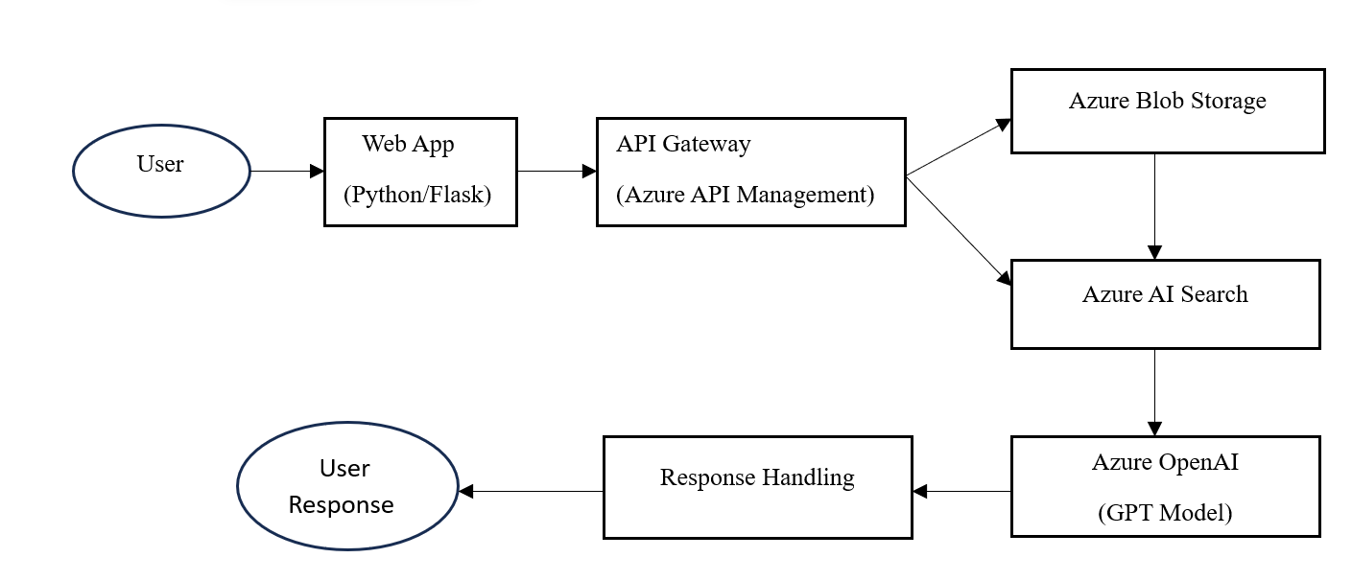
TECH ARCHITECT

Slide 4
How is Microsoft Azure used?
Microsoft Azure is used as the core cloud platform for deploying and managing the AI-powered chatbot. At a minimum, Azure AI Studio is utilized to develop and integrate AI services. Specifically, the chatbot leverages:
Azure AI Services Used:
Azure OpenAI Service – Provides access to GPT models for generating intelligent and context-aware responses.
Azure AI Search – Indexes and retrieves relevant document content for answering user queries.
Azure Blob Storage – Stores reference documents (e.g., real estate guides, driving handbooks) for AI processing.
Azure API Management or Azure Functions – Handles requests and routes them to the appropriate AI services.
Azure Content Safety – Ensures that chatbot responses are filtered for harmful or inappropriate content.
This combination of Azure services ensures a scalable, secure, and intelligent chatbot experience.

Slide 5
Tech Stack Used
The project is built using the following technologies:
Frontend: Python (Flask/ Fast API) for the web interface
Backend: Azure Functions / API Management for processing requests
AI Services: Azure OpenAI (GPT Model) for chatbot responses
Search & Data Handling: Azure AI Search for indexing documents
Storage: Azure Blob Storage for storing reference materials
Security: Azure Content Safety for filtering harmful content
Monitoring: Azure Application Insights for logging & tracking

