Slide 1
Exploratory Data Analysis (EDA) - School Dataset
Unveiling insights into student performance, fees, and demographics

Slide 2
Introduction: Understanding the Dataset
This analysis aims to uncover key insights about students, schools, and academic performance.
We will explore:
- Student demographics and income levels
- Distribution of marks and academic performance
- The relationship between school fees, family income, and performance
- Patterns and trends for better decision-making

Slide 3
Dataset Overview: Key Numbers
- Total Students: 800
- Number of Schools: 3
- Classes Represented: 12
- Age Range: 5 - 20
- Marks Range: 55 - 500
- Average Monthly Family Income: 24,664.21
- Average Monthly School Fees: 2,853.75

Slide 4
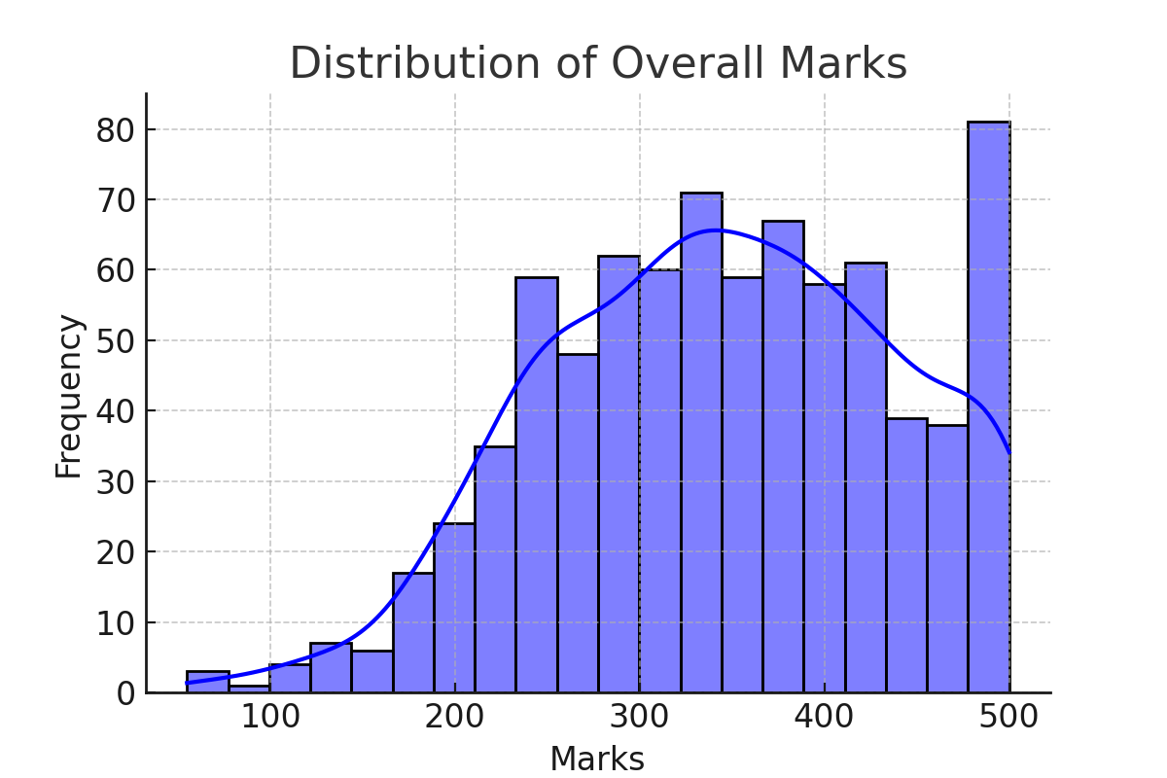
How Do Students Perform?
The distribution of student marks gives insights into overall performance.

Slide 5
Failure Rate: Who Needs More Support?
Percentage of students who scored below 200: 6.62%

Slide 6
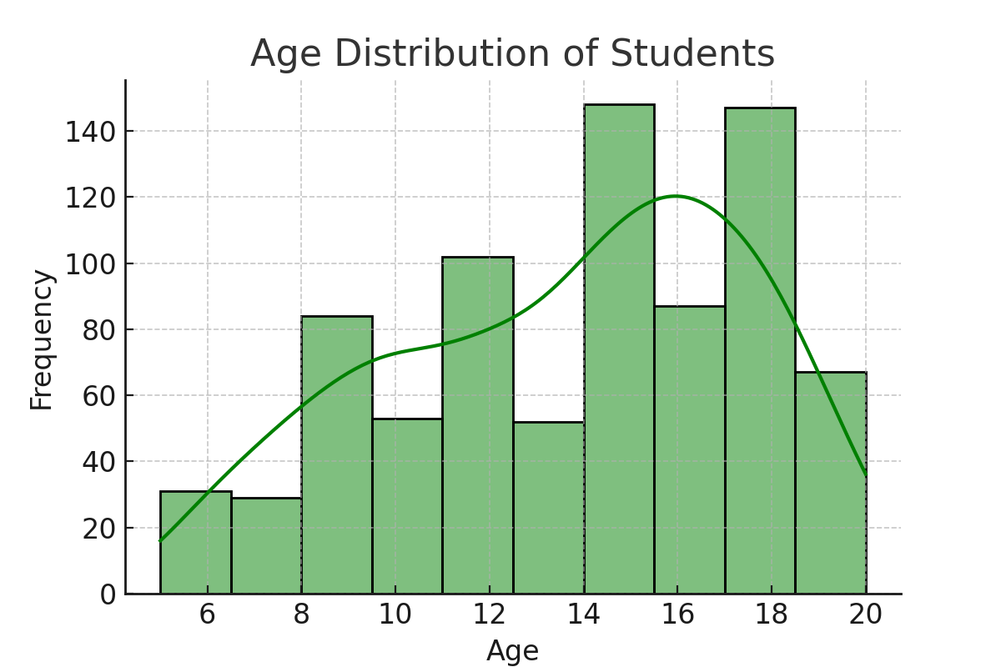
How Old Are the Students?
Understanding the age distribution across schools.

Slide 7
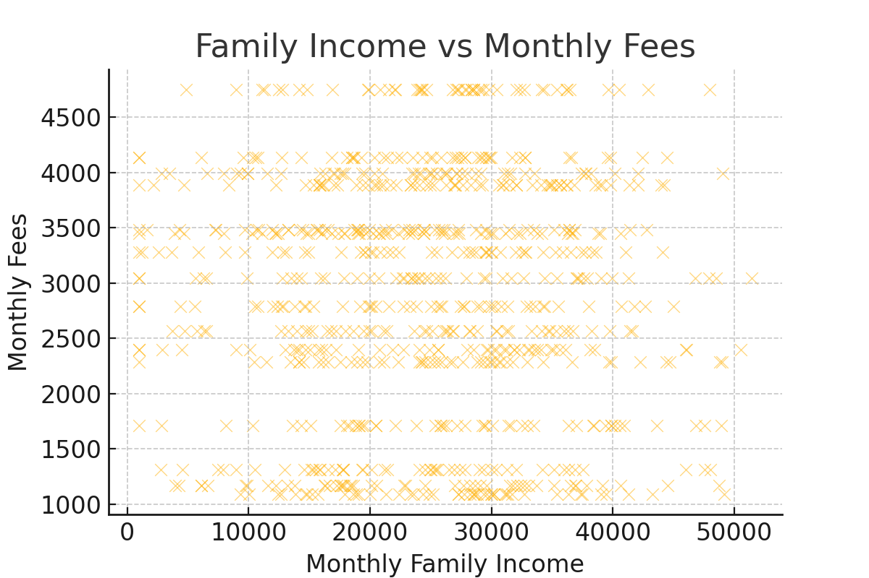
Can Families Afford School Fees?
Exploring the relationship between family income and school fees.

Slide 8
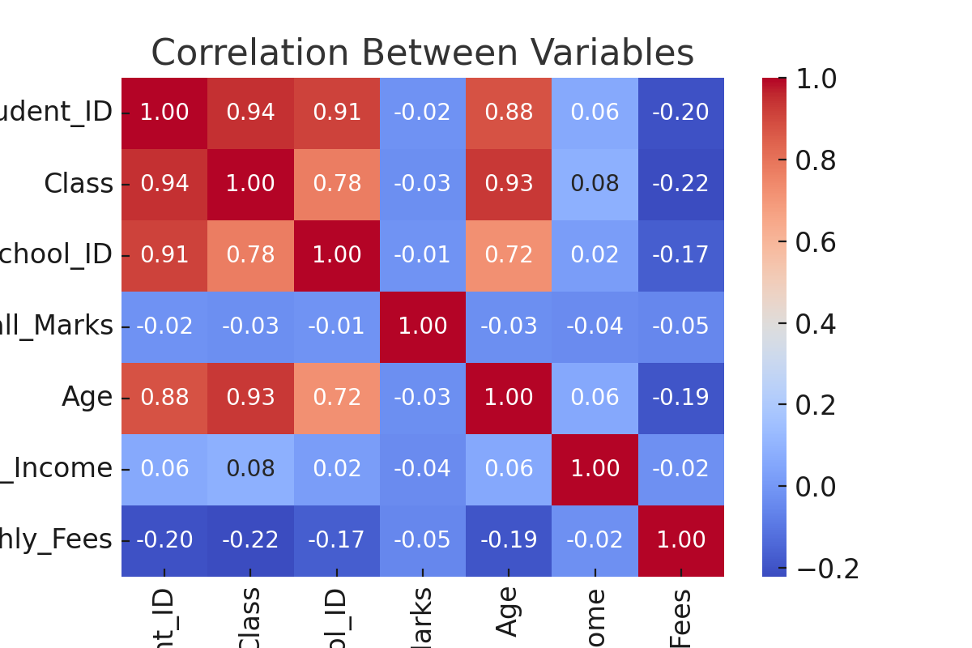
What Factors Influence Performance?
Correlation analysis between fees, marks, and family income.

Slide 9
Conclusion & Recommendations
Key Findings:
- A significant percentage of students scored below the passing mark.
- Family income influences the type of school students attend.
- Higher school fees may be linked to better academic performance.
- Further analysis is needed to understand causality and improve educational policies.
Recommendations:
- Schools should offer scholarships to students from low-income families.
- Additional academic support should be provided for struggling students.
- Policymakers should consider fee regulations based on family income distribution.

Slide 10
Professional Pointers
1. **Data-Driven Decision Making**:
Schools can utilize this analysis to optimize resource allocation, improve student performance, and design targeted interventions.
2. **Financial Insights for Policy Makers**:
The correlation between family income and school fees highlights the need for structured financial aid programs.

Slide 11
Assumption-Based Cases
- **Assumption 1**: Students from higher-income families may have access to better educational resources, impacting their performance.
- **Assumption 2**: Schools with higher fees might offer better infrastructure and teaching quality, influencing student outcomes.
- **Assumption 3**: External socio-economic factors, such as parental education, may also contribute to student performance.

Slide 12
Final Suggestions for Improvement
1. **Implementing Need-Based Scholarships**: Schools should introduce financial aid programs to support students from lower-income backgrounds.
2. **Enhancing Learning Support**: Schools should identify students at risk of failure early and provide additional academic resources.

