Slide 1
Exploratory Data Analysis (EDA) - School Dataset
Unveiling insights into student performance, fees, and demographics

Slide 2
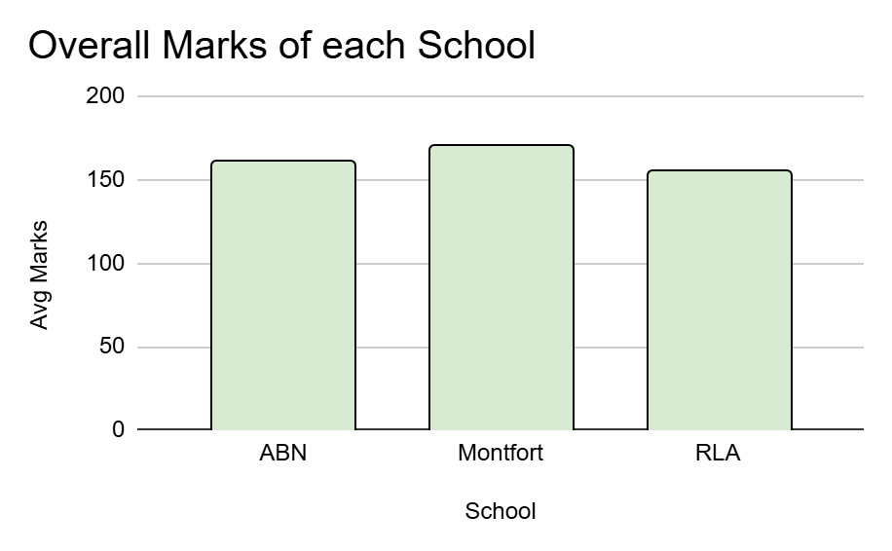
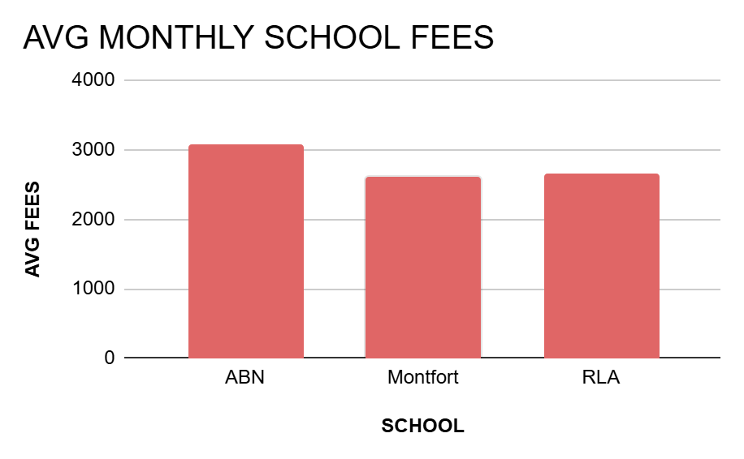
Introduction
Total class range : 9-12
Total number of students in each class:50
Total number of students in school:200
Student_ID : 3
RLA
SCHOOLS
MONTFORT
ABN
Total Class range : 9 -12
Total number of students in each class : 50
Total number of students in school:200
Student_ID : 2
Total class range : 1-8
Total number of students in each class:50
Total number of students in school : 400
Student_ID : 1

Slide 3
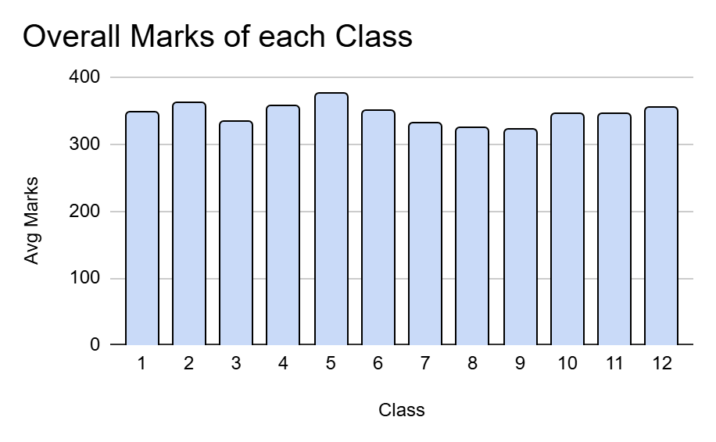
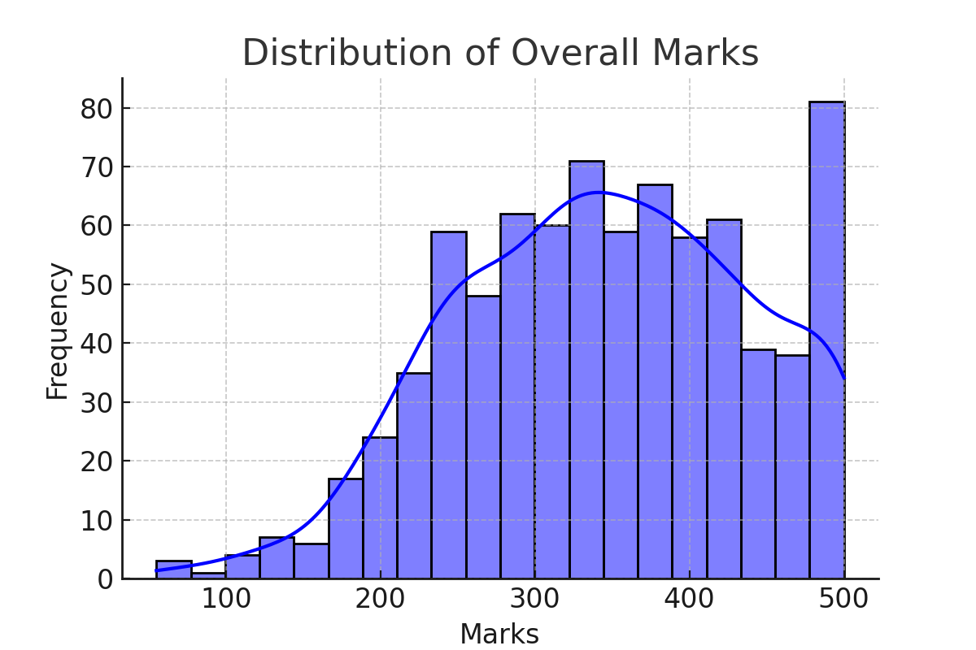
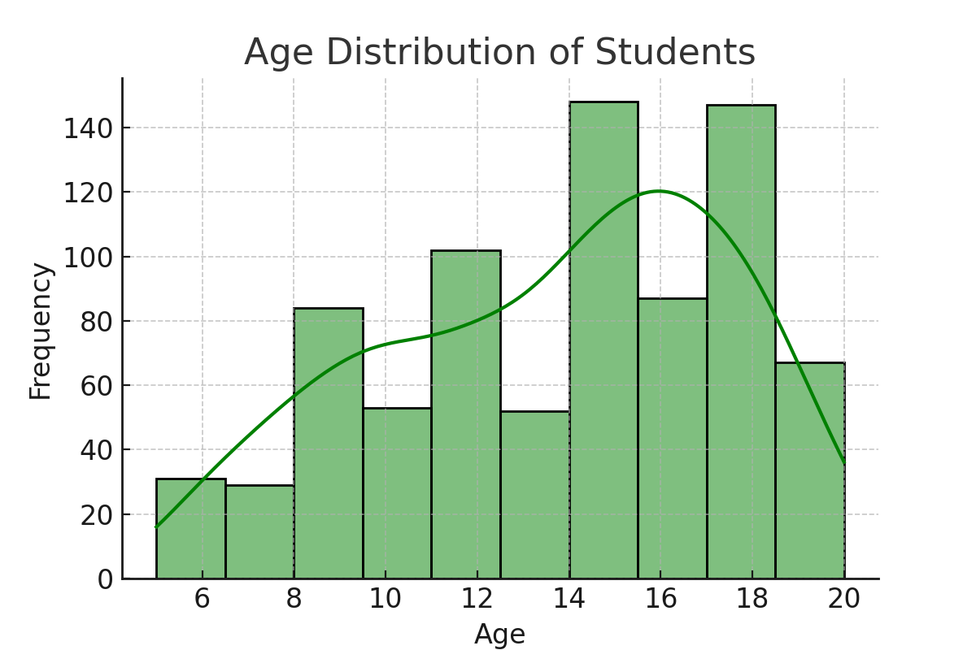
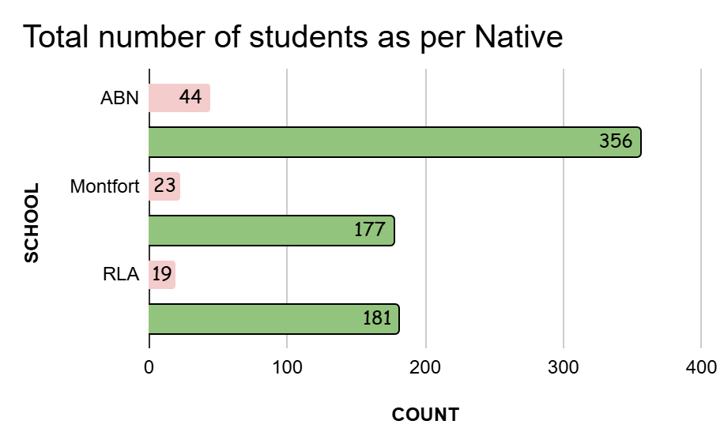
Basic Charts

Slide 4
Dataset Overview: Key Numbers
- Total Students: 800
- Number of Schools: 3
- Classes Represented: 1 to 12
- Age Range: 5 - 20
- Marks Range: 55 - 500
- Average Monthly Family Income: 24,664.21
- Average Monthly School Fees: 2,853.75

Slide 5
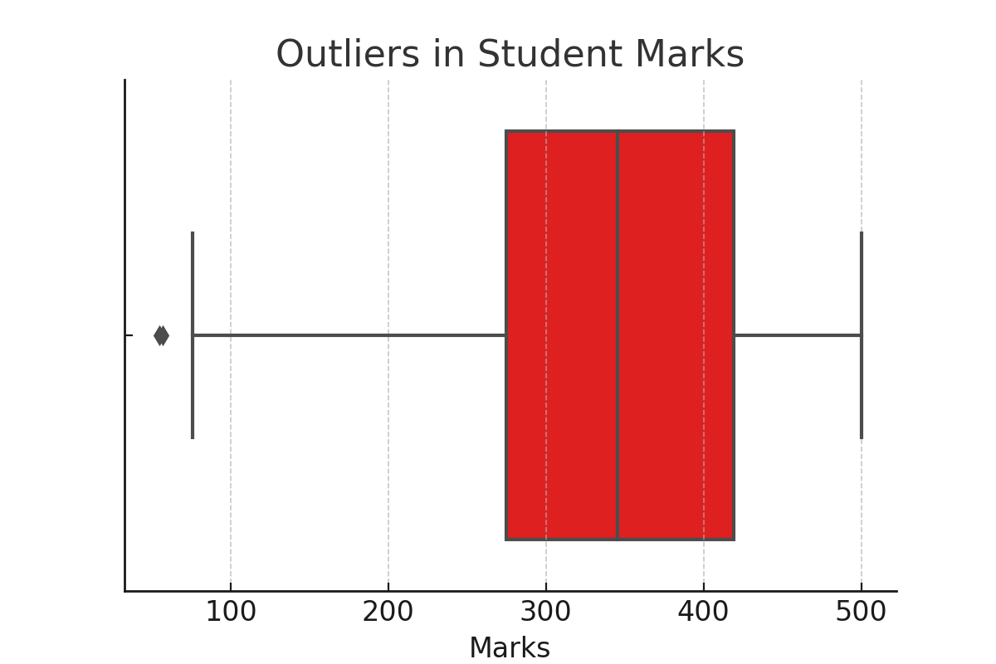
Data Quality Check
Outlier Detection
Missing Values | No Missing Values Found
Duplicate Values | No Duplicate Values Found
There are total 2 students who have every extremely low marks compared to overall marks.

Slide 6
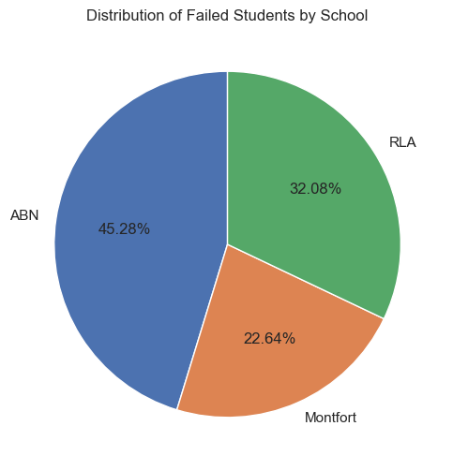
Failure Rate: Who Needs More Support?
Assumption : Passing marks = 200/500
Percentage of students who scored below 200 passing marks from all the schools : 6.62%
Class 2 has the highest failure rate, with 10% of students scoring below the passing marks.

Slide 7
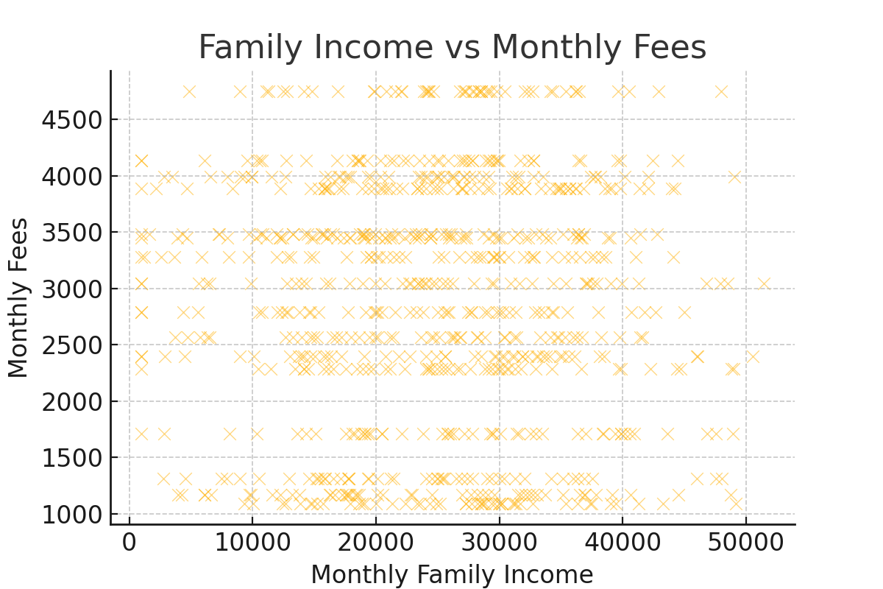
Can Families Afford School Fees?
Exploring the relationship between family income and school fees.
Assumption: Students can Afford if school fees>20 % monthly family income.
Approximately 19% of students cannot afford their school fees, as their fees exceed 20% of their monthly family income.

Slide 8
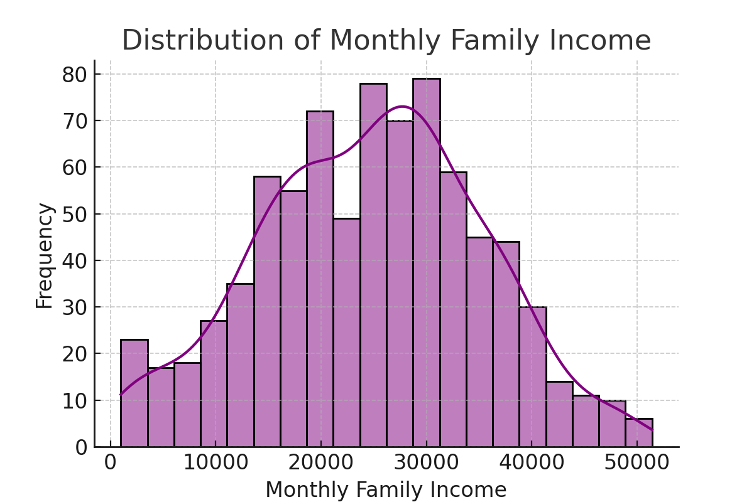
Income Levels of Families
Histogram showing the distribution of family incomes.
Approximately 9% of families have a monthly income of less than 10,000.

Slide 9
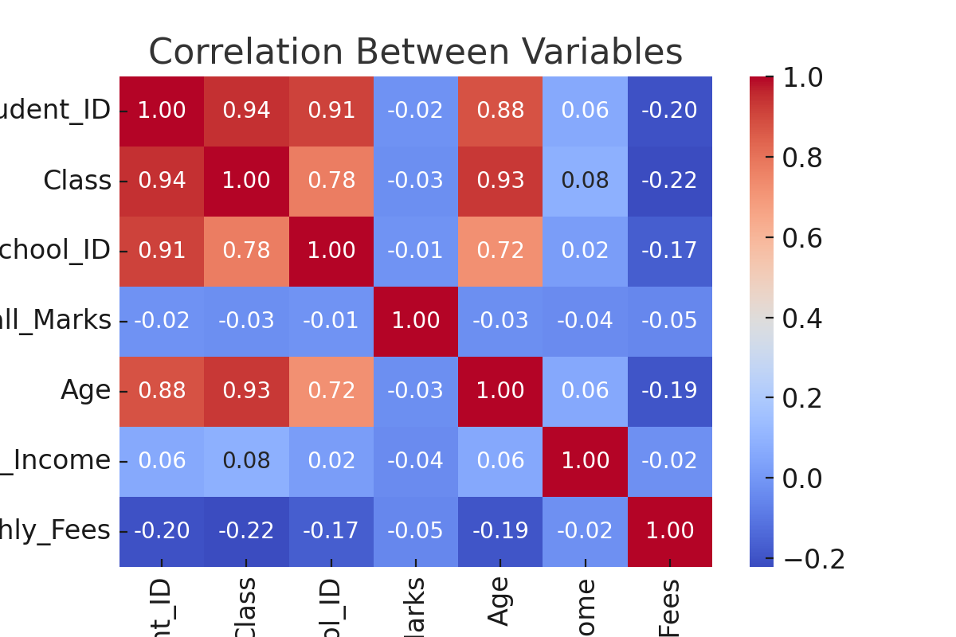
What Factors Influence Performance?
Correlation analysis between fees, marks, and family income.
Weak Correlation Between Fees and Marks (-0.05)
Negligible Correlation Between Family Income and Marks (-0.039)
Almost No Correlation Between Fees and Family Income (-0.022)

Slide 10
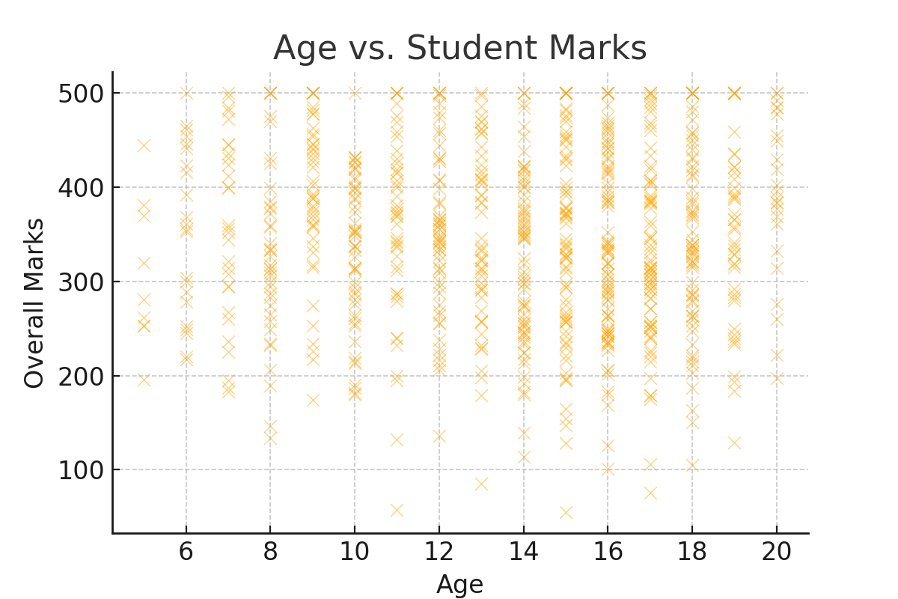
Does Age Affect Performance?
Scatter plot showing the relationship between age and student marks.
The correlation between Age and Overall Marks is -0.026, indicating an almost negligible relationship.

Slide 11
After understanding the data
1. Data-Driven Decision Making:
Schools can utilize this analysis to optimize resource allocation, improve student performance, and design targeted interventions.
2. Financial Insights for Policy Makers:
The correlation between family income and school fees highlights the need for structured financial aid programs.

Slide 12
Final Suggestions for Improvement in students
1. Implementing Need-Based Scholarships: Schools should introduce financial aid programs to support students from lower-income backgrounds.
2. Enhancing Learning Support: Schools should identify students at risk of failure early and provide additional academic resources.

Slide 13
Conclusion
Key Findings:
- A significant percentage of students scored below the passing mark.
- Family income does little influence on the type of school students attend.
- Higher school fees not strongly linked to better academic performance.

