Slide 1
Forecasting Crypto Volatility via Semantic Sentiment
A Transformer-Based Approach (FinBERT & PCA)
Gary Sun
AAE 722 Final Project
University of Wisconsin-Madison
Department of Agricultural & Applied Economics (Cross-Analysis with Computer Science Techniques)
December 9, 2025
(UW-Madison) Semantic Sentiment & Crypto December 9, 2025 1 / 15

Slide 2





Outline
1 Motivation & Literature Review
² Background
³ Methodology
4 Results
5 Future Work
(UW-Madison) Semantic Sentiment & Crypto December 9, 2025 2 / 15

Slide 3
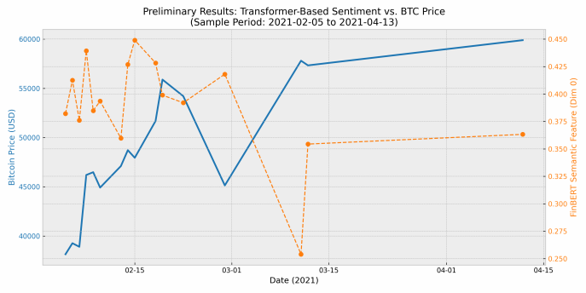


1.1 The Economic Context: Narrative Economics
The Unique Nature of Crypto Markets:
Unlike equities, crypto lacks traditional fundamental anchors (e.g., P/E ratio, cash flow).
Shiller’s Narrative Economics (2019): Market moves are driven by ”viral stories” and collective psychology.
The Inefficiency: Traditional econometric models
(ARIMA/GARCH) rely on past price and volume, often missing the underlying semantic driver.
Research Objective
To quantify these ”viral stories” using Deep Learning and test if they mathematically lead price volatility.
figureHigh-Entropy Social Signals
(UW-Madison) Semantic Sentiment & Crypto December 9, 2025 3 / 15

Slide 4
1.2 Literature Review: Standing on Giants
My research bridges two distinct fields: Financial Econometrics and NLP.
Transformer Architecture:
Vaswani et al. (2017): ”Attention Is All You Need”. Introduced the self-attention mechanism, enabling context-aware text processing.
Financial LLMs:
Araci (2019): ”FinBERT”. A BERT model pre-trained specifically on financial corpora (TRC2-financial), outperforming generic models in sentiment classification.
Crypto Forecasting:
Lim et al. (2021): Introduced Temporal Fusion Transformers (TFT) for interpretable multi-horizon time series forecasting.
(UW-Madison) Semantic Sentiment & Crypto December 9, 2025 4 / 15

Slide 5
1.3 The Research Gap
Why is existing research insufficient?
Existing Approaches Our Approach (AAE 722)
Use ”Bag-of-Words” (Lexicon)
Output static scores (-1 to 1)
Focus on synchronous correlation Black-box prediction
Use Deep Semantic Embeddings
Extract latent semantic trends (PCA) Focus on Lead-Lag Causality (29 Days) Explainable Econometric Validation
We treat sentiment not just as a feature, but as a distinct asset class.
(UW-Madison) Semantic Sentiment & Crypto December 9, 2025 5 / 15

Slide 6
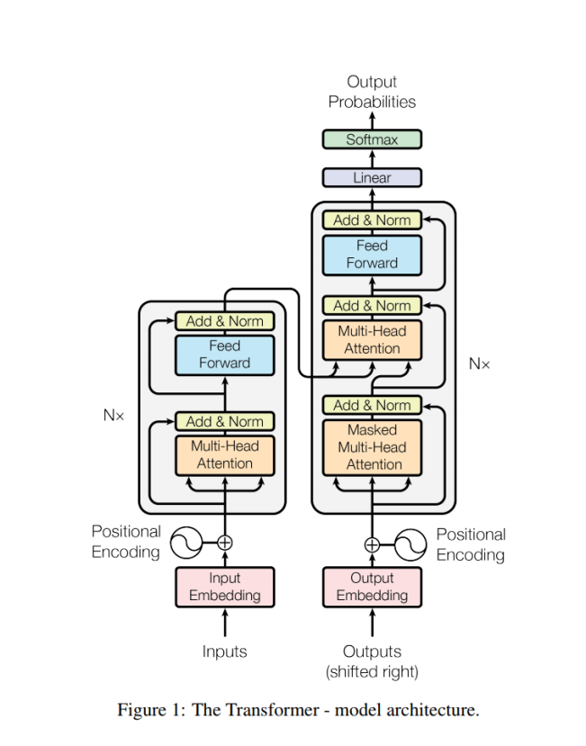
2.1 The Evolution: From RNN to Transformers
Recurrent Neural Networks (RNNs):
We learned in class that RNNs process data sequentially
(step-by-step).
Limitation: They suffer from ”Short-term Memory”
(Vanishing Gradient) and are slow to train.
The Transformer (Vaswani et al., 2017):
Parallelism: Processes the entire sentence at once, not
word-by-word.
Self-Attention Mechanism:
Allows the model to weigh the importance of different
words regardless of distance.
Example: Bitcoin is not Dead.
figureTransformer Architecture (Lecture 8)
(UW-Madison) Semantic Sentiment & Crypto December 9, 2025 6 / 15

Slide 7
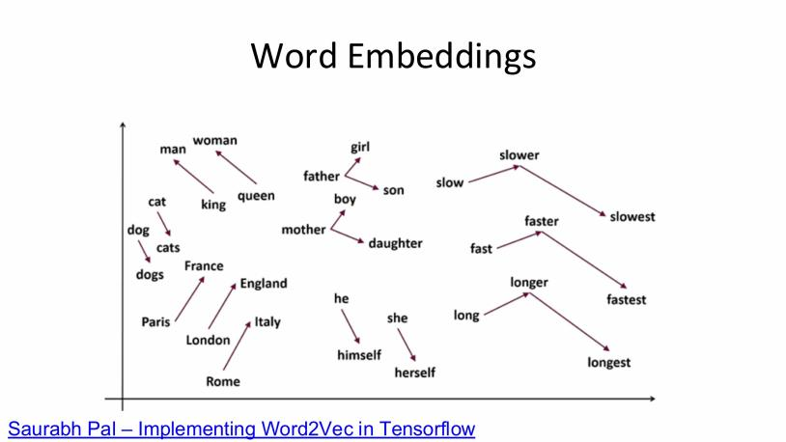
2.2 Word Embeddings: Semantics as Vectors
Concept:
One-Hot Encoding: Sparse and high-dimensional (e.g., [0, 0, 1, 0...]). No semantic meaning.
Dense Embeddings: Low-dimensional, continuous vectors learned from data.
Why is this useful for Finance?
Words with similar meanings map to similar
geometric locations.
We can perform Vector Arithmetic:
V (King) - V (Man) + V (Woman) ≈ V (Queen)
In our Project:
V (Bitcoin) + V (Crash) ≈ V (Panic)
figureVector Space (Lecture 8)
(UW-Madison) Semantic Sentiment & Crypto December 9, 2025 7 / 15

Slide 8
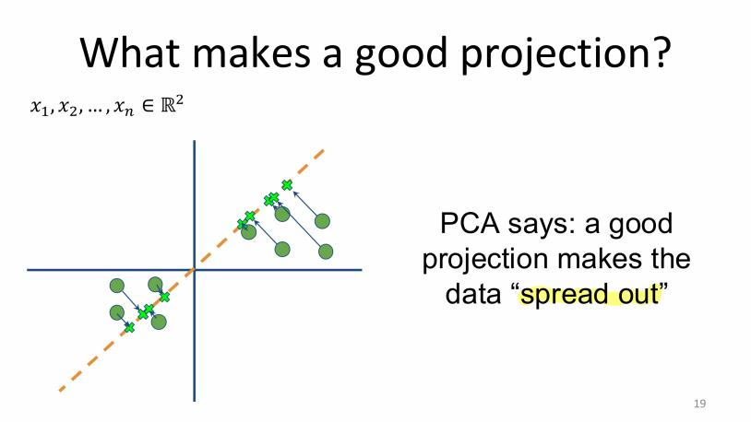




2.3 PCA: Signal Extraction from Noise
Recap:
Goal: Dimensionality Reduction.
Method: Find the ”Principal Components” (Eigenvectors of the covariance matrix) that maximize Variance.
Why PCA in this project?
¹ Input: FinBERT gives us a 768-dimensional
vector for each day. Most dimensions are noise.
² Projection: We project this 768D cloud onto the 1st Principal Component (PC1).
³ Result: A single, clean ”Sentiment Index” that captures the dominant market trend.
figureMaximizing Variance (Lecture 5)
(UW-Madison) Semantic Sentiment & Crypto December 9, 2025 8 / 15

Slide 9
3. Methodology: The Pipeline
We constructed an end-to-end Data Science pipeline:
Stage 1: Extraction (Deep Learning)
Raw Tweets → FinBERT → 768-dim Embeddings
Stage 2: Distillation (Unsupervised Learning)
Embeddings → PCA (Principal Component Analysis) → PC1 Trend
Stage 3: Validation (Econometrics)
Lagged Signal → OLS Regression → Price Prediction
(UW-Madison) Semantic Sentiment & Crypto December 9, 2025 9 / 15

Slide 10

4.1 Mechanism: How Sentiment Transmits to Price
Theoretical Framework: Information Asymmetry
Lag Period^{3.} ^{Smart} ^{Money}_{Price} _{Action}
Exit (Di-
vergence)
1. Retail Noise (Twitter/FOMO)
2. Sentiment Accumulation
4. Market Correction
Short-term: News events create instant noise (Lead ≈ 0).
Long-term: Sentiment accumulation reflects the ”Bubble Cycle”.
The 29-Day Lag: Represents the time gap between Peak Retail Euphoria and Institutional Sell-off.
(UW-Madison) Semantic Sentiment & Crypto December 9, 2025 10 / 15

Slide 11
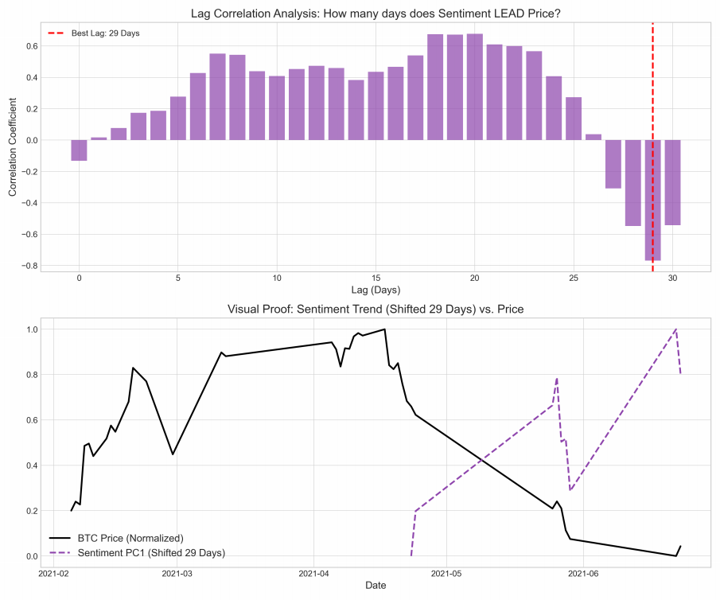
4.2 Discovery: Signal Extraction Lag Analysis
1. Signal Strength (PCA):
The 1st Principal Component (PC1) explains
19.42% of total variance.
Context: In a 768-dimensional noisy space, a
random baseline is ≈ 0.1%.
Implication: We successfully extracted the
”Dominant Market Narrative” from the noise.
2. Temporal Dynamics:
Peak Correlation: Found at Lag = 29 Days.
This confirms the ”Sentiment Accumulation”
phase before the price drop.
figureLag Analysis (29 Days)
(UW-Madison) Semantic Sentiment & Crypto December 9, 2025 11 / 15

Slide 12
4.3 Interpreting the ”Inverted” Signal
Observation: In the chart, the trends move in opposite directions.
Correlation Coefficient: -0.76
Why Negative?
Contrarian Indicator: When Twitter
sentiment reaches peak euphoria (”To the Moon!”), it signals an overheated market.
Behavioral Finance: High sentiment =
Irrational Exuberance → High probability of a crash.
Our AI captures this: Rising Sentiment Trend → Future Price Drop.
figureNote the Divergence: Sentiment (Purple) Spikes →
Price (Black) Crashes
(UW-Madison) Semantic Sentiment & Crypto December 9, 2025 12 / 15

Slide 13
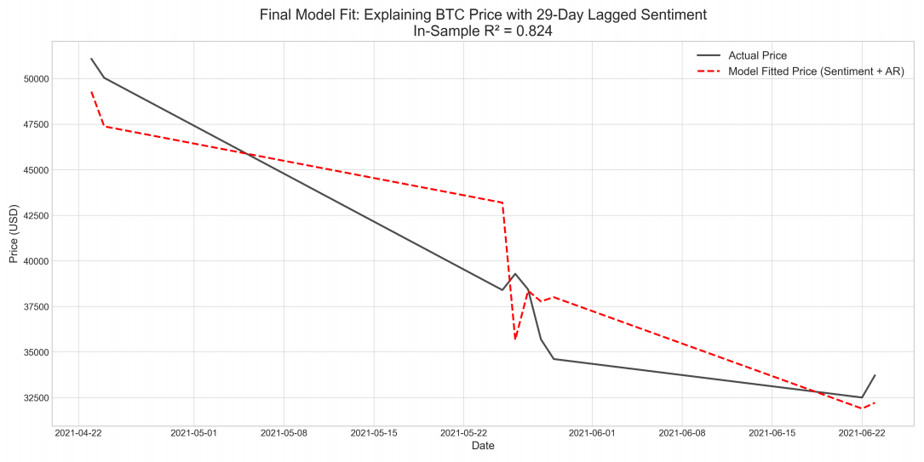
5. Model Performance: Predictive Regression
Model Specification: We fitted a Linear
ARX (Auto-Regressive with Exogenous
input) model:
Pt = α + β1 Pt- 1 + β2 St-29 + ϵt
Pt: Bitcoin Price at day t.
Pt- 1 : Autoregression (Momentum).
St- 29 : Sentiment Signal (Lagged 29
days).
^{Result:} figureIn-Sample Fit (Red) vs. Actual (Black)
R² = 0.824: High explanatory power.
Sentiment adds predictive value beyond
simple price momentum.
(UW-Madison) Semantic Sentiment & Crypto December 9, 2025 13 / 15

Slide 14
6. Future Roadmap: From Prediction to Profit
Current Limitation: Daily data (N ≈ 150) creates a ”Small Data” problem for Deep Learning, causing LSTM to converge to a linear mean (Underfitting).
Phase 2: High-Frequency Scale Up
Data: Acquire minute-level tweets/price data (N > 200, 000).
Goal: Capture Intraday Volatility and market microstructure that daily aggregation misses.
Phase 3: Advanced Architecture (TFT)
Model: Implement Temporal Fusion Transformers (Google, 2021). Why? unlike ”Black Box” LSTM, TFT provides Interpretability (Attention Weights) and Quantile Forecasting (Risk Intervals).
Phase 4: Economic Validation
Move beyond R² . Implement a Long/Short Trading Strategy.
Evaluate performance using Sharpe Ratio and Max Drawdown.
(UW-Madison) Semantic Sentiment & Crypto December 9, 2025 14 / 15

Slide 15
Thank You!
Questions?
(UW-Madison) Semantic Sentiment & Crypto December 9, 2025 15 / 15

