Slide 1

Vector Norms And OOV Words
Visualize vector norms vs term-frequency (count)
FastText Norm vs TF ~ Word2Vec Norm vs TF
Norm ~ context specificity?
non-averaged norm ~ non-english word indicator

Slide 2


Vaclav Kosar
studied physics
develops software
dabbles in ML
works for “Time is Ltd” startup (internal comms analytics)
@

Slide 3
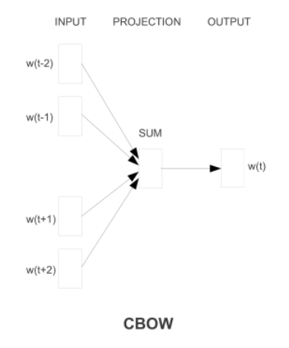
Word embeddings intro
Word is represented by an 100 dim vector
Representation is trained or statistical
Word similarity via cosine similarity (angle)
Vector norm is length of a vector
Norms are usually not used

Slide 4
Word2vec norms (Schakel 2015)
(Schakel 2015) Measuring Word Significance using Distributed Representations of Words
Word significance ~ context distinctiveness
Document term frequency vs global TF (tf-idf)
word2vec norms ~ word significance (within training corpus and frequency band)

Slide 5
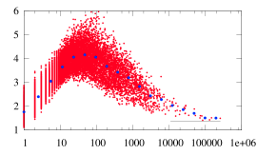
Word2vec norms (Schakel 2015)
Corpus mainly about Q Mechanics
Longest vectors in the high-tf bands:
“inflation” (v=4.64, tf= 571)
“sitter” (v= 3.81, tf= 1490) “de Sitter”
“holes” (v= 3.41, tf=2465) “black holes”
Word vector length versus term frequency of all words in the hep-th vocabulary.

Slide 6
ngram is subsequence within word
fastText(word) = (v_{word} + Σ_{g ∈ ngrams(word)} v_{g})/ (1 + |ngrams(word)|)
If the word is not present in the dictionary (OOV) only n-grams vectors are used.
To study OOV words removed asymmetry by only utilizing word’s n-grams vectors
10k most common english words to contrast them with FT vocabulary including dataset artifacts (non-words)

Slide 7
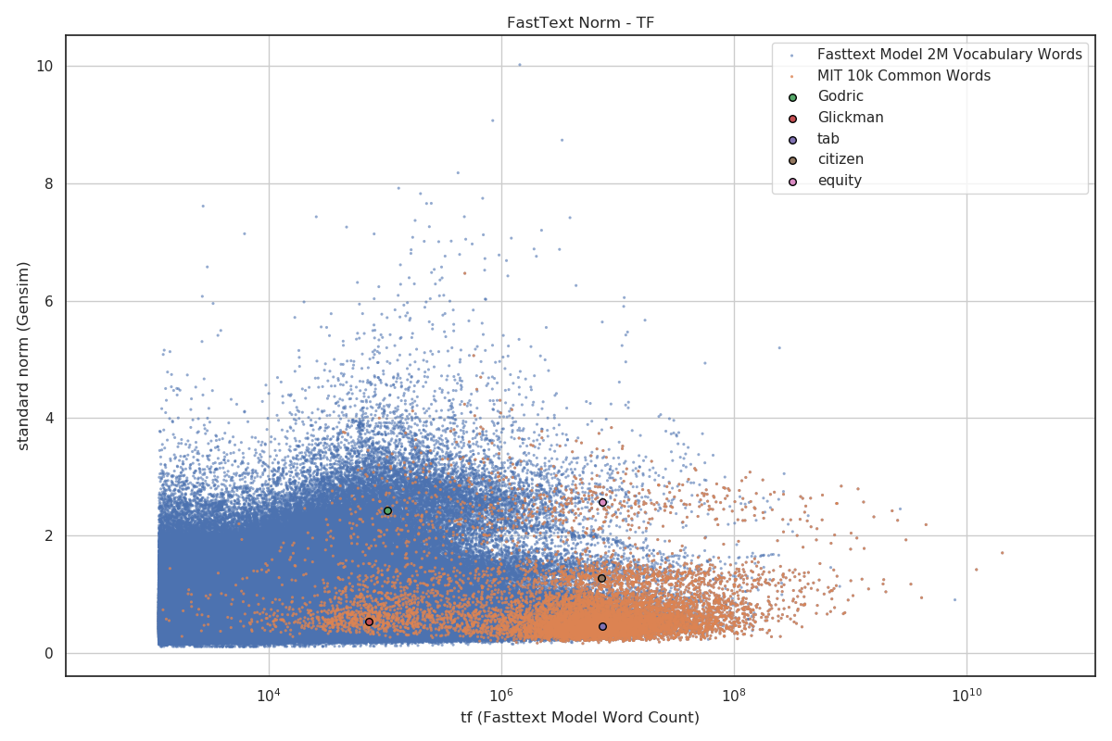
FastText: Standard Vector Norm
Standard
4 clusters with unknown meaning

Slide 8
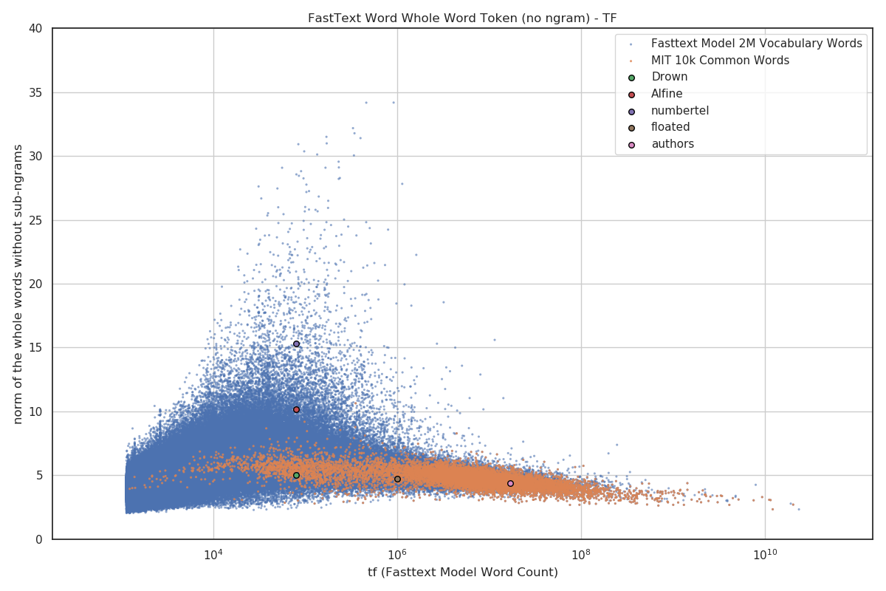
FastText: No-Ngrams Norm
Only whole-word vectors used
Norm ~ word significance
Shape similar to word2vec

Slide 9
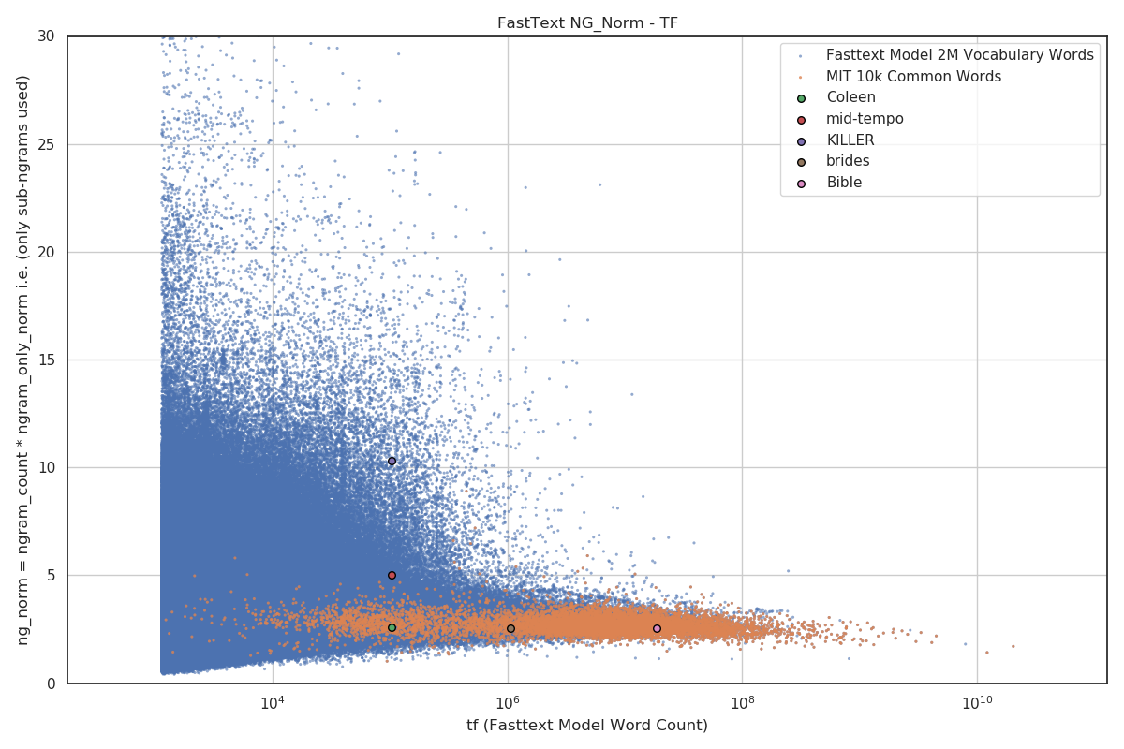
FastText: NG_Norm
Only ngram vectors used
No ngram count averaging
common words in narrow norm-band

Slide 10
FastText: Hypo and Hypernyms
67 hypo-hypernyms norms pairs
Disregarding TF no_ngram_norm most predictive
Filtering to max 30% away TF to 7 samples standard norm most predictive
hyper | hypo | standard_norm | no_ngram_norm | ng_norm | count
month | January | -25.4 | 11.5 | 25.4 | 55.6
month | February | -41.7 | 12.5 | 26.8 | 44.6
month | March | 19.6 | 7.9 | 19.6 | 62.8
month | April | 23.0 | 9.9 | 23.0 | 60.6
month | May | 110.6 | 6.4 | 14.7 | 104.7
month | June | 60.5 | 9.2 | 21.8 | 57.3
color | red | 103.4 | -2.5 | 4.6 | -15.4
color | black | -5.6 | -3.8 | -5.6 | 23.1
color | pink | 47.1 | 1.4 | 7.5 | -119.8
color | yellow | -28.8 | 1.5 | -0.3 | -111.3
color | cyan | 61.0 | 17.2 | 22.4 | -197.7
color | violet | -33.9 | 9.6 | -5.4 | -193.6
… | … | … | … | … | …
average |  | 2.6 | 8.1 | 7.7 | -105.1
counts |  | 43.9 | 77.3 | 65.2
counts selected |  | 43.9 | 77.3 | 65.2

Slide 11
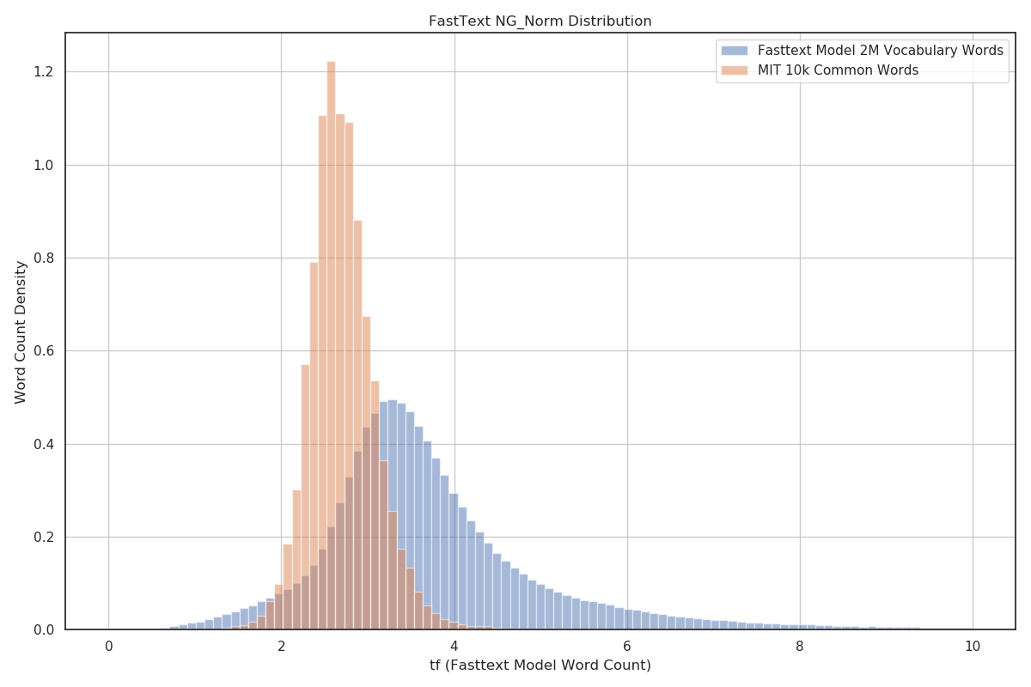
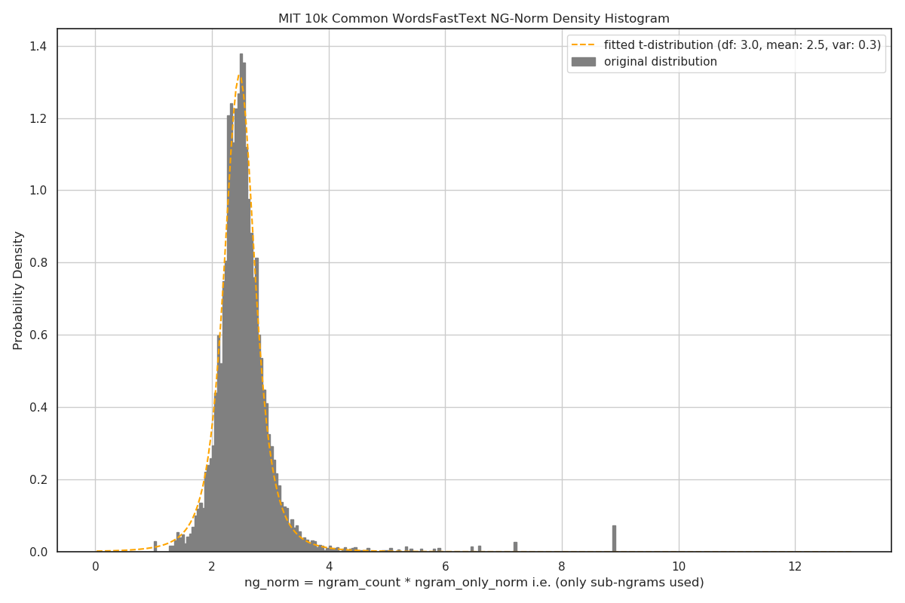
FastText: Vocab vs Common
NG_Norm distributions
Bayes approach

Slide 12
FastText: Splitting To English Words
Algo:
Join 2 common words
Generate all possible splits
Decide looking at norms
48% accuracy
word1 | word2 | norm1 | norm2 | prob1 | prob2 | prob
i | nflationlithium | 0 | 4.20137 | 0 | 0.000397 | 0
in | flationlithium | 0 | 4.40944 | 0 | 0.000519 | 0
inf | lationlithium | 1.88772 | 3.86235 | 0.010414 | 0.000741 | 7.721472E-06
infl | ationlithium | 2.29234 | 4.04391 | 0.053977 | 0.000428 | 2.308942E-05
infla | tionlithium | 2.24394 | 4.74456 | 0.052467 | 0 | 0
inflat | ionlithium | 2.55929 | 3.45802 | 0.048715 | 0.002442 | 0.0001189513
inflati | onlithium | 3.10228 | 3.55187 | 0.007973 | 0.001767 | 1.408828E-05
inflatio | nlithium | 3.34667 | 3.26616 | 0.003907 | 0.003159 | 1.234263E-05
inflation | lithium | 2.87083 | 2.73886 | 0.017853 | 0.035389 | 0.0006318213
inflationl | ithium | 3.36933 | 2.35156 | 0.002887 | 0.053333 | 0.0001539945
inflationli | thium | 3.73344 | 2.21766 | 0.001283 | 0.052467 | 6.730259E-05
inflationlit | hium | 4.16165 | 1.66477 | 9.6E-05 | 0.004324 | 4.139165E-07
inflationlith | ium | 4.40217 | 1.59184 | 0.000519 | 0.002212 | 1.147982E-06
inflationlithi | um | 4.71089 | 0 | 0 | 0 | 0
inflationlithiu | m | 4.91263 | 0 | 0.000213 | 0 | 0

Slide 13
Conclusion
Visualized FastText vector norms vs term-frequency
Standard Norm vs Term-Frequency plot interesting clustering of common words
No-NGram Norm vs TF is shaped as Word2Vec Norm vs TF
The word significance ~ No-N-Gram Norm.
NG_Norm show that non averaging over n-gram count could be useful
Code at https://github.com/vackosar/fasttext-vector-norms-and-oov-words
More at http://www.vaclavkosar.com

