Slide 1


SMART INDIA HACKATHON 2026
TITLE PAGE
Problem Statement ID – SIH26101
Problem Statement Title – Develop an AI enabled learning platform that identifies competency gaps, recommends personalized training through integration with the iGOT Karmayogi ecosystem, and capable of generating Quizzes and Multiple choice questions (MCQs) from uploaded learning materials to strengthen capacity building in India's Official Statistical System.
Theme – Smart Education
PS Category – Software
Team ID – 176881
Team Name – Why Not 6

Slide 2
IDEA TITLE
Why Not 6
PROBLEM CONTEXT
IDEA / PROPOSED SOLUTION
Officials need continuous upskilling, but no intelligent system matches iGOT's vast course repository to their actual role, competency level, or skill gaps.
Traditional training lacks personalization, gap-diagnosis, and auto-generated assessments, no way to turn existing materials into targeted MCQs at scale.
Our solution builds an AI-enabled Skill Intelligence Platform that profiles officials, diagnoses competency gaps, and routes them through a personalized, explainable learning pathway across India's official training ecosystems.
Role → FRAC-aligned competency profiling (STAT/TECH/GOV/BEH, L1–L5) with diagnostic MCQ assessment.
Deterministic gap engine: rule-based scoring, explainable "why this gap" reasoning per competency.
Dual-catalogue pathway blending iGOT courses + NSSTA/TPAC programmes, ranked by role and prerequisites.
AI MCQ generation: upload PDF/PPT/video → RAG-grounded quiz creation → admin review → publish.
Adaptive assessment difficulty + competency decay modeling, flags refresher needs before gaps widen.
Multilingual layer via Bhashini (regional-language MCQs/explanations, UI stays English).
UNIQUE VALUE PROPOSITIONS (UVP)
Explainable gap engine: rule-based scoring, every recommendation traced to the exact wrong answer or missing competency, not a black-box LLM decision.
Grounded MCQ generation: RAG pulls from uploaded material with source citations, human admin approval before publish.
Single pathway across iGOT + NSSTA/TPAC: ranks and blends both catalogues by role, level, and prerequisites, no manual course hunting.
India-first sovereign AI stack: Sarvam-105B/30B on-prem, GPT only as fallback.

Slide 3
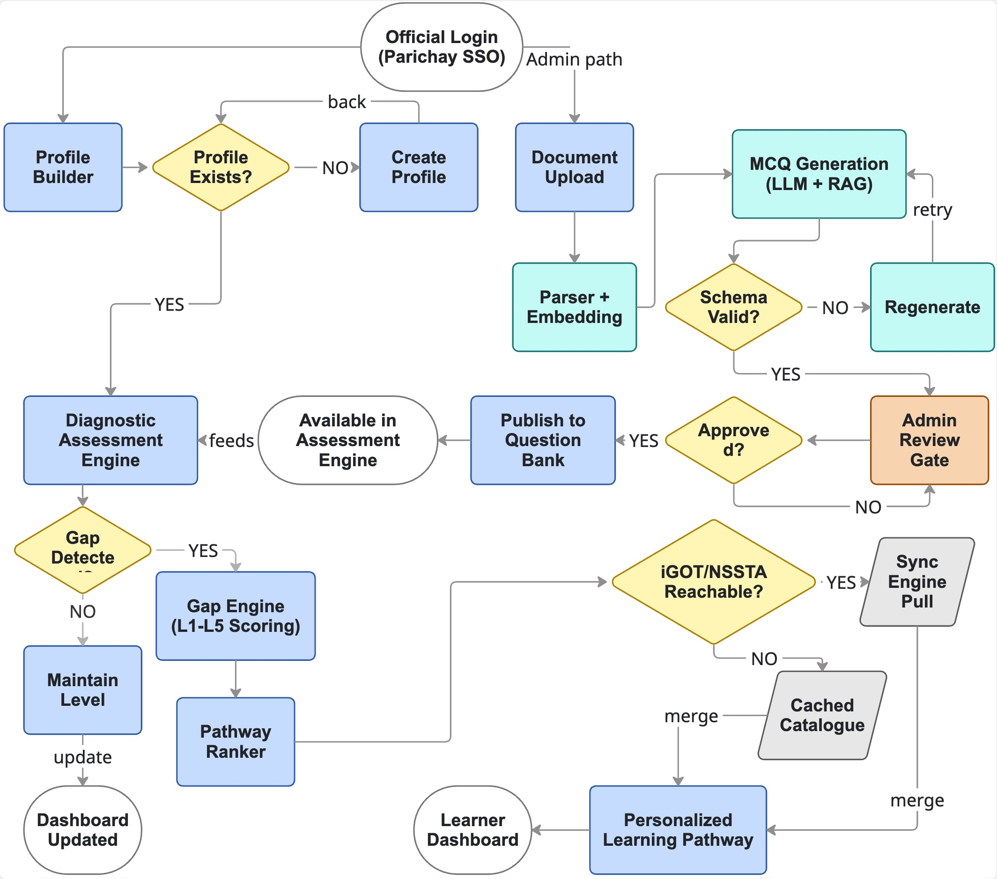
TECHNICAL APPROACH
Why Not 6
FLOW DIAGRAM
TECHNOLOGY STACK
Frontend (User Interface)
Next.js + TypeScript
Tailwind + shadcn/ui
Backend / Orchestration
FastAPI (Python)
LangGraph (agent/workflow orchestration)
Data Layer
PostgreSQL + pgvector
Redis (cache/queue)
S3/MinIO (object storage)
AI / Sovereign Stack
Sarvam-105B/30B (local LLM)
multilingual-e5-large (embeddings)
Bhashini (regional-language layer)
Auth & Integration
JWT + OIDC (Parichay/Keycloak-compatible)
iGOT/NSSTA adapters (mock now, live-ready)

Slide 4
FEASIBILITY AND VIABILITY
Why Not 6
Feasibility | Managed Constraints | Mitigation
Software-only, deployable as secure web app — no hardware dependency Covers all 6 PS musts: assessment, gap analysis, iGOT+NSSTA recs, MCQ gen, learner + admin dashboards Proven stack: Next.js, FastAPI, PostgreSQL, Redis, Docker Sovereign AI: Sarvam-105B/30B local, GPT fallback only Adapter design: mock catalogue now, live iGOT/NSSTA API swap later, zero core rewrite Every AI-generated MCQ passes human admin gate before publish | No public iGOT write/enrolment API yet — access requires MoSPI authorization LLM latency/quality varies under load Gap scoring must be trustworthy for govt use, not black-box Uploaded govt material needs content-safety checks before MCQ publish Govt data needs strict access control + audit trail iGOT + NSSTA/TPAC are separate catalogues, no native single pathway exists today | Adapter pattern: curated catalogue works now, live API plugs in later, no rewrite 3-tier LLM fallback: local Sarvam → cached snapshot → curated bank, zero hard-fail 100% deterministic gap scoring (rule-based), explainable reason on every recommendation RAG source citations + schema validation + mandatory admin approval before any MCQ goes live RBAC + append-only audit log + OIDC/Parichay-ready SSO One blended pathway ranks both catalogues together, source-tagged per course

Slide 5
IMPACT AND BENEFITS
Why Not 6
Impact on Target Audience | Benefits
Statistical Officers / OSS staff: clear gaps + personalized pathways Training Admins / NSSTA: MCQ banks from approved materials (governed) Supervisors / DIID: cohort competency heatmaps for planning MoSPI leadership: measurable role → training → proficiency loop iGOT & NSSTA: better use of existing courses (complement, not replace) | Social: inclusive cadre upskilling; Hindi UI toggle Economic: less mismatched training; reuse MoSPI materials as assessments Institutional: FRAC-aligned competency culture in Official Statistical System Digital public good: plugs into iGOT + NSSTA/TPAC (not a siloed LMS) Trust: explainable scores, RBAC/audit, hybrid sovereign LLM option

Slide 6
RESEARCH AND REFERENCES
Why Not 6
• SIH 2026 Problem Statement 26101 - MoSPI DIID | Theme: Smart Education
• MoSPI - https://www.mospi.gov.in
• NSSTA - https://www.nssta.gov.in
• iGOT Karmayogi / Mission Karmayogi - government capacity-building ecosystem
• TPAC - NSSTA Training Programme Advisory Committee programmes
• FRAC - Framework of Roles, Activities and Competencies (DoPT / Karmayogi)
• MeitY cybersecurity expectations & DPDP Act - design alignment for gov software
• Models: Qwen3-8B · BGE-M3 · Hybrid LLM (local preferred + cloud fallback)
• Demo seeds: synthetic catalogues/PDFs structured like public NSSTA/iGOT - not scraped copyrighted courses

