Slide 1

17/WAKU2-RLN-RELAY: Privacy-Preserving Peer-to-Peer Economic Spam Protection
Sanaz Taheri Boshrooyeh (Presenter)*
Oskar Thoren*
Barry Whitehat
Wei Jie Koh
Onur Kilic
Kobi Gurkan
*Vac Research and Development
*Status Research and Development, Singapore
Link to the paper: https://github.com/vacp2p/research/blob/master/rln-research/Waku_RLN_Relay.pdf

Slide 2
Contents
WAKU2
WAKU2-RELAY: Privacy-preserving p2p transport protocol
Spam issue in WAKU2-RELAY
Privacy-preservation and spam protection
State-of-the-art p2p spam protection methods
WAKU2-RLN-RELAY: Privacy-preserving peer-to-peer economic spam protection

Slide 3
WAKU2 [1]
A family of modular, privacy-preserving peer-to-peer (p2p) protocols for private, secure, censorship resistant communication
Suitable for resource restricted devices e.g., mobile phones
WAKU2 protocols include:
WAKU2-RELAY: privacy-preserving transport
WAKU2-STORE: historical message storage
WAKU2-FILTER: light version of WAKU2-RELAY for bandwidth limited devices
WAKU2-RLN-RELAY: spam-protected version of WAKU2-RELAY
And many more …
The full list of RFCs is available in rfc.vac.dev
[1] https://rfc.vac.dev/spec/10/

Slide 4

WAKU2-RELAY [1]
Publisher-Subscriber Model
Peers subscribed to the same topic form a mesh
Mesh of peers subscribed to the same topic
[1] https://rfc.vac.dev/spec/11/

Slide 5

WAKU2-RELAY
Publisher-Subscriber Model
Gossip-based Routing (extension of libp2p GossipSub-v1.1 [2])
A
[2] https://github.com/libp2p/specs/tree/master/pubsub/gossipsub

Slide 6
WAKU2-RELAY
Publisher-Subscriber Model
Gossip-based Routing (extension of libp2p GossipSub-v1.1 [2])
A

Slide 7
WAKU2-RELAY
Publisher-Subscriber Model
Gossip-based Routing (extension of libp2p GossipSub-v1.1 [2])
Messages are anonymous [1]
Messages carry no personally identifiable information e.g., IP address about the publisher
A
B
[1] https://rfc.vac.dev/spec/11/#security-analysis

Slide 8

Spam issue in WAKU2-RELAY
We define spammers as entities that publish a large number of messages in a short amount of time, and cause denial-of-service
Spammer

Slide 9

Spam issue in WAKU2-RELAY
We define spammers as entities that publish a large number of messages in a short amount of time, and cause denial-of-service
Spam Protection = Controlled Messaging Rate
Spammer

Slide 10
Privacy-Preservation and Spam protection
Messages are anonymous: No Personally Identifiable information is available
Normal publishing peer
Messages carry no personally identifiable information about the publisher
Routing peer
Spammer
Messages are anonymous
and unlinkable
Normal publishing peer

Slide 11
Privacy-Preservation and Spam protection
Messages are anonymous: No Personally Identifiable information is available
Solutions like IP blocking are not effective
Normal publishing peer
Messages carry no personally identifiable information about the publisher
Routing peer
Spammer
Messages are anonymous
and unlinkable
Normal publishing peer

Slide 12
State-of-the-art p2p spam protections
Proof-of-work [1] deployed by Whisper [2]
Computationally expensive
Not suitable for network of heterogeneous peers with limited resources
Peer Scoring [3] in libp2p
Local to each peer
No global identification of spammer
Subject to inexpensive attacks using bots
Prone to censorship
[1] Cynthia Dwork and Moni Naor. Pricing via processing or combatting junk mail. In Annual 456 international cryptology conference. Springer, 1992.
[2] https://eips.ethereum.org/eips/eip-627.
[3] https://github.com/libp2p/specs/blob/master/pubsub/gossipsub/gossipsub-v1.1.mdpeerscoring.

Slide 13
WAKU2-RLN-RELAY [1]
WAKU2-RLN-RELAY = WAKU2-RELAY + Rate Limiting Nullifiers (RLN)
P2p solution
Global spam protection
Privacy preserving
Efficient
Economic incentives
Financial punishment for the spammers and a financial reward for those who catch spammers.
[1] https://rfc.vac.dev/spec/17/

Slide 14
RLN Primitive [1]
RLN is a zero-knowledge and rate-limited signaling framework
Each user can only send M messages for each External Nullifier
External nullifier can be seen as a voting booth where each user can only cast one vote
M and external nullifier are application dependent
M=1 for this presentation
[1] https://ethresear.ch/t/semaphore-rln-rate-limiting-nullifier-for-spam-prevention-in-anonymous-p2p-setting/5009

Slide 15
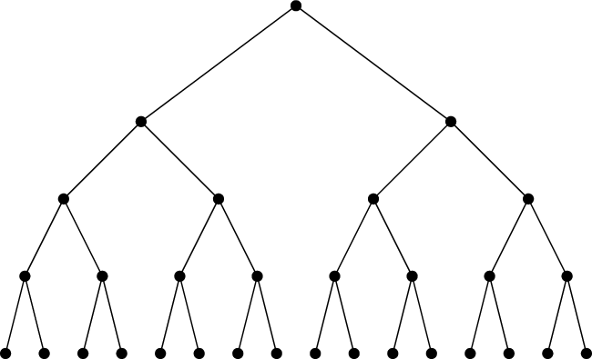

RLN Primitive: Membership Tree
RLN membership group:
Merkle tree
PK1
PK16
SK1, PK1 =H(SK1)
SK16, PK16 =H(SK16)

Slide 16
RLN Primitive: Signaling
RLN membership group:
Merkle tree
SK1, PK1 =H(SK1)
PK1
PK16
M: Message
EN: External Nullifier
IN: Internal Nullifier = H(H(SK1,EN))

Slide 17
RLN Primitive: Signaling
RLN membership group:
Merkle tree
SK1, PK1 =H(SK1)
Shamir Secret Sharing
PK1
PK16
M: Message
S1: One share of SK1
EN: External Nullifier
IN: Internal Nullifier = H(H(SK1,EN))

Slide 18
RLN Primitive: Signaling
Shamir Secret Sharing [1]
[SK1]_1
(T,N)-Sharing
SK1
[SK1]_2
[SK1]_N
RLN membership group:
Merkle tree
SK1, PK1 =H(SK1)
[SK1]_i
(T,N)-Construct
T shares
…
SK1
[SK1]_j
Shamir Secret Sharing
PK1
PK16
M: Message
[SK1]_1: One share of SK1
EN: External Nullifier
IN: Internal Nullifier = H(H(SK1,EN))
[1] Adi Shamir. How to share a secret. Communications of the ACM, 22(11):612–613, 1979.

Slide 19

RLN Primitive: Signaling
RLN membership group:
Merkle tree
SK1, PK1 =H(SK1)
Shamir Secret Sharing
zkSNARK
PK1
PK16
Zero-Knowledge Proof of
- Membership
- Correctness of [SK1]_1
- Correctness of IN
M: Message
[SK1]_1: One share of SK1
EN: External Nullifier
IN: Internal Nullifier = H(H(SK1,EN))

Slide 20
RLN Primitive: Signaling
Zero-Knowledge Succinct Non-Interactive Argument of Knowledge [1, 2]
Prover
Secret knowledge X
Verifier
RLN membership group:
Merkle tree
SK1, PK1 =H(SK1)
Proof of knowledge X
Verify the Proof
Shamir Secret Sharing
zkSNARK
PK1
PK16
Zero-Knowledge Proof of
- Membership
- Correctness of [SK1]_1
- Correctness of IN
M: Message
[SK1]_1: One share of SK1
EN: External Nullifier
IN: Internal Nullifier = H(H(SK1,EN))
[1] Groth, Jens. "On the size of pairing-based non-interactive arguments." Annual international conference on the theory and applications of cryptographic techniques. Springer, Berlin, Heidelberg, 2016.
[2] Bitansky, Nir, et al. "From extractable collision resistance to succinct non-interactive arguments of knowledge, and back again." Proceedings of the 3rd Innovations in Theoretical Computer Science Conference. 2012.

Slide 21
RLN Primitive: Detecting double signaling
RLN membership group:
Merkle tree
SK1, PK1 =H(SK1)
M, EN, IN, [SK1]_1, P
M’, EN, IN, [SK1]_2, P’
PK1
PK16

Slide 22
RLN Primitive: Slashing
RLN membership group:
Merkle tree
SK1, PK1 =H(SK1)
M, EN, IN, [SK1]_1, P
M’, EN, IN, [SK1]_2, P’
PK1
PK16
(2,N)-Construct
SK1

Slide 23

RLN Primitive: Slashing
RLN membership group:
Merkle tree
SK1, PK1 =H(SK1)
M, EN, IN, [SK1]_1, P
M’, EN, IN, [SK1]_2, P’
PK1
PK16
(2,N)-Construct
PK1=H(SK1)
SK1

Slide 24
WAKU2-RLN-RELAY: RLN Group
RLN group = Peers subscribed to the same topic e.g., waku-rln-relay

Slide 25
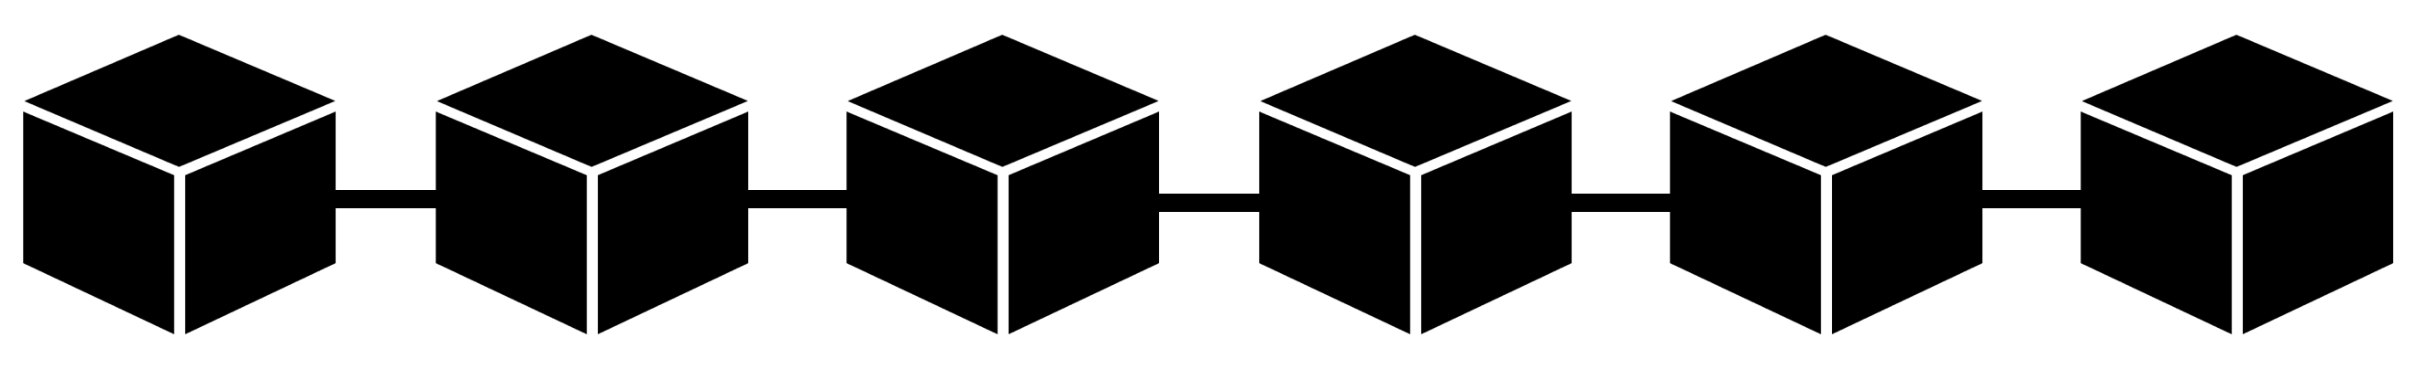


WAKU2-RLN-RELAY: Registration
Membership Contract/Registry
PK1,…,PKn
…
RLN group = Peers subscribed to the same topic e.g., waku-rln-relay

Slide 26
WAKU2-RLNR-ELAY: Registration
Membership Contract/Registry
PK1,…,PKn
…
TX: Register PK,
RLN group = Peers subscribed to the same topic e.g., waku-rln-relay
Each peer registers to the group and locks some funds

Slide 27
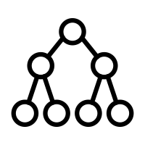
WAKU2-RLN-RELAY: Registration
Membership Contract/Registry
PK1,…,PKn
…
Membership Merkle tree

Slide 28

WAKU2-RLN-RELAY: Registration
Membership Contract/Registry
PK1,…,PKn
…
Registration and Deletion Events
Peers update their local tree

Slide 29
WAKU2-RLN-RELAY: External Nullifier
External Nullifier = Epoch = the number of T seconds that elapsed since the Unix epoch.
Messaging rate is limited to 1 per epoch.

Slide 30

WAKU2-RLN-RELAY: External Nullifier
External Nullifier = Epoch = the number of T seconds that elapsed since the Unix epoch.
Messaging rate is limited to 1 per epoch.
Each peer locally keeps track of the current epoch

Slide 31
WAKU2-RLN-RELAY: Publishing
M, Epoch, IN, [SK]_1, P

Slide 32
WAKU2-RLN-RELAY: Routing
M, Epoch, IN, [SK]_1, P

Slide 33

WAKU2-RLN-RELAY: Routing
Check for double signaling
Check against the local epoch
RLN Proof Verification
M, Epoch, IN, [SK]_1, P

Slide 34

WAKU2-RLN-RELAY: Routing
M, Epoch, IN, [SK]_1, P

Slide 35
WAKU2-RLN-RELAY: Slashing
A past record with the same nullifiers (Epoch, IN, [SK]_2)
M, Epoch, IN, [SK]_1, P

Slide 36
WAKU2-RLN-RELAY: Slashing
[SK]_2
(2,N)-Construct
SK of spammer
[SK]_1
A past record with the same nullifiers (Epoch, IN, [SK]_2)
M, Epoch, IN, [SK]_1, P

Slide 37
WAKU2-RLN-RELAY: Slashing
Membership Contract/Registry
PK1,…,PKn
…
Remove spammer’s PK
SK of spammer
PK=H(SK)

Slide 38

WAKU2-RLN-RELAY: Slashing
Membership Contract/Registry
PK1,…,PKn
…
Remove spammer’s PK
SK of spammer
PK=H(SK)

Slide 39
WAKU2-RLN-RELAY [1]
WAKU2-RLN-RELAY = WAKU2-RELAY + Rate Limiting Nullifiers (RLN)
P2p solution
Global spam protection
Privacy preserving
Efficient
Economic incentives
Financial punishment for the spammers and a financial reward for those who catch spammers.
[1] https://rfc.vac.dev/spec/17/

Slide 40

Future work
Benchmarking
Storage-efficient Merkle tree storage
P2p network of full-nodes and light-nodes
Partial view of Merkle tree
Real-time removal of spammers using off-chain/p2p solutions
Cost-effective way of member insertion and deletion using layer 2 solutions

Slide 41
References
Waku-rln-relay specs: https://rfc.vac.dev/spec/17/
Waku-rln-relay paper: https://github.com/vacp2p/research/blob/master/rln-research/Waku_RLN_Relay.pdf
Vac post on Waku-rln-relay: https://vac.dev/rln-relay
Nim-Waku implementation: https://github.com/status-im/nim-waku
js-Waku implementation: https://github.com/status-im/js-waku
RLN Ethereum research post: https://ethresear.ch/t/semaphore-rln-rate-limiting-nullifier-for-spam-prevention-in-anonymous-p2p-setting/5009
RLN medium post: https://medium.com/privacy-scaling-explorations/rate-limiting-nullifier-a-spam-protection-mechanism-for-anonymous-environments-bbe4006a57d
RLN circuits: https://github.com/appliedzkp/rln
RLN circuits spec: https://hackmd.io/7GR5Vi28Rz2EpEmLK0E0Aw
RLN in Rust: https://github.com/kilic/rln

Slide 42
Thank you

