Slide 1
17/WAKU2-RLN-RELAY: Privacy-Preserving
Peer-to-Peer
Economic
Spam Protection
Sanaz Taheri Boshrooyeh (Presenter)*
Oskar Thoren*
Barry Whitehat
Wei Jie Koh
Onur Kilic
Kobi Gurkan
*Vac Research and Development
*Status Research and Development, Singapore
Link to the paper: https://github.com/vacp2p/research/blob/master/rln-research/Waku_RLN_Relay.pdf
Notes:
1

Slide 2
Contents
WAKU2
WAKU2-RELAY: Privacy-preserving p2p transport protocol
Spam issue in WAKU2-RELAY
Privacy-Preservation and Spam protection
State-of-the-art p2p spam protections
WAKU2-RLN-RELAY: Privacy-Preserving
Peer-to-Peer Economic Spam Protection
Future work
Notes:
How to provide spam-protection in a p2p and open messaging network
2

Slide 3
WAKU2 [1]
A family of modular, privacy-preserving peer-to-peer (p2p) protocols for private, secure, censorship resistant communication
Suitable for resource restricted devices e.g., mobile phones
WAKU2 protocols include:
  WAKU2-RELAY: privacy-preserving transport
  WAKU2-STORE: historical message storage
  WAKU2-FILTER: light version of WAKU2-RELAY for bandwidth limited devices
  WAKU2-RLN-RELAY: spam-protected version of WAKU2-RELAY
  And many more …
For the full list of RFCs is available in rfc.vac.dev
[1] https://rfc.vac.dev/spec/10/
Notes:
Waku2 is a stack of peer-to-peer (p2p) protocols that enable anonymous and privacy-preserving communication.
It is designed to be able to run in resource-restricted environments.
The focus of today’s talk is WAKU-RELAY and WAKU-RLN-RELAY which are the transport layers of Waku
3

Slide 4
WAKU2-RELAY [1]
Publisher-Subscriber Model
Gossip-based Routing (extension of libp2p GossipSub-v1.1 [2])
Anonymous and Privacy-Preserving
[1] https://rfc.vac.dev/spec/11/
[2] https://github.com/libp2p/specs/tree/master/pubsub/gossipsub
Notes:
Let me start by WAKU2-RELAY transport protocol
It follows publisher-subscriber messaging model
Implements gossip-based routing protocol
Is a minor extension of libp2p GossipSub protocol
Its end goal is to enable an anonymous and privacy preserving p2p network layer
4

Slide 5

WAKU2-RELAY
Peers subscribed to the same topic form a mesh
Mesh of peers subscribed to the same topic
A
Notes:
Peers in wakurelay congregate around topics they are interested in and can send messages to that topic or receive messages within that topic
5

Slide 6


WAKU2-RELAY
Peers subscribed to the same topic form a mesh
Peers route messages by sending them to a subset of their connections
A
Notes:
To publish a message, the author forwards its message to a subset of neighbors.
6

Slide 7
WAKU2-RELAY
Peers subscribed to the same topic form a mesh
Peers route messages by sending them to a subset of their connections
A
Notes:
The neighbors proceed similarly till the message gets propagated in the network of the subscribed peers.
7

Slide 8
WAKU2-RELAY
Peers subscribed to the same topic form a mesh
Peers route messages by sending them to a subset of their connections
Messages are anonymous [1]
No personally-identifiable information e.g., IP about the publisher
A
B
[1] https://rfc.vac.dev/spec/11/#security-analysis
Notes:
Messages are anonymous, i.e., there is no personally identifiable information like IP address attached to them, thus it is not feasible to identify the message origin.
For more detailed security analysis see the link below
8

Slide 9


Spam issue in WAKU2-RELAY
We define spammers as entities that publish a large number of messages in a short amount of time, and cause denial-of-service
Spammer
Notes:
Waku Relay, as an open messaging network, is prone to spam messages and spammers;
we define spammers as entities that publish a large number of messages in a short amount of time, and cause Denial of Service attack.
9

Slide 10

Spam issue in WAKU2-RELAY
We define spammers as entities that publish a large number of messages in a short amount of time, and cause denial-of-service
Spam Protection = Controlled Messaging Rate
Spammer
Notes:
Waku Relay, as an open messaging network, is prone to spam messages and spammers;
we define spammers as entities that publish a large number of messages in a short amount of time, and cause Denial of Service attack.
With that definition, Spammers can be controlled if we can control their messaging rate
10

Slide 11

Privacy-Preservation and Spam protection
Messages are anonymous: No Personally Identifiable information is available
Messages carry no personally identifiable information about the publisher
Normal peer
Spammer
Messages are anonymous
and unlinkable
Normal peer
Notes:
But there is an issue, messages are anonymous (no information like IP is available) and not linkable to their authors
A routing peer wont be able to tell apart spam messages from non-spam
11

Slide 12
Privacy-Preservation and Spam protection
Messages are anonymous: No Personally Identifiable information is available
Solutions like IP blocking are not effective
Messages carry no personally identifiable information about the publisher
Normal peer
Spammer
Messages are anonymous
and unlinkable
Normal peer
Notes:
But there is an issue, messages are anonymous (no information like IP is available) and not linkable to their authors
A routing peer wont be able to tell apart spam messages from non-spam
Thus solutions like IP blocking are not effective
12

Slide 13
State-of-the-art p2p spam protections
Proof-of-work [1] deployed by Whisper [2]
  Computationally expensive
  Not suitable for network of heterogeneous peers with limited resources
Peer Scoring [3] in libp2p
  Local to each peer
  No global identification of spammer
  Subject to inexpensive attacks using bots
  Prone to censorship
[1] Cynthia Dwork and Moni Naor. Pricing via processing or combatting junk mail. In Annual 456 international cryptology conference. Springer, 1992.
[2] https://eips.ethereum.org/eips/eip-627.
[3] https://github.com/libp2p/specs/blob/master/pubsub/gossipsub/gossipsub-v1.1.mdpeerscoring.
Notes:
The state-of-the-art p2p spam protection techniques are Proof of Work (POW) deployed by Whisper
and Peer scoring method adopted by libp2p
The PoW is not computationally efficient and does not fit resource limited devices (limited resources won't be able to participate and benefit from the messaging system)
In peer scoring
The solution is local since each peer monitors and scores its direct connections and drops the connections with low scores.
However, a spammer would be still able to continue its activity by switching its connection from one peer to another as soon its score drops a threshold.
Peer scoring is also subject to inexpensive attacks where the spammer can deploy millions of bots to send bulk messages.
It is also prone to censorship
13

Slide 14
WAKU2-RLN-RELAY [1]
WAKU2-RLN-RELAY = WAKU2-RELAY + Rate Limiting Nullifiers (RLN)
P2p solution
Global spam protection
Privacy preserving
Efficient
Economic incentives
[1] https://rfc.vac.dev/spec/17/
Notes:
In WAKU-RLN-RELAY we cope with the aformenetioned issues
in a nutshell, WAKU-RLN-RELAY provides a private p2p transport protocol that is spam-protected
it uses waku-relay and combines it with rate limiting nullifier construct to control the messaging rate
The end result has a p2p structure, with no central entity involved
it allows global identification and removal of spammers
it is privacy-preserving since there is no need to personally identifiable information e.g., email address, IP, etc. about peers to be able to identify and block spammers
It is efficient i.e., with no unreasonable computational, storage, memory, and bandwidth requirement, as such, it fits the network of heterogeneous peers with limited resources.
It has economic-incentives, i.e., there is a financial punishment for the spammers and a financial reward for those who catch spammers.
14

Slide 15
RLN Primitive [1]
RLN is a zero-knowledge and rate-limited signaling framework
Each user can only send M messages for each External Nullifier
External nullifier can be seen as a voting booth where each user can only cast one vote
M and external nullifier are application dependent
M=1 for this presentation
[1] https://ethresear.ch/t/semaphore-rln-rate-limiting-nullifier-for-spam-prevention-in-anonymous-p2p-setting/5009
Notes:
Lets begin with the RLN construct
it is a zero-knowledge and rate-limited signaling framework
It allows a set of users to broadcast arbitrary signals (where signal is any value like a string, vote, etc.) while proving they are among a group of authorized users without disclosing their identities
The idea is that each user can only send M messages for a specific external nullifier. External nullifier can be seen as a voting booth where each user can only cast one vote
For the rest of this presentation we consider M as 1
15

Slide 16
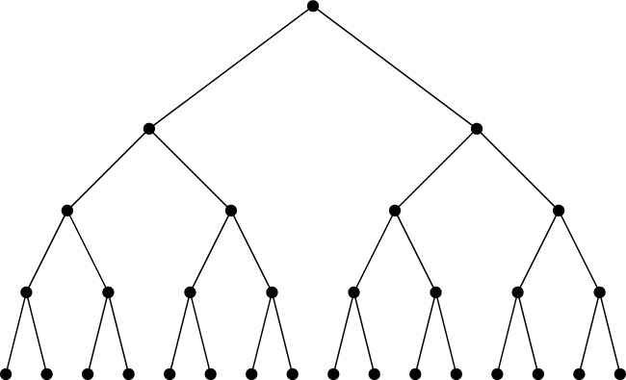


RLN Primitive: Membership Tree
RLN membership group:
Merkle tree
PK1
PK16
SK1, PK1 =H(SK1)
SK16, PK16 =H(SK16)
Notes:
It consists of A merkle tree that represents a group of authorized users, each user has a pk registered in this tree, the corresponding SK is only known to the user
16

Slide 17
RLN Primitive: Signaling
RLN membership group:
Merkle tree
SK1, PK1 =H(SK1)
PK1
PK16
M: Message
EN: External Nullifier
IN: Internal Nullifier = H(H(SK1,EN))
Notes:
For the signaling/publishing:
The user specifies a external nullifier as well as an internal nullifier which is derived from the SK and the external nullifier
17

Slide 18
RLN Primitive: Signaling
RLN membership group:
Merkle tree
SK1, PK1 =H(SK1)
Shamir Secret Sharing
PK1
PK16
M: Message
S1: One share of SK1
EN: External Nullifier
IN: Internal Nullifier = H(H(SK1,EN))
Notes:
The user also discloses a share of its secret key using shamir secret sharing scheme
This share will be used to remove the user from the group in case of double signaling
18

Slide 19

RLN Primitive: Signaling
RLN membership group:
Merkle tree
SK1, PK1 =H(SK1)
Shamir Secret Sharing
zkSNARKs
PK1
PK16
Zero-Knowledge Proof of
Membership
Correctness of S1
Correctness of IN
M: Message
S1: One share of SK1
EN: External Nullifier
IN: Internal Nullifier = H(H(SK1,EN))
Notes:
Finally, the user proves in zero knowledge manner that:
It is part of the group
And that has computed the secret share and the Internal nullifier correctly
19

Slide 20
RLN Primitive: Detecting double signaling
RLN membership group:
Merkle tree
SK1, PK1 =H(SK1)
M, EN, IN, S1, P
M’, EN, IN, S1’, P’
PK1
PK16
Notes:
If a user publishes more than 2 times for the same external nullifier, it will end up having two messages with the same external and internal nullifiers (remember those are deterministic values computed from SK and external nullifier)
So the double signal can be detected
20

Slide 21
RLN Primitive: Detecting double signaling
RLN membership group:
Merkle tree
SK1, PK1 =H(SK1)
M, EN, IN, S1, P
M’, EN, IN, S1’, P’
PK1
PK16
Notes:
Also, it will disclose 2 shares of its SK
21

Slide 22
RLN Primitive: Detecting double signaling
RLN membership group:
Merkle tree
SK1, PK1 =H(SK1)
M, EN, IN, S1, P
M’, EN, IN, S1’, P’
PK1
PK16
Shamir Secret Sharing
SK1
Notes:
using which the corresponding SK can be reconstructed (property of shamir secret sharing).
22

Slide 23

RLN Primitive: Detecting double signaling
RLN membership group:
Merkle tree
SK1, PK1 =H(SK1)
M, EN, IN, S1, P
M’, EN, IN, S1’, P’
PK1
PK16
Shamir Secret Sharing
SK1
Notes:
And the user gets removed from the tree. Thus, it Can no longer use that sk for messaging.
23

Slide 24
WAKU2-RLN-RELAY
RLN group = Peers subscribed to the same topic e.g., waku-rln-relay
Notes:
Now lets see the end to end integration of RLN into Waku-rln-relay
In Waku-rln-relay, the rln group consists of peers that belong to the same GossipSub layer (subscribed to the same topic)
24

Slide 25
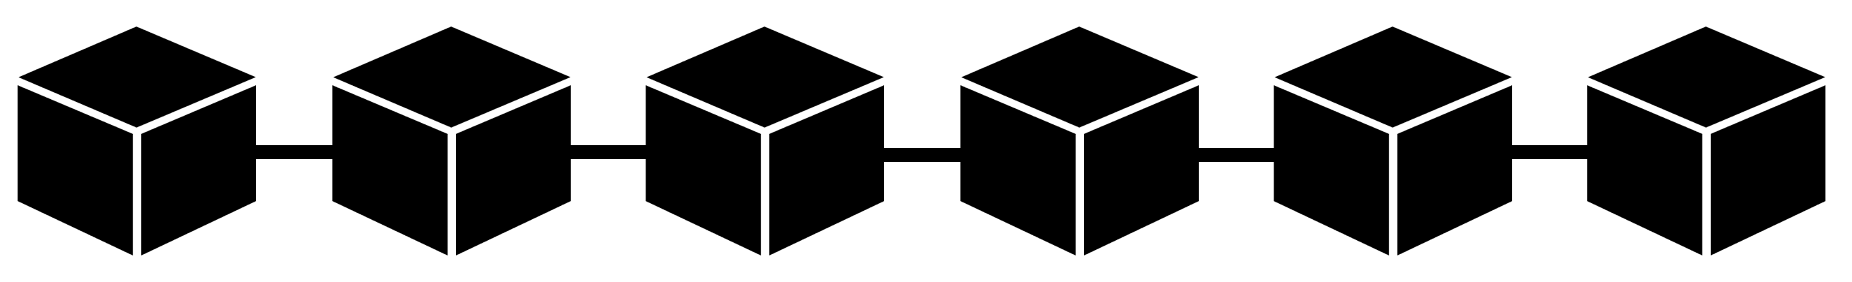


WAKU2-RLN-RELAY: Registration
Membership Contract/Registry
PK1,…,PKn
…
RLN group = Peers subscribed to the same topic e.g., waku-rln-relay
Notes:
Each peer has a rln pk, and the list of pks is stored in a contract deployed on the Eth blockchain.
25

Slide 26
WAKU2-RLNR-ELAY: Registration
Membership Contract/Registry
PK1,…,PKn
…
TX: Register PK,
RLN group = Peers subscribed to the same topic e.g., waku-rln-relay
Each peer registers to the group and locks some funds
Notes:
A peer willing to publish a message should register by sending a tx to the contract that contains its rln pk and some amount of Ether. This amount is deposited on the contract to prevent spam activity.
26

Slide 27
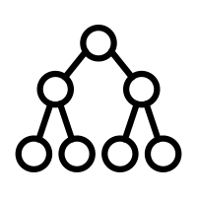
WAKU2-RLN-RELAY: Registration
Membership Contract/Registry
PK1,…,PKn
…
Membership Merkle tree
Notes:
Peers construct the rln membership Merkle tree locally
27

Slide 28

WAKU2-RLN-RELAY: Registration
Membership Contract/Registry
PK1,…,PKn
…
Registration and Deletion Events
Peers update their local tree
Notes:
And listen for the registration and deletion events emitted from the contract to update their trees.
28

Slide 29
WAKU2-RLN-RELAY: External Nullifier
External Nullifier = Epoch = the number of T seconds that elapsed since the Unix epoch.
Messaging rate is limited to 1 per epoch.
Notes:
For the external nullifier we define it as the number of T seconds that elapsed since the Unix epoch.
Peers are allowed to publish one message per epoch without being slashed
29

Slide 30

WAKU2-RLN-RELAY: External Nullifier
External Nullifier = Epoch = the number of T seconds that elapsed since the Unix epoch.
Messaging rate is limited to 1 per epoch.
Each peer locally keeps track of the current epoch
Notes:
Each peer locally keeps track of the current epoch.
30

Slide 31
WAKU2-RLN-RELAY: Publishing
M, Epoch, IN, S, P
Notes:
Message publishing is the same as RLN framework
The message owner, attaches the external and internal nullifiers, share of its sk, and zero knowledge proof part to the message
31

Slide 32
WAKU2-RLN-RELAY: Routing
M, Epoch, IN, S, P
Notes:
A routing peer follows the regular routing protocol of wakurelay (gossipSub protocol) and in addition checks
That Epoch of the incoming message does not have huge gap with the current epoch
Verifies the membership proof and the correctness of other fields
Checks the nullifiers to see whether the rate limit is violated or not (I will explain it a bit more in the next slides)
32

Slide 33

WAKU2-RLN-RELAY: Routing
M, Epoch, IN, S, P
Notes:
Relays the message if all these conditions are met, discards otherwise
33

Slide 34

WAKU2-RLN-RELAY: Routing
M, Epoch, IN, S, P
Notes:
The peer keeps record of the rln metadata to catch spammers and slash them
34

Slide 35
WAKU2-RLN-RELAY: Slashing
Shamir Secret Sharing
S’
SK of spammer
S
M, Epoch, IN, S, P
Finds a past record (Epoch, IN, S’)
Notes:
While checking the nullifiers, If the routing peer finds out that the messaging rate is violated, i.e., an old message with the same Epoch and internal nullifier values
it reconstructs the sk of the spammer
35

Slide 36
WAKU2-RLN-RELAY: Slashing
Membership Contract/Registry
PK1,…,PKn
…
Remove spammer’s PK
SK of spammer
PK=H(SK)
Notes:
Sends a transaction to the contract and removes the spammer pk from the group
36

Slide 37

WAKU2-RLN-RELAY: Slashing
Membership Contract/Registry
PK1,…,PKn
…
Remove spammer’s PK
SK of spammer
PK=H(SK)
Notes:
and withdraws its fund
37

Slide 38

Future work
Benchmarking
Lowering the storage overhead per peer
  Hybrid architecture of full-node and light-nodes
  Partial view of Merkle tree
Real time spam removal using off-chain p2p slashing
Cost-effective way of member insertion and deletion using L2 solutions
Notes:
Currently, peers are supposed to maintain the entire tree locally and it imposes storage overhead which scales linearly with the size of the group
- One way to cope with this is to use the light-node and full-node paradigm in which only a subset of peers who are more resourceful retain the tree whereas the light nodes obtain the necessary information by interacting with the full nodes.
Another way to approach this problem is through a more storage efficient method where peers store a partial view of the tree instead of the entire tree. Despite having a partial view, peers are able to construct and update the tree root and their authentication based on the dynamic state of the group.
Real time spam removal using off-chain slashing
In the current design, the gas consumption for member insertion and deletion are almost 40 k, we are looking into a more effective method using L2 solutions
38

Slide 39
References
Waku-rln-relay specs: https://rfc.vac.dev/spec/17/
Waku-rln-relay paper: https://github.com/vacp2p/research/blob/master/rln-research/Waku_RLN_Relay.pdf
Vac post on Waku-rln-relay: https://vac.dev/rln-relay
Nim-Waku implementation: https://github.com/status-im/nim-waku
js-Waku implementation: https://github.com/status-im/js-waku
RLN Ethereum research post: https://ethresear.ch/t/semaphore-rln-rate-limiting-nullifier-for-spam-prevention-in-anonymous-p2p-setting/5009
RLN medium post: https://medium.com/privacy-scaling-explorations/rate-limiting-nullifier-a-spam-protection-mechanism-for-anonymous-environments-bbe4006a57d
RLN circuits: https://github.com/appliedzkp/rln
RLN circuits spec: https://hackmd.io/7GR5Vi28Rz2EpEmLK0E0Aw
RLN in Rust: https://github.com/kilic/rln

Slide 40
Thank you
Notes:
40

Slide 41
Asymptotic Performance
The following table summarizes the result of our analysis for Method A. The gas consumption results are borrowed from https://hackmd.io/JoxnlDq3RT6WhtA-KBxtYg?both#A-Pubkey-map.
Parameters in the table should be interpreted as below:
- `d` is the tree depth
- `H` is the size of the hash output
- `N` is the number of Merkle tree leaves which is `2^d`
- The gas consumption is for `d=32`
- A Batch consists of `B=128` keys. <!-- TODO: recalculate these for d=20. -->
| Method | Gas cost for registration | Gas cost for deletion | Storage per user | User computation per update| Bandwidth cost per update| Security | Supported operations| Bootstrapping computation cost| Bootstrapping Bandwidth|
| :-------------- | :------------------------ | :------------ | :------------------ |:-------------- | :------------------------ | :------------ | :------------------ | :------------ | :------------------ |
| A: Offchain root | Batch: 20k, Single: 40k | Batch: 20k, Single: 40k | _full tree:_ `d`=32 274 GB, `d`=20 67 MB <br /><br />_partial tree_: `d`=32 2.048 KB, `d`=20 0.128 KB | O(log(`d`)) to recalc root and auth path | `H` | None | Insertion and Deletion | `N` hashing | O(`N`)|
Notes:
Use this for more https://hackmd.io/U8nFzfLpQVGu5Zu0dVfJ_Q
41

Slide 42
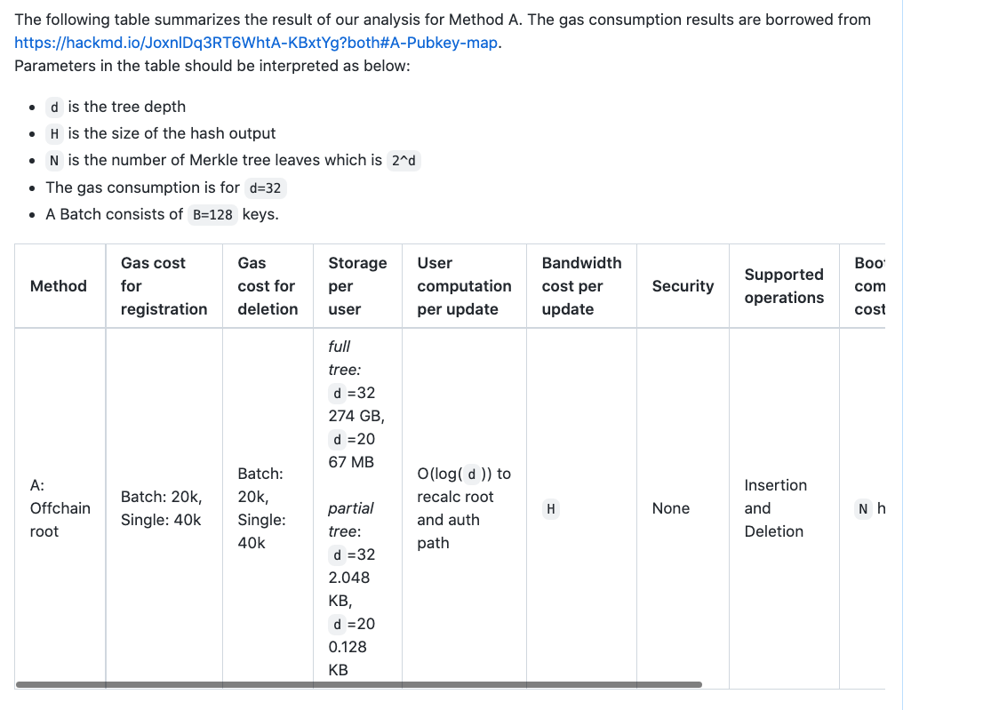
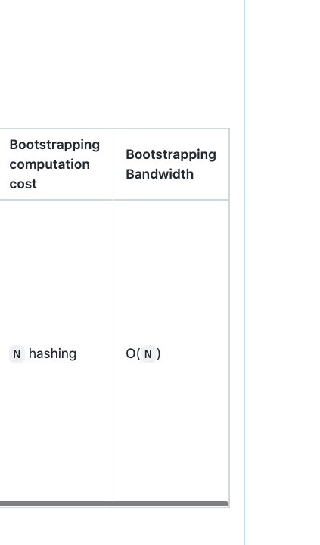
Asymptotic Performance

Slide 43
Implementation Details
zkSNARKs Groth16
RLN circuit: RLN Rust lib
Key generation: powers of tau MPC + MPC for circuit dependent parameters

