Slide 1
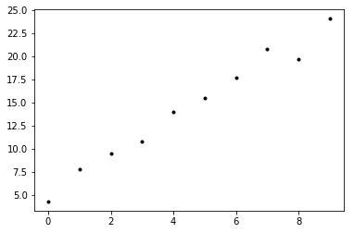
Basics of parameter estimation
In Physics we like to measure things.
Sometimes the things that we want to measure are directly measurable, for example the width of this room.
Some other times the measurements are not direct but come from a model. This process is called inference.
Say for example that you have a scatter plot with some points that show your measurements (practical example: time in seconds and distance in meters).

Slide 2
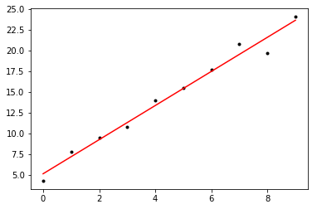
In this case, the data seems to suggest that a simple model, a straight line, could “fit” your data.
To “fit” the data means that you would be able to draw a model that goes through the data reasonably well, and allows you to predict what happens in regions not covered by the points.
For this simple case, you would draw a line through your points, and you can find (for example) the slope and intercept of this line.
The SLOPE and INTERCEPT are not measured directly, but they are inferred from your measurements + your model.
Those are the parameters of your model.

Slide 3
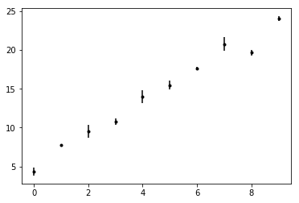
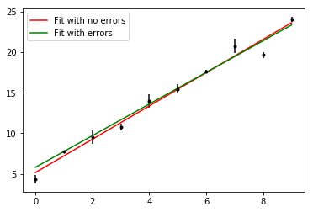
In real life, data have uncertainties associated to them.
A good thing to do is to take into account the uncertainties when we fit models to data.
Data points with larger uncertainties should matter less. This is called inverse error weighting.
Weighing the errors may lead to a different result.
The green line is a better fit to the data because
it takes into account experimental uncertainties.

Slide 4
Parameter fitting
The previous fits to straight lines were done by Python using algorithms that do stuff in the background.
If we want to fit the line ourselves (finding the parameters ”slope”, “intercept”), what should we do?
We can make a grid of all possible parameter values.
Each (slope, intercept) pair corresponds to a (unique) straight line.
The straight line that minimizes the difference between model and data, while inverse-weighing the errors is the winning model (best fit).
So we’ll go through all the possible combinations of (slope, intercept) pairs and find the one that minimizes the difference.

Slide 5
Goodness of fit: the 𝜒² function
We have seen that fitting parameters can often be achieved by finding the model that is closest fit to the data
This is ”coded” as minimizing a function (loss function or error function).
Say you have n data points. How should we write that function?
𝜒² = ∑^{n}_{i=1} (Data_{i} – Model_{i}(par1,par2,…))²/err²_{i}

Slide 6
How does this work with SNe data and models of the Universe? This will be the topic of the next worksheet ☺

