Slide 1
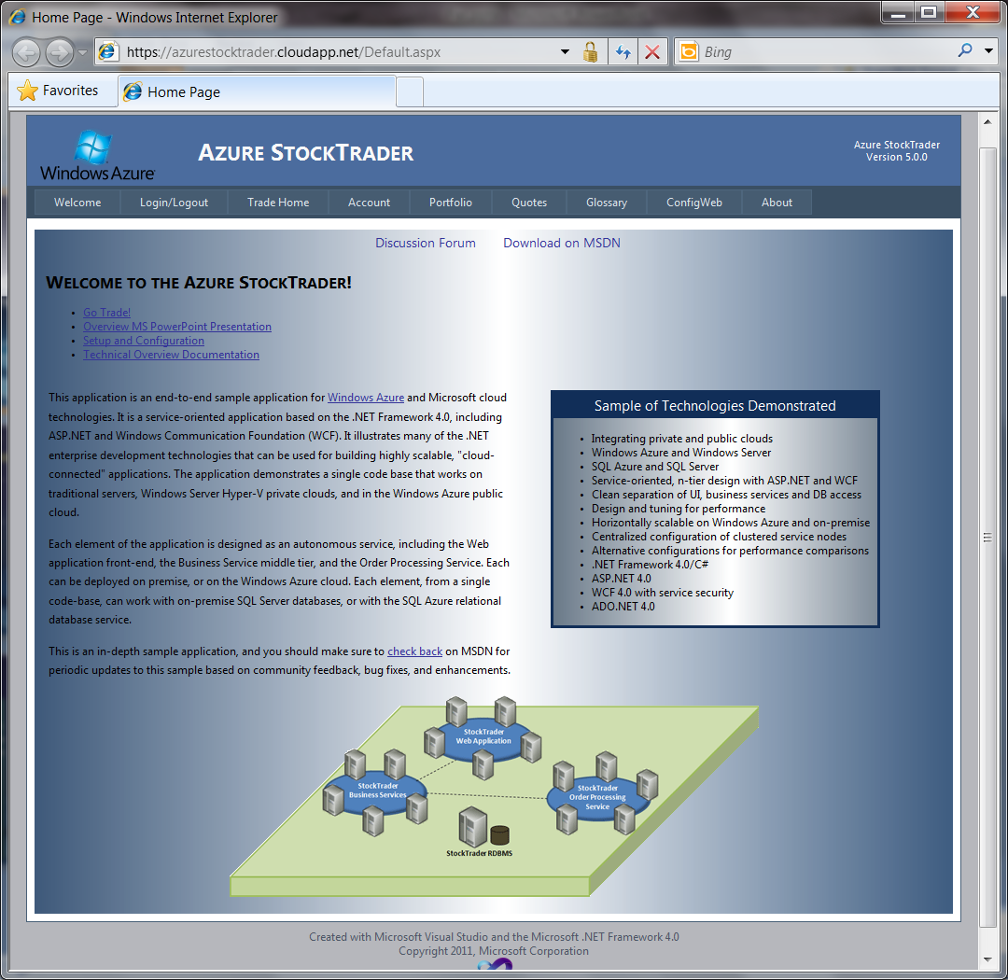
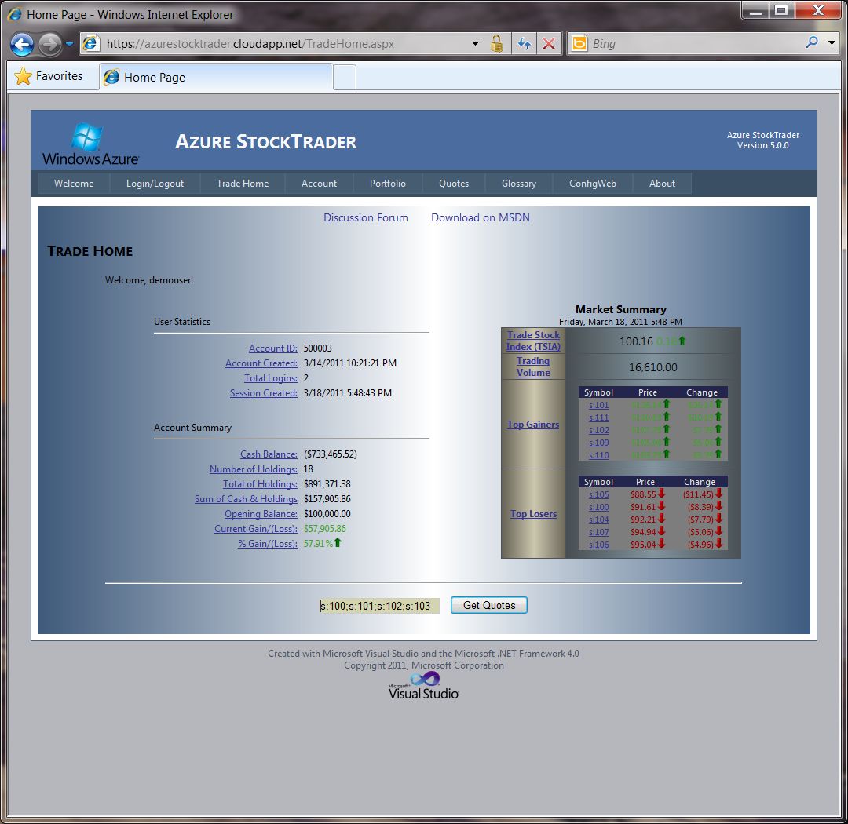



Azure StockTrader 5.0
Integrating Public and Private Clouds
6/9/2011

Slide 2

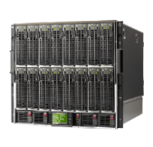
What is StockTrader?
End-to-end Sample Downloadable from MSDN – msdn.microsoft.com/stocktrader
N-tier application
  Web tier: ASP.NET
  Middle tier(s): .NET WCF Services
  Data tier: SQL Server/SQL Azure
Many modes of operations
  Single box
  Scale-out across cluster
  On-premise or Windows Azure
  Across hybrid clouds
High Performance
  Benchmarks
  Benchmark/capacity planner tool included
Secure
  Data tier security
  Communication and message security
Web Application Layer (UI)
User Interface
Middle-Tier Business Services Layer (BSL)
Middle Tier
Business Services
Order Processor Service (OPS)
Orders Tier
Data Access Layer (DAL)
Data Access
SQL Server/
SQL Azure

Slide 3
Azure StockTrader Highlights
Migration
Migrated to Windows Azure
Migrated to SQL Azure
Single code base now runs
on-premise and in cloud
StockTrader Web UI as Azure Web Role
Business Services as Azure Web Role
Order Processor as Azure Worker Role
SQL Azure for Data Tier
Integration
Hybrid public and private clouds
Any tier on-premise or on Azure
Fast and secure communication
SQL Azure or
SQL Server (on-premise)
WCF/X509 Security
Hyper-V Virtualized Private Data Center
Forefront TMG Gateway
Performance
Design pattern for high tx
throughput
Low latency user access
Asynchronous operations
Seamless Scale-out Across Azure Instances
Scale-out on premise with
Hyper-V
High-performance data access

Slide 4



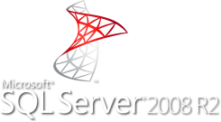
StockTrader On Premise Architecture
Internet
Corporate-managed data center
Scales out on Hyper-V instances
System Center - VMM 2012 For VM and
Application Provisioning/Management
Internet-facing via Forefont firewall
Threat Management Gateway
Firewall
StockTrader Business Services
VM
VM
VM
VM
VM
VM
VM
VM
StockTrader Web Application
StockTrader DB
VM
DMZ
VM
StockTrader Order Processor Service
VM
VM

Slide 5

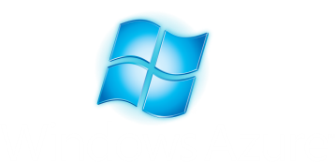
StockTrader Complete Azure Migration
Windows Azure
Web Role
Windows Azure Web Role
Azure StockTrader Business
Services
StockTrader DB
Azure StockTrader Web Application
Scale-out
Instances
SQL Encrypted
Https and
Client Certificate
Net.tcp encrypted and
Client Certificate
SQL Encrypted
Scale-out
Instances
Azure StockTrader Order Processor
Service
Scale-out
Instances
Internet
Windows Azure Worker Role
Existing On Premise Application
StockTrader Order Processor Service
StockTrader Order Processor Service
VM
VM
VM
VM
VM
VM
VM
VM
StockTrader DB
VM
DMZ
VM
StockTrader Web Application
StockTrader Web Application
StockTrader Business Service
VM
StockTrader Business Services
VM
VM
VM
VM
VM
VM
VM
VM
VM
VM
VM
VM
VM

Slide 6
Private-Public Cloud Hybrid Scenarios
Windows Azure Web Role
StockTrader DB
Windows Azure Web Role
StockTrader DB
Windows Azure
Web Role
Azure StockTrader Business
Services
Windows Azure
Web Role
Azure StockTrader Business
Services
Scale-out
Instances
SQL Encrypted
Azure StockTrader Web Application
Https and
Client Certificate
Scale-out
Instances
SQL Encrypted
Azure StockTrader Web Application
Net.tcp encrypted and
Client Certificate
SQL Encrypted
Net.tcp encrypted and
Client Certificate
SQL Encrypted
Scale-out
Instances
Azure StockTrader Order Processor
Service
Scale-out
Instances
Azure StockTrader Order Processor
Service
Scale-out
Instances
Internet
Scale-out
Instances
Internet
Internet
Internet
Internet
Internet
Windows Azure Worker Role
Internet
Windows Azure Worker Role
Hybrid Scenario 2
On-premise Web application consumes
cloud-hosted Azure Services
Hybrid Scenario 1
Azure Web application integrates with
on-premise business logic and database
StockTrader Order Processor Service
VM
VM
VM
VM
VM
DMZ
StockTrader DB
StockTrader Web Application
VM
VM
StockTrader Business Services
VM
VM
VM
VM
VM

Slide 7
Considerations for Migrating to Public Cloud
Migrate
  Many classes of applications easily migrate
    Web applications
    Services
    Backend processing applications (no UI)
Hybrid Integration
  Choosing correct integration technology for the scenario is key
    Secure Services
    Windows Azure Connect
    Windows Azure AppFabric Service Bus
Optimize for the Cloud
  Key differences with public-deployed vs. traditional on-premise applications
    Security considerations
    Assume scale-out of middle tier
    Cross-browser/device compatibility for Web applications
    Incorporate more asynchronous calls to handle higher network latencies
    Stateful database and cache connections: design for more frequent network failures especially when crossing Internet boundary between client and server
    Look at new technologies for building next-gen, cloud-optimized applications
      Mobile, Social, Unstructured Data, WCF RIA Services, etc.
      On the roadmap for StockTrader!

Slide 8

© 2010 Microsoft Corporation. All rights reserved. Microsoft, Windows, Windows Vista and other product names are or may be registered trademarks and/or trademarks in the U.S. and/or other countries.
The information herein is for informational purposes only and represents the current view of Microsoft Corporation as of the date of this presentation. Because Microsoft must respond to changing market conditions, it should not be interpreted to be a commitment on the part of Microsoft, and Microsoft cannot guarantee the accuracy of any information provided after the date of this presentation.
MICROSOFT MAKES NO WARRANTIES, EXPRESS, IMPLIED OR STATUTORY, AS TO THE INFORMATION IN THIS PRESENTATION.

